Slide 1









Service Area Leadership Team Meeting
August 25, 2025
Please enter your name, Service Unit number and Service Team position in the chat!
Notes:
{Have this slide on when people log in}

Slide 2
Welcome!
Please enter your name, Service Unit number and Service Team position in the chat!
Notes:
SANDI: Good evening and welcome to our August SALT meeting. I’m Sandi Heavener and I am the Director of Girl Scout Engagement.
Our hope tonight with this meeting and with the monthly events to follow this year...that you will leave here with lots of up to date information and resources to take back to your service units and service unit meetings. Thank you for being here with us! Please introduce yourself in the chat with your name, SU number and Service Team position.

Slide 3
Tonight’s Agenda
Rallyhood
Delegate Updates
Property Updates
Membership Updates
Upcoming Events
GSUSA Award and GSCP2P Badge Updates
Fall Product Program Updates
Marketing Updates
Next Steps and Questions
Notes:
SANDI:
Our agenda is packed this evening with lots of great information!
Go through list…
Please make sure you stay on mute for the presentation portion of this evening, but you are welcome to add questions and comments to the chat as you think of them. We will also have time at the end of tonight’s meeting for you to unmute and ask any additional questions.
Now I would like to kick off our meeting by introducing our council’s interim CEO, Kathryn Benison. Kathryn?

Slide 4




Rallyhood!
Private communication all in ONE platform
Multiple rallies for communication between troops, service units and families!
Each service unit has its own rallies.
Each troop will have its own rally.
Rallies all have: Message wall, calendar, opportunity to collect payment (for a small fee), space for photos (gallery), files for documents, most utilized links section and more
Troop leaders will invite families to join.
Rallies for Troop Fall Product and Service Unit Fall Product invitations going out next week!
Notes:
KATHRYN:
Thank you, Sandi, and good evening everyone!
If you attended our Volunteer Conference on August 2 this will be a slight repeat for you but we do have some more information on our timeline for on-boarding onto Rallyhood. For those of you who were not able to make the Conference, let me introduce you to Rallyhood!
We as a council, as I know you as Service Teams and as troops, have been looking for a better way to keep everyone connected.
Rallyhood is your central hub for private communication between troops, service units and families!
Every service unit has its own rally.
Every troop has one too.
Each rally includes:
A message wall for updates
A calendar to stay organized
Secure payment collection options
A photo gallery
Document storage
A go-to section for your most-used links
…and more!
Troop leaders will personally invite families to join their troop’s rally.
Coming next week — invitations for Troop Fall Product and Service Unit Fall Product rallies!

Slide 5
Rallyhood!
Rallies coming for:
Daisy Troop Leaders
Brownie Troop Leaders
Junior Troop Leaders
Cadette Troop Leaders
Senior/Ambassador Troop Leaders
Plus, rallies for outdoors, Highest Awards and more coming!
Accept EACH invitation to each rally to join the conversation! And request to join the rallies you are interested in and hold the role!
Rallyhood will become the PRIMARY communication device– all with one log-in- to fix trying to find items on website!
Notes:
KATHRYN:
Rallies are also coming for all Troop Leaders, too, to join the conversation around your program level.
But that’s not all!
We’re also launching Rallies for Outdoors, Highest Awards, and much more!
Now here’s what you need to do:
➡️ Accept every invitation to each Rally that applies to your role — that’s how you join the conversation.
➡️ Request to join the Rallies you're interested in and qualified for.
This will help keep communication streamlined, organized, and accessible.
Rallyhood will become our primary communication tool.
Just one login — no more digging through the website to find what you need.
Everything will be in one place — clear, easy, and connected.

Slide 6
Rallyhood Training!
Learn how to be an ADMIN for your Service Unit Rallies or your Troop Rally.
Troop Leadership and Service Unit Specialists receive invites to Admin Training in the next two weeks
Training: September 18 from 8-9 p.m.
  Can’t make it? It will be recorded!
REMINDER! Accept the invitations to the "Welcome Volunteers" Rally! You will also receive invitations to Level Rallies, SU Team Rallies and more. Accept now to be included in the conversation.
The "Welcome Volunteers" Rally is a GREAT PLACE to ask questions!
Notes:
KATHRYN:
Want to learn how to be an ADMIN for your Service Unit Rallies or your Troop Rally?
Troop Leadership and Service Unit Specialists—watch your inbox! Admin Training invites are going out over the next two weeks.
The training session is happening on September 18, from 8–9 p.m.
Can’t make it? Don’t worry—it will be recorded!
Remember to accept your invitations to the “Welcome Volunteers” Rally!
You’ll also receive invites to Level Rallies, SU Team Rallies, and more.
Accept now to make sure you’re part of the conversation from the start.
And don’t forget—the “Welcome Volunteers” Rally is the perfect place to ask and answer questions!

Slide 7



Service Unit Delegates! YOUR DIRECT REPRESENTATION!
Notes:
KATHRYN:
Now I want to shift gears to the Delegate Process here at GSCP2P.

Slide 8
Volunteer Run, Volunteer Led – Your SU Delegates give and get feedback and represent with your Volunteer Board of Directors
Delegate Count –
Each Service unit gets one delegate per 100 girls registered for the previous year.
1-100 girls: 1 Delegate/1 Alternate
101-200 girls: 2 Delegates/2 Alternates
201-300 girls: 3 Delegates/3 Alternates
301–400 girls: 4 Delegates/4 Alternates
401–500 girls: 5 Delegates/5 Alternates
Service Unit | Total Girls registered by August 2025 | Total Number of Delegates
Service Unit 129 | 201 | 3 Delegates/3Alternates
Service Unit 127 | 99 | 1 Delegate/1 Alternate
Service Unit 144 | 335 | 4 Delegates/4 Alternates
Service Unit 151 | 157 | 2 Delegates/2 Alternates
Service Unit 117 | 425 | 5 Delegates/5 Alternates
EXAMPLE:
Notes:
KATHRYN:
This year, as you see on the slide, we are adjusting our delegate process and SU allotment of delegates. Each SU will get one delegate for every 100 girls registered for the previous year.

Slide 9
Volunteer Run, Volunteer Led – Your SU Delegates give and get feedback and represent with your Volunteer Board of Directors
NEW PROCESS TO PROVIDING FEEDBACK AT FORUMS:
Service Units Elect delegates between October 1 and December 15, 2025.
Delegates and Alternate Delegates register in role in Volunteer Systems for a 1-year term ending September 30, 2026.
Girl Delegates/Alternates (aged 14 years of age or older by January 1) that are elected contact Info@girlscoutsp2p.org to be added to role.
Delegates receive questions from board to get feedback from Service Unit volunteers.
Delegates and Alternates attend one FORUM to give and receive feedback and information with Board members.
  Forums will be held in each office location in February and March 2026.
Delegates go back to their service unit and share feedback and experience at forums and prep for Annual meeting votes.
Delegates attend Annual Meeting in April – Alternates are promoted to Delegate if Delegate cannot attend.
Notes:
KATHRYN:
So, Service Units—get ready to elect your delegates!
Elections run October 1 through December 15, 2025.
Delegates and Alternate Delegates will register their roles in Volunteer Systems for a one-year term ending September 30, 2026.
For Girl Delegates or Alternates—if you’re 14 or older by January 1, once elected, contact Info@girlscoutsp2p.org to be added to your role.
So, what do delegates do?
Receive questions from the board and gather feedback from Service Unit volunteers.
Attend one Forum in February or March 2026 to share and receive information directly with board members.
Bring that feedback from the Forum back to your Service Unit and prepare for Annual Meeting votes.
Delegates also attend the Annual Meeting in April.
If a Delegate can’t attend, Alternates are promoted to Delegate.

Slide 10
Volunteer Run, Volunteer Led – Your SU Delegates give and get feedback and represent with your Volunteer Board of Directors
For Delegate Availability:
FORUMS:
Gastonia Office: February 5, 2026 6-7:30 p.m.
Hickory Office: February 17, 2026 6-7:30 p.m.
Triad Office: March 5, 2026 6-7:30 p.m.
Asheville Office: March 17, 2026 6-7:30 p.m.
Notes:
KATHRYN:
Here are the dates, times and locations for the Delegate Forums planned for next February and March so please make note now of which one is closest to you.

Slide 11
Volunteer Run, Volunteer Led – Your SU Delegates give and get feedback and represent with your Volunteer Board of Directors
For Service Unit Specialists and Service Unit Meetings:
Please ensure you add elections at some point during your meetings either October or November (ideally before December).
Ensure you add time for your Delegates to seek feedback at your January Meeting.
Add time for your delegates to report back at your March or April Meeting.
Add time for your delegates to report back at your May meeting about the Annual Meeting.
Notes:
KATHRYN:
So what do you need to do now?
READ LIST ON SLIDE

Slide 12
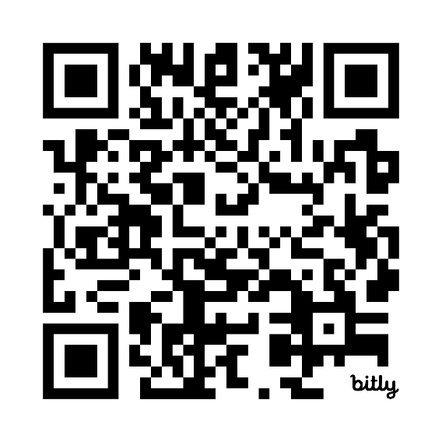
Property Updates
Pisgah, Keyauwee and Ginger - OH MY!
A GSCP2P Property Assessment took place with Structural Engineers last week, visiting all four service centers and three camp properties.
We will receive a comprehensive cost list of items that need repaired to begin a priority list.
Members will receive a survey on their property needs and priorities
Volunteers and girls can be a part of focus groups conducted by the Property Assessment company.
If you would like to be a part of an in-person focus group, complete the form here: https://bit.ly/4mUVArU or scan the QR code below.
The Property Assessment will be complete in December of 2025.
Notes:
KATHRYN:
Now, shifting gears again to some Property updates.
Last week, structural engineers completed a Property Assessment, visiting all four service centers and three camp properties.
What’s next?
We’ll receive a comprehensive cost list for needed repairs, which will help create a priority list.
Members will receive a survey to share your property needs and priorities.
Plus, volunteers and girls can join focus groups conducted by the Property Assessment company.
Want to participate in an in-person focus group?
Complete the form at the link on the screen or scan the QR code and complete the interest form.
The full Property Assessment is due to be completed in December 2025.

Slide 13

Current State: Camp Ginger Cascades – currently closed
Dining Hall:
Cannot be used at this time
Decking around dining hall and troop house has been deemed unsafe
Dining hall roof has significant issues - Needs further assessment
Rainbow and Rocky Ridge:
Issues with deck removal and new decking
Not able to be used at this time – Need further assessment
Hilltop:
Roof issue causing mold
Mushroom:
New building replaced due to Hurricane damage
New bathhouse still needs to be built
Mary Leach:
Some structural issues found in area – need assessment
We hope to open the Challenge Course and Archery Range this fall for day use!
Notes:
KATHRYN:
Now I am going to share some initial property findings with you for each site. Please note that other findings may come later as the structural engineer has plans to return back to the sites.
READ SLIDE

Slide 14

Current State: Camp Pisgah
Water is not passing inspection due to bacteria (Not e-coli)
Lightning strike took out Internet
Multiple electrical issues need fixed prior to Internet replacement
Structures need further assessment to determine if there are issues
Cannot allow girls to use the site due to water issue at this time
Notes:
KATHRYN:
READ SLIDE

Slide 15

Current State: Keyauwee Program Center
Celebrating its 80th birthday!!!! Please come out on September 20th – Registration is available on gsEvents!
5 new canvas tents!
New maintenance building (replacement for building that burned down)
New deck at Caraway!
New sump pump going in THIS week to fix issues!
New $105,000 dining hall roof going in this week
New fire alarm system in dining hall
Need new horse lean-to structure needed
Structures “offline” due to potential hazards – need further assessment:
  Apache Unit
  Chippawa Unit
  Comanche Unit
  Amphitheater Stage
  Nature Center
  Area around the dining hall retaining wall
Notes:
KATHRYN:
We’re celebrating a huge milestone—our 80th birthday!
Mark your calendars for September 20th and join us for the celebration. Registration is now open on gsEvents!
There’s so much happening at this camp:
Five brand-new canvas tents!
A new maintenance building to replace the one that was lost.
A new deck at Caraway.
A new sump pump going in this week to fix ongoing issues.
A brand-new dining hall roof—$105,000 investment—being installed this week!
A new fire alarm system in the dining hall.
But there’s still work to do:
We need a new horse lean-to structure.
Several structures are offline due to potential hazards and need further assessment, including:
Apache Unit
Chippawa Unit
Comanche Unit
Amphitheater Stage
Nature Center
The area around the dining hall retaining wall

Slide 16
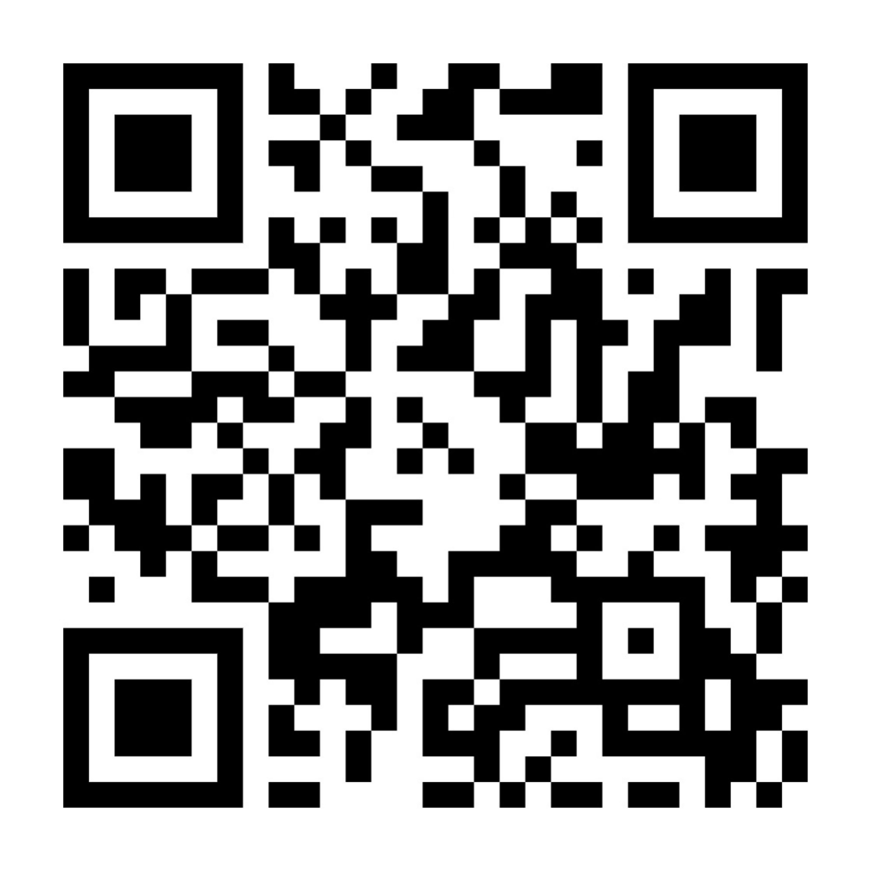
Please help us help Girl Scouts!
Volunteer Delegates voted to raise dues last year and annual dues will go to $65.
More girls and families will need financial assistance!
As a non-profit organization, GSCP2P relies on donations to ensure our program continues!
Consider becoming part of our Evergreen Circle and making a monthly donation to help all girls have the opportunity for Girl Scouting!
Donating $10 per month can help a new Girl Scout join along with her family.
Donating $25 per month can assist programming each corner of our council.
Donating $50 per month can help us to cover some of the costs of our amazing Circle C Equestrian Center.
Donating $85 per month allows you to join the Juliette Circle and make a lasting impact to an area.
Juliette Circle donors of $1000 in a year receive a special Sterling Silver pin and an invitation to our Chairwoman’s Dinner!
Use this QR code to make a donation to help Girl Scouts today!
Notes:
KATHRYN:
And shifting gears one more time to some fund development updates.
As you all know, national Volunteer Delegates voted last year to raise annual membership dues. Beginning with the upcoming membership year, annual dues will increase to $65 for girls.
This change means that more girls and families will need financial assistance to participate. As a non-profit organization, GSCP2P relies on donations to ensure that every girl has the opportunity to experience the benefits of Girl Scouting.
We encourage you to consider becoming part of our Evergreen Circle by making a monthly donation:
$10/month – Helps a new Girl Scout and her family join.
$25/month – Supports programming across our council.
$50/month – Offsets costs at our Circle C Equestrian Center.
$85/month – Allows you to join the Juliette Circle and make a lasting impact.
Juliette Circle donors who contribute at least $1,000 in a year receive a Sterling Silver pin and an invitation to our Chairwoman’s Dinner.
You can start your donation journey now by scanning the QR code on the screen.
Thank you for your continued dedication and support. Together, we can ensure that Girl Scouting remains accessible and impactful for all.
Now I would like to turn it over to Sandi for some Membership Updates.

Slide 17
GSCP2P Membership Updates
Membership Year 2025
Total Girl Goal - 6,760
Total Adult Goal - 4,562
As of 8/25/25...
MY25 Girl Membership – 6,302
MY25 Adult Membership – 4,635
For a Total of 10,937
Membership Year 2026
Girl Goal 6500
New Troop Starts at 150
As of 8/25/25…
MY26 Girl Membership – 3,331
Notes:
SANDI:
Hi again, everyone. Our current MY25 numbers are 6,302 girl members and 4,635 adult members, which includes all volunteers and lifetime members. That puts our total membership number for P2P at 10,937. We are around 5 ½ percent down in girls and down around 8% of adults from last year. For 2026, we have set a Girl Membership Goal of 6500 girls and starting approximately 150 new troops. As of today, we are at 3,331 girls (or 51.2% to our goal).

Slide 18
Fall Recruitment
Fall Recruitment across our P2P Footprint has taken off
240 events are scheduled for August and September
How can you help?
  Volunteer to man an Open House table
  Volunteer to do classroom visits at a school
  Volunteer to hold a Troop Formation night
No time for that? No problem!
  WEAR YOUR Girl Scout gear to promote Girl Scouting!
Thank you to everyone who has already signed up! (Contact your Engagement Manager to sign up.)
Notes:
SANDI:
As we kickoff our Fall Recruitment efforts, our council -which includes staff and volunteers working together- have lined up over 240 events for August and September so far. BUT we need your continued support at our School Rallies and Classroom visits, troop formation nights, AND the promotion of Girl Scouts by proudly sporting your Girl Scout t-shirts and gear. If you haven't signed up for an event yet, contact your Engagement Manager today. Thank you to everyone who has already participated in an event and/or are already signed up.

Slide 19
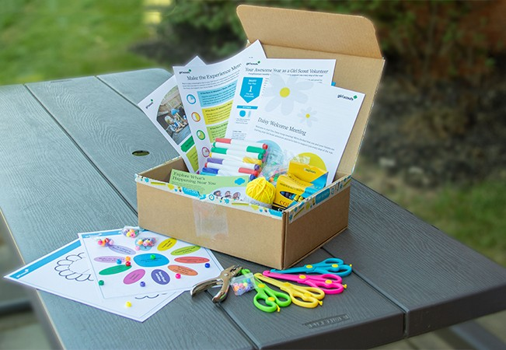

Volunteer Training Refresh with Service Unit and Troop Committee Role Descriptions and trainings
GSUSA is providing monthly Experience Boxes to:
Troops with 4 new Daisy age-level Girl Scouts
OR 4 new to Brownie age-level Girl Scouts
They include step-by-step instructions, ready-to-go supplies, a script, parent information and more.
Notes:
SANDI:
To better support our volunteers, GSCP2P will be standardizing Troop and Service Unit positions across the council. This will allow you to set clear expectations, define responsibilities, and ensure every volunteer understands the part they play in creating a safe, memorable experience for our girls. Trainings will be on gsLearn.
We are excited to have the opportunity to help with new girl recruitment and troop formation by providing a Daisy or Brownie Experience Box to any troop with 4 new Daisy age-level Girl Scouts or 4 new to Brownie age-level Girl Scouts. If you have a troop that is interested, please have them reach out to their Engagement Manager.

Slide 20
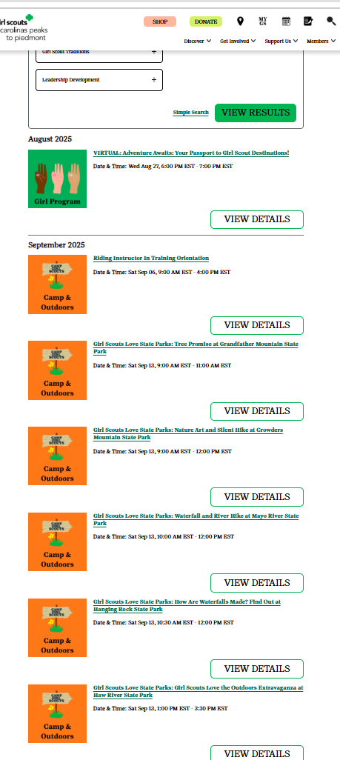
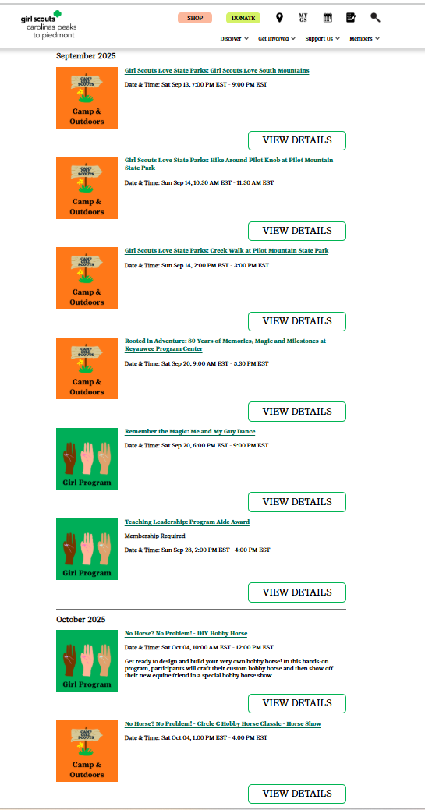
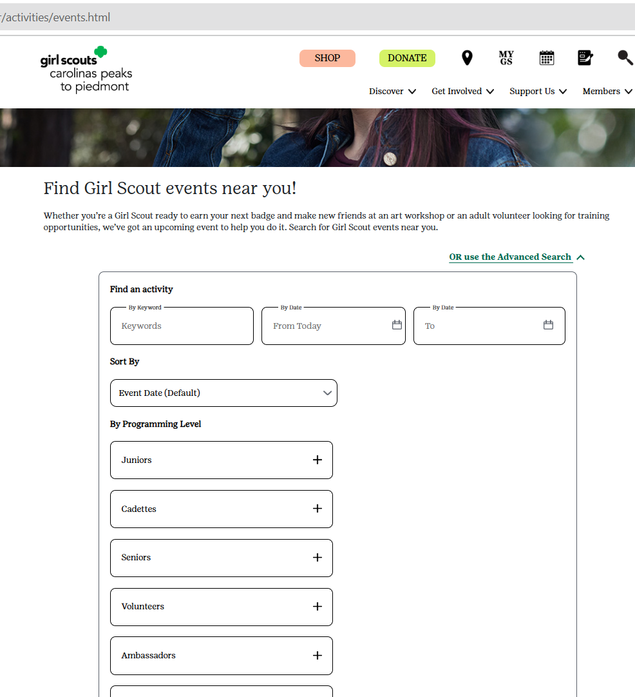
Upcoming Events- Search the Calendar!
Notes:
SANDI:
Fall also means FUN at Girl Scouts. Be sure to check out our program calendar on our website and encourage your troops to begin registering for their Fall activities. You can search the calendar on our website at any time for upcoming programs by activity, date, programming level and more.
For example, you can see if you search by Cadette level, all the events for our Cadette Girl Scouts show up in list form.
Some events for all Girl Scouts to sign up for now are the Keyauwee 80th Birthday, Girl Scouts Love State Parks, International Day of the Girl, an assortment of Circle C programs and more. Events are being added every day right now so keep checking back.

Slide 21

2025 Leaderee Volunteer Learning Event
September 26-28, 2025
Keyauwee Program Center, Sophia, NC
Training Financial Assistance
Request Deadline:
August 29, 2025
Registration Deadline:
September 8, 2025
Notes:
SANDI:
For our adult members, we have Leaderee coming up at KPC in September with registration closing September 8.

Slide 22


NEW! Road Map to a Great Year and The Girl Scout Adventure- My First Year patches!
Notes:
SANDI:
As you may have seen early this month, we are proud to introduce the Road Map to a Great Year patch program. This guide is here to support troop leaders through a successful year—from meetings and badge work to special events and traditions. Even better, each year that your troop completes the road map, you'll earn a unique souvenir patch! Whether you are brand new or a returning leader, the Road Map is a great tool to guide your journey and make every Girl Scout year one to remember. This patch replaces our Outstanding Troop Award.
For new, first year troops - Get ready for a year filled with connections, adventure, and fun through The Girl Scout Adventure – My First Year patch!
Created especially for first-year Daisy and Brownie troops, this program brings the Girl Scout Law to life with monthly activities that foster friendship, teamwork, and community.

Slide 23
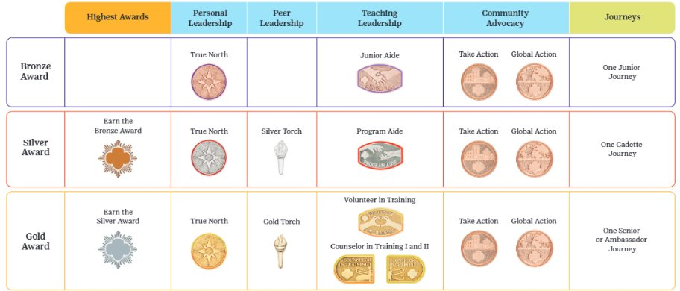
New GSUSA Leadership Awards
Notes:
SANDI:
Also shared at our Volunteer Conference were the updates to the new GSUSA Leadership Awards. Join us on the SALT call next month for a deep-dive into these new Awards.
And now I would like to turn things over to Alexis Braca, Director of Product Program Operations. Alexis?

Slide 24
Product Program Updates
Council training for SU volunteers and troops
Participation Goal
Badge Guide
Product Program Team
Notes:
ALEXIS:
Hello everyone, I’m Alexis Braca, Director of Product Program Operations. I’m excited to connect with you today to share key updates on our Product Program, with a focus on the Fall Product Program.
Together, we have an incredible opportunity to inspire girls, engage volunteers, and make this Fall Product Program our most successful yet.

Slide 25

Fall Program: Council Trainings
SU Training was held on 8/12
Troop Training was held on 8/19
Sessions were recorded and available on gsLearn
SU-led training details
E-mail Alexis at abraca@girlscoutsp2p.org if you would like the recordings.
Notes:
ALEXIS:
Your role as volunteers is what makes our product programs successful as you are the bridge between families, girls, and the staff—and we could not do this without you. Thank you for attending our training sessions over the last few weeks about the Fall Product Program. This program is more than just a fundraiser. It builds skills—goal setting, decision making, money management, people skills, and business ethics. And, of course, the funds raised help troops power their activities, from service projects to adventures.
We held SU FP training on 8/12 and troop FP training this past Tuesday, 8/19. Both sessions were recorded. If you are interested in these recordings you can find them in your gsLearn account. If you as a SU would like to host in person training I am happy to provide you with the PowerPoint presentation and talking points. Please send me an e-mail and I will send these to you via WeTransfer (due to the size of the file).

Slide 26
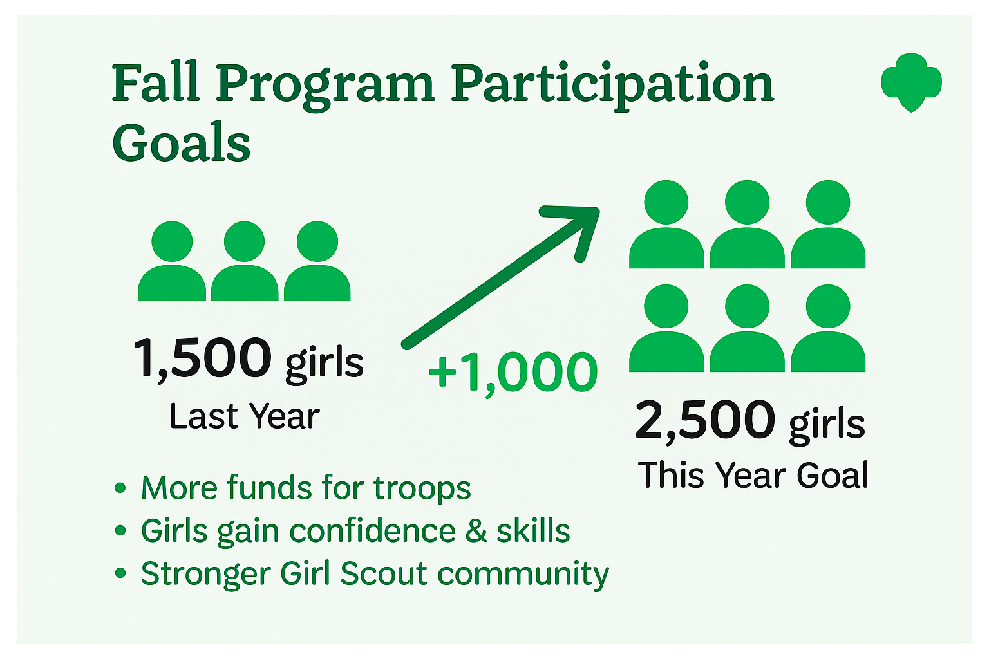

Fall Program: Council-wide Goal
Notes:
ALEXIS:
Last year, we had a really strong Fall Product Program. Over 1,500 girls participated, and together our troops raised more than $230,000. We saw great engagement—but we also know there’s still room to grow.
This year, we’re setting our sights even higher. Our goal is to increase participation by 1,000 more girls.
So why does participation matter? When more girls take part, everyone benefits:
Troops earn more funds for activities and adventures.
Girls gain new skills and confidence that last a lifetime.
Families feel more connected and engaged.
And most importantly, we’re building an even stronger Girl Scout community across all of our counties.
The Fall Program kicks off on September 15. So let’s talk about some simple and creative ways we can encourage more troops to join in and help us reach this exciting goal.

Slide 27

Fall Program: How can you help?
Notes:
ALEXIS:
You are probably asking yourself, "how can I help?" "how do I encourage more troops to participate?" As service unit and troop volunteers, you are the key to reaching that goal of 1,000 more girls.
The first thing I want to recommend is that each of you join Rallyhood. You’ll receive an invitation the first week of September, as was mentioned earlier.
By joining Rallyhood, you’ll not only get direct updates and materials from staff, but you’ll also be able to connect with other service unit and troop volunteers. This creates a space to share ideas, activity guides, and best practices that can encourage more troop participation.

Slide 28
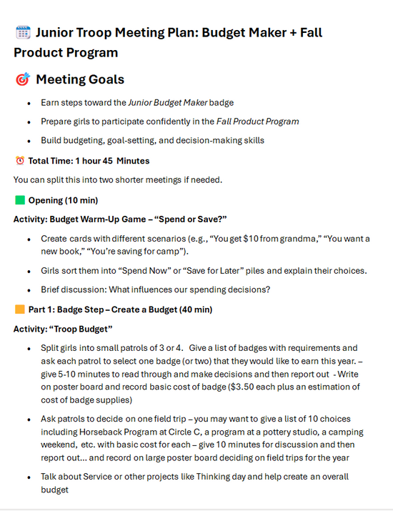
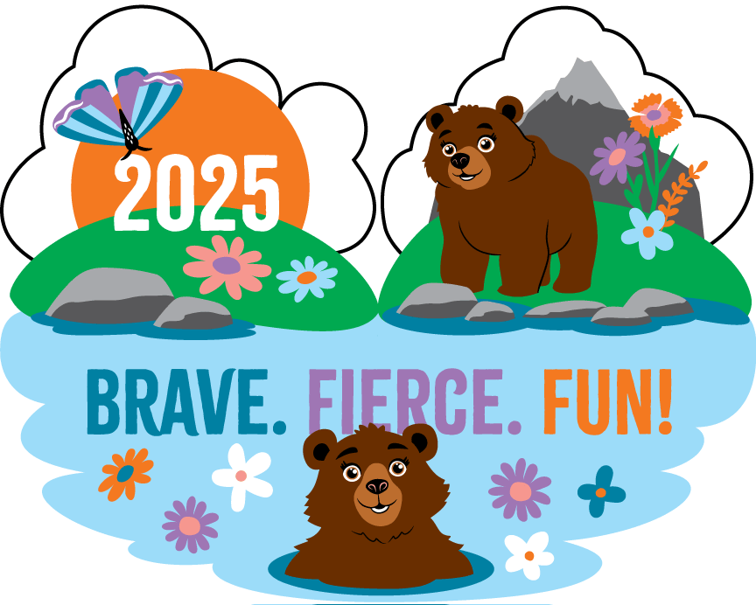
Fall Program: How can you help?
Notes:
ALEXIS:
We’re also developing several new guides to support you and your troops. One exciting resource is our Badge Guide, which goes hand-in-hand with the Fall Product Program. It’s organized by age level and highlights specific badges girls can earn alongside their Fall Product Program rewards. This makes it easier for troop leaders to fold the program into regular meetings and badge work. All of these guides will be available on Rallyhood.
Here’s how it works: girls automatically earn the badges you see on the left of the screen when they reach participation goals during the Fall Program. But leaders can go further by using the guide to connect the program with additional badges.
For today’s example, I’m sharing the Junior Troop Meeting Plan. This plan shows how the Fall Program aligns with badge work—specifically, how Juniors can work toward their Budget Maker badge while participating. The guide even includes helpful tips and activity suggestions to make it simple for leaders to bring these connections to life.
And the best part? By participating in the Fall Product Program, troops earn funds that can immediately be used to cover the cost of those badges—so girls aren’t just earning them, they’re helping pay for them too.

Slide 29

Fall Program: How can you help?
Notes:
ALEXIS:
Another way to encourage participation is through meaningful conversations at your service unit meetings. When you invite troop leaders to attend, you can set shared goals together. When troops feel invested in reaching those goals, participation rises.
And remember—there’s a double benefit. Each troop earns their own proceeds, but the service unit also earns funds when more troops participate. Those service unit funds can be put right back into supporting girls. For example, they could help cover the cost of a year-end celebration, awards banquet, or other special events.
This makes the Fall Product Program not just a fundraiser, but a way to build community within each of your individual Service Units and provides experiences for all of our girls.
And it’s simple! Troops can choose to participate fully, or even just online. If a volunteer prefers not to handle money, the online-only option is perfect. Just asking each girl to send 10–20 emails can make a big difference. Small steps like that add up quickly across an entire service unit.

Slide 30


Fall Program: Council Support
Alexis Braca
Hickory Service Center
abraca@girlscoutsp2p.org
Karin Rochester
Triad Service Center
krochester@girlscoutsp2p.org
Notes:
ALEXIS:
I want to end by saying thank you again for everything you do. The Fall Product Program wouldn’t be possible without your time, passion, and commitment. Together, we’re building something bigger than a fundraiser—we’re shaping confident young leaders. Let’s make this year the best one yet!
We would love to hear any questions that you might have or ideas moving forward. Please email us at the addresses listed here.
Now I would like to turn things over to our Chief Mission Delivery Officer, Jaclyn Johnson. Jaclyn?

Slide 31

Girl Scout News Form
Share your adventures with us through the Girl Scout News Form located at the bottom of our homepage or here: http://bit.ly/4n6kR2N.
Field trips
Community service
Learning new skills
Earning badges
Notes:
JACLYN
Thanks, Alexis.
Our Marketing team would like to remind you to share adventures from your Girl Scout journey with us using the Girl Scout News form! We love to see girls in action and this form is the best place to share stories about field trips, community service projects and learning new skills. Be sure to add photos if you would like to have your story featured on social media. These special shout outs on Facebook and Instagram are a great way to show your appreciation for volunteer efforts, highlight community resources, and create a sense of inclusion for Girl Scouts of all ages.

Slide 32

Media Girls Applications Open to
GSCP2P Girl Scouts of All Ages
Write for our blog, create social media content, take photos at events and participate in television, print and radio interviews.
Applications close on Friday, September 12!
Notes:
JACLYN:
Media Girls also help us tell our story, so please encourage your Girl Scouts to apply. Applications close on Friday, September 12. If you know a Media Girl, let her know you would be happy to be interviewed or request their help covering your event.

Slide 33

Service Unit and Troop Event Promotion
Be a Girl Scout Brand Ambassador
Boost your event promotion efforts through council communication channels.
www.girlscoutsp2p.org calendar
Today's Tips Newsletter to all membership
Print-ready flyer files
Social Media
Rallyhood
Press Releases
Elevate the trefoil
Always use Girl Scout or Girl Scouting rather than "scouts" or "scouting" to avoid marketplace confusion
Clarify Girl Scout terms for the general public
Notes:
JACLYN:
And finally if you are creating promotional materials and graphics, anything with the national or council logo must be approved by marketing. You can work with your engagement manager to submit a request to the marketing department. If the event is open to attendees outside of your troop or service unit, the council can boost your promotions by adding to our website calendar as well as featuring in Today's Tips and on social media.
The marketing team can also write press releases for you. All press release drafts must be approved by marketing and will be sent from the council. Girl Scouts and volunteers should not be responding to media inquiries- requests for comments should be redirected to council staff.
If you don't have our logo or name, you do not need marketing approval. You can choose to use a trefoil, but you do need to clearly state who is hosting like "Girl Scout Troop 1121" or "Girl Scouts of Iredell County" or "Girl Scout Service Unit 117."
Avoid confusion by always referencing our organization as Girl Scouts. Help us move our movement forward by never using just "scout" or "scouting"- we are proud to be Girl Scouts!

Slide 34
Next Steps
E-mail with this PowerPoint and a sample SU Meeting Agenda
Questions?
Notes:
JACLYN:
That concludes the end of our information sharing. Later this week you all will receive this PowerPoint presentation and notes as well as a sample SU Meeting Agenda for September. Our hope is that these will be useful tools for you as you go back to your Service Units and share information.
We have been answering questions in the chat as the meeting has been going on but would anyone like to unmute and ask any final questions tonight?

Slide 35
Thank you for joining us!
Next Meeting: September 22 at 8 p.m.
Notes:
JACLYN:
Thank you for spending time with us this evening, and we can’t wait to see you next month, September 22 at 8 p.m. Have a good night!

