Slide 1









Service Area Leadership Team Meeting
January 26, 2026

Slide 2
Welcome!
Please enter your name, Service Unit number and Service Team position in the chat!
Notes:
Good evening and welcome to our January SALT meeting.
Our hope tonight is that you will leave here with lots of up to date information and resources to take back to your service units and service unit meetings. Thank you for being here with us! Please introduce yourself in the chat with your name, SU number and Service Team position.

Slide 3
Tonight’s Agenda
CEO Updates
Property Updates
Membership Update
SU Team Update
Rallyhood
Cookie Program Updates
World Thinking Day
Upcoming Programs and Trainings
Adult Awards
Retail Updates
Notes:
Our agenda is packed this evening with lots of great information!
Go through list…
Please make sure you stay on mute for the presentation portion of this evening, but you are welcome to add questions and comments to the chat as you think of them. We will also have time throughout the meeting and at the end of tonight’s meeting for you to unmute and ask any additional questions.

Slide 4

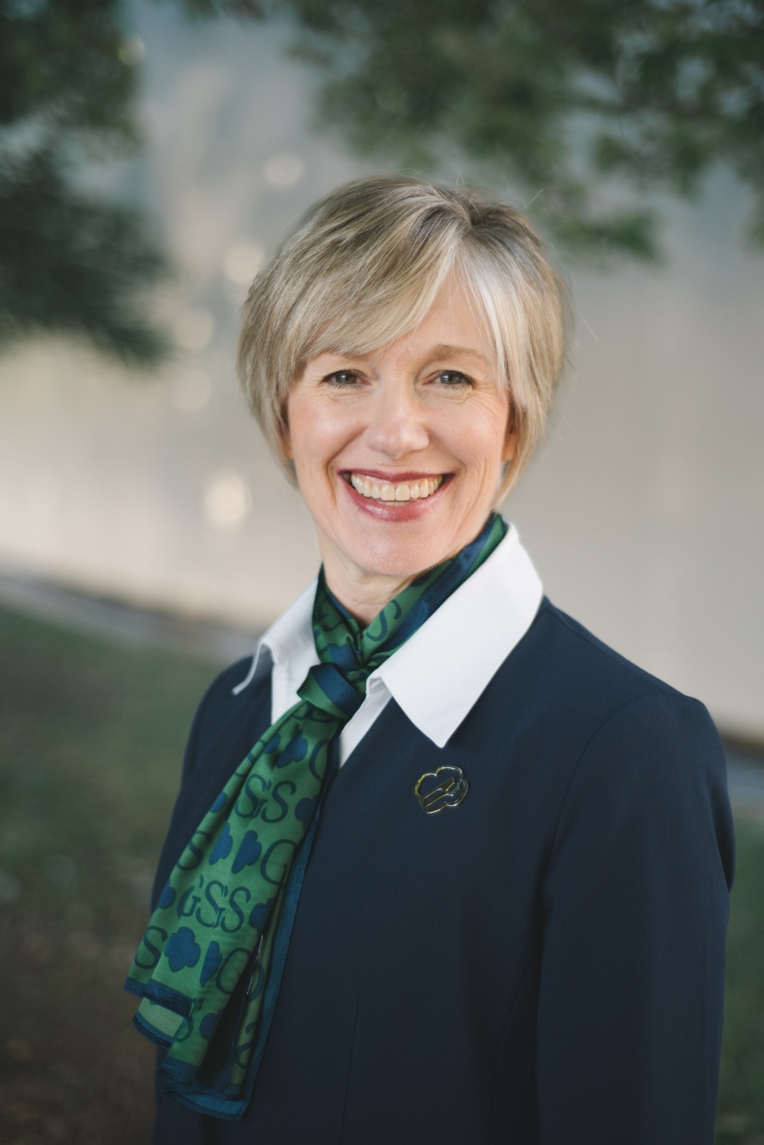

CEO Updates
Notes:
Elaine’s remarks and then turn over to Jaclyn for Property and Summer Camp Updates

Slide 5

Summer Camp and Property Updates
Notes:
Property Updates
Keyauwee
Welcomed a new ranger, Wayne Lawrence, to the team on December 1!
Units are open for reservations through CampLife now but activities are limited until we hire a new Outdoor Experience Manager. Interviews for that position are well underway.
Wayne’s priorities are to get all program areas at camp up and running in time for summer, including the pool, and work on any necessary unit repairs. He is hosting groups that come onsite and is the main point of contact for all vendors.
Camp Ginger Cascades
We are continuing to employ Doll Enterprises to complete Phase 1 projects in our hurricane recovery efforts and conduct site visits 2 times a month to ensure all is ok at camp and some minor landscaping. We are awaiting our final reports back from Newmark, the Property Assessment team, to see final recommendations on infrastructure repairs and will then begin to formulate a priority list.
This camp has had some water issues as well and is scheduled for compliance testing in February to ensure water passes all tests and then we can reopen for programming in the spring.
Camp Pisgah
Electrical Work
A local electrical company that we have used for several years has been released to proceed on assigned electrical items that will result in some much needed improvements and address several things on the Newmark Property Assessment.
They are currently scheduling approximately 3 weeks out so we are working towards the goal of having that work completed by end of February.
Water System
Background: Earlier county testing during summer 2025 identified bacterial contamination (total bacteria, not E. coli), and the water was deemed non-potable. Quarterly state testing including a recent 4th quarter test, has consistently passed as “clean” for several years. Samples were taken from the same locations as the county samples (Dining Hall Kitchen Sink and Westfeldt Men’s Restroom Sink). Corrective actions were taken but did not work long term. The camp has remained closed since that time, and water system approval will be required prior to reopening for the 2026 season.
Immediate Actions:
Clear vegetation around cisterns and repaint exteriors with a dark, opaque coating.
Hire a qualified vendor to clean and chlorinate both cisterns and flush the system.
Install screened protection on overflow spouts.
Request testing from the county health department after all these steps have been taken (must pass two samples at each location).
Work must be scheduled in warmer weather due to paint requirements so we are hoping for this to happen later in February.
Summer Camp Updates
Registration launched last Tuesday, January 20
We are in the process of hiring a new Outdoor Experience Manager but are excited to welcome back Lena “Pyro” Watson as our assistant director who is helping hire and onboard staff right now.
We are very excited to welcome a new summer camp food vendor, Wolfoods, this summer to KPC.
We will offer transportation for any western NC Girl Scouts the weeks of June 21 and July 12.
Financial assistance is available for any Girl Scout who needs help attending camp. An application is available once the $50 deposit is made on a reservation. We also have discounts for early bird registration (through March 31) and multi weeks and also siblings.
All campers will have the opportunity for a horse experience at camp like last summer.
Updates and changes to the TOLP and CIT Program:
CIT I is no application and they can just register through gsEvents if they are rising 11th graders. If they are rising 12th graders and did not do CIT I but want to join the CIT program, they are allowed to but if they are YOUNGER, they cannot.
CIT II will be application in conjunction with the gsEvents registration. CIT II girls must be rising 12th graders and have completed CIT I.
Any girls that have completed CIT II are eligible to work as unit counselors at camp this summer!
Excited to welcome Clayton Sheehan as our new Director of Outdoor Experience and Property! Clayton started last Tuesday and is eager to get to all the camps and help move our projects along so that we can work towards having all three camps open this spring and summer.

Slide 6
GSCP2P Membership Updates
Renewed girls: 4017
New girls: 1178
Total girls: 5195
Total numbers (Girls + Adults) = 9411
Congratulations to our SUs for achieving their December 31 goal: 118, 124, 131, 135, 137, 141, 146, 148, 155.
With your help, 24 new troops have been started this year so far!
It's not too late to sign up for the Girl Scout Experience Boxes – Daisy or Brownie. Contact your Engagement Manager before February 20, 2026!
On April 1, 2026, we will begin MY27 GSEB registrations!
Notes:
SANDI:
A quick update for everyone.
Read slide and celebrate!

Slide 7
SU TEAM UPDATE
Rallyhood top contributors:
November – Service Unit 144, 125, 155 and 147
December – Service Unit 127 and 141
Troop ACH yearly collection: (112 not submitted)
If you have not submitted your ACH form with all information and signatures, please do so ASAP. Send to info@girlscoutsp2p.org.

Slide 8


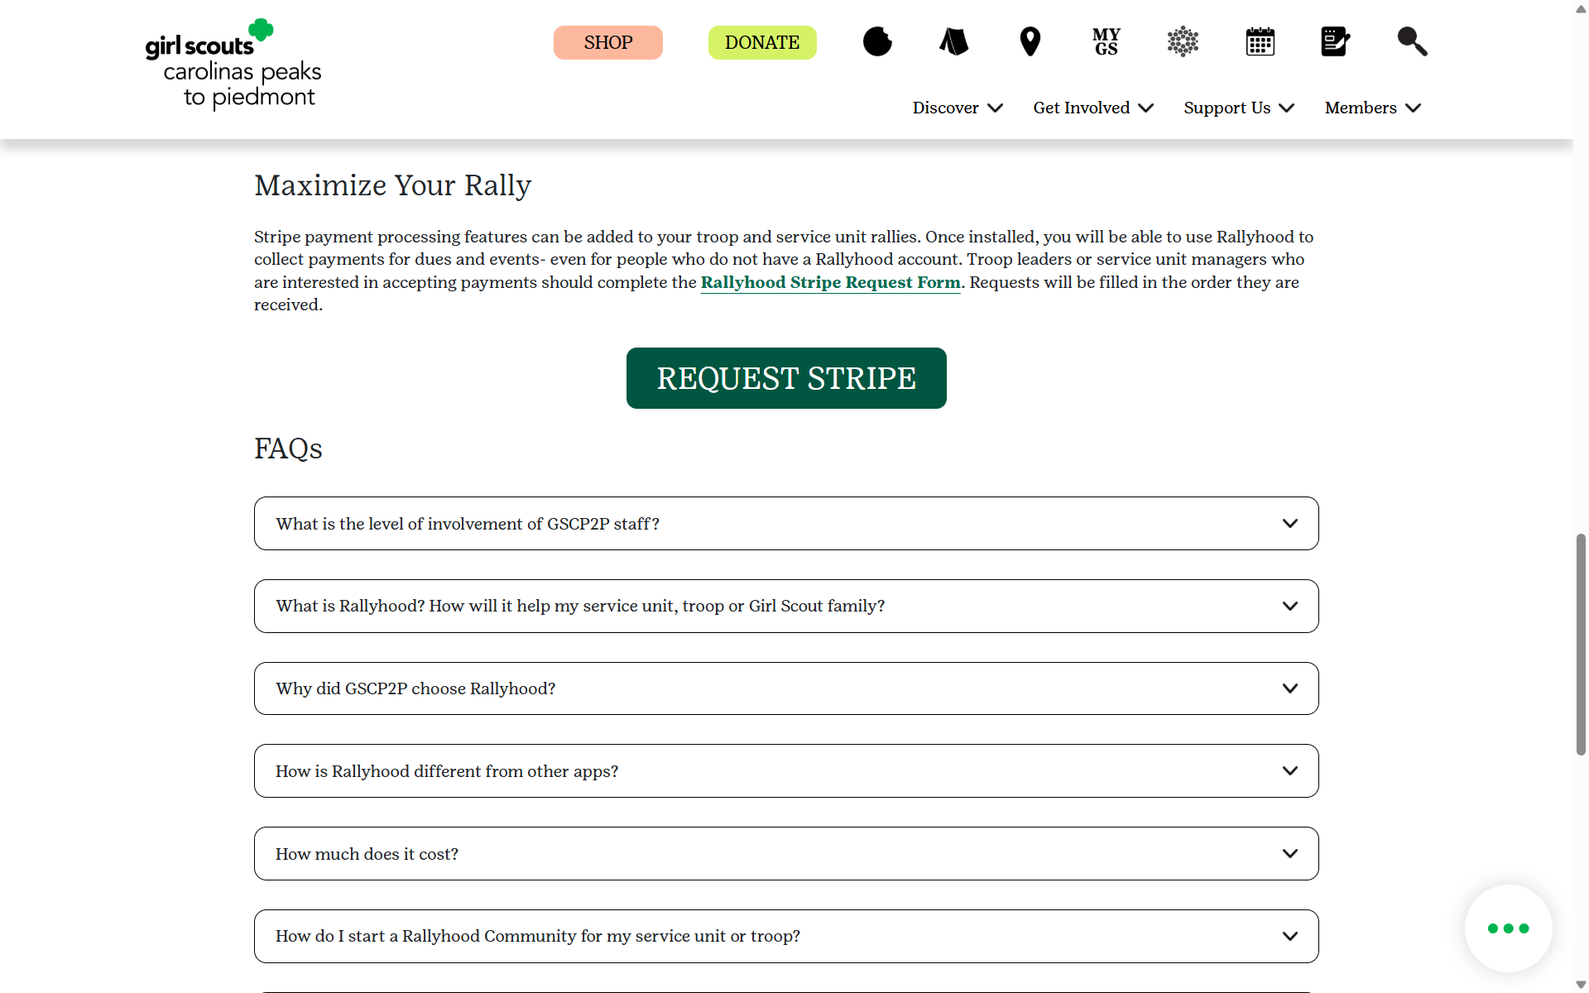


Rallyhood
Encourage members to join the Welcome Volunteers Rally as that is where mass announcements are made- including inclement weather updates during Girl Scout Cookie Season.
Stripe requests are now available for troop and service unit rallies!
Notes:
Thank you for creating your free Rallyhood accounts and for encouraging members to join us on this new platform to connect and collaborate. We are excited to announce the completion of our initial set-up and our next step is to install Stripe payment processing features for troop and service unit rallies. Once installed, you will be able to use Rallyhood to collect payments for dues and events- even for people who do not have a Rallyhood account. Troop leaders or service unit managers who are interested in accepting payments should complete the Rallyhood Stripe Request Form. Requests will be filled in the order they are received.

Slide 9

Girl Scout Cookie Program Updates
Remember to encourage all troops to place a planned order!
Why Planned Orders Matter
Help us prepare inventory ahead of time
Ensure cookies are available when your troop arrives
Reduce the risk of running out of popular varieties
Supports smoother, faster pickups for everyone
Help the council better support troop sales and goals
Notes:
Give info.

Slide 10

Girl Scout Cookie Program Updates
Banking Information in Smart Cookies:
Each troop is required to submit a completed and signed ACH form annually.
If you are unsure whether we have current banking information on file for your troop, please let us know.
Earlier today, Monday, 1/26/2026, council uploaded bank account information into Smart Cookies. Please log in and verify that your troop’s routing number and account number are listed correctly. If this information is missing or incorrect, it means we do not have a current signed ACH form on file for your troop. Please contact us at info@girlscoutsp2p.org or 800-672-2148 so we can assist you.
Notes:
Give info and then invite anyone to ask questions here.

Slide 11

Girl Scout Cookie Program Updates
Important Dates
December
January
February
March/April
December 5– Troop initial order due in Smart Cookies
December 8 ⁻ Digital Cookie e-mails launched to both girls and troop volunteers
December 16 – Cookie Program begins
January 3 – Start of booth lottery selections
January 7– 10 – Cookie deliveries
January 10 – 18 – Walk-about week
January 12 – Cupboards open
January 16 – Booth sales begin
February 2 – Troops can begin changing proceeds and recognition plans in Smart Cookies
February 17 – Troops can begin creating recognition orders in Smart Cookies
March 1 – Program ends
March 5 – First ACH withdrawal
March 10 – Buy 5 entries due council
April 2 – Second/final ACH withdrawal
April 9 – ACH credits

Slide 12

Celebrating 100 Years of
World Thinking Day
and Global Sisterhood
Download the activity guides here!
Notes:
We are celebrating 100 years of World Thinking Day in 2026! World Thinking Day is a Girl Scout holiday that is celebrated every year on February 22. It’s a day to celebrate our international sisterhood and stand up for causes that can improve girls’ lives around the world.
This year’s special theme is Our Friendship. The World Thinking Day awards can be earned at any time during the year and World Thinking Day resources can help you easily prepare meeting activities to celebrate this tradition and earn the award.

Slide 13
Daisies/Brownies/Juniors
February 20-21 - Robotics Camp-in at the Kaleideum,Winston-Salem
February 16 – Safe @ Home (Junior Babysitter Skills), Statesville
March 7 – Design in Nature, Winston-Salem
March 7 – Playing the Past at Historic Johnson Farm, Hendersonville
March 8 – Climbing Day at Fiddlehead Farm & Forest, Fletcher
March 8 – Coppelia with the Charlotte Youth Ballet, Charlotte
March 8 - Gargoyles Hockey Game, Greensboro
March 14 – Girl Scout Fest, All Service Centers
March 14 – Fantastic Plants, KidSenses, Rutherfordton
March 21 – Power of Me! & Rise Up: Mental Health Day for Juniors with MADD, Hickory
March 21 - Junior RIIT Explorer, Circle C
March 28 – Ring Around the Planets, KidSenses, Rutherfordton
April 4 – LEGO Liaison & Structurally Speaking, KidSenses, Rutherfordton
April 11 – Curiosity Quest, Winston-Salem
April 18 – Science Shenanigans, KidSenses, Rutherfordton
April 19 – Safe @ Home for Juniors, Gastonia
Notes:
For our Daisies, Brownies, and Juniors, we have a packed spring lineup with lots of hands-on, high-energy programming across the council.
You’ll see everything from STEM and arts, to outdoor adventures, and life skills. A couple of highlights I want to call out—our Curiosity Quest in Winston Salem is an opportunity for the whole family to have fun exploring science through hands-on experiments like testing stream water, decoding horse DNA, and getting up close and personal with some scaly friends. Registration will open February 1st for this exclusive event!
For Juniors, we’re offering some really impactful experiences like Safe @ Home, which focuses on babysitting and home safety skills, and Power of Me! & Rise Up, our mental health day in partnership with MADD.

Slide 14
Cadettes/Seniors/Ambassadors
February 12 – Gold Award Training, Virtual
February 15 – Adventure Awaits: Destination Diaries, Virtual
February 16 – Safe @ Home, Statesville
February 21 – Just the 3s – Hoof & Arrow Club, Circle C
February 25 – Teaching Leadership – Program Aid Award, Virtual
February 28 – RIIT (Riding Instructor in Training) Orientation, Circle C
February 28 – Safe Sitter Essentials, Black Mountain
March 5 – Gold Award Training, Virtual
March 7 – Future Designer, Winston-Salem
March 8 – Climbing Day at Fiddle Head Farm & Forrest, Fletcher
March 8 – Coppelia with the Charlotte Youth Ballet
March 8 –Gargoyles Hockey Game, Greensboro
March 14 – Girl Scout Fest! All Service Centers
March 14 – Fantastic Plants, KidSenses, Rutherfordton
March 16 – Highest Awards Info Night, Virtual
March 21 - Power of Me! & Rise Up: Mental Health Day with MADD, Hickory
March 28 – Ring Around the Planets, KidSenses, Rutherfordton
March 28 – Sisterhood Success, Day with Kappa Delta, Wake Forest University
March 28 – Kick Trash to the Can, Statesville
April 4 – LEGO Liaison & Structurally Speaking, KidSenses, Rutherfordton
April 11 – Curiosity Quest, Winston-Salem
April 13 – Gold Award Training, Virtual
April 18 – Blow It Up, KidSenses, Rutherfordton
April 19 – Safe @ Home, Gastonia
April 25 – Annual Meeting, Thomasville
Notes:
For our Cadettes, Seniors, and Ambassadors, our programming features leadership, independence, and preparation for what comes next.
We’re offering experiences that build real-world skills and confidence—things like Program Aide and Baby Sitter Training and a Mental Wellness Day.
At the same time, we’re making sure there’s still plenty of fun and connection. Girls can explore careers and creativity through programs like Future Designer and Adventure Awaits: Destination Diaries, take on physical challenges with Climbing Day, or just enjoy shared experiences like Girl Scout Fest, ballet, hockey, and museum programs.
Overall, this lineup is about giving older girls meaningful choices that fit their busy lives.
Be sure to check out our Events Calendar to register for these programs.

Slide 15

Notes:
Get ready to celebrate 114 years of Girl Scouting! Every year in March, Girl Scouts across the country party for a whole week to commemorate the founding of our movement. Kick off the week with Spirit Sunday and close the week by attending Girl Scout Fest at your nearest Service Center. Enjoy games, crafts and activities inspired by Girl Scouts past and present. It's a day to laugh, learn and celebrate everything that makes being a Girl Scout amazing!

Slide 16


Upcoming Adult Trainings
February 9 - Virtual Basic Camping Skills License Renewal
February 28 - Hybrid First Aid/CPR Certification, Greensboro
March 5 - Virtual Basic Camping Skills License Renewal
March 14 - Hybrid First Aid/CPR Certification, Gastonia
March 21 - Leaderfest, Hickory
April 11 – Basic Camping Skills License, High Point
April 18 - Basic Camping Skills License, Gastonia
April 20 - Virtual Basic Camping Skills License Renewal
Save the date for Leaderfest on March 21 at St. Luke’s in Hickory.
Registration opens soon!
Notes:
Introduce Maureen Stoudt to make announcement about Leaderfest
Leaderfest is on Saturday, March 21st, at St. Luke's Methodist Church in Hickory.
The theme is Find Your Path to Troop Success!
There will be classes available for new and experienced leaders.
Watch the Council Calendar for the link to register!
It is going to be a fantastic day!

Slide 17

Board Approved Awards
Deadline for submission is February 1!

Slide 18

Retail/ Mobile Shops Updates
Coming Soon!
Want to schedule a mobile shop? Check out our website and request a mobile shop today!

Slide 19
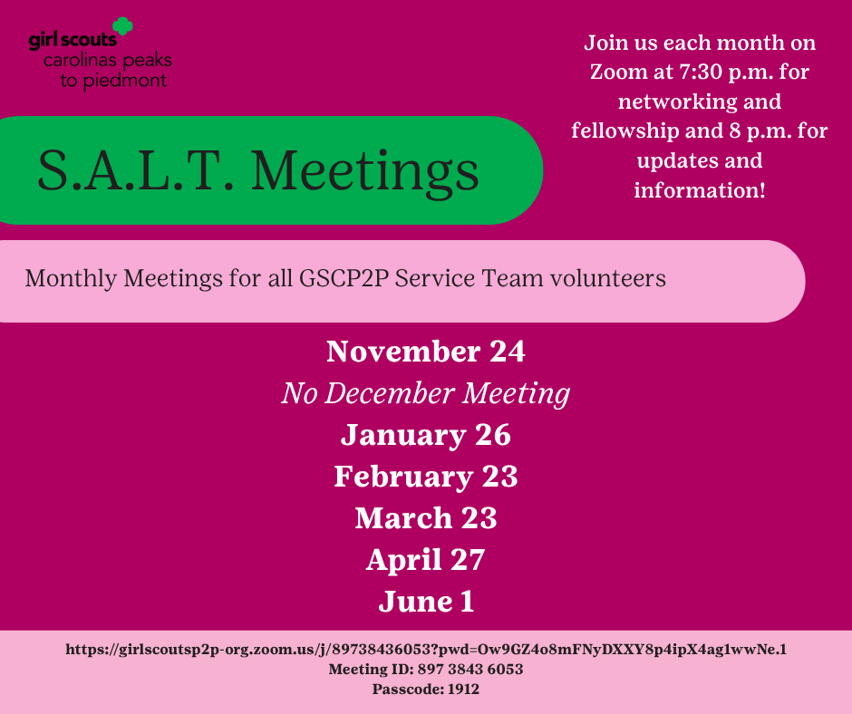

Slide 20
Next Steps and Questions
Next Meeting: February 23, 2026
Notes:
That concludes the end of our information sharing. Later this week you all will receive this PowerPoint presentation and notes as well as a sample SU Meeting PowerPoint and Agenda for your February SU meetings. It will also be posted in Rallyhood. Our hope is that these will be useful tools for you as you go back to your Service Units and share information.
We have been answering questions as the meeting has been going on, but we will now take down the presentation and ask if anyone would like to unmute and ask any final questions tonight?

