Slide 1






Service Area Leadership Team Meeting
June 1, 2026

Slide 2
Welcome!
Please enter your name, Service Unit number and Service Team position in the chat!
Notes:
JACLYN:
Good evening and welcome to our final SALT meeting of this troop year.
Our hope tonight is that you will leave here with lots of up to date information and resources to take back to your service units and service unit meetings. Thank you for being here with us! Please introduce yourself in the chat with your name, SU number and Service Team position.

Slide 3
Tonight’s Agenda
CMDO Updates
G.E.O. Event Updates
Membership Updates
Graduation Promotion
Service Team Updates and Deadlines
Upcoming Events
Property and Outdoor Experience Updates
Retail Updates
Notes:
JACLYN:
Our agenda is packed this evening with lots of great information!
Go through list…
Please make sure you stay on mute for the presentation portion of this evening, but you are welcome to add questions and comments to the chat as you think of them. We will also have time throughout the meeting and at the end of tonight’s meeting for you to unmute and ask any additional questions.

Slide 4
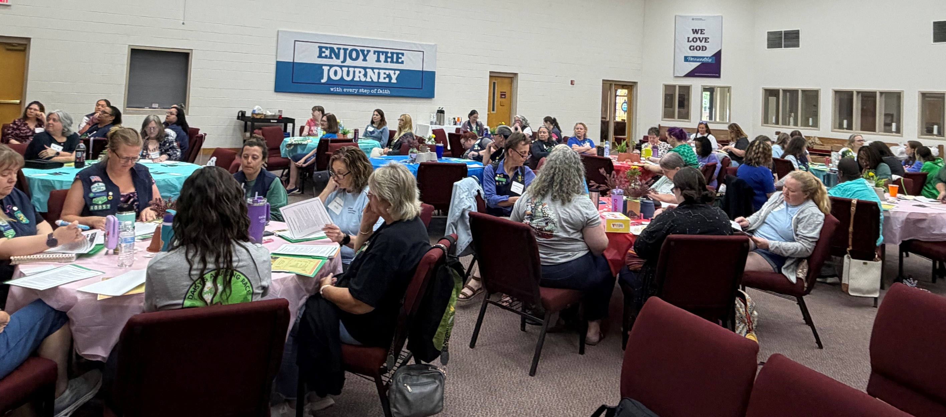

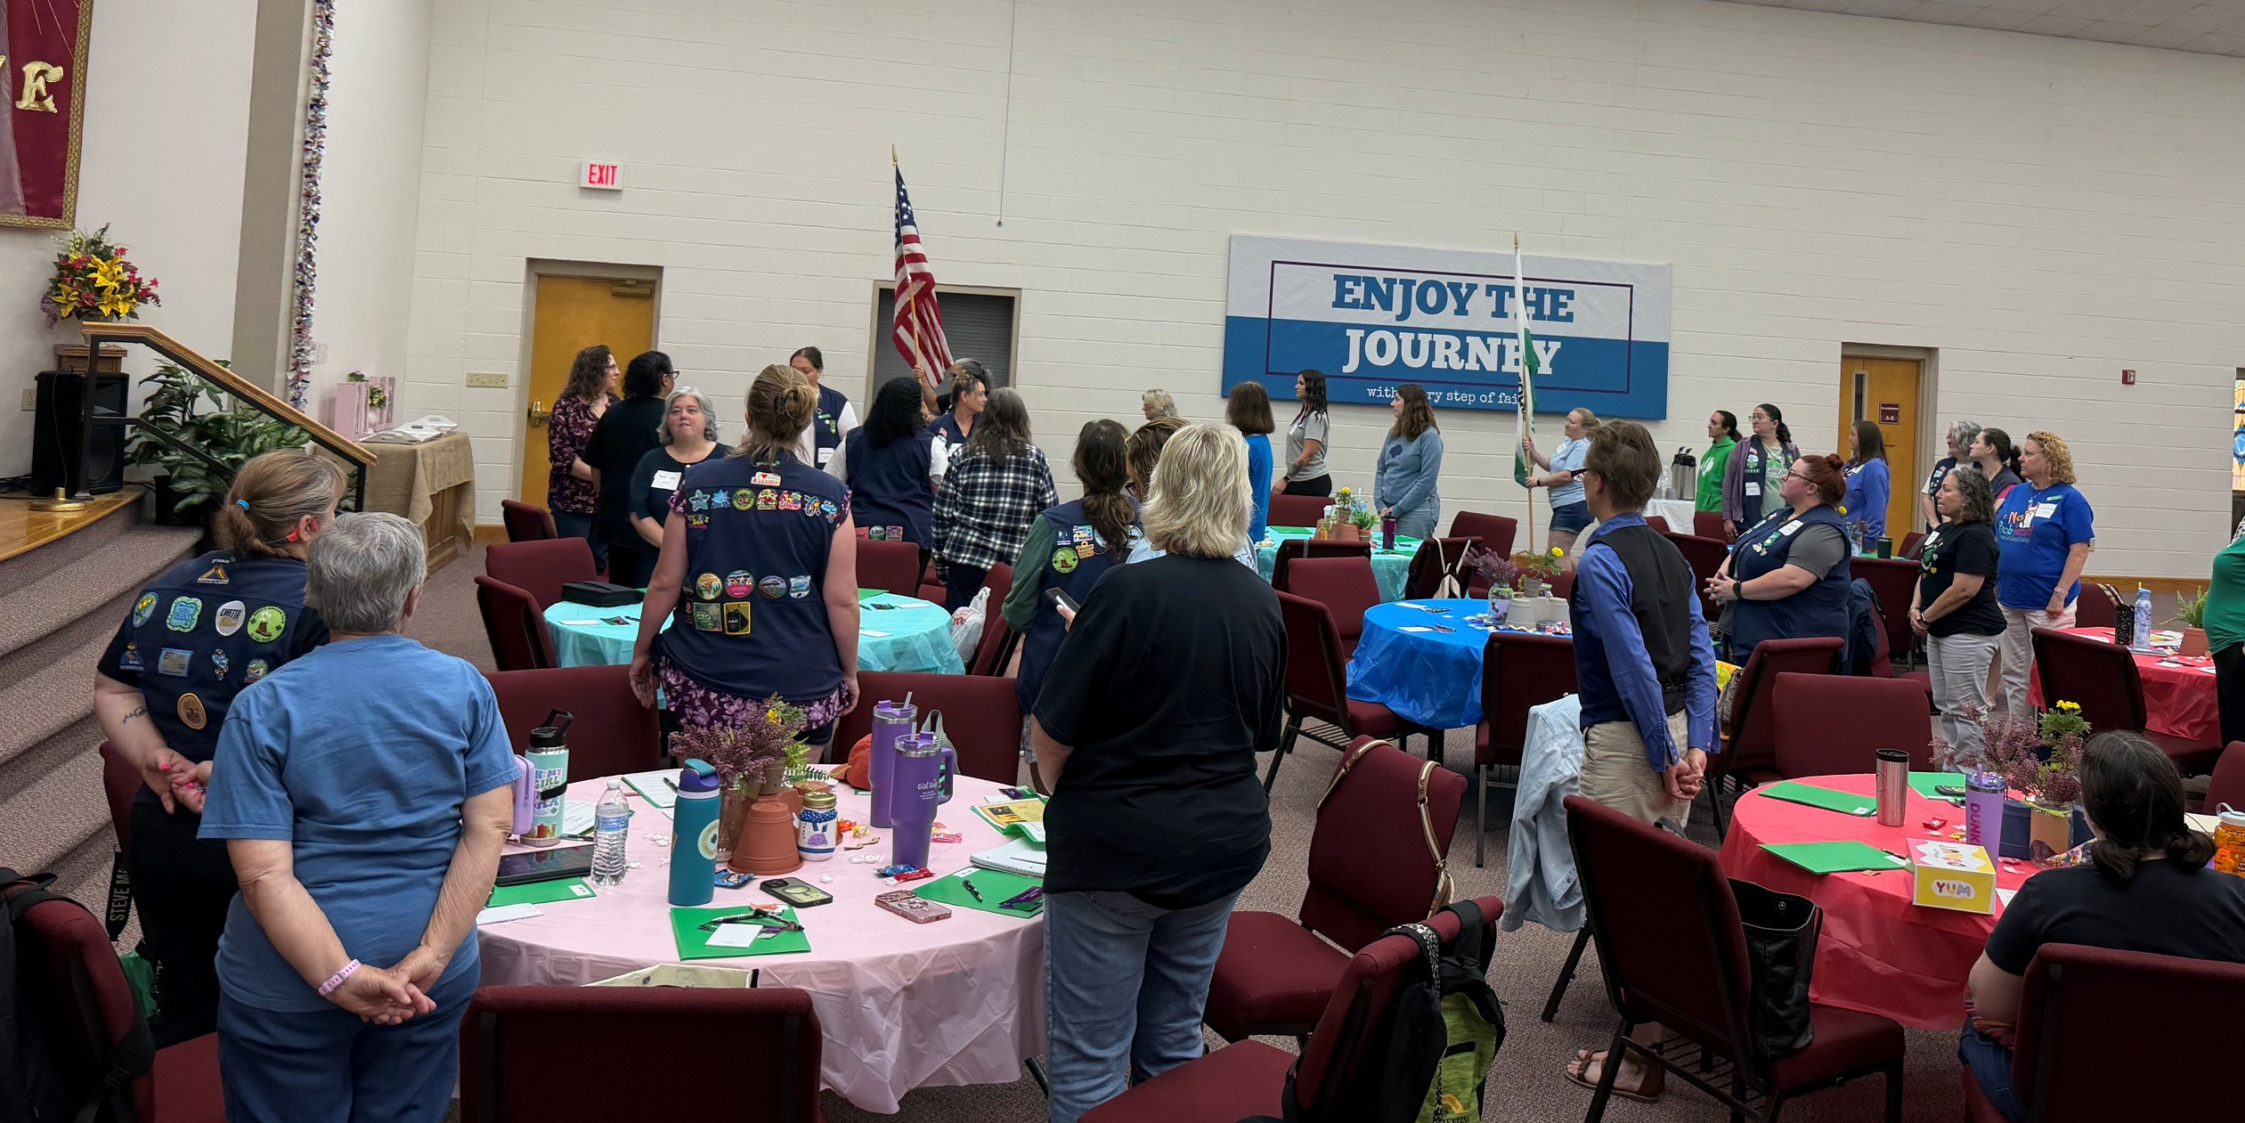
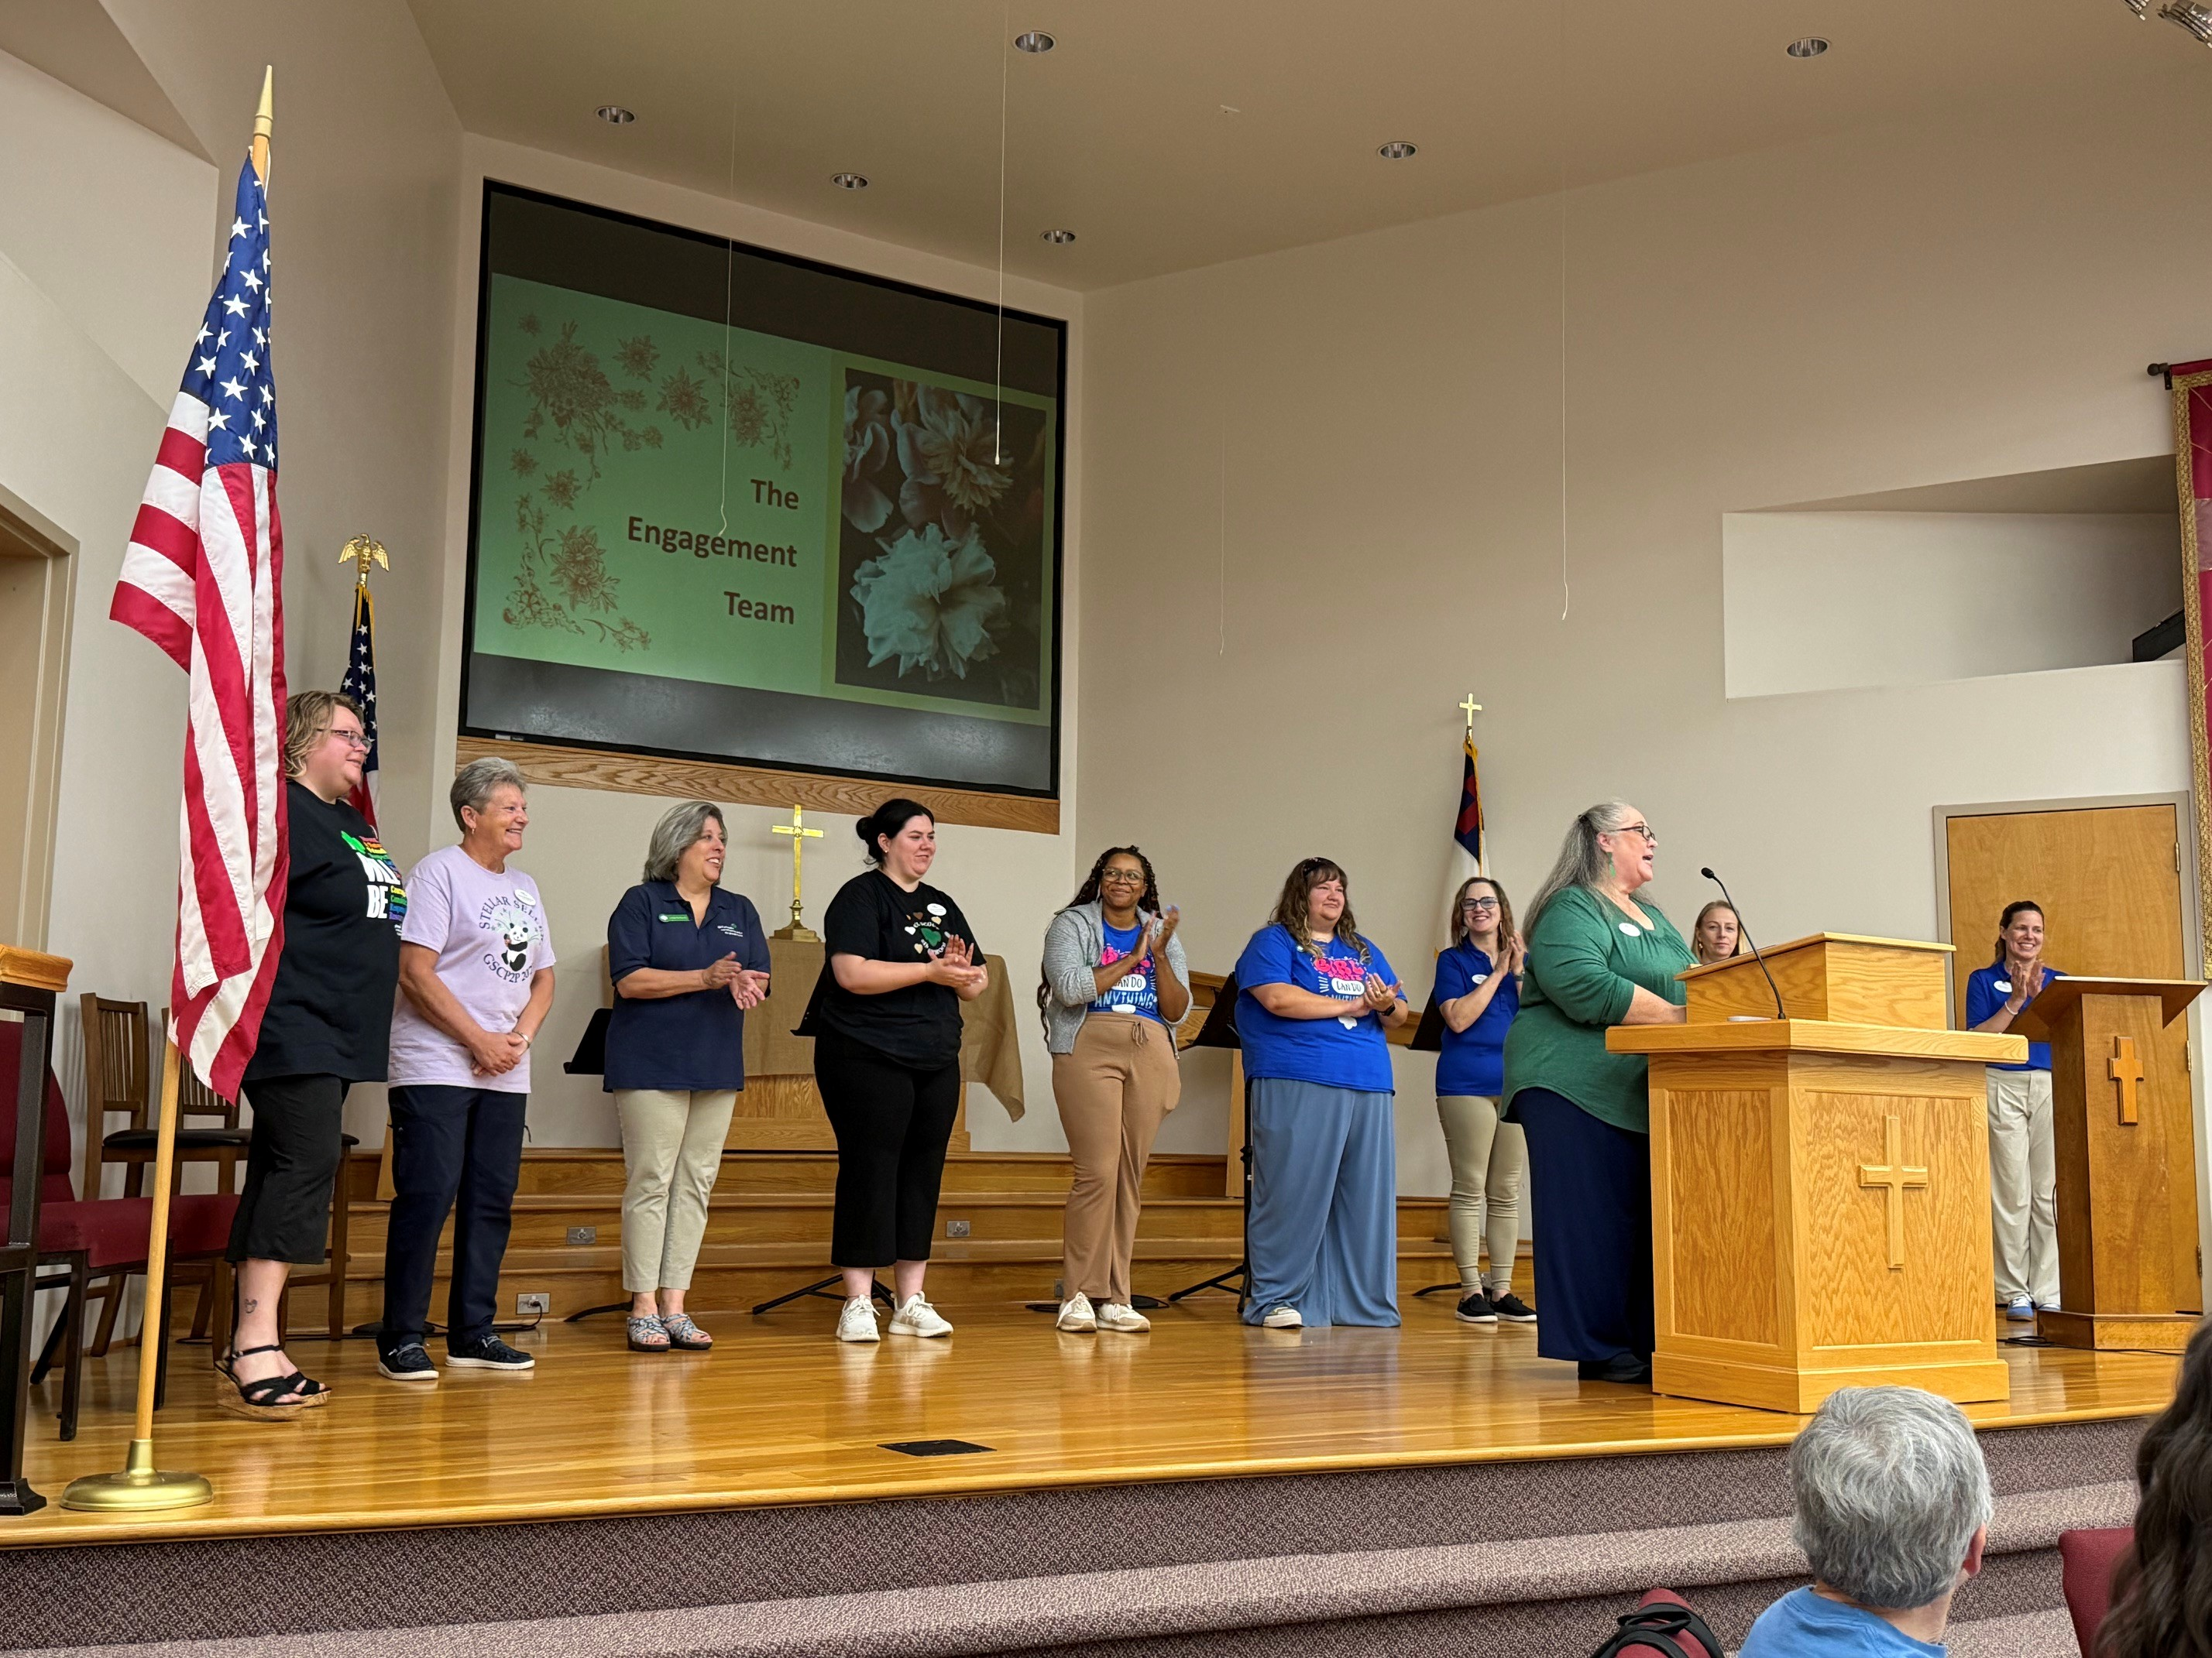
Thank You!
Thank you for spending your Saturday with us!
Notes:
JACLYN: Thank you to everyone who attended our Service Team Retreat on Saturday in Statesville. It was a great day together and a perfect way to end this membership year and look ahead to next year. We had 52 volunteers from 18 Service Units and hope everyone who attended had as much fun as we did!

Slide 5

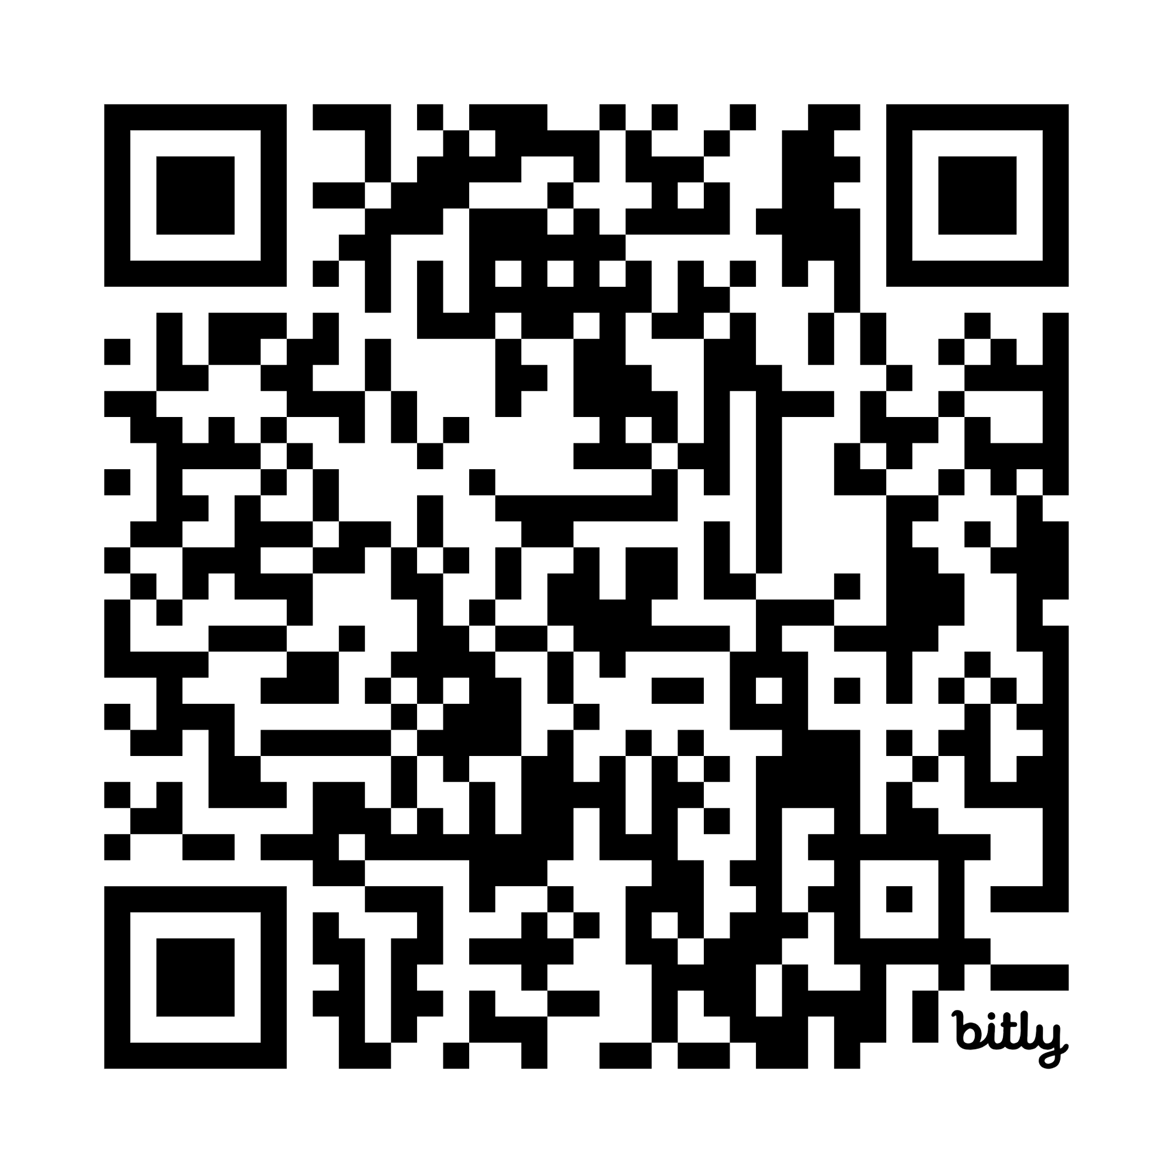
GSCP2P Wants to Know Survey Closes on June 5!
Notes:
JACLYN:
As we wind down this year's SALT meetings, we would also love to hear from you on any ways we can improve upon them for you. All of you should have seen the GSCP2P Wants 2 Know survey in Today's Tips. Please let us know any and all feedback in that survey so we can come back better and stronger in MY27. This survey opened on April 25 and will close on June 5. GSCP2P Wants to Know Survey .

Slide 6
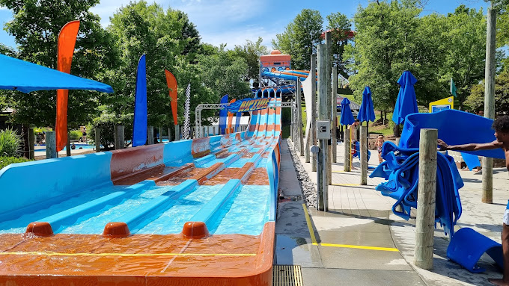

Product Program Updates
G.E.O. Celebration
June 6, 2026
Notes:
Just a reminder that the G.E.O. event takes place this coming weekend on Saturday, June 6! Join us to celebrate all girls who sold 500 or more packages at Emerald Pointe, Wet n' Wild waterpark. We look forward to celebrating this weekend with all our top sellers from the 2026 Cookie Program and nearly 1500 of our closest Girl Scout friends.
Just as a reminder:
GEO girls and their adult chaperone both receive a free admission ticket to the water park, valid for June 6 only.
The deadline has now passed (May 29th) to use cookie dough/nut bucks/daisy dollars to purchase additional tickets.
Reach out to info@girlscoutsp2p.org with questions.

Slide 7
GSCP2P Membership Updates
MY26 Renewed girls = 4075
New girls = 1449
Total girls = 5604 (-9.60%)
Total GSCP2P Members (Girls + Adults) = 10,071 (-6.62%)
Where have we gained?
New Troop Total = 37
Spring Renewal Numbers = 2512 girls / 5452 total
Extended Year Number = 73 girls / 134 total
Notes:
SANDI: A quick update for everyone.

Slide 8

CELEBRATE GRADS
Lifetime Membership is 50% for young alums!
Notes:
Graduating Girl Scouts can enjoy a lifetime membership for $200—our discounted rate for alums under age 30. Best of all, your grad will get all the benefits of membership for years to come, like travel adventures, campus Girl Scouts and more!
Encourage graduating Girl Scouts to submit their Post Grad Plans with us! We'll give them a special shout out on social media but also provide the option to stay connected through our P2P young alum opportunities.

Slide 9
SU TEAM UPDATE
Rallyhood Top Contributors:
SU125, SU144, SU142 and SU148
Due July 1, 2026:
POA first draft – Engagement Managers will fill in goals and girl level breakdowns for planning.
Troop and SU End of Year Reports are also due.
NEW 2026 Troop Year End Report
NEW 2026 Service Unit Year End Report
SAVE THE DATE: Service Unit Retreat March 19-20, 2027
Notes:
Again, Thank you for continuing to be advocates for Rallyhood!

Slide 10
2026
Volunteer Conference
Saturday, August 1
10 a.m. - 3 p.m.
Monticello Community Church,
Statesville
Registration opens June 5!
Discount codes for those who renewed during Spring Renewal April 1 – May 31st will be sent out on or around June 5, 2026. Please register using that code for FREE admission.
Lifetime members will also receive an e-mail and code for FREE admission to the Volunteer Conference.
Notes:
Read and encourage to join!

Slide 11
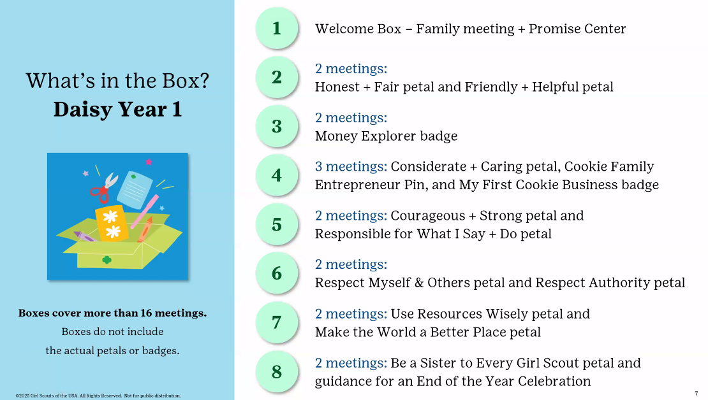
2026-2027
Girl Scout Experience Boxes
4 renewing Girl Scouts and/or 4 NEW Daisy Girl Scouts
To get registered, contact your Engagement Manager TODAY!
Notes:
Read and encourage to join!

Slide 12
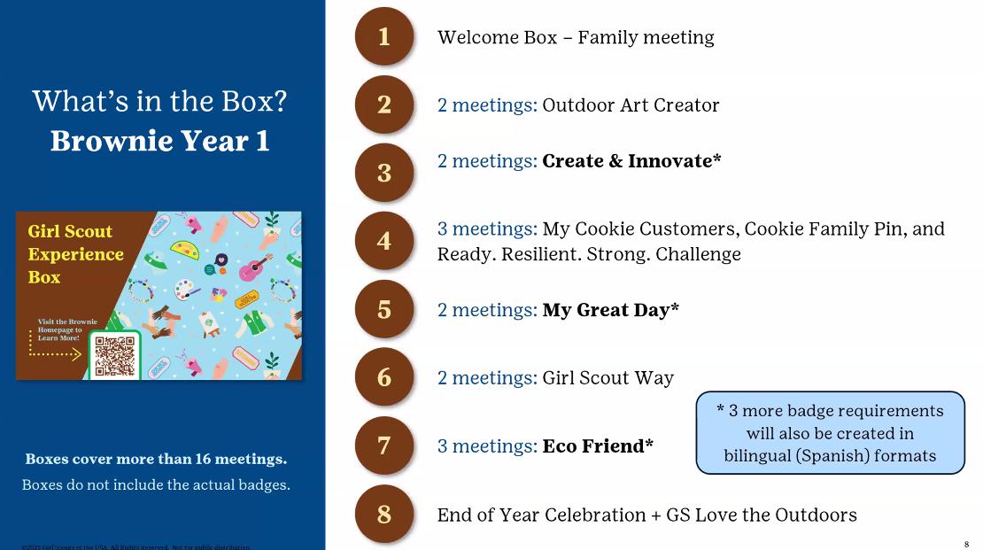
2026-2027
Girl Scout Experience Boxes
4 Bridging Girl Scout Daisies, 4 renewing and/or 4 NEW Brownie Girl Scouts. To get registered, contact your Engagement Manager TODAY!
Notes:
Read and encourage to join!

Slide 13


Tuesday Explorers is a virtual series kicking off in June. These unique meetings are open to all girls and Girl Scouts, so invite your friends to join you to experience what Girl Scout fun is all about! See what is in store and save your spot at https://www.girlscoutsp2p.org/en/discover/activities/events.html?q=tuesday%20explorers.
Notes:
Tuesday Explorers is a virtual series kicking off in June. These unique meetings are open to all girls and Girl Scouts, so invite your friends to join you to experience what Girl Scout fun is all about! Download the new Passport to Adventure: Summer Edition patch program and tackle your bucket list.

Slide 14

Notes:
New event- a Smithsonian National Zoom viewing party for our Girl Scouts!

Slide 15


Rallyhood Updates: Summer Camp Photos and Accepting Payments
Now is a great time to encourage volunteers and families to join Rallyhood as we approach local end of year celebrations and summer camp.
This summer, parents will be able to view photos of their camper while they are away at camp through Rallyhood. We will send an invite to access your camper's session prior to their arrival.
Want to accept payments through Rallyhood? Request for Stripe to be enabled on your troop or service unit rally
Notes:
Stripe request form on website https://girlscoutsp2p.wufoo.com/forms/xat5oab058p6k5/

Slide 16
Camp Property Updates
Camp Ginger Cascades
Drywall work at the Director's House
Property Committee reviewing the Newmark Report for CGC next month and then set priorities.
Camp Pisgah
Reviewing bids for work at Westfeldt, demolition of the Tree Houses and the construction of two shelters (destroyed by Hurricane Helene)

Slide 17
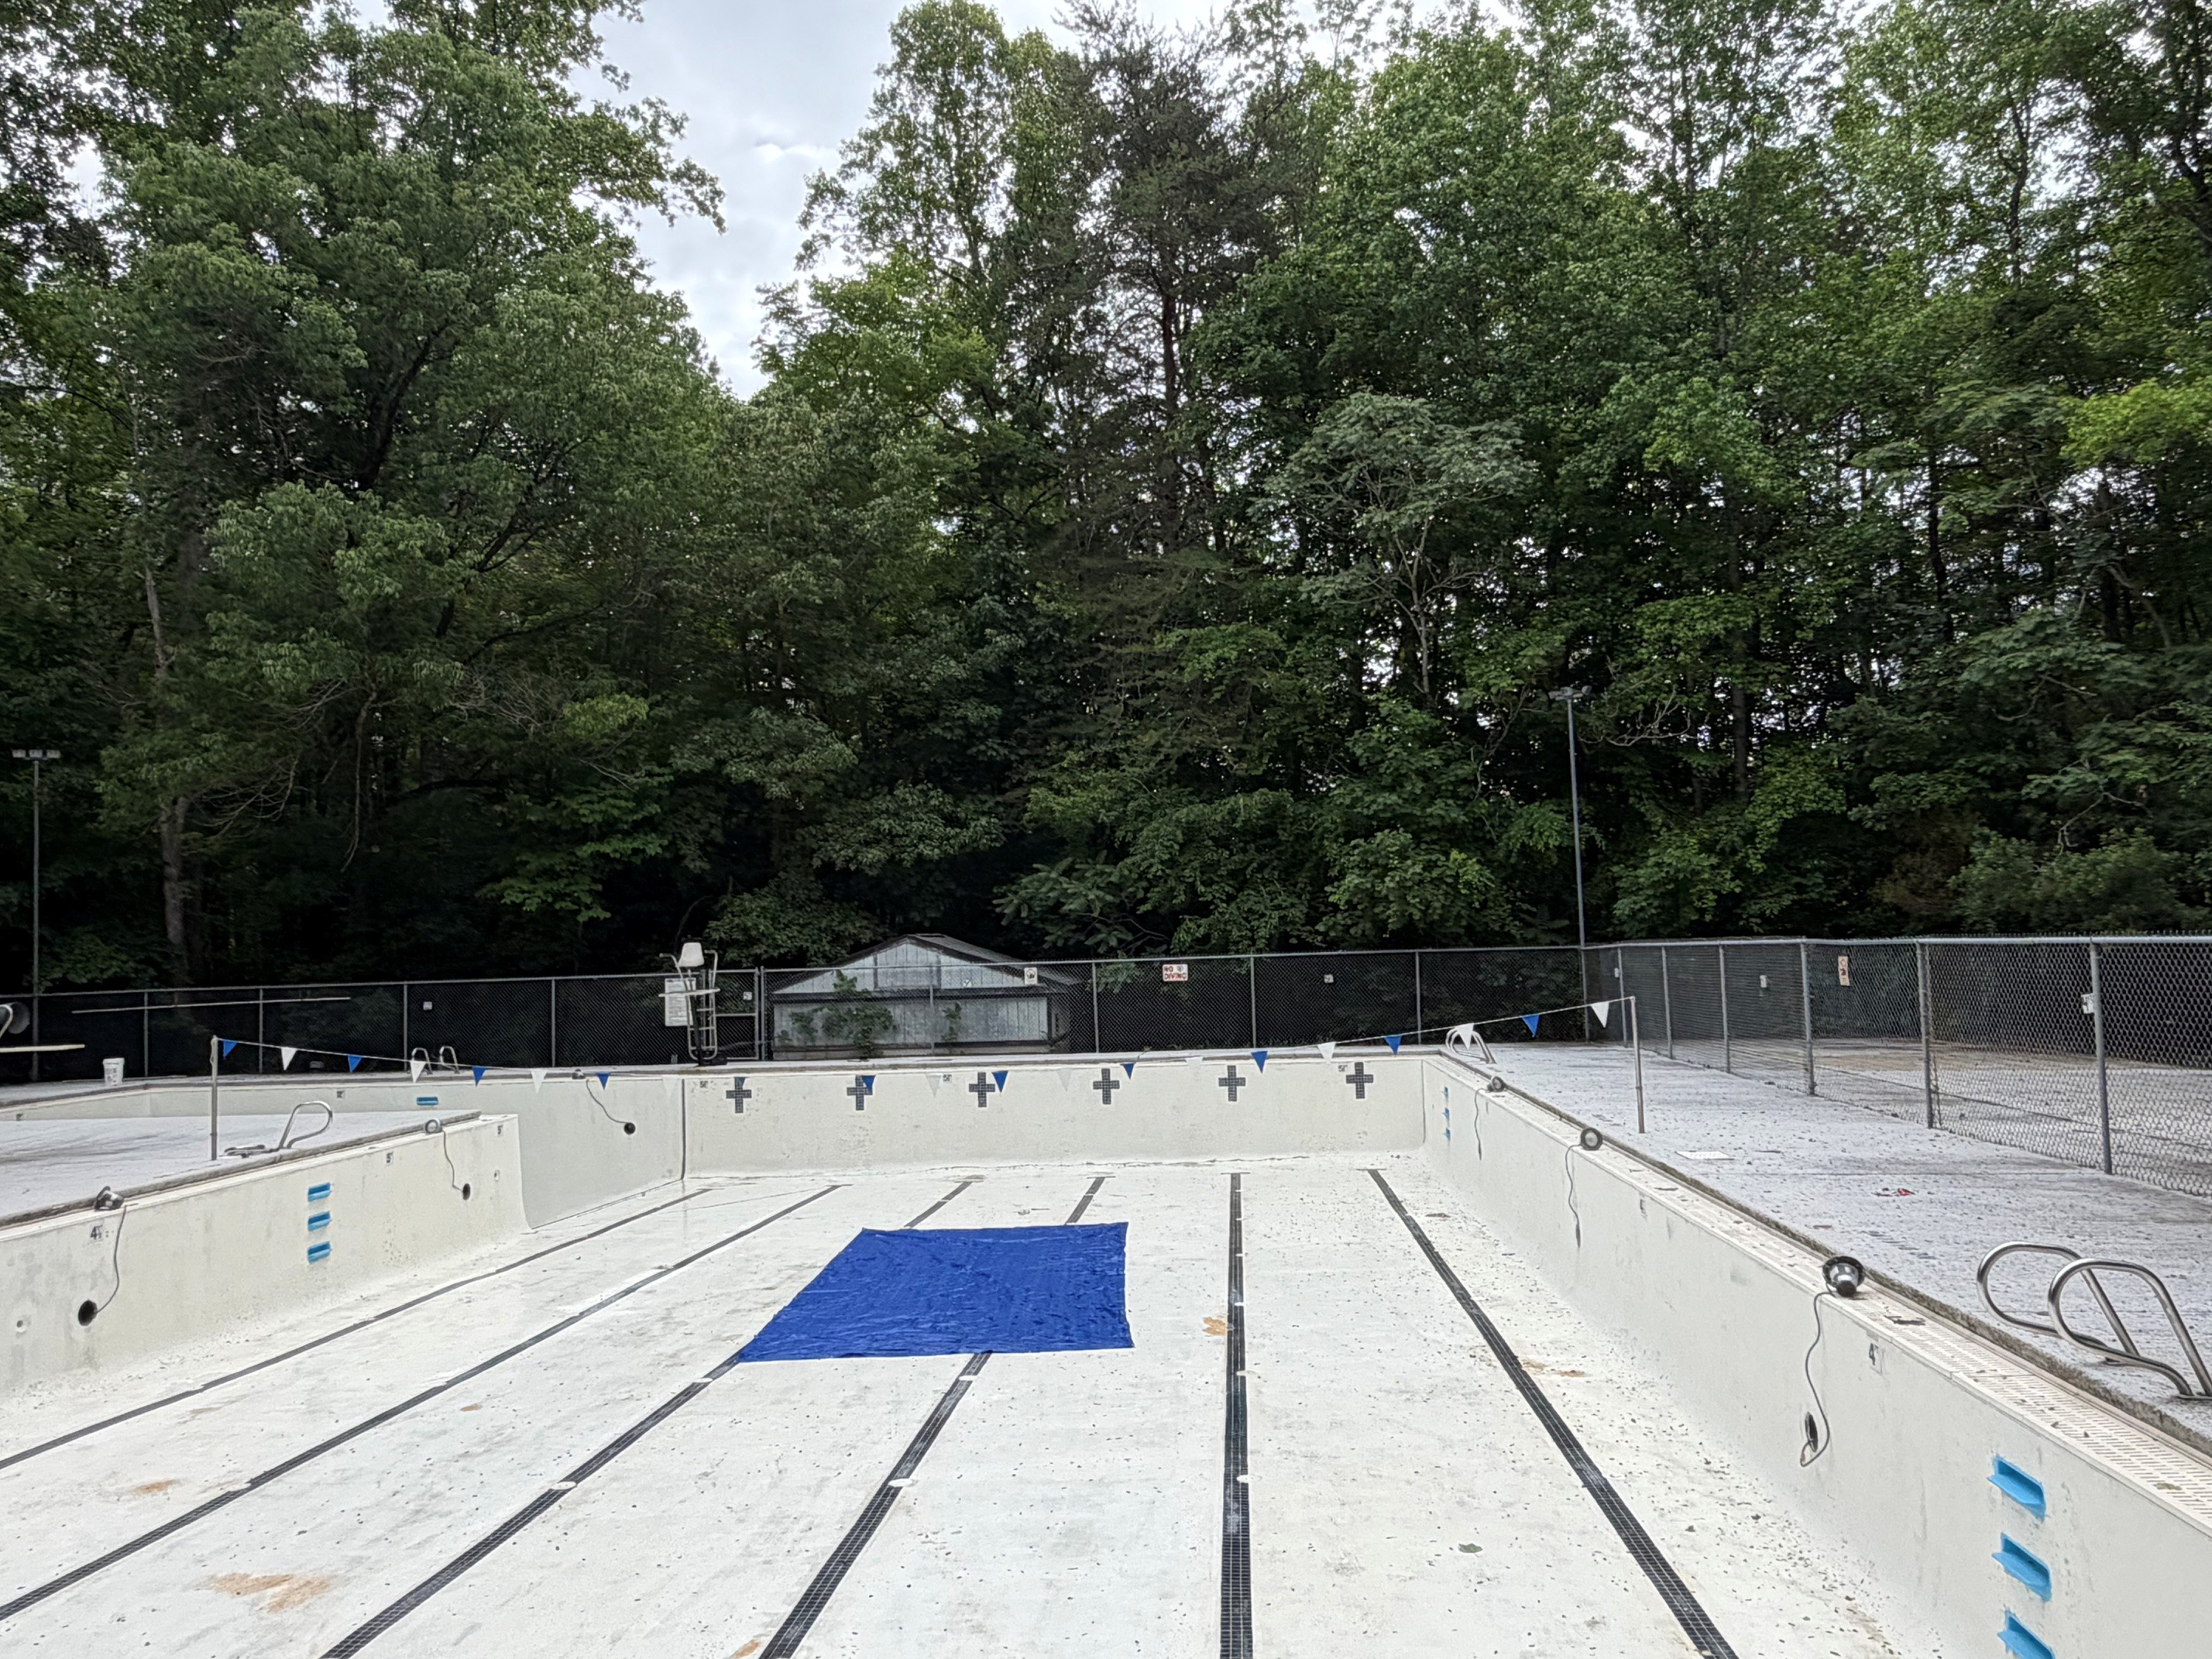
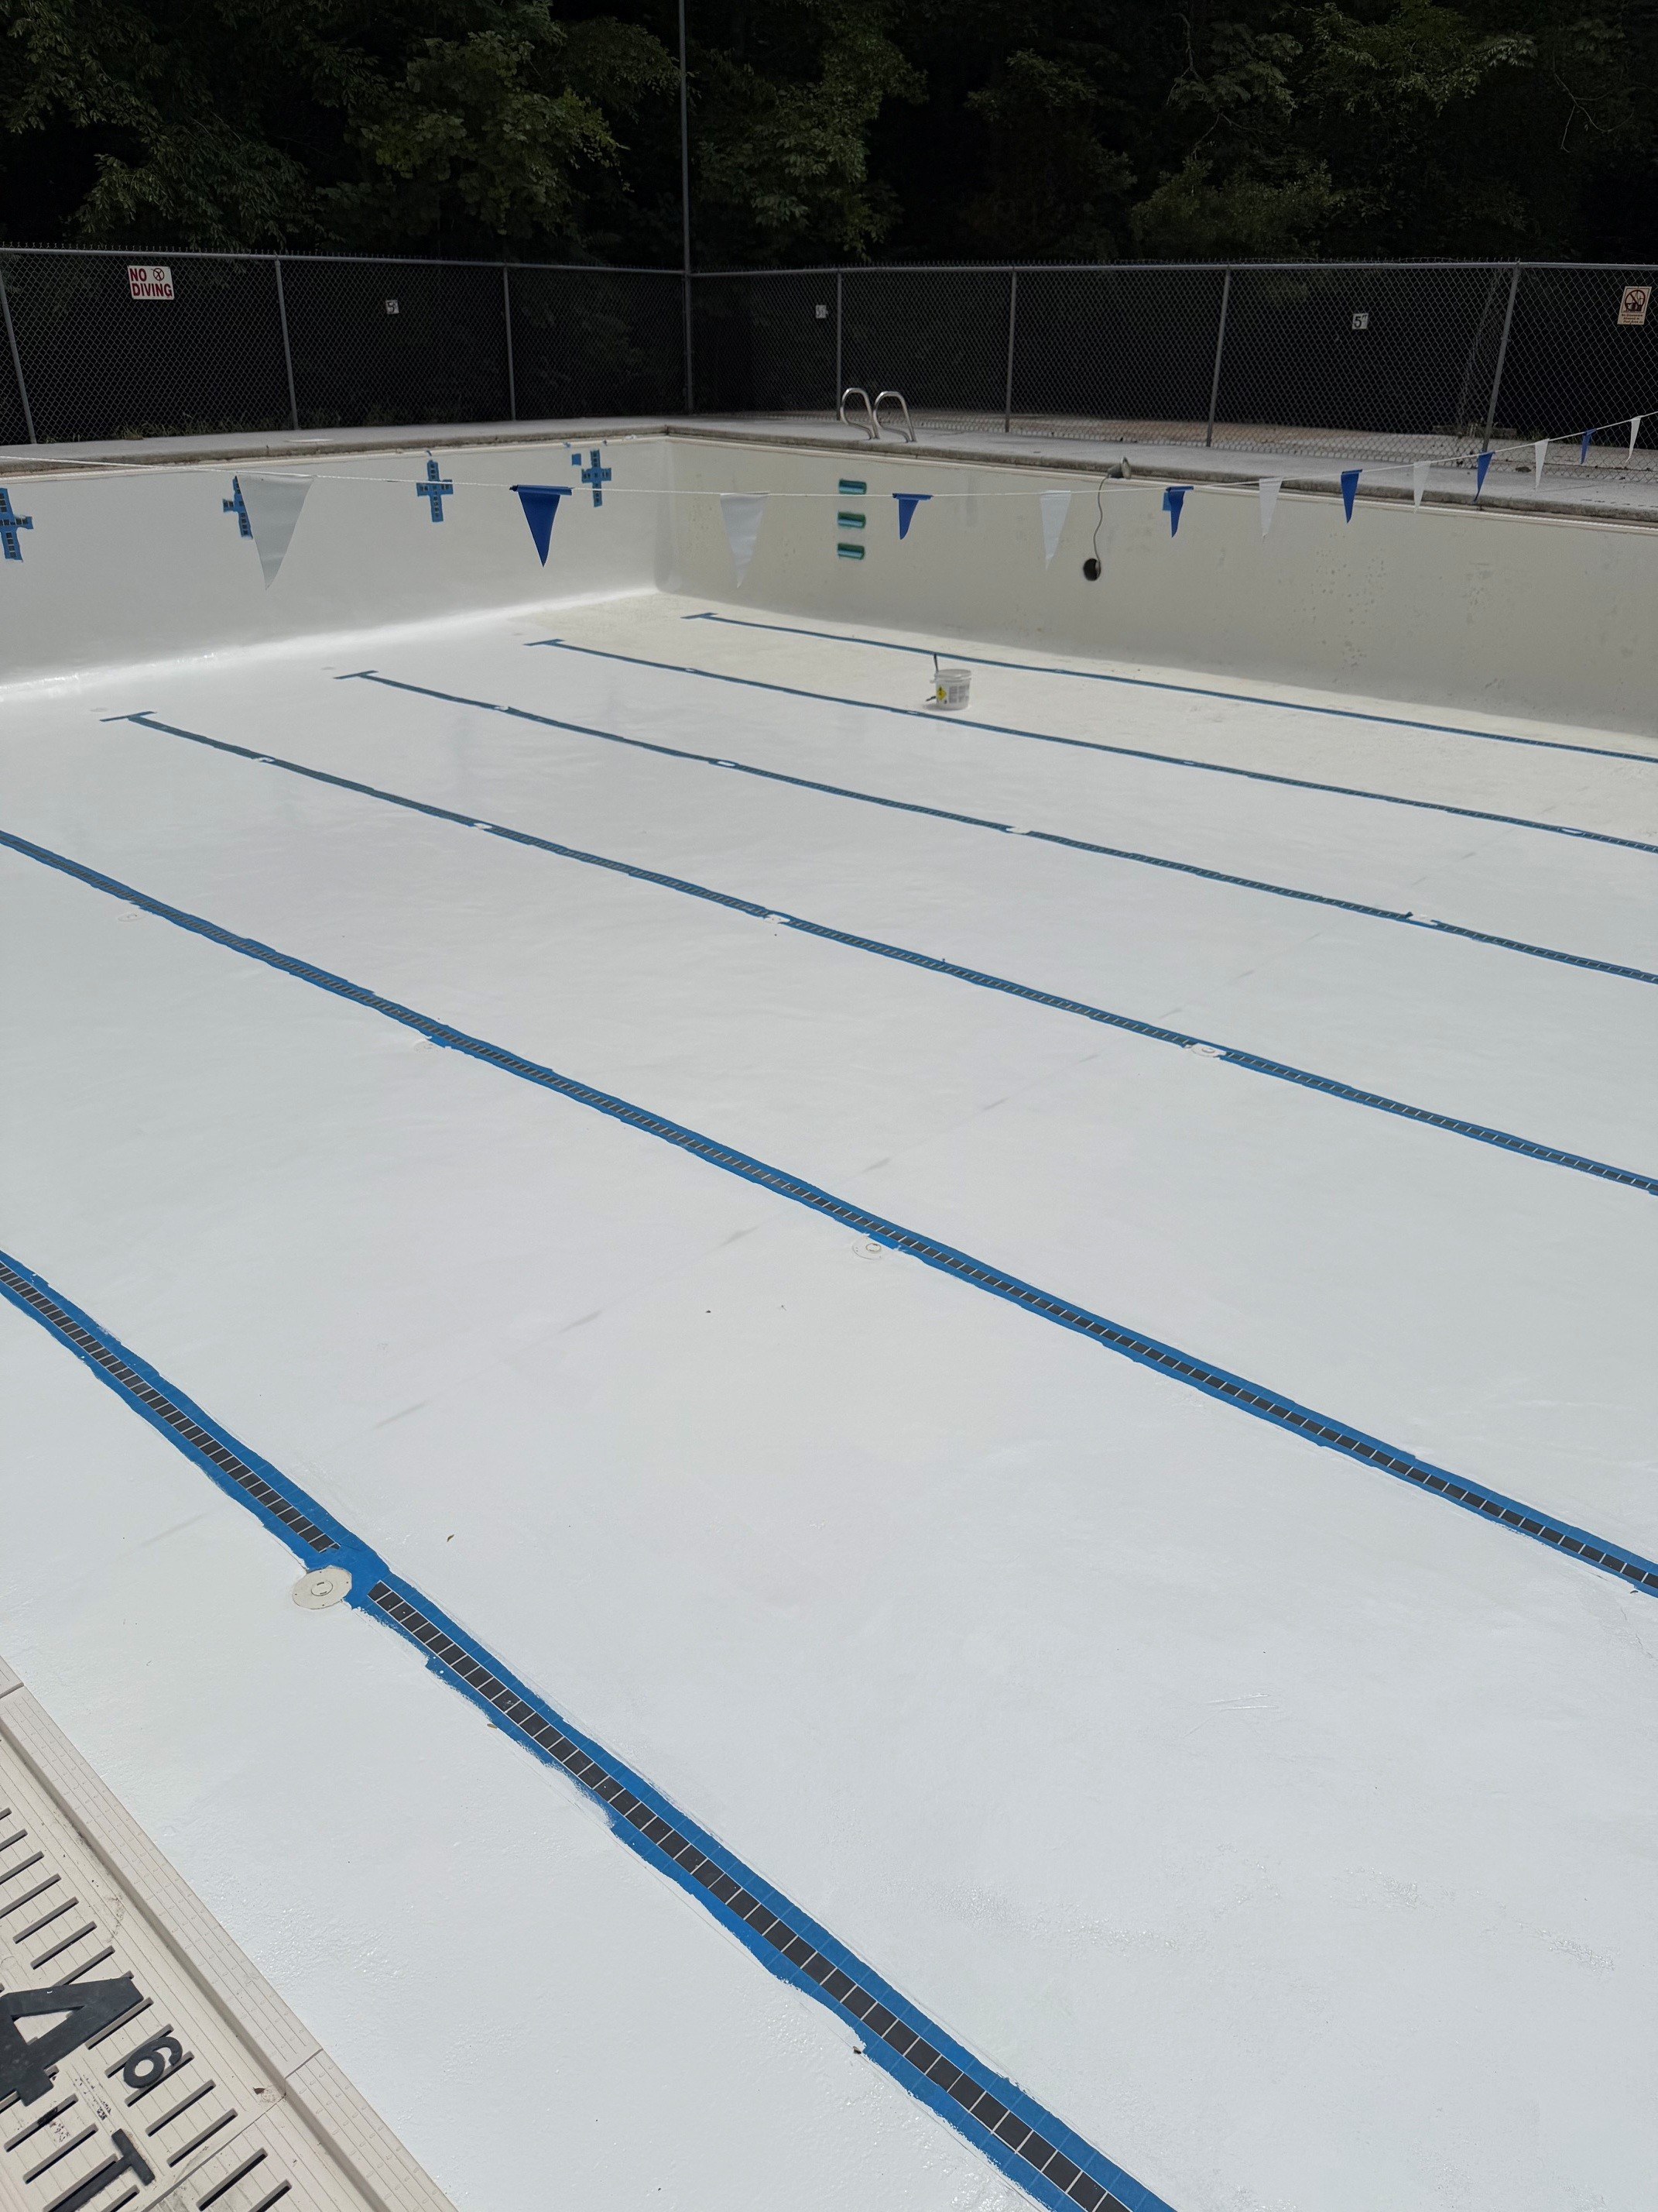
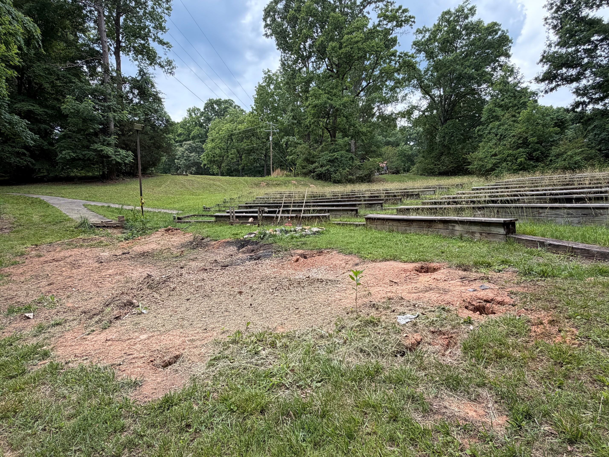
Camp Property Updates
Keyauwee Program Center
Projects in Progress
Pool and Amphitheater

Slide 18
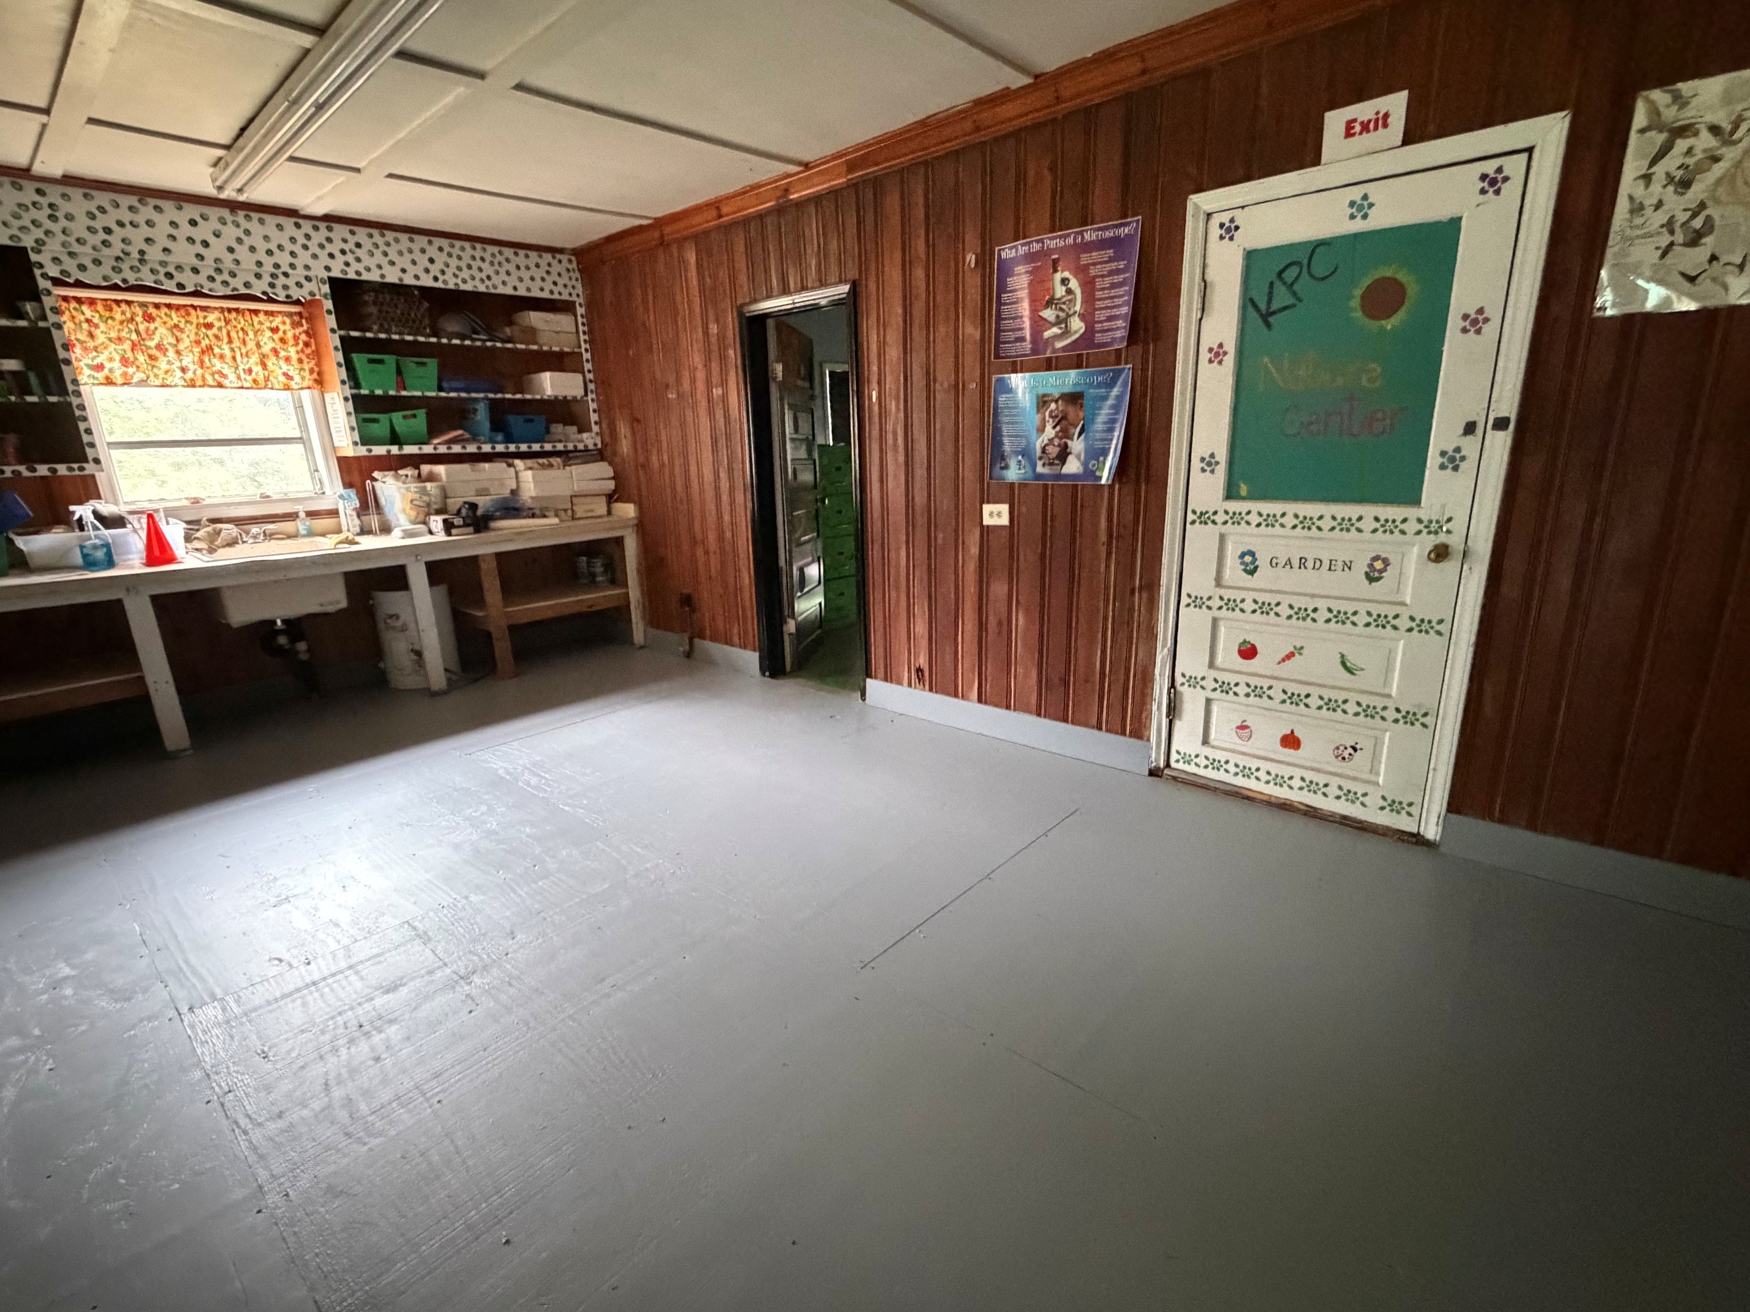
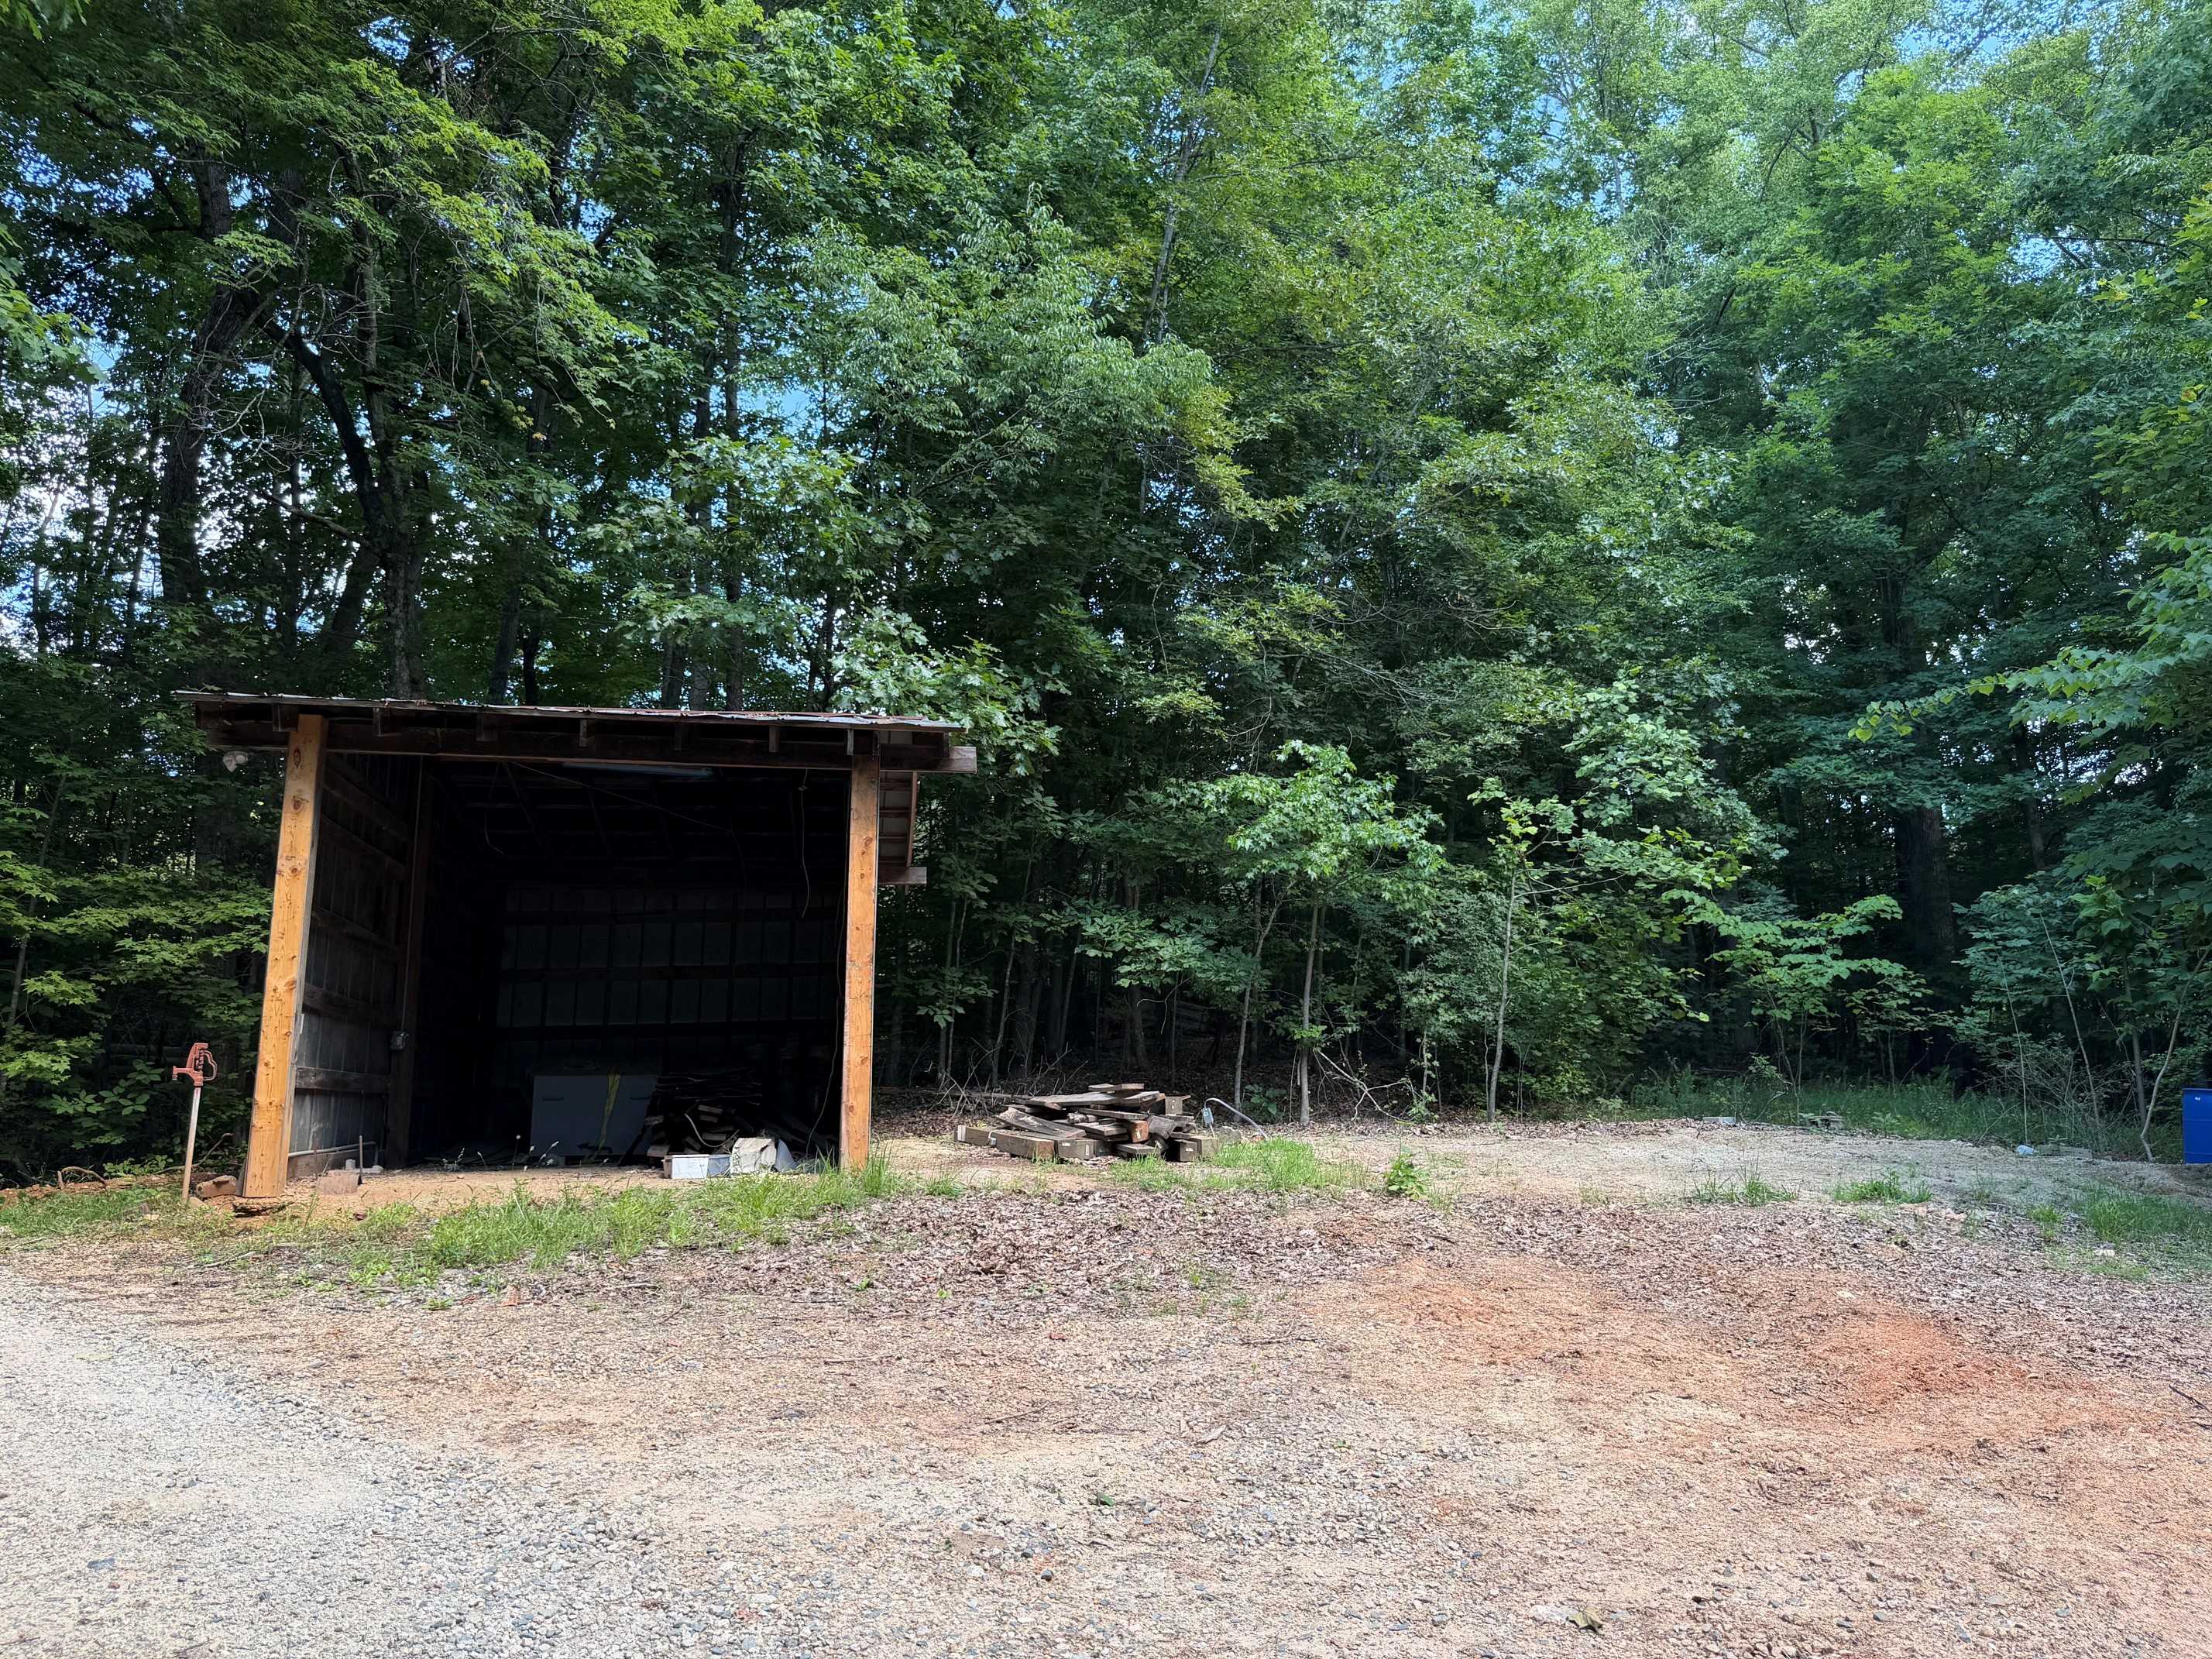
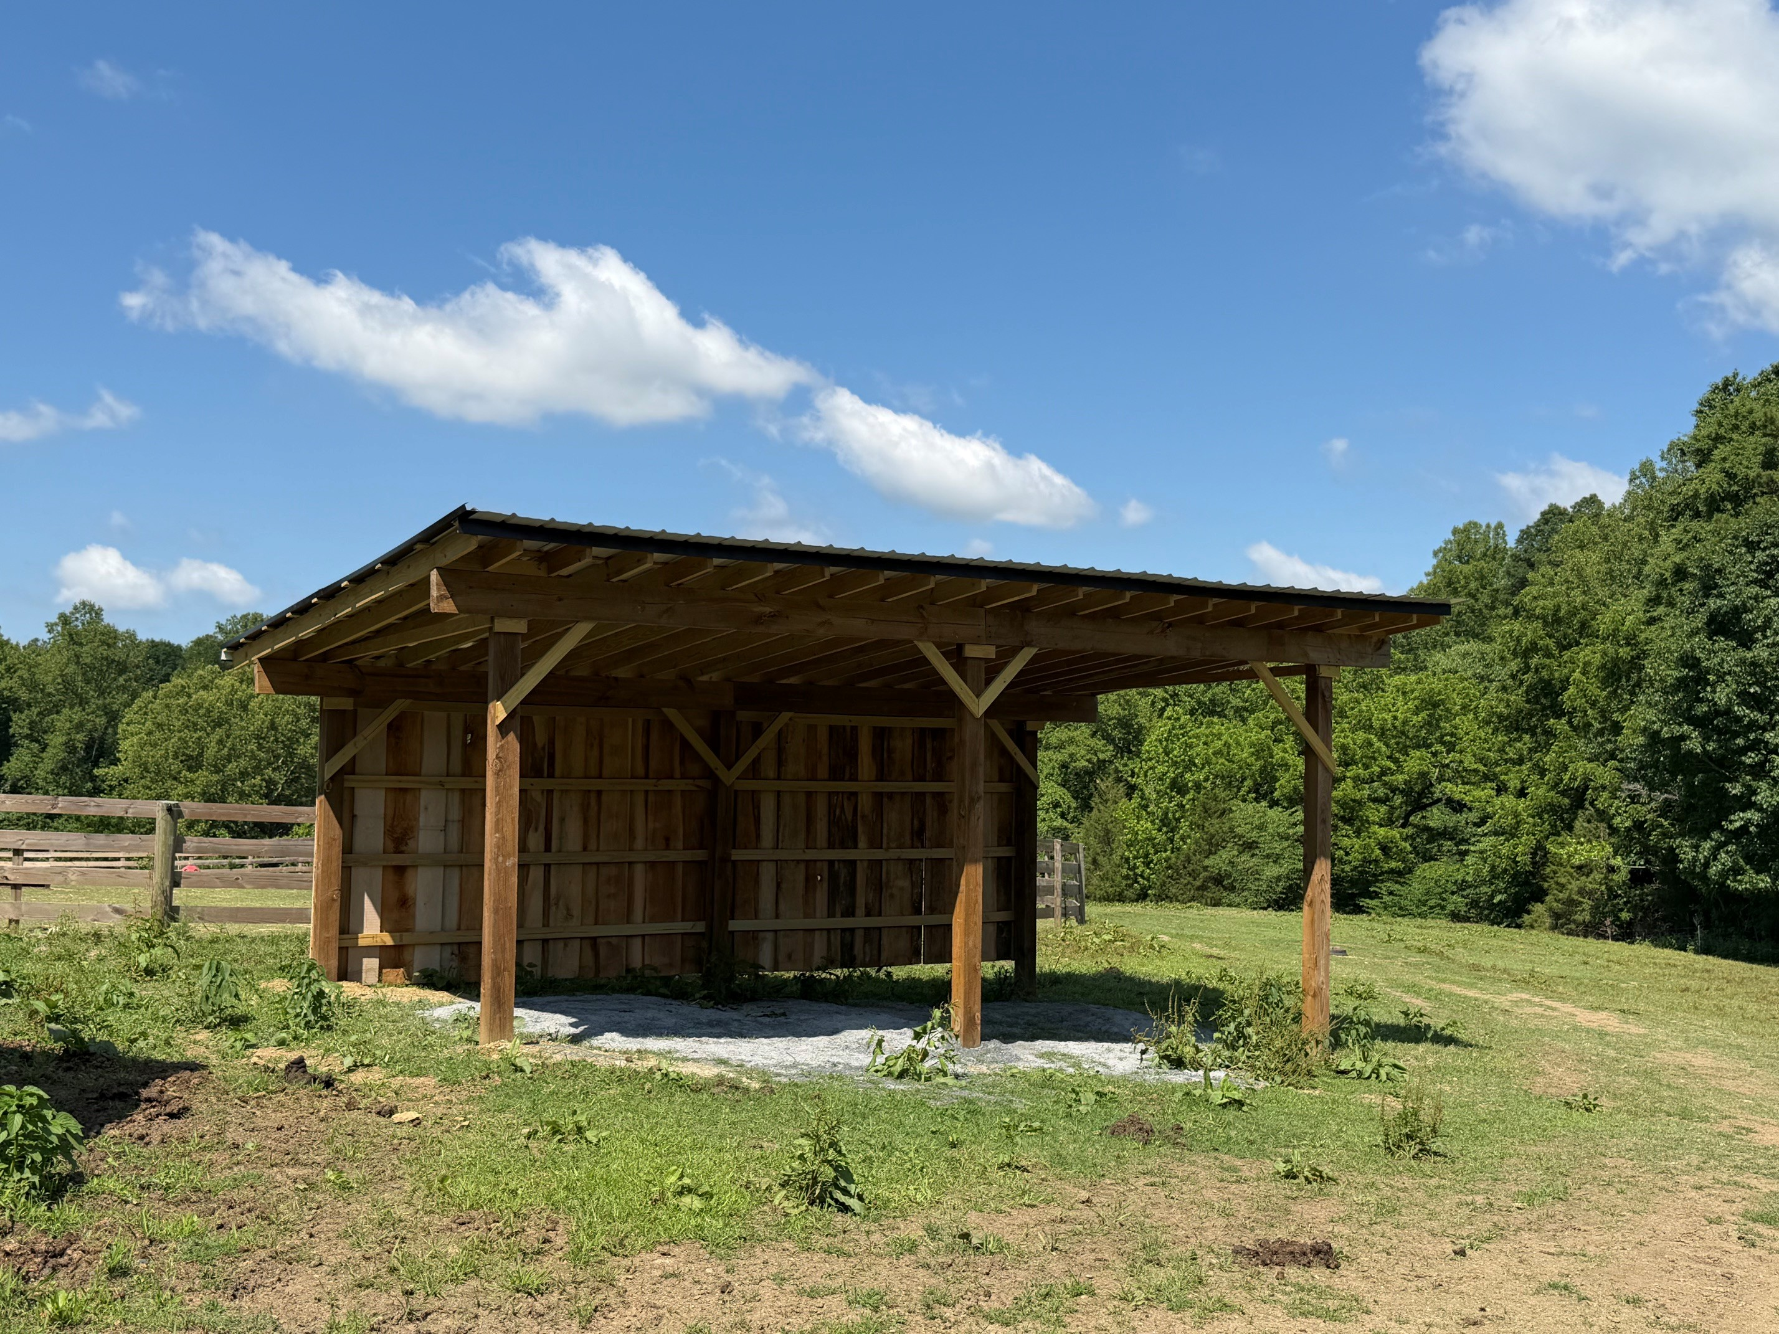
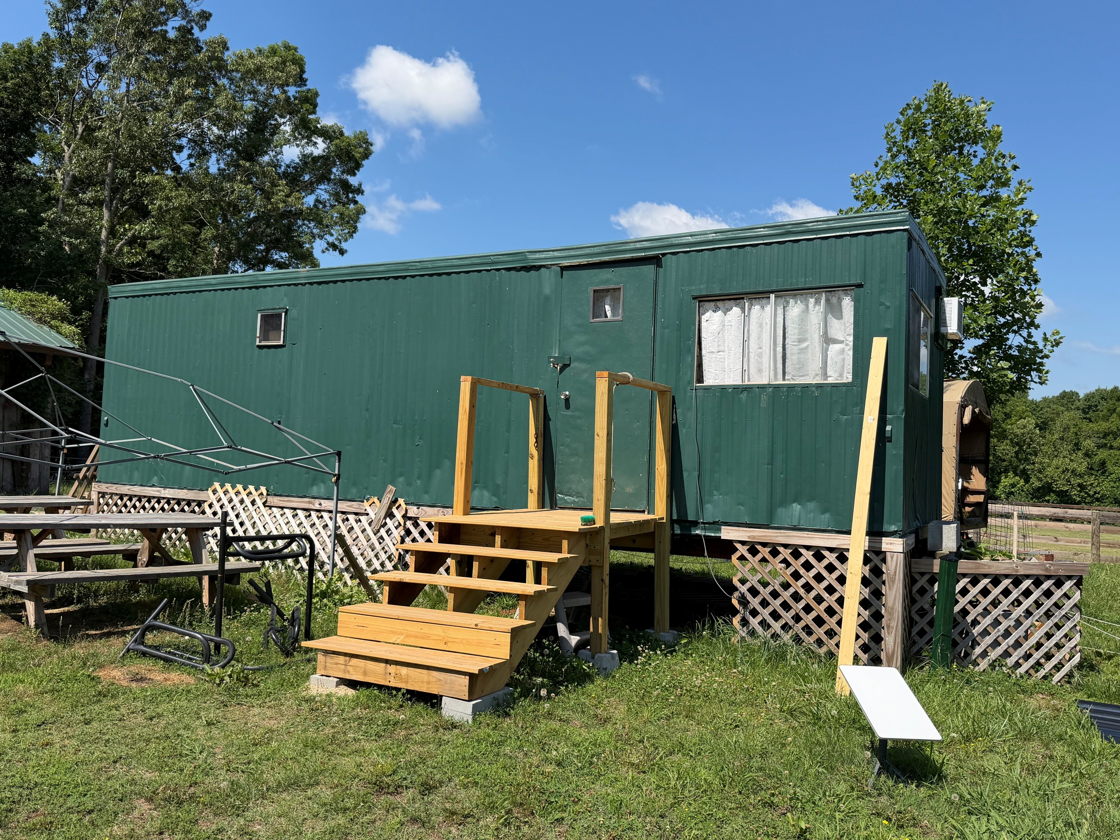
Keyauwee Program Center
Projects Completed!
Nature Center, Pole Barn, Run In Shelter and Circle C Office

Slide 19

Outdoor Experience Updates
Notes:
CLAYTON:
Fall Camporees- looking at schedule this week and should be reaching out to volunteer contacts soon with dates and locations
Troop camping options should open up in CampLife by June 12.
Spring camporees- can submit interest form through July 1 and will open to Troop Camping by August 1.

Slide 20

Summer Camp
There are still spots left and still financial aid available!
Overnight camp is for rising grades 2-12.
Day camp is for rising grades 1-5 and will be hosted in Black Mountain, Greensboro, Hickory and Winston-Salem.

Slide 21


Summer Fun Ahead!
Keep the Girl Scout Fun going all summer long with our Game Changers patch and Passport to Adventure patch programs!
Keep the fun going with our
new summer patch programs!
Notes:
EMILY: We already have game nights booked with the Gastonia Ghostpeppers, Winston-Salem Dash, Burlington Sock Puppets, Greensboro Grasshoppers, Hickory Crawdads, and Charlotte Knights baseball, The Groove Women's Basketball and NC Courage Women's Soccer. Plus more games are in the works!

Slide 22

Girl Scout Road Trip
As your troop year wraps up, don't forget to order your Year 1 Road Trip patches!

Slide 23
Daisies/Brownies/Juniors
June 6 – Girl Scout Day at Wet n’ Wild, Greensboro
June 13 – Council-wide Bridging and Family Fun Day, Keyauwee Program Center, Sophia
Girl Scouts doesn’t stop just because school is out. Stay connected through our Tuesday Explorer Series! Girls can join us virtually every Tuesday night for a troop meeting or head out on an adventure with one of our community partners. Our full summer calendar is coming soon—stay tuned!

Slide 24

Cadettes/Seniors/Ambassadors
June 6 – Girl Scout Day at Wet n’ Wild, Greensboro
June 9 – Gold Award Training, Virtual
June 12 – Power of Engineering with Doosan Bobcat, Statesville
June 13 – Council-wide Bridging & Family Fun Day, Keyauwee Program Center, Sophia
The Girl Advisory Board (GAB) allows Girl Scout Cadettes through Ambassadors the opportunity to serve as an advisory team providing programmatic input to the Experience Team and the Chief Executive Officer (CEO). By lending a voice to a movement that wants, needs and values girl-led contributions, these young leaders will play a significant role in shaping the ongoing work of GSCP2P. Applications are open now and will be accepted through July 1, 2026.

Slide 25


Adult Learning Opportunities
Leaderee and Trainfest are both live and on our council calendar. New this year! A La Carte! Choose your own adventure! Stay for the weekend or only come for a couple classes, order a meal or bring your own and customize your experience.
Leaderee
"The Great Pajama Jam"
September 25-27, 2026
Registration Deadline: September 10
Trainfest:
"The Road to OZ
October 9-11, 2026
Early Bird Registration Deadline: August 27
Registration Deadline : September 24

Slide 26

Retail/ Mobile Shops Updates
New Keyauwee Program Center Hoodie. Pre-order yours today!
Notes:
https://www.girlscoutsp2p.org/en/sf-events-repository/2026/explore-more-keyauwee-hoodie.html

Slide 27

Retail/ Mobile Shops Updates
Summer shop hours are around the corner! From June 1 through August 7, the Triad shop will be open from Monday, Tuesday and Thursday from 10 a.m. to 5 p.m. Volunteers can book appointments for any weekday or shop 24/7 through the official online shop.

Slide 28
Next Steps and Questions
Have a great summer!
Notes:
Thank you for attending our SALT meeting tonight! Are there any final questions for our team this evening?
Take down PowerPoint.
Pause for questions
After all questions are done…
Later this week you all will receive this PowerPoint presentation and notes as well as a sample SU Meeting PowerPoint and Agenda for your May SU meetings. It will also be posted in Rallyhood. Our hope is that these will be useful tools for you as you go back to your Service Units and share information.
Our next meeting will be August 24, 2026. Have a great summer!

