Slide 1









Service Area Leadership Team Meeting
March 23, 2026

Slide 2
Welcome!
Please enter your name, Service Unit number and Service Team position in the chat!
Notes:
SANDI:
Good evening and welcome to our March SALT meeting.
Our hope tonight is that you will leave here with lots of up to date information and resources to take back to your service units and service unit meetings. Thank you for being here with us! Please introduce yourself in the chat with your name, SU number and Service Team position.

Slide 3
Tonight’s Agenda
Membership Updates
Service Unit Team Updates
Spring Renewal
Outdoor Experience & Property Updates
Cookie Program Final Dates
Upcoming Programs and Trainings
Retail Updates and Experience Center Rentals
Questions
Notes:
SANDI:
Our agenda is packed this evening with lots of great information!
Go through list…
Please make sure you stay on mute for the presentation portion of this evening, but you are welcome to add questions and comments to the chat as you think of them. We will also have time throughout the meeting and at the end of tonight’s meeting for you to unmute and ask any additional questions.

Slide 4


GSCP2P Membership Updates
Renewed girls = 4059
New girls = 1351
Total girls = 5410
Total GSCP2P Members (Girls + Adults) = 9753
New Troop Total = 29
On April 1, 2026, we will begin MY27 GSEB registrations! Current box recipients please watch for an email about how to register for next year's box and/or for second year troop plans.
Notes:
SANDI: A quick update for everyone. Read slide and celebrate!

Slide 5
SU TEAM UPDATE
Rallyhood Top Contributors:
January- SU 147, SU 132, and SU 144
You asked…we planned!
Service Unit Retreat "Where Service Units Grow"
May 30, 2026 from 10 a.m. -3 p.m.
Monticello Community, Statesville
Registration is NOW open - Where Service Units Grow (Statesville)
Notes:
SANDI:
Read top contributors for SUs: I want to sincerely thank you for not only embracing our new platform, Rallyhood, but for actively advancing it across your Service Unit. Your willingness to learn the system, use it consistently, and encourage others to engage has made a meaningful difference. Thank you for your leadership and continued support.
Registration is now open for our Where Service Units Grow -Service Unit Team members Retreat on May 30, 2026, to be held at Monticello Community Church, Statesville from 10 a.m. -3 p.m. Get ready for an exciting day of role-specific training, SU team building, and meaningful collaboration as we connect, share ideas, and learn best practices from across our council! Bring your current SU team as well as those volunteers wanting to join the team for next year.

Slide 6
2026
Volunteer Conference
Saturday, August 1
10 a.m. - 3 p.m.
Monticello Community Church,
Statesville
Registration link coming soon!
Notes:
SANDI

Slide 7

SPRING RENEWAL
Notes:
All Girls who renew their membership during April 1 – May 31, 2026, will receive an automatic discount of $20 off their membership during the renewal process and a patch. Those girls who earned their MY27 membership through the cookie program will also receive a patch.
Every volunteer that renews between April 1 - May 31, 2026, will receive free admission to the Volunteer Conference August 1, 2026, including our Lifetime members. We will provide a code to be used during registration for this discount.
Every SU that meets their spring renewal girl goal will receive a $200 program or store gift certificate.
For every girl over the Service Unit's Spring Renewal goal, the SU will also receive $10 bonus.
I have had several questions about using financial aid for renewals. When renewing they will select financial aid as payment and receive an email for next steps. These girls will receive the early bird patch, if the process is completed during April/May.
NEW EXTENDED YEAR INCENTIVE – Each SU that meets their extended year girl goal will receive a $50 program/retail gift certificate. Additionally, for every girl over their goal, they will receive a $5 extra bonus.

Slide 8
April is
Volunteer Appreciation Month
Thank you for serving Girl Scout families in your Service Unit!
Remember to thank your fellow volunteers- old and new.
Notes:
SANDI - Girl Scout volunteers are essential mentors who inspire girls to dream big, build skills, and lead with courage. YOUR dedication transforms lives and shapes future leaders, acting as the heart of the Girl Scout movement. We at P2P would like to honor your invaluable time, creativity, and commitment to making the world a better place.

Slide 9

2026 Annual Meeting
Saturday, April 25
10 a.m. - 3 p.m.
Mary E. Rittling Conference Center
Thomasville
Registration is open!
Notes:
SANDI:
Registration is now open for annual meeting! All delegates, if you have not already, please join the Rallyhood SU Delegates rally. All information for Delegates will be shared there including a discount code for registration and training information. If you have girl delegates, their primary caregiver was invited to the rally. If you have changes to your Delegates, please let me know ASAP.
Turn things over to Jaclyn

Slide 10

Summer Camp
Financial assistance is still available!
Overnight camp is for rising grades 2-12.
Save $50 before our Early Bird Discount ends on March 31.
Overnight campers joining us June 21-26 or July 12-17 can request free transportation assistance from the Asheville or Hickory Service Center. Transportation assistance requests are due May 17.
Day camp is for rising grades 1-5 and will be hosted in Black Mountain, Greensboro, Hickory and Winston-Salem.
Notes:
JACLYN

Slide 11




Rallyhood
& Summer Camp
Now is a great time to encourage volunteers and families to join Rallyhood as we approach local end of year celebrations and summer camp.
This summer, parents will be able to view photos of their camper while they are away at camp through Rallyhood. We will send an invite to access your camper's session prior to their arrival.
Notes:
JACLYN

Slide 12
Outdoor Experience Updates
This month we welcomed a new Outdoor Experience Manager, Emma White!
Emma brings experience in-
  Camp Leadership
  Challenge Courses
  Teaching / Education (both outdoors and in a school classroom)
Spring Camp Activities are limited to troop-led experiences.
Additional Camp Activities will be open in the fall but limited due to facilitators.
  We are planning Adult Certification days for the fall that will be open to volunteers and staff to build our facilitator pool so we can offer more activities throughout the council.
Notes:
JACLYN

Slide 13
Property Updates
KPC-
Spring Volunteer Workday, March 28
Pool reopening has started today!
CGC-
Working to continue assessing repairs at camp- both scope and cost.
Projects include, but are not limited to:
  Roof replacements
  Repairs to well
  Repairs to Directors house
  Dining Hall decking and roof
CP-
Water System (It’s 75% good news!)
  Wells have passed!
  Kitchen passed!
  Water from Cistern to Westfeldt did not pass and tested positive for Total Coliform (NOT E. Coli)
    Total Coliform is very common and is caused by any growth in the water lines due to stagnancy or intrusion from outside sources (i.e. broken lines).
  Sanitizing from Cistern to Westfeldt and retesting happening this week.
Notes:
Jaclyn
Then turn things over to Emily Satterfield.

Slide 14

Girl Scout Cookie Program Updates
Important Dates
December
January
February
March/April
December 5– Troop initial order due in Smart Cookies
December 8 ⁻ Digital Cookie e-mails launched to both girls and troop volunteers
December 16 – Cookie Program begins
January 3 – Start of booth lottery selections
January 7– 10 – Cookie deliveries
January 10 – 18 – Walk-about week
January 12 – Cupboards open
January 16 – Booth sales begin
February 2 – Troops can begin changing proceeds and recognition plans in Smart Cookies
February 16 – Troops can begin creating recognition orders in Smart Cookies
NEW March 15 – Program ends
March 5 – First ACH withdrawal
NEW March 24 – Buy 5 entries due council
NEW April 16 – Second/final ACH withdrawal
NEW April 23 – ACH credits
Notes:
EMILY:
NEW dates to point out: March 24 (Buy fives are due to council offices), April 16 (final ACH withdrawal), April 23 (ACH credits)
Just as a reminder all reward selections for troops are due in Smart Cookies by TONIGHT at 11:59pm. Recognition orders must be submitted in Smart Cookies- all digital cookie selections do NOT transfer to Smart Cookies.
On behalf of the Product Program Team and our P2P Council, we would like to thank you for a fantastic cookie season. We deeply appreciate your time, dedication, and efforts.

Slide 15

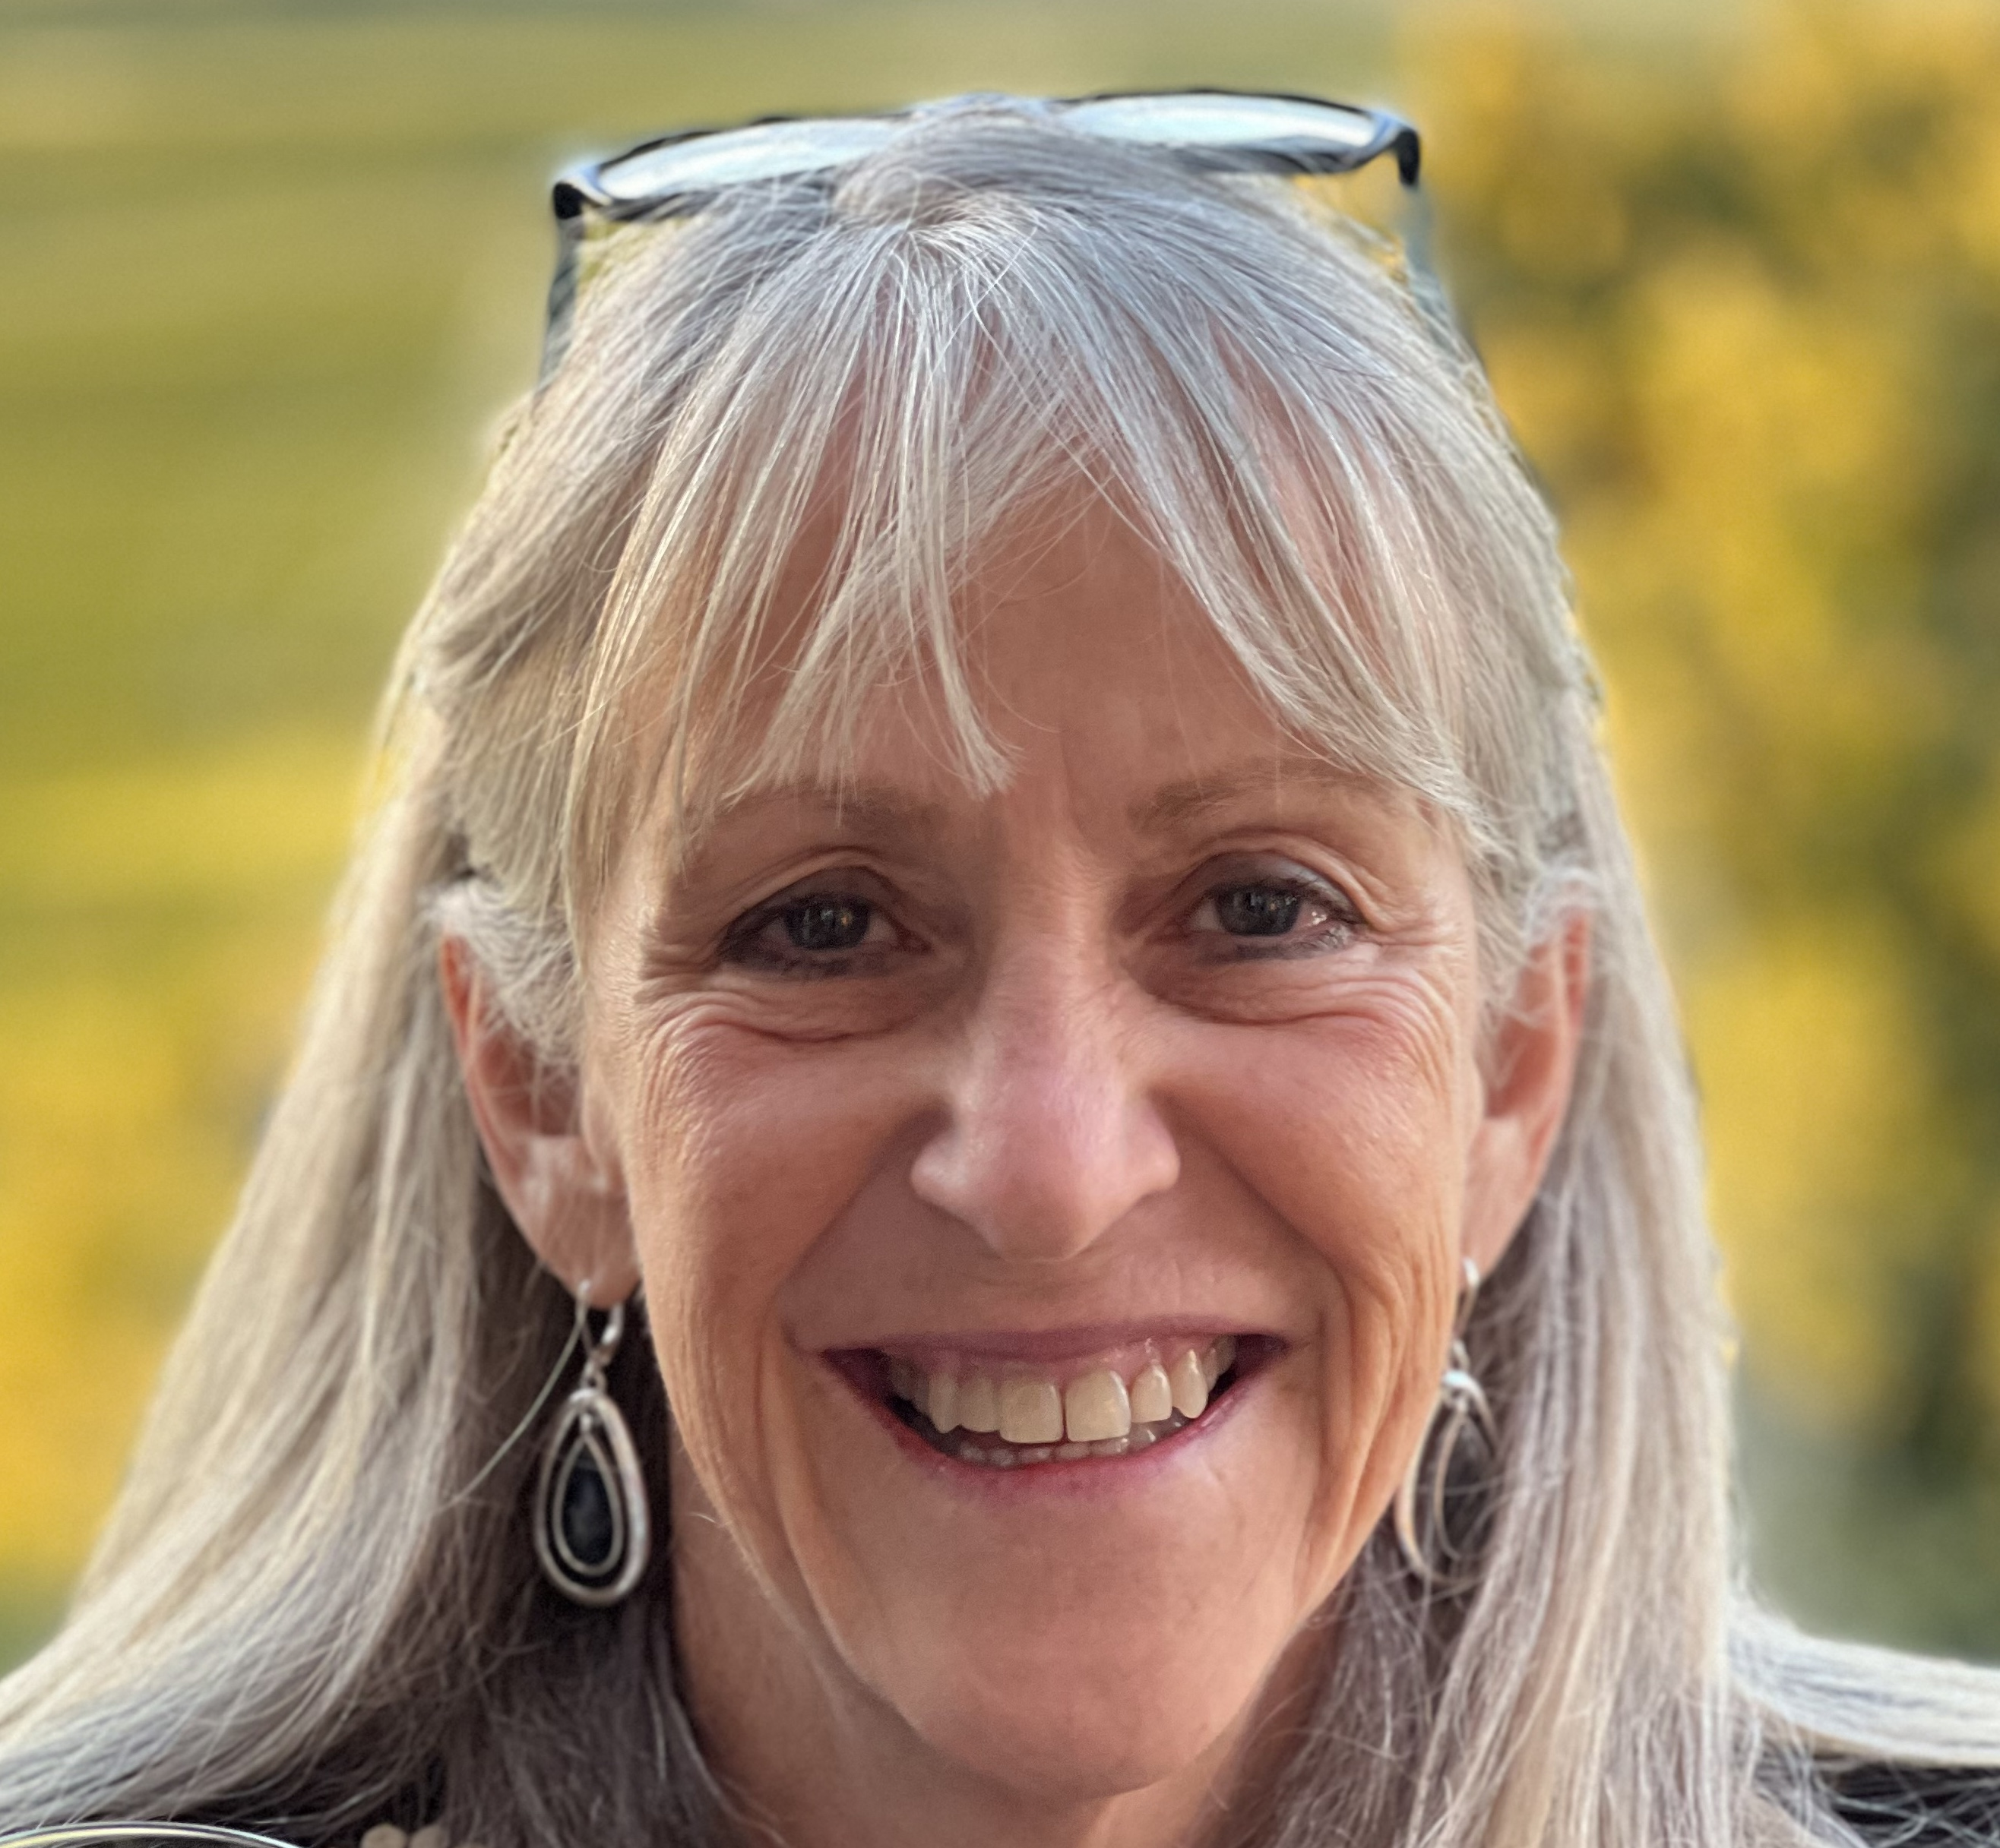
Curiosity Quest
Saturday, April 11
10:30 a.m. - 1:30 p.m.
Kaleideum, Winston-Salem
Featured guest speaker:
Dr. Mary Lynn Dittmar
President, Dittmar Associates
Space industry leader and policy maker
Ticket includes an all-day pass to the children's museum and three hours of Girl Scout programming!
Notes:
EMILY
We have some great programs coming up this spring. One of which I would like to highlight is Curiosity Quest happening on April 11 in Winston-Salem. This event features 14 community partners that will be bringing a wide range of fun, hands-on activities – from testing horse DNA, to looking at microbes in stream water, and even getting messy mining for gems. We are also pleased to announce that we will be joined by Dr. Mary Lynn Dittmar as our guest speaker for the day. Dr. Dittmar is a space industry expert and the founder of the Coalition for Deep Space Exploration. She will be sharing with us her personal journey in choosing her career and girls will have time to ask questions and take photos with her.

Slide 16
Daisies/Brownies/Juniors
April 11 – Curiosity Quest, Winston-Salem
April 19 – Safe @ Home for Juniors, Gastonia
May 2 – GS Day at the NC Transportation Museum, Spencer
May 9 – Brownie Day Camp at the Little House, Brevard
June 13 – Council-wide Bridging and Family Fun Day, Keyauwee Program Center
Girl Scouts doesn’t stop just because school is out. Stay connected through our Summer Fun Series! Girls can join us virtually every Tuesday night for a troop meeting or head out on an adventure with one of our community partners. Our full summer calendar is coming soon—stay tuned!
Notes:
EMILY

Slide 17
Cadettes/Seniors/Ambassadors
April 11 – Curiosity Quest, Winston-Salem
April 13 – Gold Award Training, Virtual
April 19 – Safe @ Home, Gastonia
April 25 – Annual Meeting, Thomasville
May 2 – GS Day at the NC Transportation Museum, Spencer
May 7 – Gold Award Training
May 16 – Her Future, Her Impact: A Girl Awards Gala, Dobson
June 9 – Gold Award Training
June 13 – Council-wide Bridging & Family Fun Day, Keyauwee Program Center, Sophia
Notes:
EMILY

Slide 18


Upcoming Adult Trainings
April 11 – Basic Camping Skills License, High Point
April 18 - Basic Camping Skills License, Gastonia
April 20 - Basic Camping Skills License Renewal, Virtual
Notes:
EMILY

Slide 19

Retail/ Mobile Shops Updates
Want to schedule a mobile shop? Visit our website and request a mobile shop today!
Notes:
EMILY

Slide 20
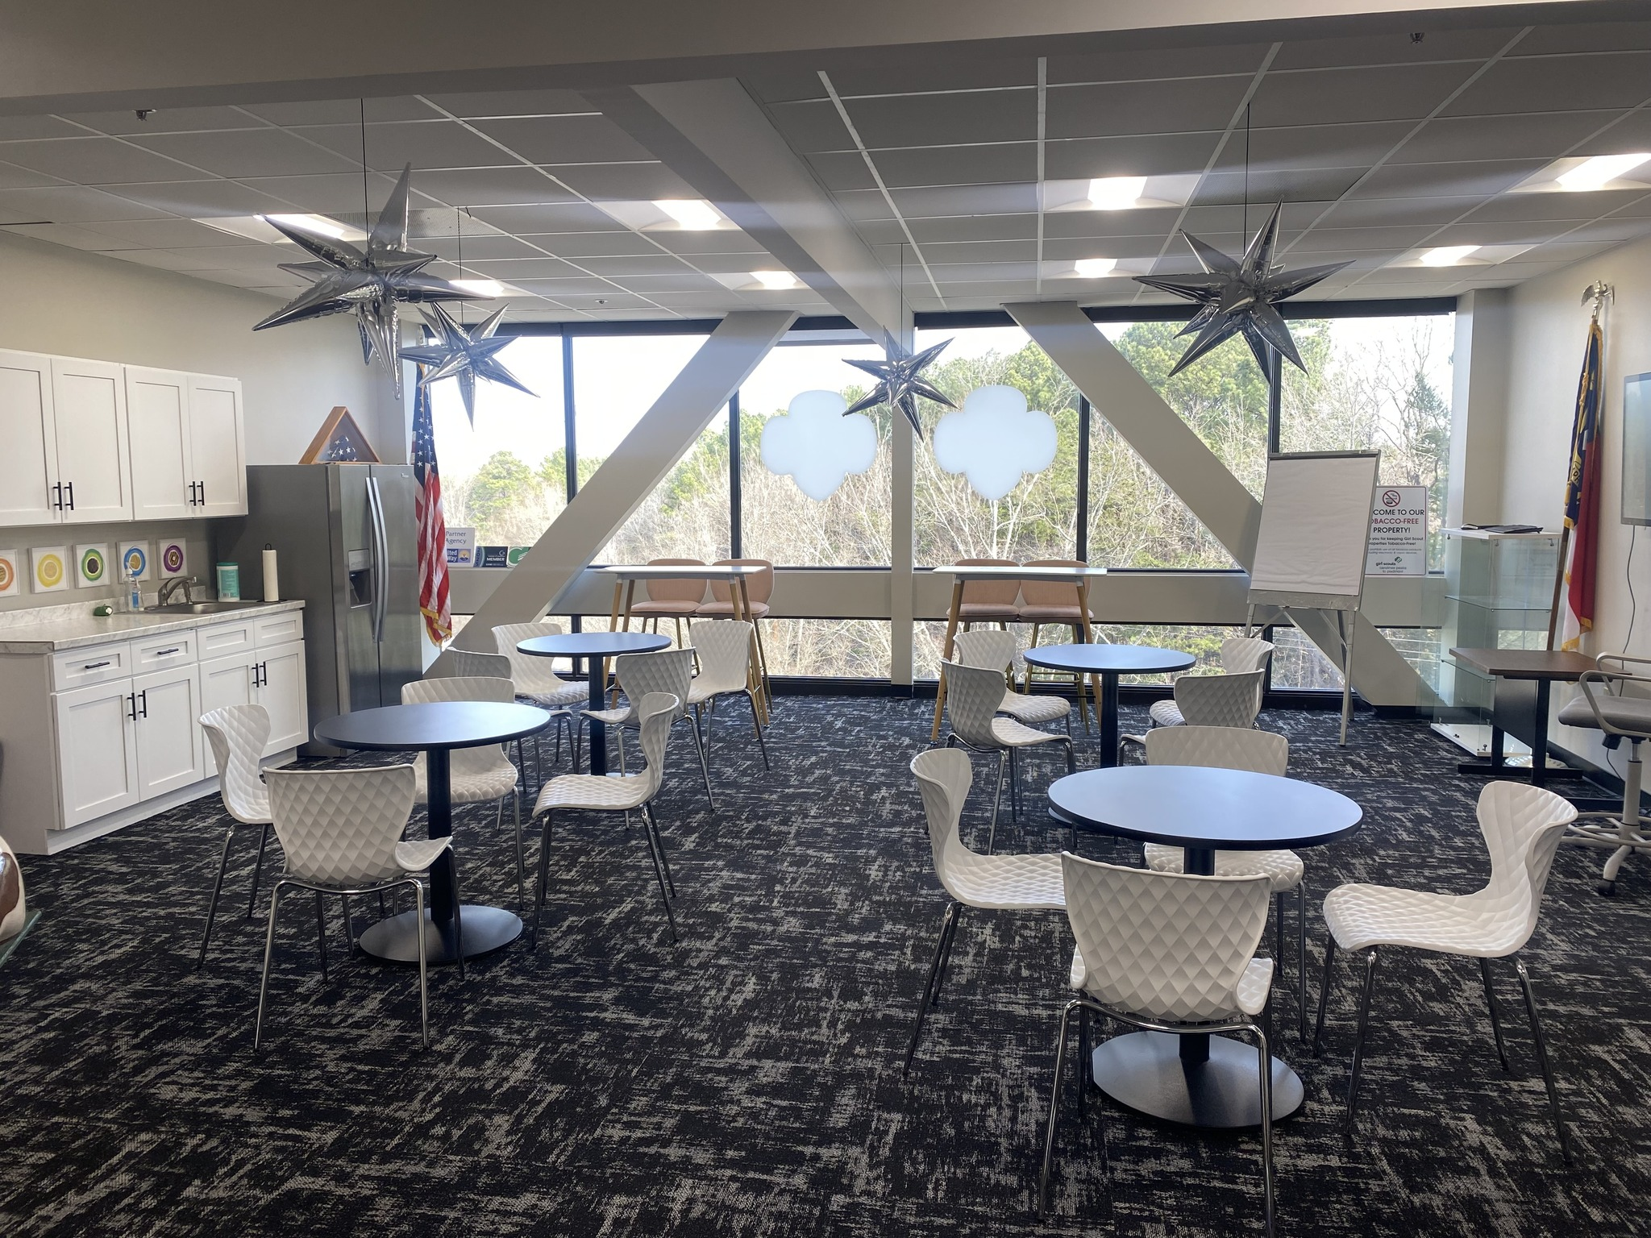
NEW!
Experience Centers
We are excited to announce a NEW resource to accommodate troop travels- the Triad Experience Center! This space can be reserved for free and provides a unique space for troop sleepovers, meetings or programs.
Keep an eye out for our Experience Center opening soon in Asheville!
Notes:
EMILY

Slide 21
Next Steps and Questions
Next Meeting: April 27, 2026
Notes:
EMILY:
Thank you for attending our SALT meeting tonight! Our next meeting will be April 27! Are there any final questions for our team this evening?
Take down PowerPoint.
Pause for questions
After all questions are done…
Later this week you all will receive this PowerPoint presentation and notes as well as a sample SU Meeting PowerPoint and Agenda for your April SU meetings. It will also be posted in Rallyhood. Our hope is that these will be useful tools for you as you go back to your Service Units and share information.
Have a great rest of your evening! Goodnight!

