Slide 1









Service Area Leadership Team Meeting
October 27, 2025
Please enter your name, Service Unit number and Service Team position in the chat!

Slide 2
Welcome!
Please enter your name, Service Unit number and Service Team position in the chat!
Notes:
JACLYN: Good evening and welcome to our October SALT meeting. I’m Jaclyn Johnson, Chief Mission Delivery Officer.
Our hope tonight is that you will leave here with lots of up to date information and resources to take back to your service units and service unit meetings. Thank you for being here with us! Please introduce yourself in the chat with your name, SU number and Service Team position.

Slide 3
Tonight’s Agenda
Welcome, Elaine!
Save the Date: Annual Meeting
Membership and Service Team Updates
Fall Product and Cookie Program Reminders
Upcoming Events
CampLife and Looker Information
Banking Updates
Next Steps and Questions
Notes:
JACLYN
Our agenda is packed this evening with lots of great information!
Go through list…
Please make sure you stay on mute for the presentation portion of this evening, but you are welcome to add questions and comments to the chat as you think of them. We will also have time at the end of tonight’s meeting for you to unmute and ask any additional questions.
And now I am very excited to introduce our new CEO, Elaine Loyack! Elaine hopped on around 7:30 p.m. and talked to several of you but she’s here now to say a few words to the group.
Elaine?

Slide 4

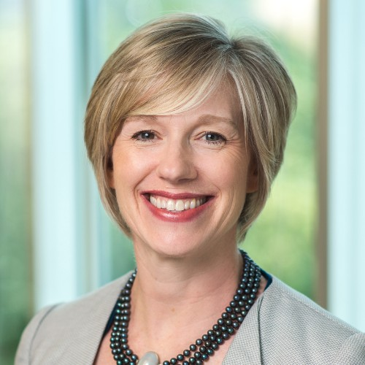
Welcome to our new CEO, Elaine Loyack!
Notes:
ELAINE REMARKS
Then turn back over to Jaclyn

Slide 5
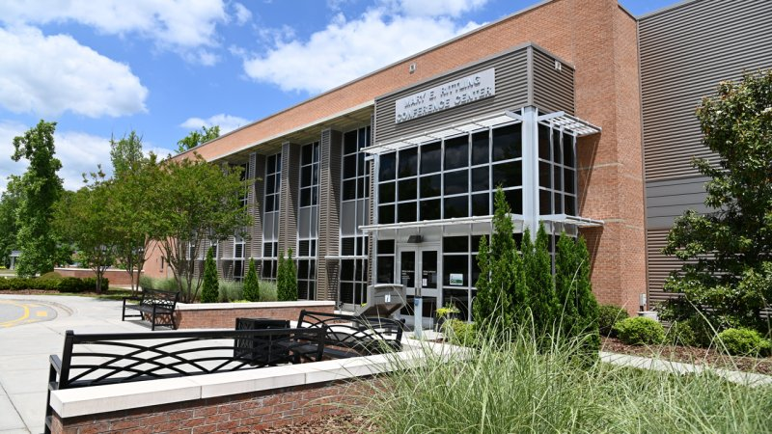
Annual Meeting 2026
Saturday, April 25, 2026
Rittling Conference Center at Davidson/Davie Community College
Notes:
JACLYN:
Thank you so much, Elaine, and welcome to GSCP2P!
We are excited to announce that this year’s 2026 Annual Meeting will be Saturday, April 25 at the Rittling Conference Center on the campus of Davidson/Davie Community College. More details, including specific times, will be coming soon.
Now I would like introduce Sandi Heavener, Director of GS Engagement, for a membership update.

Slide 6

GSCP2P Membership Updates
MY26 Membership as of 10/29/25:
Girls: 4,693 (7.73% down from last year- 5086)
New: 828 this year vs. 1089 last year
Renewed: 3865 this year vs. 4077 last year
Congratulations to SU 114, 117, 118, 124, 125, 126, 131, 135, 141, 146, 148, 149 and 155 for achieving their ON TIME October 31 GOAL!
Shout out to SU 130, 132, 137, 140 and 145 who are all less than 5 girl members away from reaching their on time goals!
Notes:
SANDI:
A quick update for everyone as we are now almost one month into our 2026 membership year.
Read slide and celebrate!

Slide 7
SU TEAM UPDATE
Delegates:
October and November is the time to elect! After election – delegates go in and select the role in Volunteer Systems – reach out to us if you need assistance.
MYGS
Log in (reset your password if needed)
Under Household names – select manage
Under your name – select add a new role
In the search bar type in SU#
Then select Service Unit Delegate – elected or Service Unit Alternate Delegate – elected
Add Role
Notes:
SANDI:
Read Slide.
Turn things back over to Jaclyn.

Slide 8
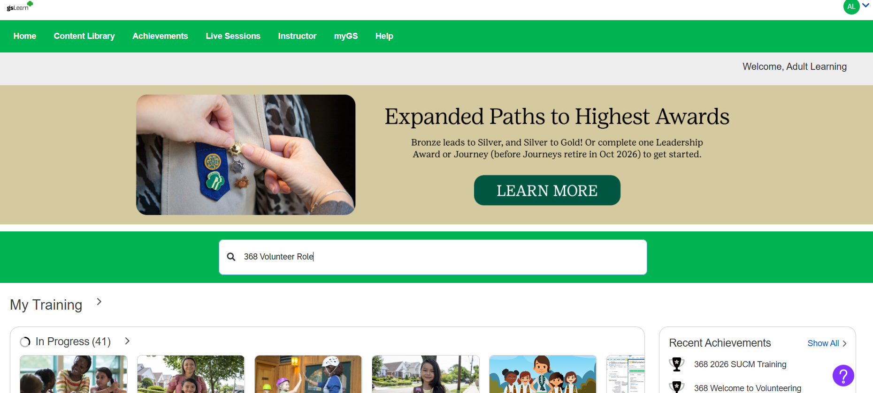
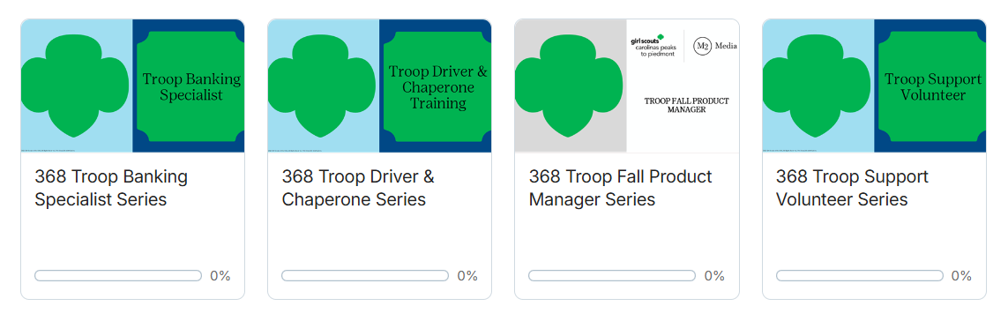
New gsLearn Trainings available!
Use the search bar to find the learning series for your troop or service unit role.
Select a training series to add it to your dashboard.
Notes:
JACLYN:
New trainings are available in gsLearn to help every volunteer prepare to serve girls. Troop volunteer roles are available now and service unit roles will be available in the coming weeks.
Volunteers can access this training at any time – simply log into gsLearn through your MyGS account. Then use the search bar to find your specific role. Look for your role name with the word “series”, and this will make sure you have everything you need to know in one convenient location. Once you click on the learning series you want, it will appear on your dashboard so you can easily find it every time you log in.
Please note, if this is the first time you have logged into gsLearn, it may take up to 30 minutes for your council-specific courses to appear. GSUSA is working to repair this and the work should be complete by November 15th.
For MY26, all volunteers will be required to complete training for their position. All volunteers are required to complete a Child Abuse and Neglect Prevention course from GSUSA along with training specific to their role. Volunteers are asked to complete this training within 90 days of onboarding. You will receive automated email reminders to complete your training as you get close to the 90 day deadline.

Slide 9

The Fall Product Program Updates
Online Sales-Now through November 10
Keep encouraging troops to share their links and finish strong!
Key Dates:
Tuesday, Oct. 21 – Wednesday, Oct 22: Troop volunteers can enter or edit in-person sales from girl order cards in M2
Thursday, Oct. 23 – Saturday, Oct. 25: Our amazing Service Unit Product Managers can enter or edit any remaining in-person candy/nut orders in M2
Saturday, Oct. 25: Last day for online girl-delivered candy/nut sales — remind families to wrap up those deliveries!
Monday, Nov. 10: Final day for direct-ship sales and for customers to order magazines, Tervis tumblers, Bark Boxes, candles and personalized stationery.
Notes:
JACLYN:
As Service Team members we have a few asks and reminders of each of you in regards to the Fall Product Program:
Keep encouraging troops to share their online links and finish strong!
The online portion of the Fall Program runs through November 10 — there’s still time for families to participate.
Incentive reminder:
Troops that participate in the Fall Program and sell 100 or more items will earn an extra $0.05 per package during the Cookie Program.
It’s a great way to give troops a head start on cookie season and boost their proceeds!
Read slide for upcoming date reminders.

Slide 10

Topic: TCM Training 11/10
Time: Nov 10, 2025 06:30 PM Eastern Time (US and Canada)
https://girlscoutsp2p-org.zoom.us/j/3486985020?pwd=dEc1TzA5VlhnMzhISjgrelpHTHpJUT09&omn=89273566855
Topic: TCM Training 11/20
Time: Nov 20, 2025 07:00 PM Eastern Time (US and Canada)
https://girlscoutsp2p-org.zoom.us/j/3486985020?pwd=dEc1TzA5VlhnMzhISjgrelpHTHpJUT09&omn=86294859487
Topic: Cookies 101- 11/13
Time: Nov 13, 2025 06:00 PM Eastern Time (US and Canada)
https://girlscoutsp2p-org.zoom.us/j/3486985020?pwd=dEc1TzA5VlhnMzhISjgrelpHTHpJUT09&omn=84090339622
Topic: Cookies 101- 11/19
Time: Nov 19, 2025 10:00 AM Eastern Time (US and Canada)
https://girlscoutsp2p-org.zoom.us/j/3486985020?pwd=dEc1TzA5VlhnMzhISjgrelpHTHpJUT09&omn=89371376510
Topic: Cookies 101- 11/24
Time: Nov 24, 2025 06:00 PM Eastern Time (US and Canada)
https://girlscoutsp2p-org.zoom.us/j/3486985020?pwd=dEc1TzA5VlhnMzhISjgrelpHTHpJUT09&omn=84881974737
Topic: Cookies 101- 12/2
Time: Dec 2, 2025 06:00 PM Eastern Time (US and Canada)
https://girlscoutsp2p-org.zoom.us/j/3486985020?pwd=dEc1TzA5VlhnMzhISjgrelpHTHpJUT09&omn=87002023462
Cookie Program Trainings
Notes:
JACLYN:
Now shifting gears to the Cookie Program…..
All training sessions will be hosted via Zoom this year and will be recorded. Recordings will be available on GSLearn.
We’re excited to offer both live council-led and new volunteer sessions to support everyone in getting ready for cookie season.
Troop Cookie Manager (TCM) Trainings — Council-Led
Live, council-led TCM trainings will take place on:
Monday, November 10 at 6:30 PM
Thursday, November 20 at 7:00 PM
Hosting an In-Person Training
If your Service Unit would like to host an in-person TCM training, please contact Alexis Braca at abraca@girlscoutsp2p.org. Alexis will provide the PowerPoint presentation and talking points to help you lead your own session.
Materials will be available by the end of this week, as we’re finalizing updates related to C-Share with ABC.
Cookies 101 — For New Volunteers Only
These sessions are designed especially for new troop volunteers who are participating in the Cookie Program for the first time.
Topics include cookie basics, key dates, and how to get started confidently.
Dates available:
Thursday, Nov 13 — 6:00 PM (ET)
Wednesday, Nov 19 — 10:00 AM (ET)
Monday, Nov 24 — 6:00 PM (ET)
Tuesday, Dec 2 — 6:00 PM (ET)

Slide 11

12/6 Black Mountain: Cookie Expo – Get ready for the Girl Scout Cookie program and flex those entrepreneurial muscles.
12/6 Black Mountain: Cookie University – Take your cookie skills to the next level. Create your own business and roll the dice to see where life takes you.
ABC Cookie Rally Guide
Notes:
JACLYN:
Cookie training isn't just for volunteers and parents. Cookie Rallies are a great way to get girls excited about the cookie program. A mix of training and fun – these events allow girls to build their five skills and prepare for a successful cookie season. All service units are invited to join the council-wide Cookie Events in Black Mountain on December 6. Cookie Expo is a time just for Daisies, Brownies, and Juniors to learn more about their cookie business. And for Cookie University – which is the next step for Cadettes, Seniors and Ambassadors – is where girls take what they have learned through the cookie program and apply it to real-world situations where they create their own business and roll the dice to see what happens next.
We are also in the process of adding a few smaller cookie expos so stay turned as those dates and locations are added.
Service Units hosting their own Cookie Rallies can take advantage of ABC Cookies’ easy-to-follow event guide—packed with everything volunteers need to plan a fun and successful event! Our Experience team is working hard to help equip you with what you need. If you have a SU Cookie Rally planned for this year, please reach out to Emily Satterfield, Director of GS Experience, who can help you!

Slide 12

Happy Founder's Day!
Through The Decades Patch and program checkout boxes.
https://www.girlscoutsp2p.org/en/members/for-volunteers/volunteer-training-and-program-resources/archives-and-history.html
Notes:
JACLYN:
As you all know, Founder’s Day is October 31 and celebrates Juliette Gordon Low’s birthday and the importance of the Girl Scout movement she created! Fall is a great time to teach Girl Scouts about Juliette Gordon Low and explore Girl Scout traditions.
Use the history resources page on our website to discover traditions and unique opportunities presented by our Archives Committee- including the new Through the Decades patch program and history program checkout boxes. Program boxes can be reserved and picked-up from your nearest Girl Scout Service Center and include all the activities supplies and instructions needed for an easy meeting or Service Unit event.

Slide 13


Daisies/Brownies/Juniors
  11/16 Winston-Salem: Science of Roller Skating – Through hands-on activities and interactive demonstrations participants will uncover the physics and motion that make skating possible.
  11/11 Virtual: Sharks, Science & Service – Talk with Ocearch marine biologists about conservation and cutting-edge technology.
  11/22 KPC: No Horse No Problem! Model Artist Show
  12/6 Rutherfordton: SubZERO Effect - Using liquid nitrogen, we'll shatter a ball, make an explosion, and examine the three states of matter!
  12/6 Black Mountain: Cookie Expo – Get ready for the Girl Scout Cookie program and flex those entrepreneurial muscles.
  12/13 Rutherfordton: Aeronautics - Launch into learning while exploring the nature of things that fly!
Notes:
JACLYN:
Be sure to check out our program calendar for exciting programs for every level. We have some great programs for Daisies Brownies and Juniors coming up, including the Science of Roller Skating and programs sponsored by KidSenses, our community partner in Rutherford County.

Slide 14

Cadettes/Seniors/Ambassadors
  11/9 KPC: Cadette Animal Helpers Badge
  11/9 Winston-Salem: Science of Roller Skating – Through hands-on activities and interactive demonstrations participants will uncover the physics and motion that make skating possible.
  11/9 Virtual: Safe@Home (Cadettes) – Learn the skills needed to be safe at home alone or while supervising siblings.
  11/13 Virtual: Sharks, Science & Service – Talk with Ocearch marine biologists about conservation and cutting-edge technology.
  11/17 Virtual: Highest Awards Info Night – Learn more about earning your Bronze, Silver or Gold Award
  11/19 Virtual: Safe Sitter – Earn your Cadette Babysitting Badge and Safe Sitter certification.
  11/22 KPC: No Horse No Problem! Model Artist Show
  12/6 Black Mountain: Cookie University – Take your cookie skills to the next level. Create your own business and roll the dice to see where life takes you.
  12/6 Rutherfordton: SubZERO Effect - Using liquid nitrogen, we'll shatter a ball, make an explosion, and examine the three states of matter!
  12/13 Rutherfordton: Naturally ART-ificial - This dynamic program encourages creativity and critical thinking through the creation of a nature inspired robot! Girl Scouts will gain an understanding of the engineering design process and circuitry.
Notes:
JACLYN:
We also have some fabulous programs for our Cadettes, Seniors and Ambassadors. Girls can talk with a marine biologist during out Sharks, Science and Service events, earn their Program Aide Award or become a Babysitter Boss. They can also participate in some special older girl programs with KidSenses.

Slide 15
Upcoming Adult Trainings
11/6 Virtual: Power of Parents – Presented by MADD. Learn how to support your teen in making smart choices about underage drinking and peer pressure.
11/6 Virtual: Gold Award Training
11/8 Hickory: First Aid/CPR
11/8 Hickory: Basic Camp Skills
11/17 Virtual: Lead the Change Highest Awards Info Night
12/8 & 10 Virtual: Youth Mental Health First Aid – support the kids in your life by learning how to spot the warning signs for a mental health challenge.
  Registration coming soon!
12/11 Virtual: Gold Award Training
Notes:
JACLYN:
For volunteers - We have a special enrichment opportunity for all volunteers presented by Mothers Against Drunk Driving about how parents can support teens in making smart choices around underage drinking and driving. Deadline to register for that is tonight so don’t delay in saving your spot!

Slide 16
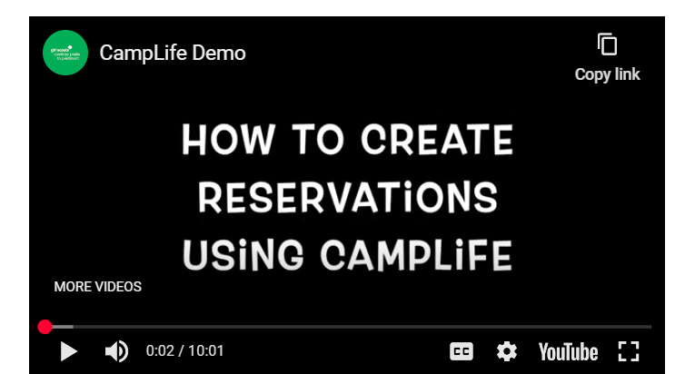
CampLife Tutorial Available Now
Reservations opened for Troop and SU camping October 10.
We will open up more units as they become available.
Click here for a tutorial of how to navigate CampLife: https://youtu.be/TJiTVyIKQqo
Notes:
JACLYN:
Reservations opened for Troop and SU camping October 10, and as you all know about our property challenges, we will open up more units as soon as they become ready to host troops. Visit the website on this slide here for a tutorial of how to navigate CampLife and make your reservations today. Feedback received so far is that this is a very easy platform to use but let us know if you run into any issues.

Slide 17
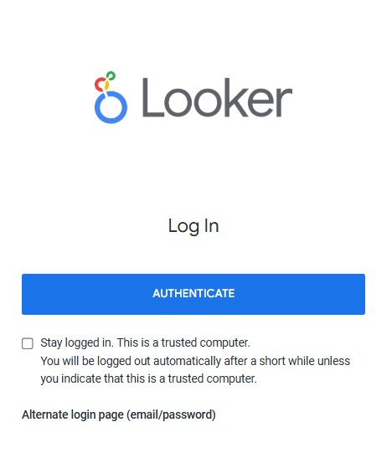
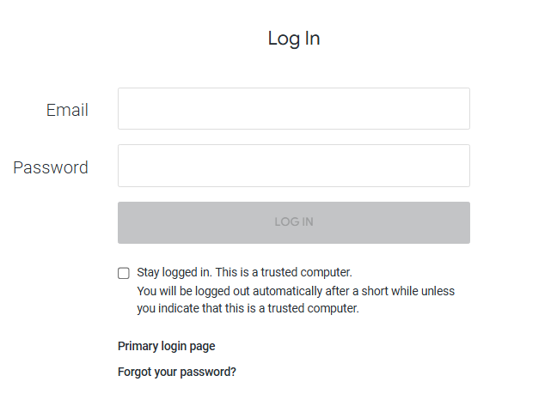
Logging in to Looker
As of May 2025, "Authenticate" is the staff-only login button. For SU Volunteers, use the "Alternate login page" instead.
If you didn't get the account activation email:
  Click "Forgot your password?" from the alternate login page
  Even if you never set a password to begin with, this button will reset your account and let you (re)activate it
  If you still don't get an e-mail, add noreply@lookermail.com to your safe sender list and check your spam
If issues persist, ensure you are using a supported browser:
  Firefox, Safari, Google Chrome, Microsoft Edge
  Make sure your browser is up to date! Looker only works on the 1st and 2nd-most recent version of these browsers
Notes:
JACLYN:
Have you had trouble logging in to Looker this month? See the information here that will help you troubleshoot and regain access. Always click on the Alternate Login Page button to gain access as a SU Volunteer.
If you didn't get the account activation e-mail, click "Forgot your password?" from the alternate login page. If you still don't get an e-mail, add noreply@lookermail.com to your safe sender list and check your spam folder.
If you are still having trouble after these steps, reach out to our team at info@girlscoutsp2p.org.
And now I would like to turn things over to our Finance Operations Specialist, Kim Shelton, with some banking updates for you.
Kim?

Slide 18
Banking Updates
ACH Update Form
Account Management
Deposit Practices & Fees
Financial Stewardship
Banking Issues
Processing Time
Point of Contact
New Troop Accounts
Notes:
KIM SHELTON:
Info here and turn things back over to Jaclyn when done.

Slide 19
Next Steps and Questions
Next Meeting: November 24, 2025
Notes:
JACLYN:
That concludes the end of our information sharing. Later this week you all will receive this PowerPoint presentation and notes as well as a sample SU Meeting PowerPoint and Agenda for your November meetings. It will also be posted in Rallyhood. Our hope is that these will be useful tools for you as you go back to your Service Units and share information.
We have been answering questions in the chat as the meeting has been going on, but we will now take down the presentation and ask if anyone would like to unmute and ask any final questions tonight?

