Slide 1









Service Area Leadership Team Meeting
February 23, 2026

Slide 2
Welcome!
Please enter your name, Service Unit number and Service Team position in the chat!
Notes:
Good evening and welcome to our February SALT meeting.
Our hope tonight is that you will leave here with lots of up to date information and resources to take back to your service units and service unit meetings. Thank you for being here with us! Please introduce yourself in the chat with your name, SU number and Service Team position.

Slide 3
Tonight’s Agenda
Happy World Thinking Day!
Mission Delivery Updates
Membership and Service Team Updates
Outdoor Experience and Property Updates
Cookie Program Updates
Program Updates
Girl Scout Week
Save the Dates
Retail Updates
Notes:
Our agenda is packed this evening with lots of great information!
Go through list…
Please make sure you stay on mute for the presentation portion of this evening, but you are welcome to add questions and comments to the chat as you think of them. We will also have time throughout the meeting and at the end of tonight’s meeting for you to unmute and ask any additional questions.

Slide 4



Celebrating 100 Years of
World Thinking Day
and Global Sisterhood
Download the activity guides here!
Notes:
Happy World Thinking Day! Yesterday, Girl Scouts and Girl Guides around the world celebrated 100 years of World Thinking Day! This year’s theme was Our Friendship and we hope that you were able to celebrate Girl Scouts' global connects with your troops and service unit.

Slide 5
Chief Mission Delivery Officer Updates
Girl Members of Board of Directors
Board Forums
National Convention in DC this summer!
Notes:
JACLYN:
Good evening, everyone! Thanks for being with us tonight! I have three announcements to share with you.
First: We are still looking for more applicants for Girl Representatives to the Council Board of Directors. Any Girl Scout in grades 10th or 11th grade has the opportunity to learn leadership and real-world skills through a one-year term with the board of directors, beginning at the Annual Meeting in April. During her term she will learn about the inner workings of Girl Scouts, how the board influences and supports the council and the girls, group dynamics, planning skills and financial accountability. Applications to become a Girl Board Member are open until March 1, 2026 and you can find the link to apply in the Today’s Tips email sent today.
Speaking of the Board of Directors, we are hosting Board Forums at each service center throughout February and March and look forward to seeing you in-person or virtually for these informational and governance meetings with the GSCP2P Board of Directors. The Hickory Forum was held last week but you have three more chances.
Gastonia is Thursday February 26, 6-7:30 p.m.
Greensboro will be Thursday, March 12, 6-7:30 p.m.
And Asheville will be Tuesday March 17, 6-7:30 p.m.
You can register through the events calendar on our website.
And finally….
This summer is the 58th National Council Session and Girl Scouts Unite event in Washington, D.C.! The Girl Scout National Convention occurs every three years and is a stellar opportunity to see girl-led governance in action, connect with Girl Scouts from all over, hear from inspiring speakers, learn leadership skills through interactive workshops and discover unique adventures. GSCP2P is not organizing an official trip to Washington, D.C. but Girl Scouts, volunteers, alums and families are all invited to attend, and group travel plans can be coordinated within your troop or service unit. Our council has booked several rooms and is able to offer discounted lodging to our members traveling for the convention. Learn more and complete our National Convention Lodging Interest Form found in today’s Today’s Tips to reserve your rooms. Now I would like to turn things over to Sandi for a membership update. Sandi?

Slide 6
GSCP2P Membership Updates
Renewed girls: 4035
New girls: 1270
Total girls: 5305
Total numbers (Girls + Adults) = 9602
With your help, 29 new troops have been started this year so far!
On April 1, 2026, we will begin MY27 GSEB registrations!
Notes:
SANDI: A quick update for everyone. Read slide and celebrate!

Slide 7
SU TEAM UPDATE
Rallyhood top contributors:
January- SU 125, SU 147/148 and SU 135
Troop ACH yearly collection: 90 not submitted
If you have not submitted your ACH form with all information and signatures, please do so ASAP. Send to info@girlscoutsp2p.org.
SU ACH collection will begin this week!
SAVE THE DATE: May 30, 2026
From 10 a.m. -3 p.m. at Monticello Community, Statesville
Service Unit Retreat "Where Service Units Grow"
Notes:
Read top contributors for SUs: I want to sincerely thank you for not only embracing our new platform, Rallyhood, but for actively advancing it across your Service Unit. Your willingness to learn the system, use it consistently, and encourage others to engage has made a meaningful difference. Thank you for your leadership and continued support.
Troop ACH – we still have about 90 outstanding. Please watch for follow up emails from customer care letting you know what additional information is needed.
SU ACH – watch for an email coming this week.
Back by Popular Demand...Service Unit Retreat on May 30, 2026 to be held at Monticello Community Church, Statesville from 10 a.m. -3 p.m. Get ready for an exciting day of role-specific training, SU team building, and meaningful collaboration as we connect, share ideas, and learn best practices from across our council! Registration will be opening soon!

Slide 8
SPRING RENEWAL
Spring Renewal will kick-off April 1, 2026, and run through May 31, 2026.
All girls who renew their membership during these months will receive a $20 membership discount AND an early bird patch.
Every volunteer- including Lifetime members- that renew their membership and roles during these months will receive free admission to the August 1, 2026 Volunteer Conference.
Every Service Unit that meets their spring renewal goal by May 31, 2026 will receive a $200 GSCP2P program credit or retail gift certificate.
In addition, for every girl renewed over the Service Unit's Spring Renewal goal, the SU will also receive a $10 bonus per girl over the goal.
Notes:
All girls who renew their membership during April 1 – May 31, 2026, will receive an automatic discount of $20 off their membership during the renewal process.
Every volunteer that renews between April 1 - May 31, 2026, will receive free admission to the Volunteer Conference August 1, 2026.
Every SU that meets their spring renewal girl goal will receive a $200 program or store gift certificate.
For every girl over the Service Unit's Spring Renewal goal, the SU will also receive $10 per girl extra bonus
NEW EXTENDED YEAR INCENTIVE – Each SU that meets their extended year girl goal will receive a $50 program/retail gift certificate. Additionally, for every girl over their goal, they will receive a $5 extra bonus.

Slide 9

2026 Annual Meeting
Saturday, April 25
10 a.m. - 3 p.m.
Mary E. Rittling Conference Center
Thomasville
Registration is open!
Notes:
Registration is now open for annual meeting! All delegates will be receiving a discount code, so please make sure that your Service Unit is represented and your delegates have been assigned their correct role in MYGS. If there are changes, please let me know ASAP.
Turn things over back to Jaclyn

Slide 10

Summer Camp
Overnight camp is for rising grades 2-12 and day camp is for rising grades 1-5.
Save $50 before our Early Bird Discount ends on March 31
You can stack $150 in savings! Register for two overnight sessions during the Early Bird Discount and enjoy an extra $50 in savings with the Multi-Week Discount.
All overnight campers will be offered an equestrian experience at no additional cost. Options may include barn tour, horseback riding or Equine Assisted Learning activity.
Free transportation assistance from the Asheville and Hickory Service Centers is available for select weeks of overnight camp.
We are also hosting several virtual Summer Camp Q&A sessions in March to help you feel excited and prepared for camp!

Slide 11
PROPERTY UPDATES
Camp Pisgah
Cisterns have been painted and WNCIL started the cleaning the water system on 2/20/26.
Once completed, we will schedule with Transylvania County to re-test water system.
Ranger position has been posted and we will begin interviews this week.
CGC
Site visit with team tomorrow; Continued work with hurricane projects and water testing to happen in March
KPC
Various projects are being done around camp.
Run-in Shelter
Maintenance Barn repair
Amphitheatre Stage Demo
Dining Hall Wall Demo/Repair

Slide 12

Girl Scout Cookie Program Updates
Cookie Program Extended to
March 15, 2026!

Slide 13

Girl Scout Cookie Program Updates
Troop Incentives
Here’s how your troop can earn extra proceeds:
· Additional $0.10 per package sold: Troops that increase their PGA (Per Girl Average) selling by at least 50 packages and sell at least one more package than in 2025 will receive an additional $0.10 per package regardless of what incentive plan they have chosen.
· Additional $0.20 per package sold: Troops that increase their PGA (Per Girl Average) selling by at least 100 packages and sell at least one more package than in 2025 will receive an additional $0.20 per package regardless of what incentive plan they have chosen.
· New troops or troops that did not participate in 2025: Your bonus will be based on overall PGA relative to the council goal of 303 packages.
o 353 packages per girl selling = $0.10 per package additional proceeds
o 403 packages per girl selling = $0.20 per package additional proceeds
· Requirement: A troop must have at least two girls participating in the cookie program to earn these additional proceeds.
NEW
Notes:
We hope that you will encourage your troops to continue selling to earn these great incentives:
Additional 10 cents per package – Per Girl Average increase by 50 packages and at least 1 more package than 2025.
Additional 20 cents per package – PGA increase by 100 packages and at least 1 more package than 2025
NEW Troops or troops that did not sell last year (with at least 2 girls selling cookies this season) – 353 PGA = 10 cents additional / 403 PGA = 20 cents additional

Slide 14

Girl Scout Cookie Program Updates
Booth Opportunities
Additional locations and Walmart stores council-wide
Check Rallyhood for new location/dates in your area
New booth dates have been added for
March 7-8
March 14-15
NEW

Slide 15

Girl Scout Cookie Program Updates
Important Dates
December
January
February
March/April
December 5– Troop initial order due in Smart Cookies
December 8 ⁻ Digital Cookie e-mails launched to both girls and troop volunteers
December 16 – Cookie Program begins
January 3 – Start of booth lottery selections
January 7– 10 – Cookie deliveries
January 10 – 18 – Walk-about week
January 12 – Cupboards open
January 16 – Booth sales begin
February 2 – Troops can begin changing proceeds and recognition plans in Smart Cookies
February 16 – Troops can begin creating recognition orders in Smart Cookies
NEW March 15 – Program ends
March 5 – First ACH withdrawal
NEW March 24 – Buy 5 entries due council
NEW April 16 – Second/final ACH withdrawal
NEW April 23 – ACH credits
Notes:
NEW dates to point out: March 15 – program ends, March 5 (first ACH withdrawal), March 24 (Buy fives are due to council offices), April 16 (final ACH withdrawal), April 23 (ACH credits)

Slide 16

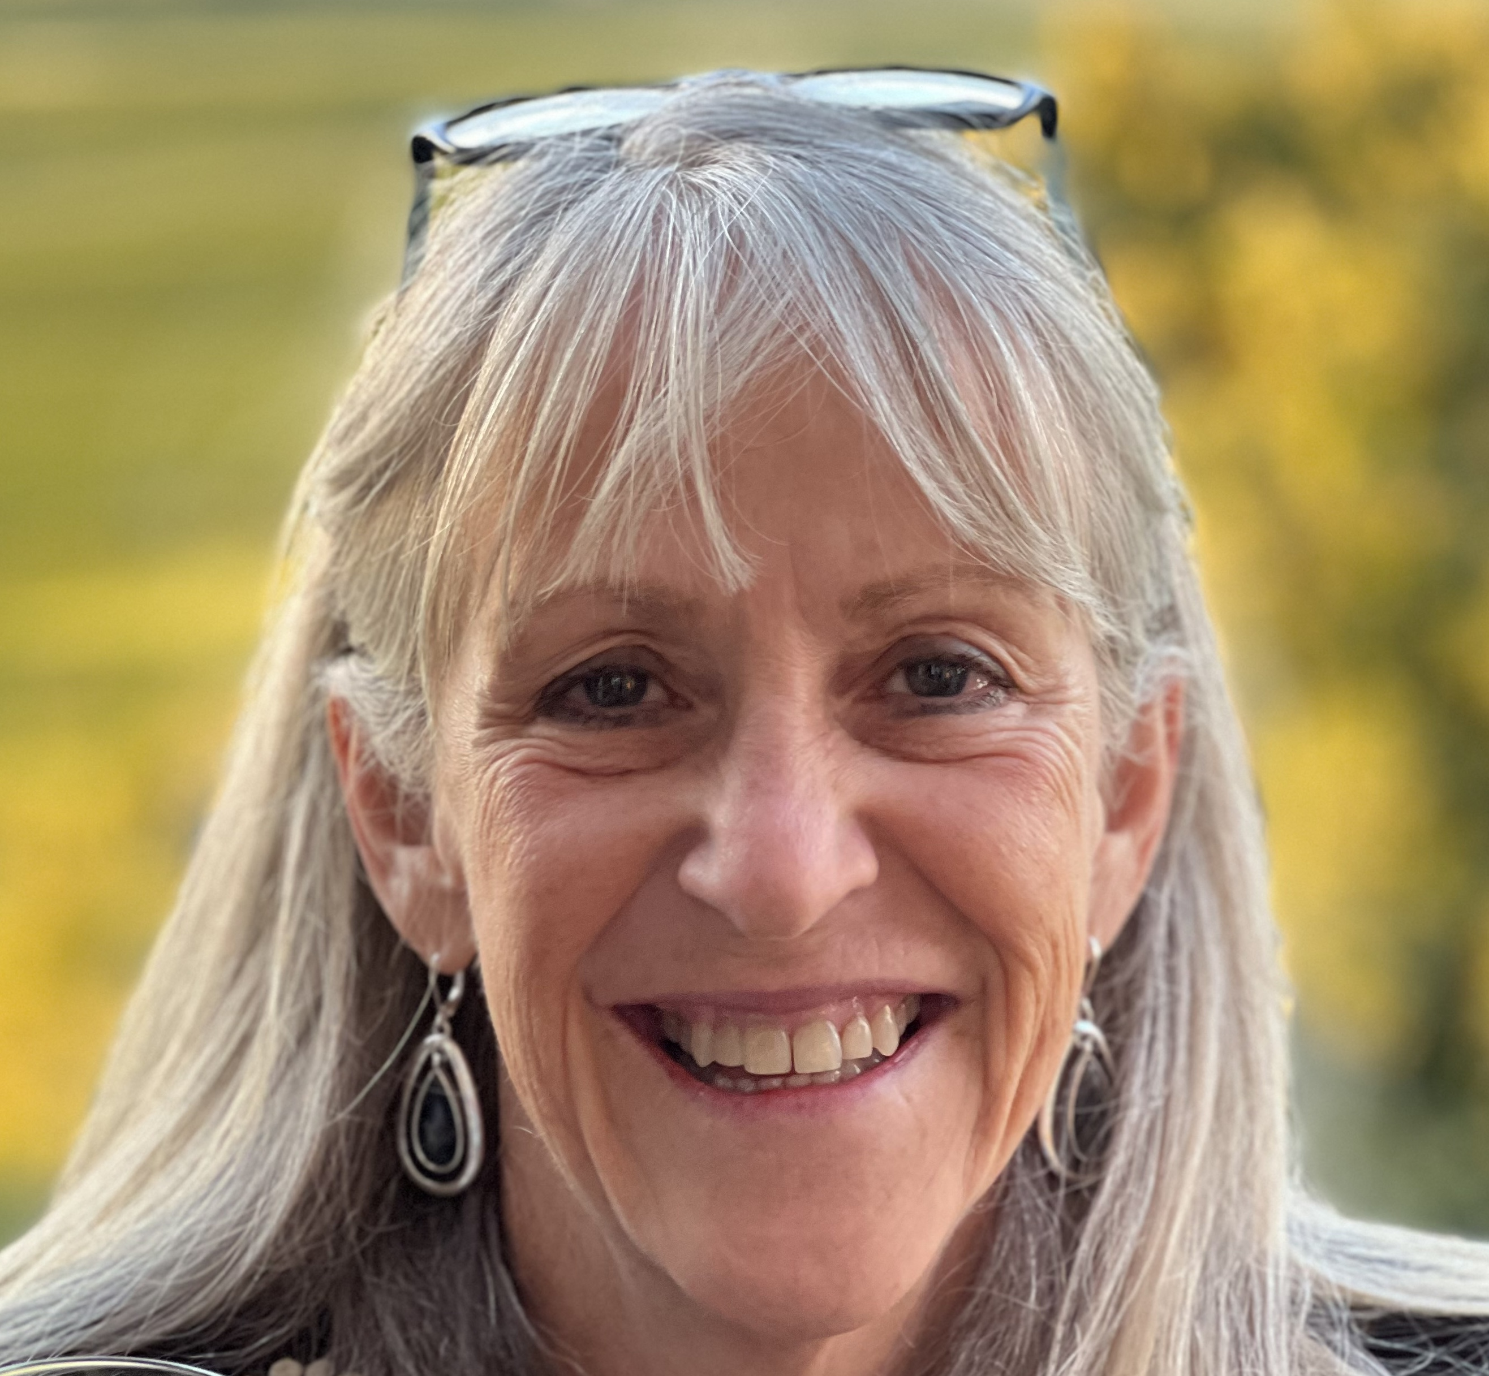
Curiosity Quest
Saturday, April 11
10:30 a.m. - 1:30 p.m.
Kaleideum, Winston-Salem
Featured guest speaker:
Dr. Mary Lynn Dittmar President, Dittmar Associates Space industry leader and policy maker
Ticket includes an all-day pass to the children's museum and three hours of Girl Scout programming!
Notes:
We have some great programs coming up this spring. One of which I would like to highlight is Curiosity Quest happening on April 11 in Winston-Salem. This event features 14 community partners that will be bringing a wide range of fun, hands-on activities – from testing horse DNA, to looking at microbes in stream water, and even getting messy mining for gems. We are also pleased to announce that we will be joined by Dr. Mary Lynn Dittmar as our guest speaker for the day. Dr. Dittmar is a space industry expert and the founder of the Coalition for Deep Space Exploration. She will be sharing with us her personal journey in choosing her career and girls will have time to ask questions and take photos with her.

Slide 17
Daisies/Brownies/Juniors
March 7 – Design in Nature, Winston-Salem
March 8 – Climbing Day at Fiddlehead Farm & Forest, Fletcher
March 8 – Coppelia with the Charlotte Youth Ballet, Charlotte
March 8 - Gargoyles Hockey Game, Greensboro
March 14 – Girl Scout Fest, All Service Centers
March 14 – Fantastic Plants, KidSenses, Rutherfordton
March 21 – Power of Me! & Rise Up: Mental Health Day for Juniors with MADD, Hickory
March 21 - Junior RIIT Explorer, Circle C
March 28 – Ring Around the Planets, KidSenses, Rutherfordton
April 11 – LEGO Liaison & Structurally Speaking, KidSenses, Rutherfordton
April 11 – Curiosity Quest, Winston-Salem
April 19 – Safe @ Home for Juniors, Gastonia
April 25 – Science Shenanigans, KidSenses, Rutherfordton
May 2 – GS Day at the NC Transportation Museum, Spencer
May 9 – Naturally Artificial, KidSenses, Rutherfordton
May 9 – Brownie Day Camp at the Little House, Brevard
May 16 – Programmed to Doodle, KidSenses, Rutherfordton
June 13 – Council-wide Bridging and Family Fun day, Keyauwee Program Center

Slide 18
Cadettes/Seniors/Ambassadors
March 5 – Gold Award Training, Virtual
March 7 – Future Designer, Winston-Salem
March 8 – Climbing Day at Fiddle Head Farm & Forrest, Fletcher
March 8 – Coppelia with the Charlotte Youth Ballet
March 8 –Gargoyles Hockey Game, Greensboro
March 14 – Girl Scout Fest! All Service Centers
March 14 – Fantastic Plants, KidSenses, Rutherfordton
March 16 – Highest Awards Info Night, Virtual
March 21 - Power of Me! & Rise Up: Mental Health Day with MADD, Hickory
March 28 – Ring Around the Planets, KidSenses, Rutherfordton
March 28 – Sisterhood Success, Day with Kappa Delta, Wake Forest University
March 28 – Kick Trash to the Can, Statesville
March 31 – GS Legislative Day, Raleigh
April 11 – LEGO Liaison & Structurally Speaking, KidSenses, Rutherfordton
April 11 – Curiosity Quest, Winston-Salem
April 13 – Gold Award Training, Virtual
April 18 – Blow It Up, KidSenses, Rutherfordton
April 19 – Safe @ Home, Gastonia
April 25 – Annual Meeting, Thomasville
April 25 – Science Shenanigans, KidSenses, Rutherfordton
May 2 – Adventure Afternoon, Camp Ginger Cascades
May 2 – GS Day at the NC Transportation Museum, Spencer
May 7 – Gold Award Training
May 9 – Naturally Artificial, KidSenses, Rutherfordton
May 16 – Programmed to Doodle, KidSenses, Rutherfordton
May 16 – Her Furutre, Her Impact: A Girl Awards Gala, Dodson
June 9 – Gold Award Training
June 13 – Council-wide Bridging & Family Fun Day, Keyauwee Program Center, Sophia

Slide 19
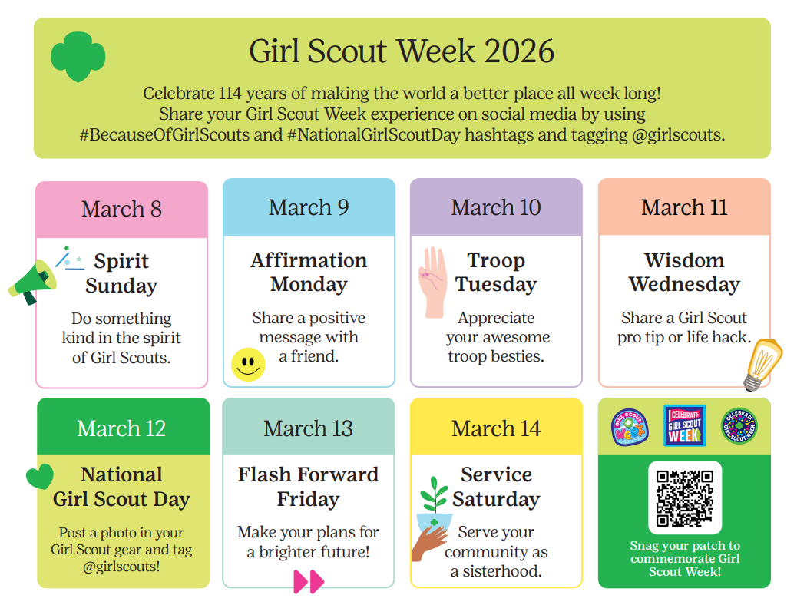
Notes:
Get ready to celebrate 114 years of Girl Scouting! Every year in March, Girl Scouts across the country party for a whole week to commemorate the founding of our movement. Kick off the week with Spirit Sunday and close the week by attending Girl Scout Fest at your nearest Service Center. Enjoy games, crafts and activities inspired by Girl Scouts past and present. It's a day to laugh, learn and celebrate everything that makes being a Girl Scout amazing!

Slide 20

Embrace Girl Scout history and traditions with the Through The Decades patch program and Decade Check Out Boxes.
Thank you to the GSCP2P Archives Committee for bringing this vision to life!
Notes:
Our March Patch of the month is the "Through the Decades Patch" which allows Girl Scouts of all levels to explore local history and traditions. Begin with a colorful center patch and add fun rockers to showcase the activities from different eras that you have completed. A very special Thank You goes to the P2P Archives Committee for creating this patch program.

Slide 21



Upcoming Adult Trainings
March 5 - Virtual Basic Camping Skills License Renewal
March 14 - Hybrid First Aid/CPR Certification, Gastonia
March 21 - Leaderfest, Hickory – Registration closes March 5!
April 11 – Basic Camping Skills License, High Point
April 18 - Basic Camping Skills License, Gastonia
April 20 - Virtual Basic Camping Skills License Renewal

Slide 22
Save the Date
Volunteer Conference
Saturday, August 1
10 a.m. - 3 p.m.
Monticello Community Church,
Statesville

Slide 23

Retail/ Mobile Shops Updates
This year's girl-designed cookie hoodie is back by popular demand and now available on the official Girl Scout Shop website. Spread the word and help celebrate our sisterhood in all 50 states!
Want to schedule a mobile shop? Check out our website and request a mobile shop today!

Slide 24
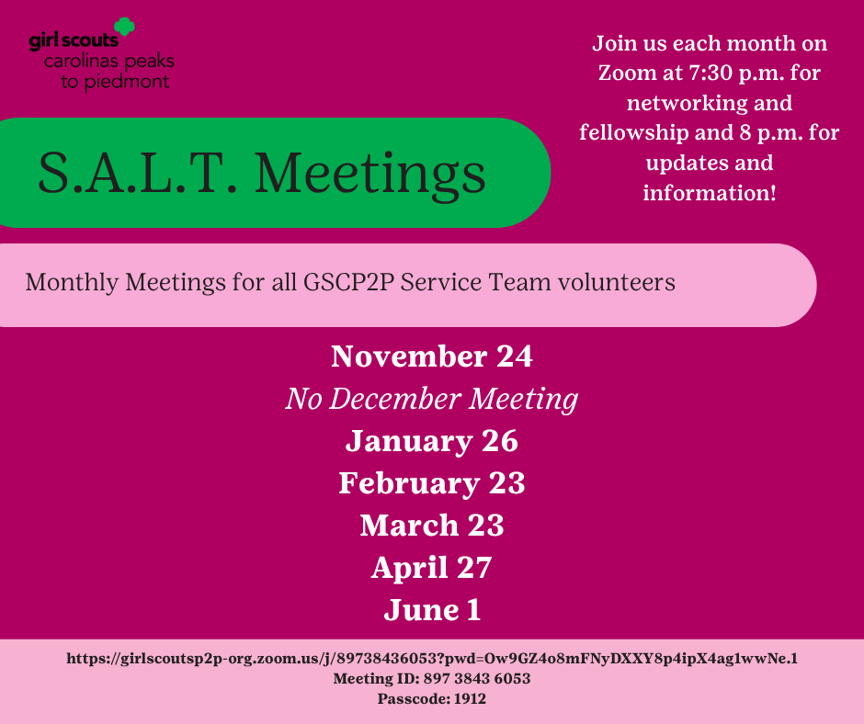
Notes:
Thank you for attending our SALT meeting tonight! Our next meeting will be March 23! Are there any final questions for our team this evening?

Slide 25
Next Steps and Questions
Next Meeting: March 23, 2026
Notes:
That concludes the end of our information sharing. Later this week you all will receive this PowerPoint presentation and notes as well as a sample SU Meeting PowerPoint and Agenda for your March SU meetings. It will also be posted in Rallyhood. Our hope is that these will be useful tools for you as you go back to your Service Units and share information.
We have been answering questions as the meeting has been going on, but we will now take down the presentation and ask if anyone would like to unmute and ask any final questions tonight?

