Slide 1




Service Unit
###
October Meeting

Slide 2
Welcome!
Our Agenda

Slide 3
SERVICE UNIT FINANCIAL UPDATES
  INSERT INFO HERE
Notes:
Get Your Troop Ready
Before September 14:
Complete all of your trainings. If you missed our virtual sessions the recordings are available in GS Learn
Dont forget to submit your troop’s annual ACH form
A new ACH form is required each membership year
We encourage troops to complete this early so you’re ready for the new year.
Thank you for everything you do to make the Product Program a success. Your leadership and support create incredible opportunities for girls across our council—we couldn't do it without you!

Slide 4
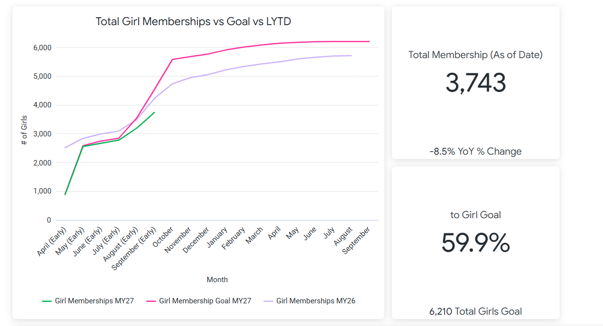
GSCP2P MEMBERSHIP UPDATES

Slide 5
SU ### MEMBERSHIP UPDATES
Membership Year 2026-2027:
Girl Goal -
Actual Girl Membership –
Percentage to Goal –
Total Membership (including adults and Lifetime members) –
New Troops -

Slide 6

Recruitment Updates
Fall Recruitment
How can you help?
  Wear your Girl Scout gear.
  Check in with your EM for volunteer opportunities (like putting out yard signs and community flyers).
  Openings in your troop? Use the Join Our Troop template to invite potential Girl Scouts to your troop.

Slide 7
WHAT’S AHEAD!
Service Unit Role trainings available now on gsLearn!

Slide 8
Girl and Volunteer Experience Updates

Slide 9

ADULT LEARNING

Slide 10

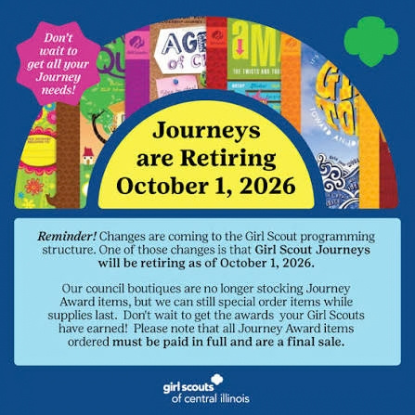

Slide 11
Daisy, Brownie and Junior Programs
Where Community Grows October Feature: Good Turn for Goodwill
October 10 - Trailside Treasures (Keyauwee)
October 17 - Nature Pals (Camp Pisgah)
October 23 - Council-Wide Campout (Camp Pisgah)
October 25 - GS Night at the Greensboro Gargoyles (Greensboro)
October 29 - Build Your Way to Bronze (Greensboro)
November 14 - Trailside Treasures (Keyauwee)
November 21 - No Horse? No Problem! Model Horse Artist (Keyauwee)
November 21 - Craft & Tink Badge Day (Asheville)
November 25 - School's Out, Camp Out (Keyauwee)
December 5 - Brownie Book Club at the Barn (Keyauwee)
December 5 - Cookie Expo (Winston-Salem)

Slide 12
Cadette, Senior and Ambassador Programs
Where Community Grows October Feature: Good Turn for Goodwill
October 3 - Trailblazer Chefs: Outdoor Cooking (Keyauwee)
October 3 - She Means Business (Hickory)
October 8 - Intro to Safe Babysitting (Virtual)
October 12 - Chapter Chats (Virtual)
October 15 - Gold Award Training (Virtual)
October 18 - Safe Sitter Essentials (Hickory)
October 20 - Lead the Change: Highest Awards Info Night (Virtual)
October 23 - Council-Wide Campout (Camp Pisgah)
October 25 - GS Night at the Greensboro Gargoyles (Greensboro)
October 26 - Intro to Safe Babysitting (Virtual)
November 3 - The Golden Spoon Society (Virtual)
November 7 - Safe Sitter Essentials (Forest City)
November 9 - Chapter Chats (Virtual)
November 10 - Gold Award Training (Virtual)
November 15 - Safe@Home (Greensboro)
November 18 - Safe Sitter Babysitting Course (Virtual)
November 21 - No Horse? No Problem! Model Horse Artist (Keyauwee)
December 7 - Safe@Home (Virtual)

Slide 13
Our Service Unit Events
List your service unit events here

Slide 14
Marketing Updates

Slide 15

RALLYHOOD
Remind troop leadership teams and caregivers to Rallyhood is free to join!
Enter important dates (like SU meetings) to your Rallyhood calendars and post reminders on your message walls.
Request Stripe payment processing functionality for your troop or service unit rallies, using the form on our website. Once installed you can collect payments for dues and events.
Connect with your Engagement Manager if you would like
council-wide promotional support (like Today’s Tips).

Slide 16
TODAY'S TIPS
Don't miss out on important council communications!
If you are not receiving our weekly e-newsletter, please contact info@girlscoutsp2p.org so that we can subscribe you to our e-mail list. This will also ensure you receive other important communications as we head into cookie season.
The new membership year started Thursday, October 1, so make sure you have renewed your membership for MY27 so you do not have a lapse in communication!

Slide 17
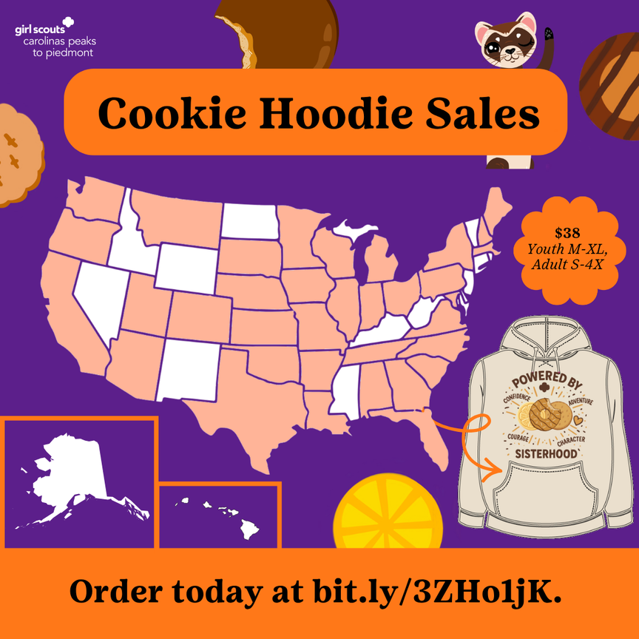
Cookie Hoodie Design Contest
We're back for year three of our Cookie Hoodie Design Contest! Encourage Girl Scouts to enter their artwork for a chance to have it produced into the council's limited edition hoodie.
Contest Dates: October 1-20
Pre-orders will begin in November and hoodies will arrive for you to sport at your cookie booths!
Last year's design was sported by Girl Scouts all over the country and is still available for purchase on the official Girl Scout Shop website! We can't wait to see what creative solutions our Girl Scouts design this year.

Slide 18


Slide 19
Product Program Updates

Slide 20


PRODUCT PROGRAM UPDATES
Troop Proceeds: Each troop that participates in the Fall Program earns 15% of all product sold.
Higher Proceeds Option: If a troop chooses higher proceeds, they do not earn the physical rewards listed on the order card but will still receive all patches. In this case, the troop earns 18% in proceeds.
Crossover Opportunity: Troops that participate in the 2026 Fall Product Program and sell at least 100 items will receive an additional $0.05 per package of cookies sold during the upcoming Cookie Program.
Notes:
We are officially underway with our Fall Product Program! As we keep the program moving, I wanted to share a few quick reminders and ways we can continue encouraging our troops and girls:
Troops earn a minimum of 15% on all products sold. Troops that choose the higher proceeds option earn 18% and will still receive all earned patches, but will not receive the physical rewards listed on the order card.
Don’t forget about the Cookie Program crossover incentive! Troops that participate in the 2026 Fall Product Program and sell at least 100 items will earn an additional $0.05 per package of cookies sold during the upcoming Cookie Program.
There is still plenty of time to keep selling! Girl-delivered orders continue through October 19, and online sales continue through November 9.
Please continue encouraging your troops to participate, share their online stores, and take advantage of the time we still have left in the program. Every sale adds up and helps troops build funds for the Girl Scout experiences they’re planning throughout the year.
Thank you for helping us keep the momentum going and for continuing to support our girls and volunteers throughout the Fall Product Program!
‹#›

Slide 21


PRODUCT PROGRAM UPDATES
NEW
Notes:
Believe it or not, it’s also time to start talking about cookies! We are well underway with preparations for the 2027 Girl Scout Cookie Program, and there are some exciting things coming this season.
As some of you may have already seen online or in the media, we’ll have two new products for 2027—the new Sparkables cookie and Patch Pals, our new blueberry-flavored dog treats! We’re excited to bring both of these products to our lineup, and our volunteers will learn much more about them during our upcoming trainings.
‹#›

Slide 22
PRODUCT PROGRAM UPDATES
UPCOMING TRAININGS
Service Unit Cookie Specialist
Troop Cookie Manager
Cookies 101
OCTOBER 5 & 8
NOVEMBER 9 & 19
NOV. 12, 18, 23 • DEC. 1
Volunteer leadership training
For troop-level cookie volunteers
For volunteers new to cookies
Juliette / IRG Cookie Training
Digital Cookie: Parents & Girls
Digital Cookie: Troop Managers
DECEMBER 2
DECEMBER 8
DECEMBER 10
Cookie training for individually registered girls
Online platform overview + Q&A
Online platform overview + Q&A
Training dates and joining links are available on the council website. Please help us spread the word!
Notes:
Our Service Unit Cookie Specialist trainings will be October 5 and October 8, followed by Troop Cookie Manager trainings on November 9 and November 19.
For volunteers who are new to the Cookie Program, we’ll offer Cookies 101 on November 12, November 18, November 23, and December 1.
We’ll also have a training specifically for our Juliette/IRG families on December 2, followed by Digital Cookie trainings on December 8 and December 10.
All of these dates are already available on our council website, along with the links volunteers will need to join the trainings. Please help us spread the word and encourage your volunteers to take advantage of these opportunities as we get ready for cookie season.
As always, if you or your volunteers have questions, please reach out. We’re happy to help and excited to get everyone ready for a great 2027 Cookie Program!
‹#›

Slide 23
Other Service Unit Business

Slide 24
Next Meeting:
XXX

Slide 25
Thank
You!

