Slide 1





Where
Leaders
Grow
August 2026
SALT Meeting

Slide 2
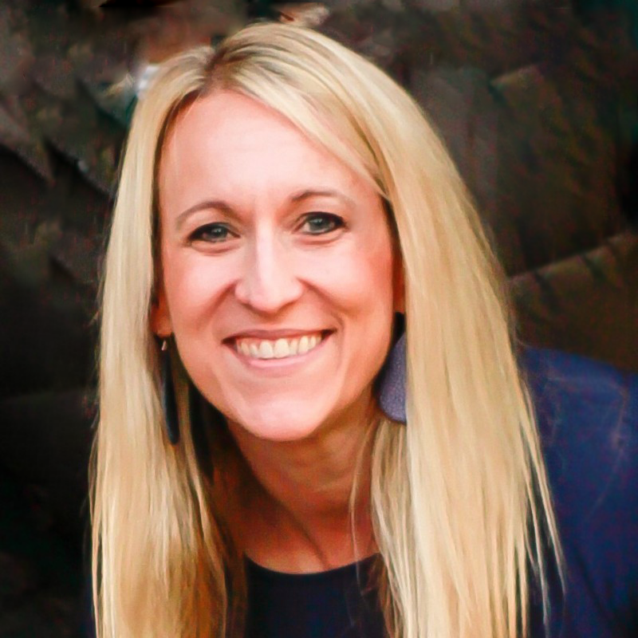
Welcome to the August SALT Meeting!
Our Agenda
Welcome
Engagement Updates
Volunteer and Girl Experience Updates
Outdoor and Property Updates
Marketing Updates
Fall Product Updates
Retail Updates
Q&A
Jaclyn Johnson
Chief Mission Delivery Officer

Slide 3
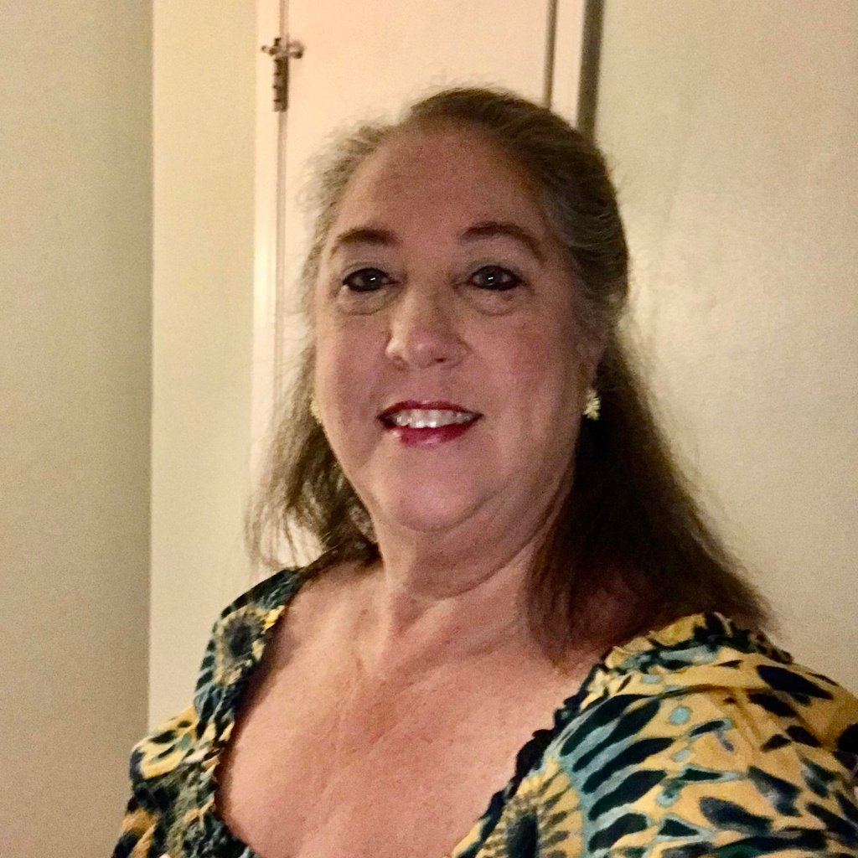
Engagement Updates
Fall Recruitment
How can you help?
  Volunteer at an Open House table
  Volunteer to facilitate a girl activity at a school parent interest meeting
  Assist with putting out fliers or yard signs in/at local businesses with your EM’s QR code and a benefits list of why they should join Girl Scouts.
  WEAR your Girl Scout gear - everywhere
Sandi Heavener
Director of Engagement

Slide 4
MEMBERSHIP UPDATES
Membership Year 2025-2026:
Girl Goal - 7,000
Actual Girl Membership - 5713
Percentage to Goal - 81.6%
Total Membership - 10,233
New Troops - 51

Slide 5
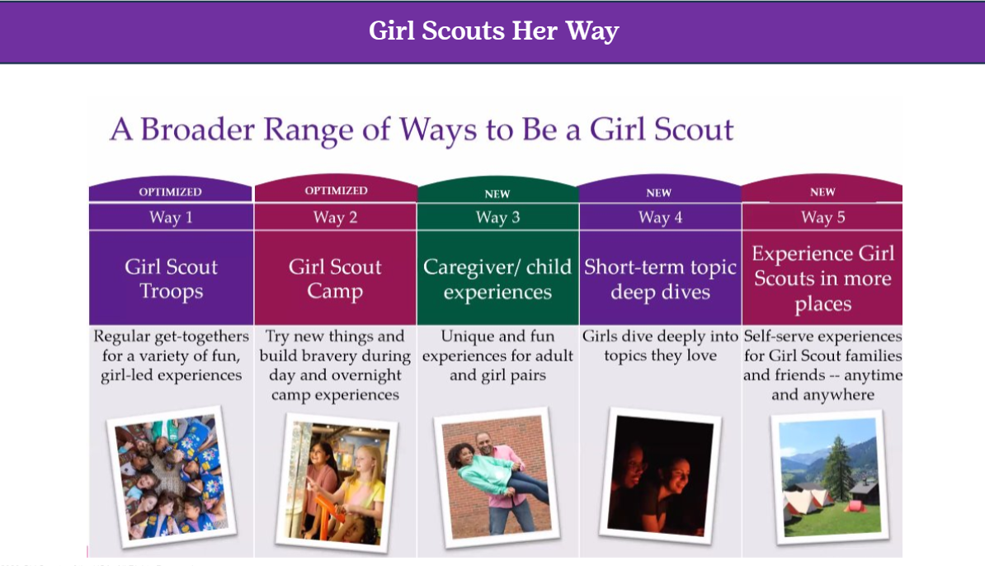
MEMBERSHIP UPDATES
MY 2026-2027:
Girl Goal - 6,210
Actual - 3,008 48.4% to goal
Total girl and adult - 6,288
New troops - 4

Slide 6
SERVICE UNIT SHOUTOUTS
Spring Renewal Girl Goal:
150 Guilford and 118 Henderson
Extended Year Girl Goal:
145 Davidson
Girl Goal for MY25-26:
124 Gaston, 135 Iredell, 141 Forsyth, 150 Guilford, 155 Rockingham,
and 137 Davie

Slide 7
WHAT’S AHEAD!
Saturday, October 3: S’more to Explore Recruitment Day across the P2P footprint
Troop Committe Roles and Expectation 1-pager
  Troop Committee Roles and Expectations
Service Unit Role training on gsLearn will be available in September

Slide 8
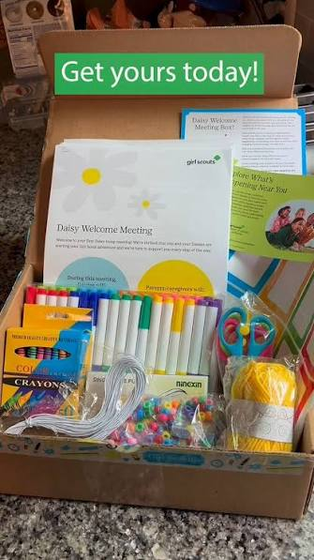
GIRL SCOUT EXPERIENCE BOXES
It’s not too late to request your Daisy or Brownie Experience Box.
Requires 4 new Daisies or
4 new to Brownies.
E-mail info@girlscoutsp2p.org to request your box today.

Slide 9
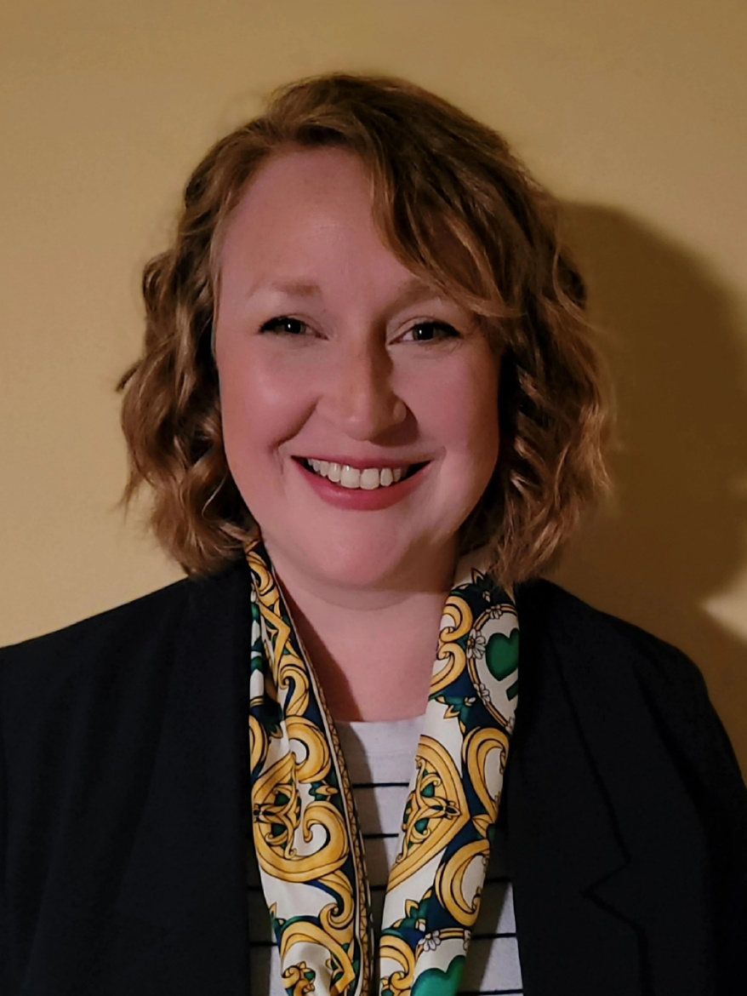
Girl and Volunteer Experience Updates
Emily Satterfield
Director of Experience

Slide 10

ADULT LEARNING

Slide 11


ADULT LEARNING WEEKENDS

Slide 12

FALL PROGRAM GUIDE
Our Girl Scout Program Guide for August-December 2026 is out now!
NEW!

Slide 13
Daisy, Brownie & Junior Programs
September - October
Where Community Grows September Feature: Girl Scouts Loves State Parks
September 12 - 13 Girl Scouts Loves State Parks (Various Locations)
September 19 - Junior RIIT Explorer (Keyauwee)
September 19 - Adaptive Equestrian Show (Keyauwee)
September 19 - Trailside Treasures (Camp Pisgah)
September 19 - Brownie Bug (Statesville)
September 21 - School’s Out, Camp Out (Keyauwee)
September 26 - No Horse? No Problem! Horse Show (Mill Spring)
September 26 - Junior Animal Habitats (Statesville)
September 26 - Shapes in Nature at Elk Knob State Park (Boone)
Where Community Grows October Feature: Good Turn for Goodwill
October 10 - Trailside Treasures (Keyauwee)
October 17 - Nature Pals (Camp Pisgah)
October 23 - Council-Wide Campout (Camp Pisgah)
October 19 - Build Your Way to Bronze (Greensboro)

Slide 14
Cadette, Senior & Ambassador Programs
September - October
Where Community Grows September Feature: Girl Scouts Loves State Parks
September 12 - 13 Girl Scouts Loves State Parks (Various Locations)
September 12 - Riding Instructor-in-Training Orientation (Keyauwee)
September 15 - Gold Award Training (Virtual)
September 19 - Safe Sitter Babysitting Course (Asheboro)
September 21 - School’s Out, Camp Out (Keyauwee)
September 26 - No Horse? No Problem! Horse Show (Mill Spring)
September 26 - Trailblazer Chefs: Outdoor Cooking (Camp Pisgah)
September 28 - Destination Diaries (Virtual)
Where Community Grows October Feature: Good Turn for Goodwill
October 3 - Trailblazer Chefs: Outdoor Cooking (Keyauwee)
October 3 - She Means Business (Hickory)
October 8 - Intro to Safe Babysitting (Virtual)
October 15 - Gold Award Training (Virtual)
October 18 - Safe Sitter Essentials (Hickory)
October 23 - Council-Wide Campout (Camp Pisgah)
October 26 - Intro to Safe Babysitting (Virtual)

Slide 15


Slide 16


Slide 17
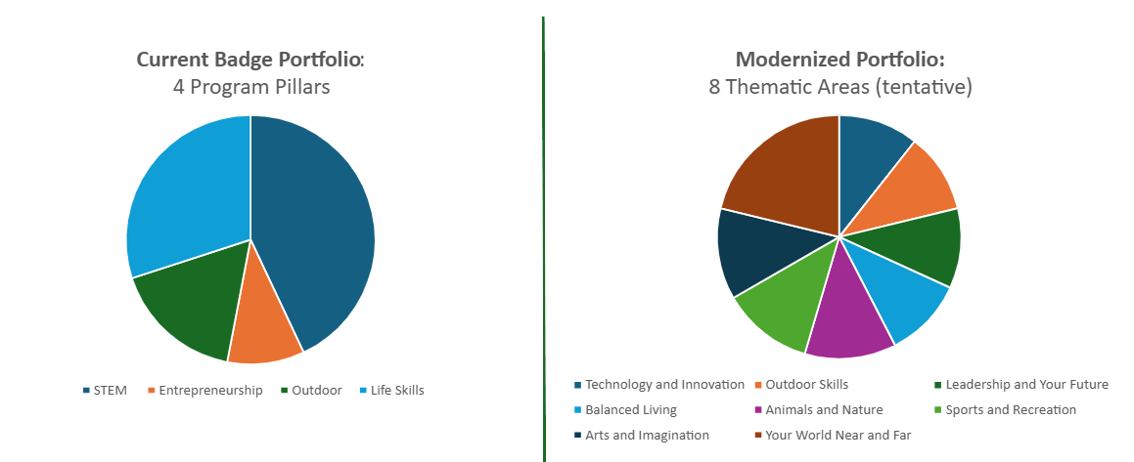
GSUSA PROGRAM UPDATES
The future portfolio mix is inspiring, active and centers topics that non-members and families are most interested in.​

Slide 18
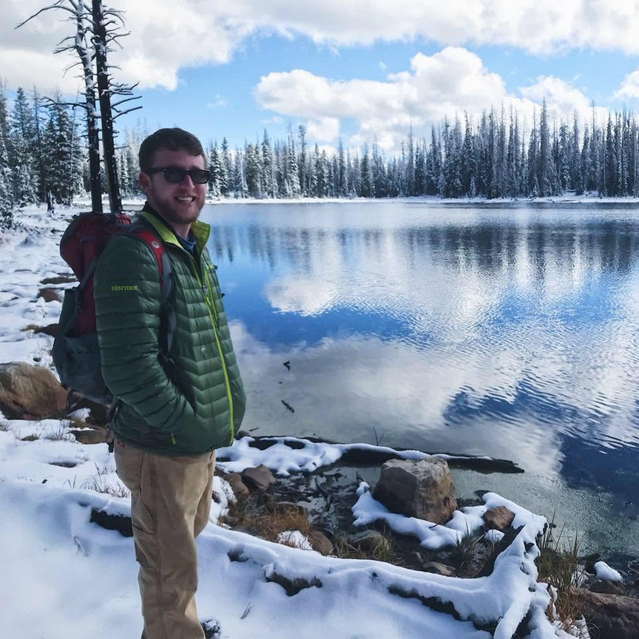
Outdoor Experience & Property Updates
Clayton Sheehan
Director of Outdoor Experience & Property

Slide 19
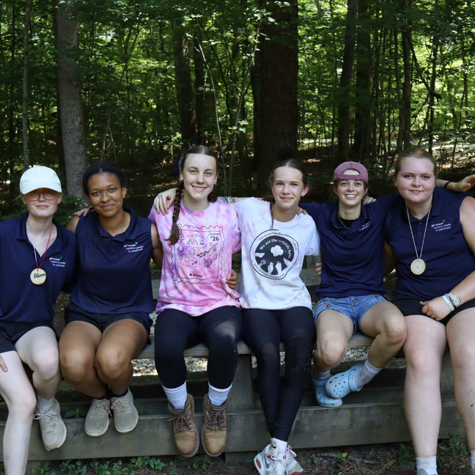
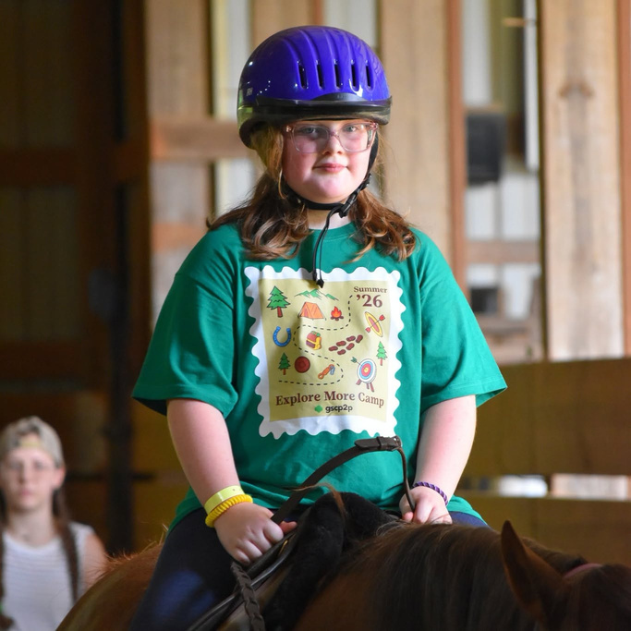
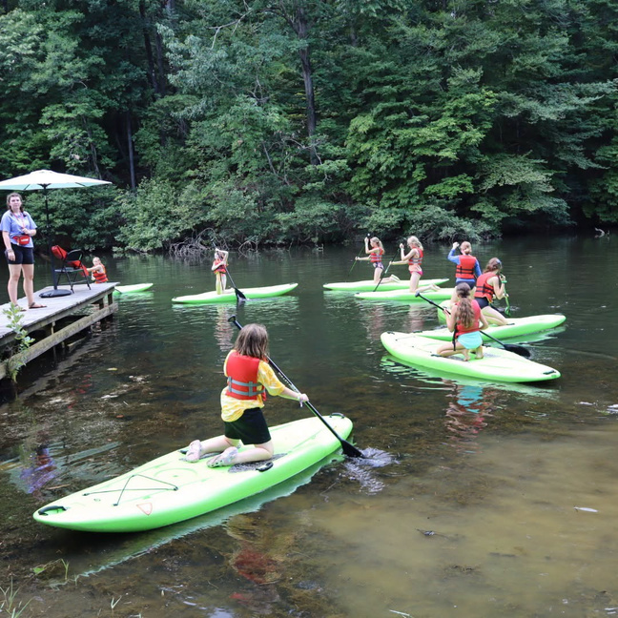
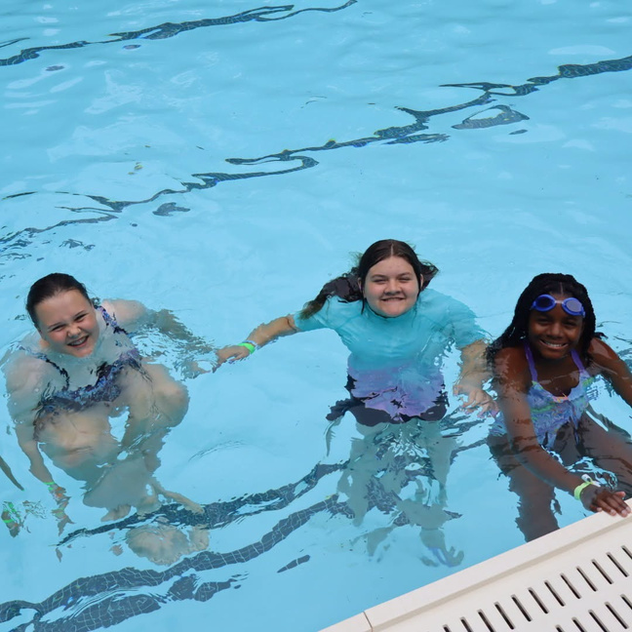
SUMMER CAMP WRAP-UP

Slide 20


FALL PROGRAMMING

Slide 21
COUNCIL-WIDE CAMPOUT
October 23-25, 2026
$75/per person
Location: Camp Pisgah (Brevard)
Join us for "A Weekend of Wonder and Whimsy"- a council-wide campout bringing together Girl Scout troops and families from across the region for an unforgettable weekend. Come out to Camp Pisgah October 23-25 for magical activities, from playful Quidditch matches to traditional camp experiences, all designed to spark imagination and connection. As the sun sets, enjoy the Great Hall Gala, an enchanting ball under the stars. It's a one-of-a-kind gathering filled with fun, friendship and a touch of magic for all ages. Our exclusive Council-Wide Campout patch is included in registration!
Meals on Saturday and Sunday will be provided! Lodging assignments and packing lists will be shared before the event.
Note: Please provide accessibility, mobility information and if you have a preferred name in the provided "Special Circumstances" section during registration.
Registration deadline: October 9, 2026

Slide 22
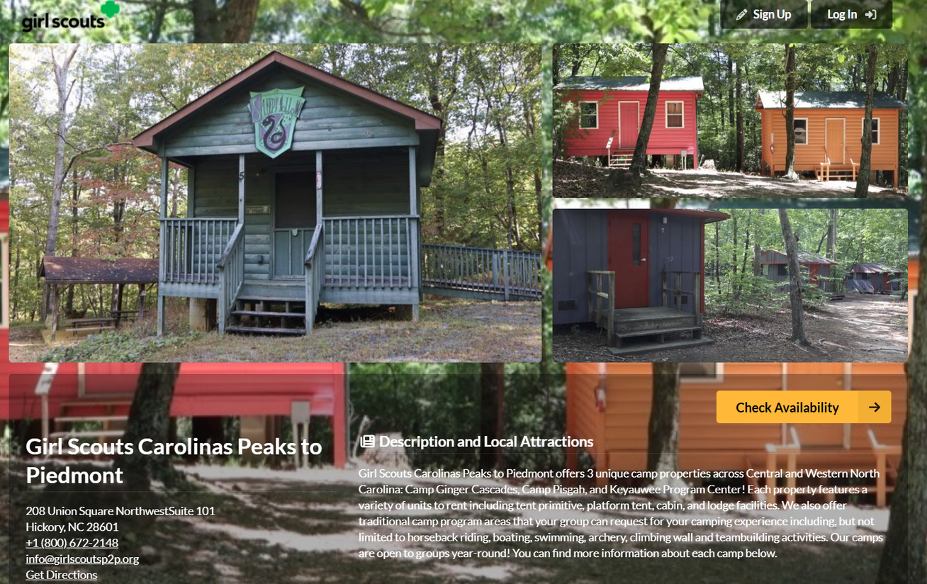

RESERVATIONS ON CAMPLIFE

Slide 23

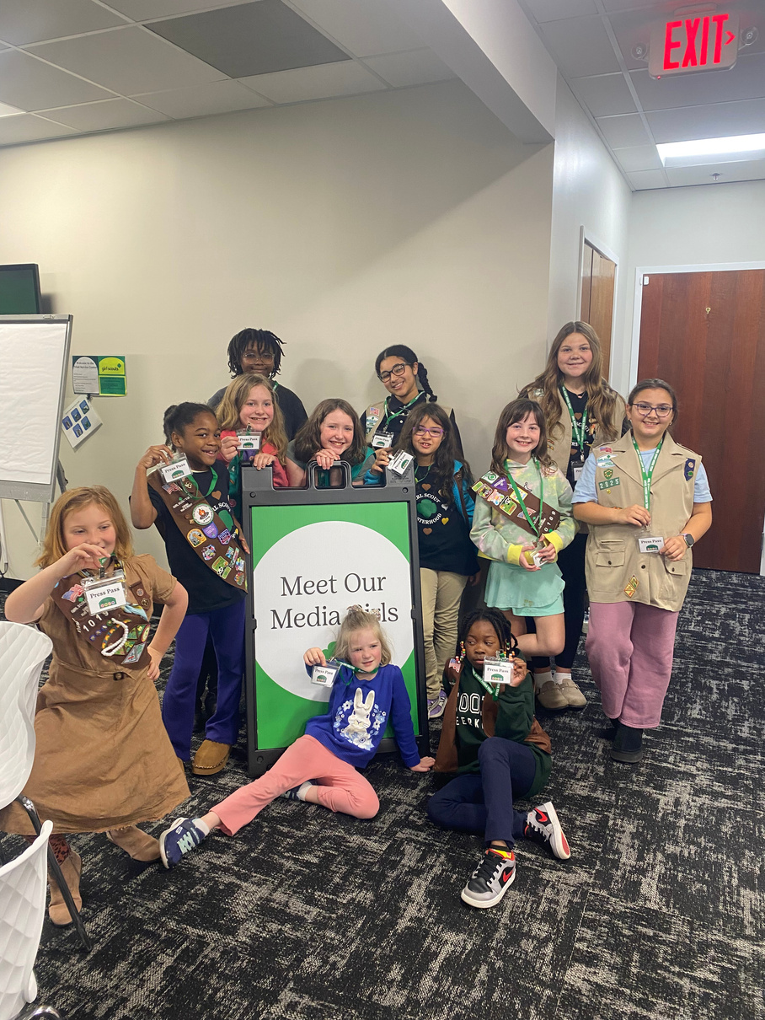
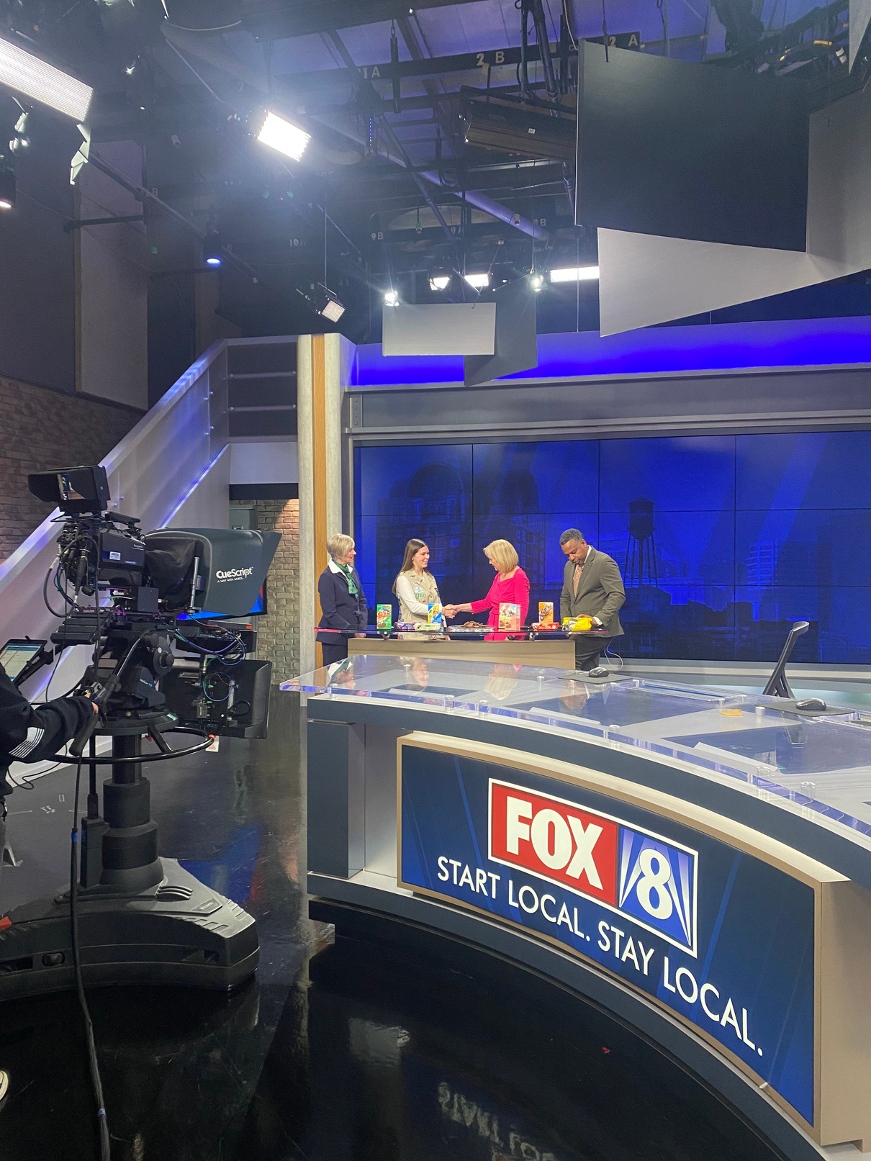
MARKETING UPDATES
JOIN MEDIA GIRLS!
For all GSCP2P Girl Scouts grades K-12!
Write for our blog, create social media content, take photos at events
and participate in television, print and radio interviews.
Applications close on Monday, September 14!

Slide 24
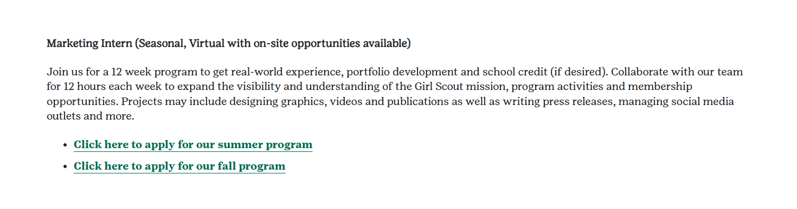
MARKETING INTERNSHIP
Our spring internship application is live on our website’s employment page!
Our fall internship applications close August 31.

Slide 25

RALLYHOOD
Remind troop leadership teams and caregivers to Rallyhood is free to join!
Enter important dates (like SU meetings) to your Rallyhood calendars and post reminders on your message walls.
Request Stripe payment processing functionality for your troop or service unit rallies, using the form on our website. Once installed you can collect payments for dues and events.
Connect with your Engagement Manager if you would like
council-wide promotional support (like Today’s Tips).

Slide 26
BE A BRAND AMBASSADOR
SHARE GSCP2P SOCIAL MEDIA POSTS TO YOUR PROFILE
AND COMMUNITY GROUPS AND INVITE FRIENDS TO DISCOVER
WHAT GIRL SCOUT FUN IS ALL ABOUT!
Avoid marketplace confusion by always referencing our organization as
Girl Scouts.
    The words "Scout", "Scouts" and "scouting" should never appear without the modifier "Girl," and each word should be capitalized.
    Girl Scouts should also be used in front of any age level or highest award (ex: Girl Scout Brownie or Girl Scout Gold Award).

Slide 27


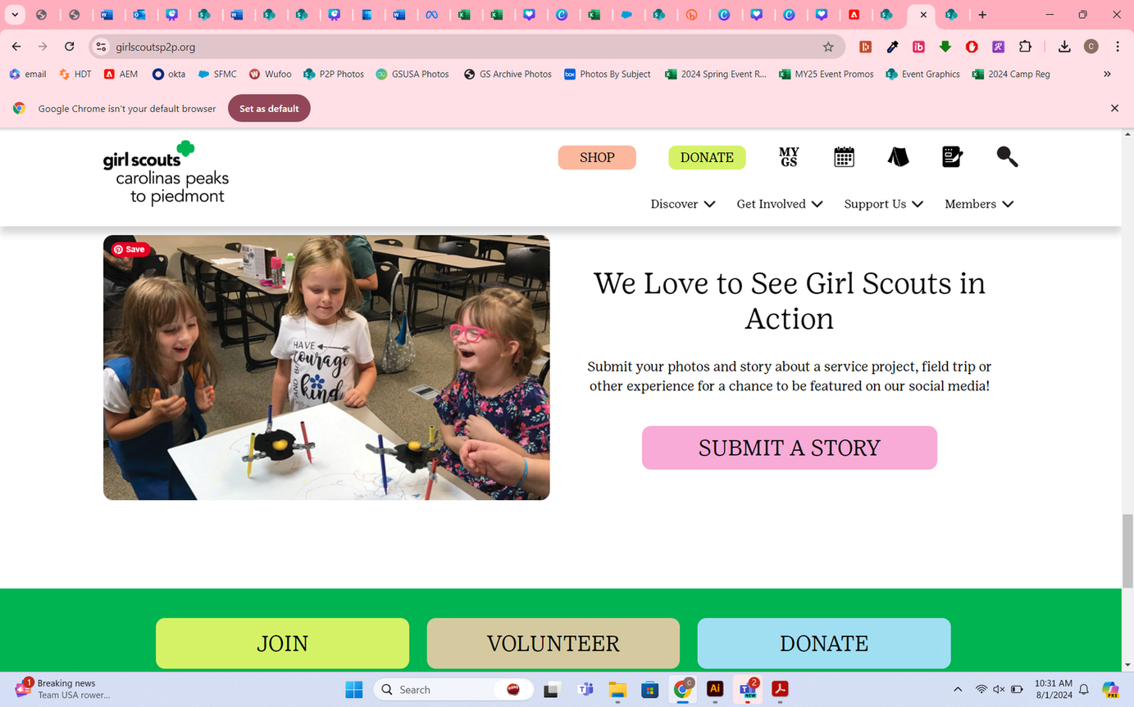

SHARE YOUR STORIES
Share your adventures with us through the Girl Scout News Form located at the bottom of our homepage.
Be sure to add photos if you would like to have your story featured on GSCP2P’s
social media!
Story submissions for Girl Scout Bronze, Silver and Gold Awards are completed in the final report forms, not the Girl Scout News Form.

Slide 28

PRODUCT PROGRAM UPDATES
  Complete all trainings for your role
  Submit ACH form
  Program Begins on September 14!
Notes:
Get Your Troop Ready
Before September 14:
Complete all of your trainings. If you missed our virtual sessions the recordings are available in GS Learn
Dont forget to submit your troop’s annual ACH form
A new ACH form is required each membership year
We encourage troops to complete this early so you’re ready for the new year.
Thank you for everything you do to make the Product Program a success. Your leadership and support create incredible opportunities for girls across our council—we couldn't do it without you!

Slide 29
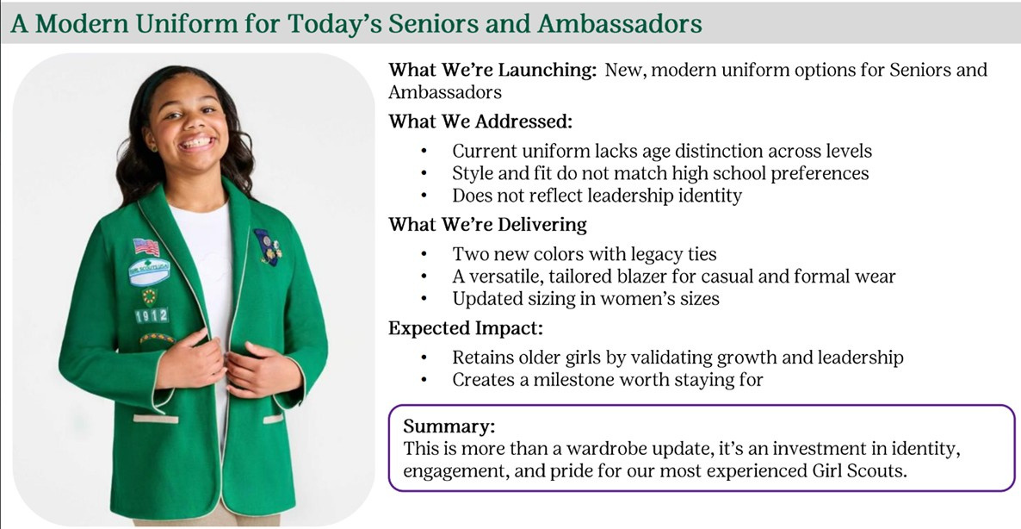
WHAT’S NEW & COMING SOON IN RETAIL

Slide 30





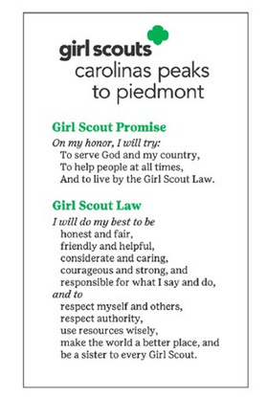
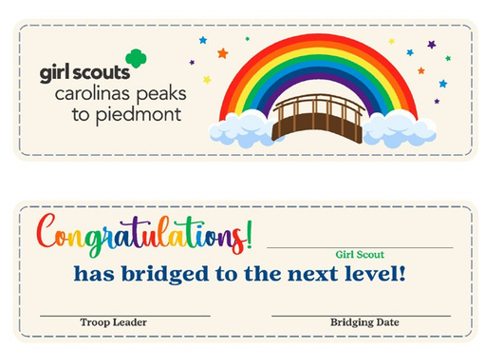


NEW P2P MERCHANDISE

Slide 31


MOBILE SHOPS & UNIFORM SHOPS

Slide 32


Slide 33
Q&A!

Slide 34
Next SALT Meeting:
September 28

Slide 35
Thank
You!

