Slide 1









Service Unit Meeting
DATE

Slide 2
Welcome!

Slide 3
Tonight’s Agenda

Slide 4


April is
Volunteer Appreciation Month!
Thank you for serving Girl Scout families in our Service Unit!
Remember to thank your fellow volunteers- old and new.

Slide 5
GSCP2P Membership Updates
Renewed girls = 4059
New girls = 1351
Total girls = 5410
Total GSCP2P Members (Girls + Adults) = 9753
New Troop Total = 29
On April 1, 2026, we will begin MY27 GSEB registrations! Current box recipients please watch for an email about how to register for next year's box and/or for second year troop plans.

Slide 6
Service Unit XXX Membership Updates
As of...
Membership Year 2026
Girl Goal -
New Troop Goal -
As of …
MY26 Girl Membership –
New Troops -

Slide 7
2026
Volunteer Conference
Saturday, August 1
10 a.m. - 3 p.m.
Monticello Community Church,
Statesville
Registration link coming soon!

Slide 8

SPRING RENEWAL
Notes:
All Girls who renew their membership during April 1 – May 31, 2026, will receive an automatic discount of $20 off their membership during the renewal process and a patch. Those girls who earned their MY27 membership through the cookie program will also receive a patch.
Every volunteer that renews between April 1 - May 31, 2026, will receive free admission to the Volunteer Conference August 1, 2026, including our Lifetime members. We will provide a code to be used during registration for this discount.
Every SU that meets their spring renewal girl goal will receive a $200 program or store gift certificate.
For every girl over the Service Unit's Spring Renewal goal, the SU will also receive $10 bonus.
I have had several questions about using financial aid for renewals. When renewing they will select financial aid as payment and receive an email for next steps. These girls will receive the early bird patch, if the process is completed during April/May.
NEW EXTENDED YEAR INCENTIVE – Each SU that meets their extended year girl goal will receive a $50 program/retail gift certificate. Additionally, for every girl over their goal, they will receive a $5 extra bonus.

Slide 9

2026 Annual Meeting
Saturday, April 25
10 a.m. - 3 p.m.
Mary E. Rittling Conference Center
Thomasville
Registration is open!

Slide 10

Summer Camp
Financial assistance is still available!
Overnight camp is for rising grades 2-12.
Save $50 before our Early Bird Discount ends on March 31.
Overnight campers joining us June 21-26 or July 12-17 can request free transportation assistance from the Asheville or Hickory Service Center. Transportation assistance requests are due May 17.
Day camp is for rising grades 1-5 and will be hosted in Black Mountain, Greensboro, Hickory and Winston-Salem.

Slide 11




Rallyhood
& Summer Camp
Now is a great time to encourage volunteers and families to join Rallyhood as we approach local end of year celebrations and summer camp.
This summer, parents will be able to view photos of their camper while they are away at camp through Rallyhood. We will send an invite to access your camper's session prior to their arrival.

Slide 12
Outdoor Experience Updates
This month we welcomed a new Outdoor Experience Manager, Emma White!
Emma brings experience in-
Camp Leadership
Challenge Courses
Teaching / Education (both outdoors and in a school classroom)
Spring Camp Activities are limited to troop-led experiences.
Additional Camp Activities will be open in the fall but limited due to facilitators.
We are planning Adult Certification days for the fall that will be open to volunteers and staff to build our facilitator pool so we can offer more activities throughout the council.

Slide 13
Property Updates
KPC-
Spring Volunteer Workday, March 28
Pool reopening has started today!
CGC-
Working to continue assessing repairs at camp- both scope and cost.
Projects include, but are not limited to:
Roof replacements
Repairs to well
Repairs to Directors house
Dining Hall decking and roof
CP-
Water System (It’s 75% good news!)
Wells have passed!
Kitchen passed!
Water from Cistern to Westfeldt did not pass and tested positive for Total Coliform (NOT E. Coli)
Total Coliform is very common and is caused by any growth in the water lines due to stagnancy or intrusion from outside sources (i.e. broken lines).
Sanitizing from Cistern to Westfeldt and retesting happening this week.

Slide 14

Girl Scout Cookie Program Updates
Important Dates
December
January
February
March/April
December 5– Troop initial order due in Smart Cookies
December 8 ⁻ Digital Cookie e-mails launched to both girls and troop volunteers
December 16 – Cookie Program begins
January 3 – Start of booth lottery selections
January 7– 10 – Cookie deliveries
January 10 – 18 – Walk-about week
January 12 – Cupboards open
January 16 – Booth sales begin
February 2 – Troops can begin changing proceeds and recognition plans in Smart Cookies
February 16 – Troops can begin creating recognition orders in Smart Cookies
NEW March 15 – Program ends
March 5 – First ACH withdrawal
NEW March 24 – Buy 5 entries due council
NEW April 16 – Second/final ACH withdrawal
NEW April 23 – ACH credits
Notes:
NEW dates to point out: March 24 (Buy fives are due to council offices), April 16 (final ACH withdrawal), April 23 (ACH credits)
Just as a reminder all reward selections for troops are due in Smart Cookies by TONIGHT at 11:59pm. Recognition orders must be submitted in Smart Cookies- all digital cookie selections do NOT transfer to Smart Cookies.
On behalf of the Product Program Team and our P2P Council, we would like to thank you for a fantastic cookie season. We deeply appreciate your time, dedication, and efforts.

Slide 15

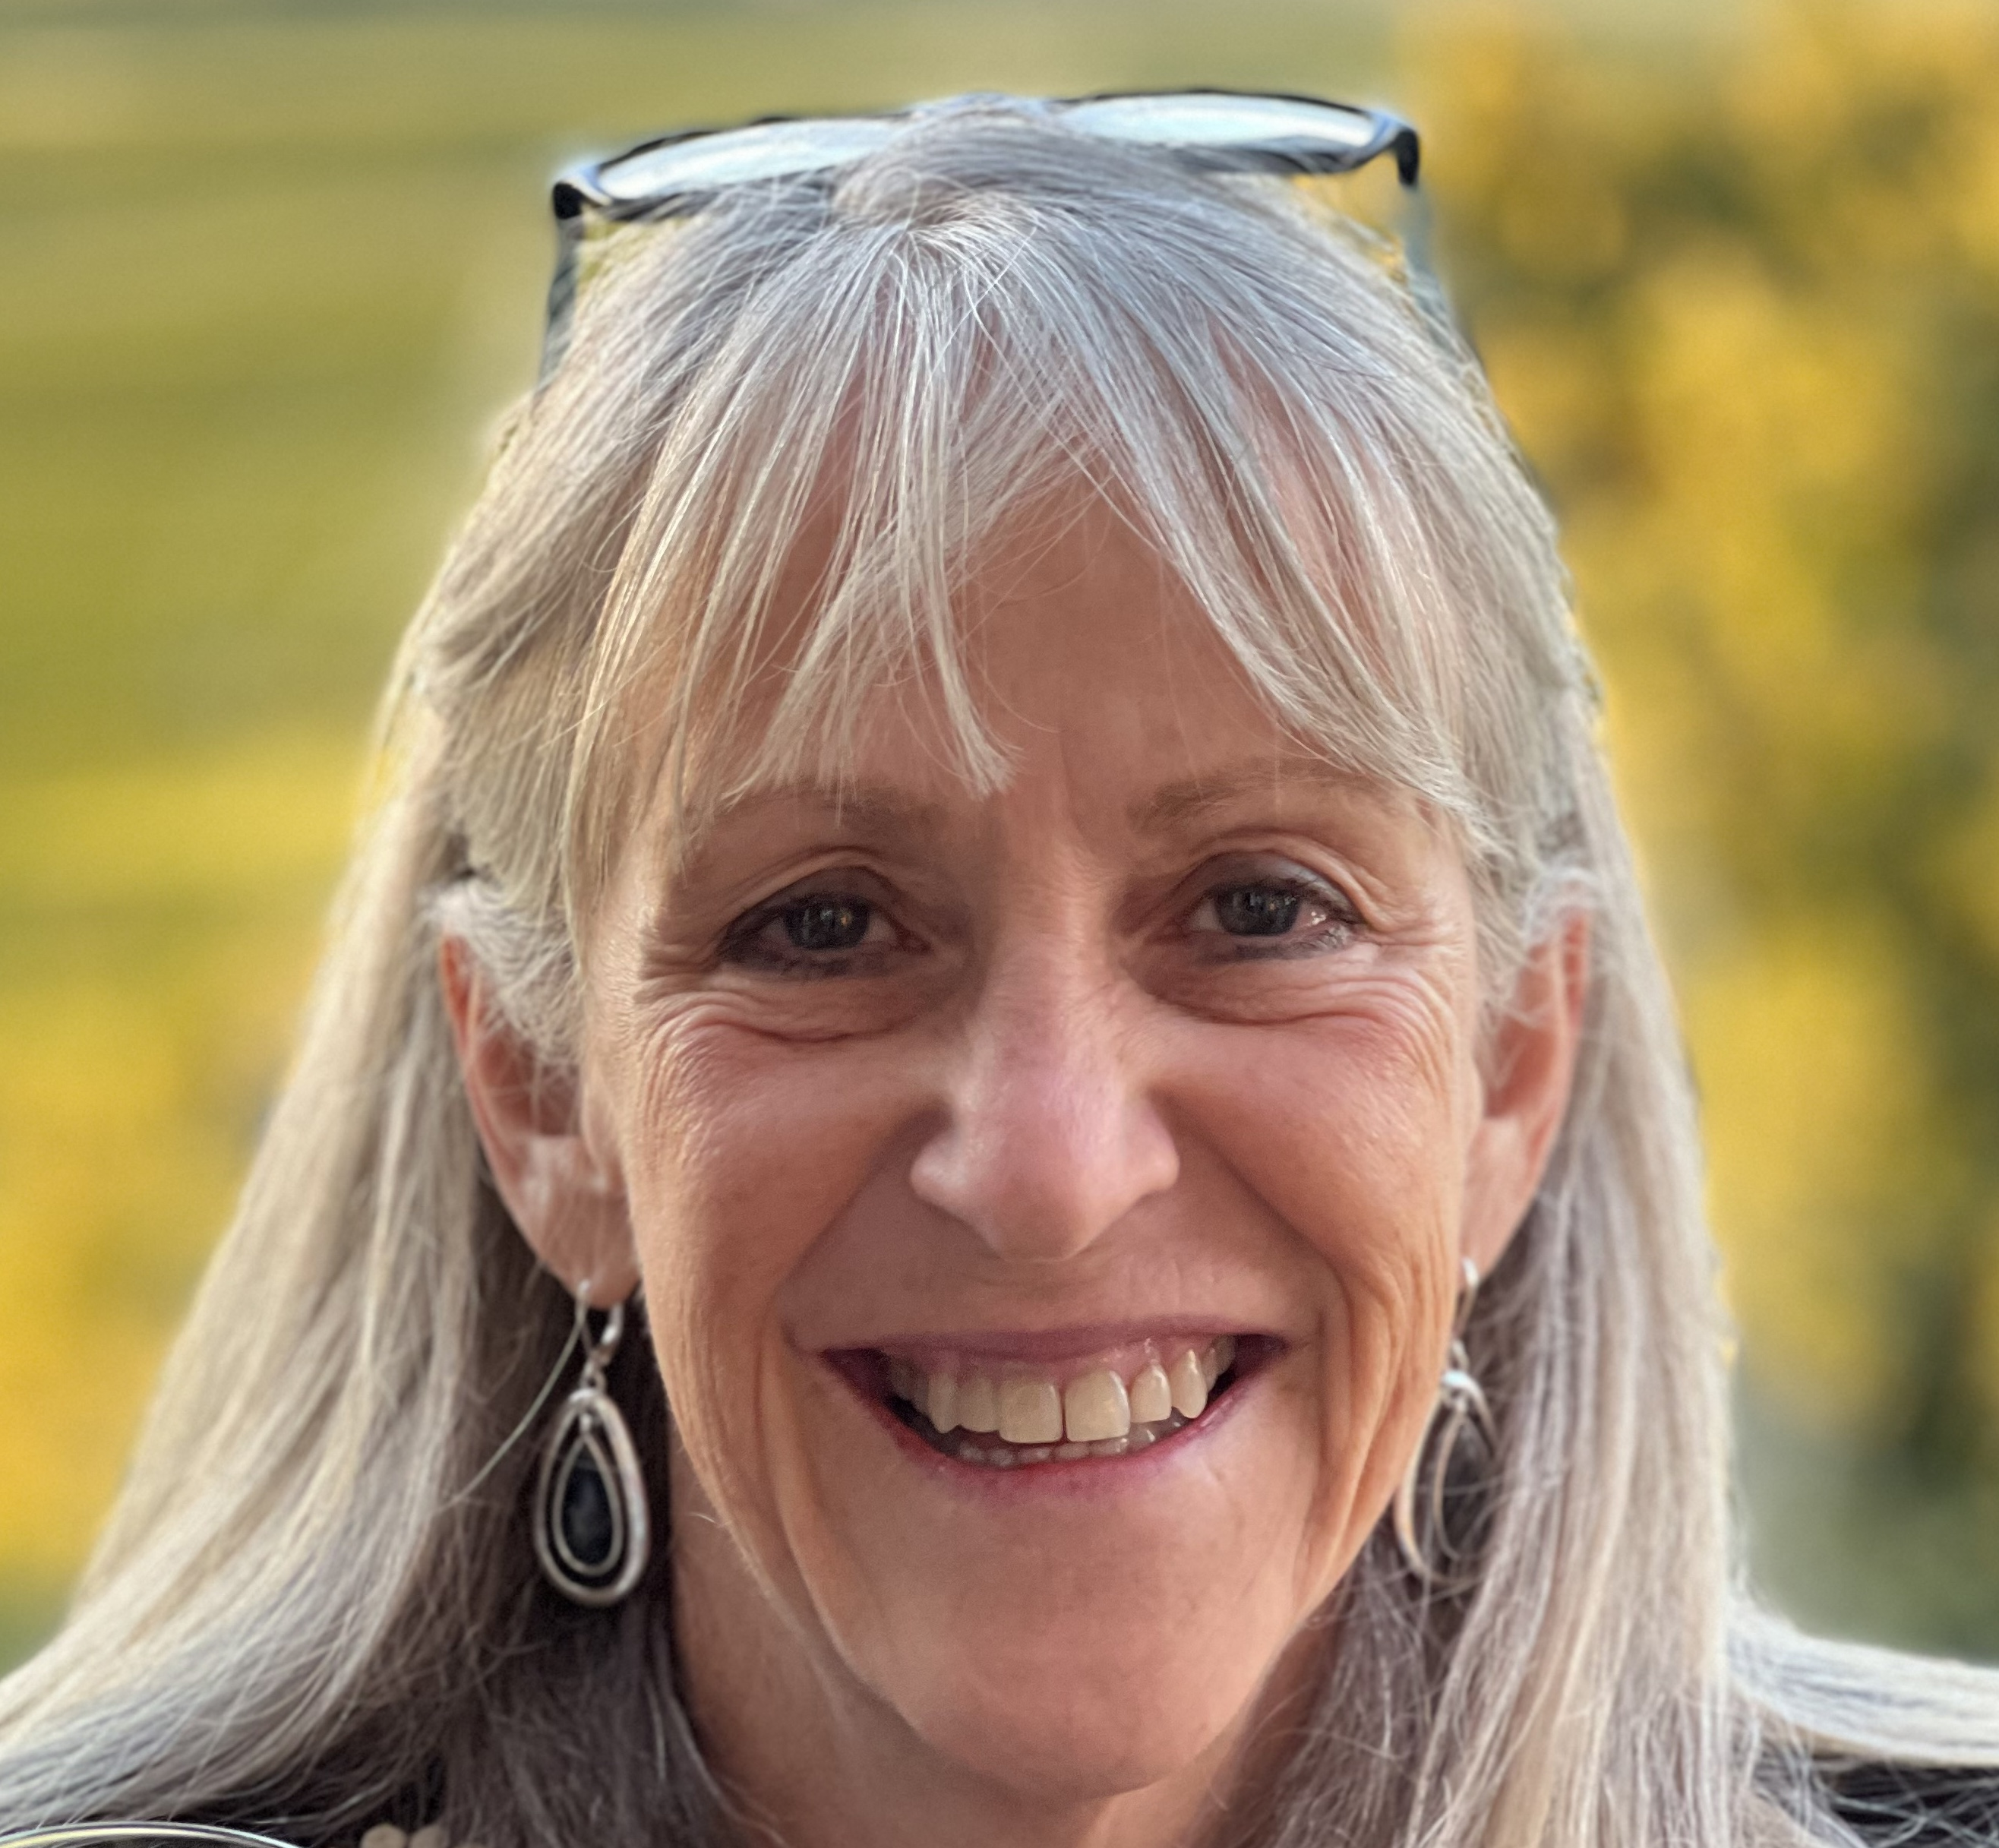
Curiosity Quest
Saturday, April 11
10:30 a.m. - 1:30 p.m.
Kaleideum, Winston-Salem
Featured guest speaker:
Dr. Mary Lynn Dittmar President, Dittmar Associates Space industry leader and policy maker
Ticket includes an all-day pass to the children's museum and three hours of Girl Scout programming!
Notes:
We have some great programs coming up this spring. One of which I would like to highlight is Curiosity Quest happening on April 11 in Winston-Salem. This event features 14 community partners that will be bringing a wide range of fun, hands-on activities – from testing horse DNA, to looking at microbes in stream water, and even getting messy mining for gems. We are also pleased to announce that we will be joined by Dr. Mary Lynn Dittmar as our guest speaker for the day. Dr. Dittmar is a space industry expert and the founder of the Coalition for Deep Space Exploration. She will be sharing with us her personal journey in choosing her career and girls will have time to ask questions and take photos with her.

Slide 16
Daisies/Brownies/Juniors
April 11 – Curiosity Quest, Winston-Salem
April 19 – Safe @ Home for Juniors, Gastonia
May 2 – GS Day at the NC Transportation Museum, Spencer
May 9 – Brownie Day Camp at the Little House, Brevard
June 13 – Council-wide Bridging and Family Fun Day, Keyauwee Program Center
Girl Scouts doesn’t stop just because school is out. Stay connected through our Summer Fun Series! Girls can join us virtually every Tuesday night for a troop meeting or head out on an adventure with one of our community partners. Our full summer calendar is coming soon—stay tuned!

Slide 17
Cadettes/Seniors/Ambassadors
April 11 – Curiosity Quest, Winston-Salem
April 13 – Gold Award Training, Virtual
April 19 – Safe @ Home, Gastonia
April 25 – Annual Meeting, Thomasville
May 2 – GS Day at the NC Transportation Museum, Spencer
May 7 – Gold Award Training
May 16 – Her Future, Her Impact: A Girl Awards Gala, Dobson
June 9 – Gold Award Training
June 13 – Council-wide Bridging & Family Fun Day, Keyauwee Program Center, Sophia

Slide 18


Upcoming Adult Trainings
April 11 – Basic Camping Skills License, High Point
April 18 - Basic Camping Skills License, Gastonia
April 20 - Basic Camping Skills License Renewal, Virtual

Slide 19

Retail/ Mobile Shops Updates
Want to schedule a mobile shop? Visit our website and request a mobile shop today!

Slide 20
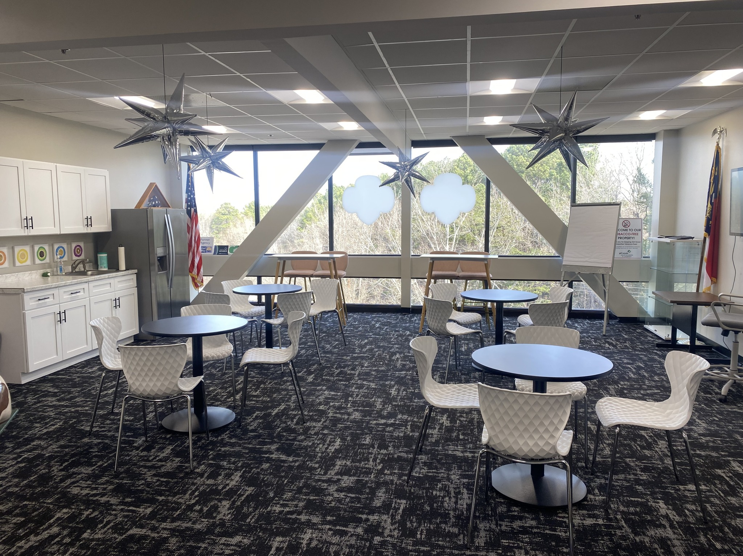
NEW!
Experience Centers
We are excited to announce a NEW resource to accommodate troop travels- the Triad Experience Center! This space can be reserved for free and provides a unique space for troop sleepovers, meetings or programs.
Keep an eye out for our Experience Center opening soon in Asheville!

Slide 21
Service Unit XXX
Budget Updates
Updates on your SU's Bank Account

Slide 22
Service Unit Announcements

Slide 23
Upcoming Service Unit Dates and Events

Slide 24
Next Steps
Questions?

Slide 25
Thank you for joining us!
Next Meeting:

