Slide 1









Service Unit Meeting
DATE

Slide 2
Welcome!
Please enter your name, Service Unit number and Service Team position in the chat!

Slide 3
Tonight’s Agenda
Notes:
Our agenda is packed this evening with lots of great information!
Go through list…

Slide 4


GSCP2P Membership Updates
Renewed girls - 3902
New girls – 999
Total girl - 4901
Total numbers (Girls + Adults) - 8835
Congratulations to our additional SUs for achieving their ON TIME October 31 goal: 130 and 137 along with last month's SUs 114, 117, 118, 124, 125, 126, 131, 135, 141, 146, 148, 149 and 155.
With your help, 19 new troops have been started this FALL!
It's not too late to sign up for the Girl Scout Experience Boxes – Daisy or Brownie. Contact your Engagement Manager!
Notes:
SANDI:
A quick update for everyone.
Read slide and celebrate!

Slide 5
Service Unit XXX Membership Updates
As of...
Membership Year 2026
Girl Goal -
New Troop Goal -
As of …
MY26 Girl Membership –
New Troops -

Slide 6
SU TEAM UPDATE
Delegates:
If you have not elected Delegates please do so ASAP, so that we can get you added to the Delegates Rally and provide training.
Those Service Units without information submitted are SU 114, 115, 117, 118, 132, 133, 142, 145, 151 and 153.
We would like to SHOUT OUT our TOP contributors on Rallyhood – SU 142, 144, 155, 146, 132 and 117.
Thank you, Service Unit teams, for helping to lead the way in Service Unit content and promotions!

Slide 7



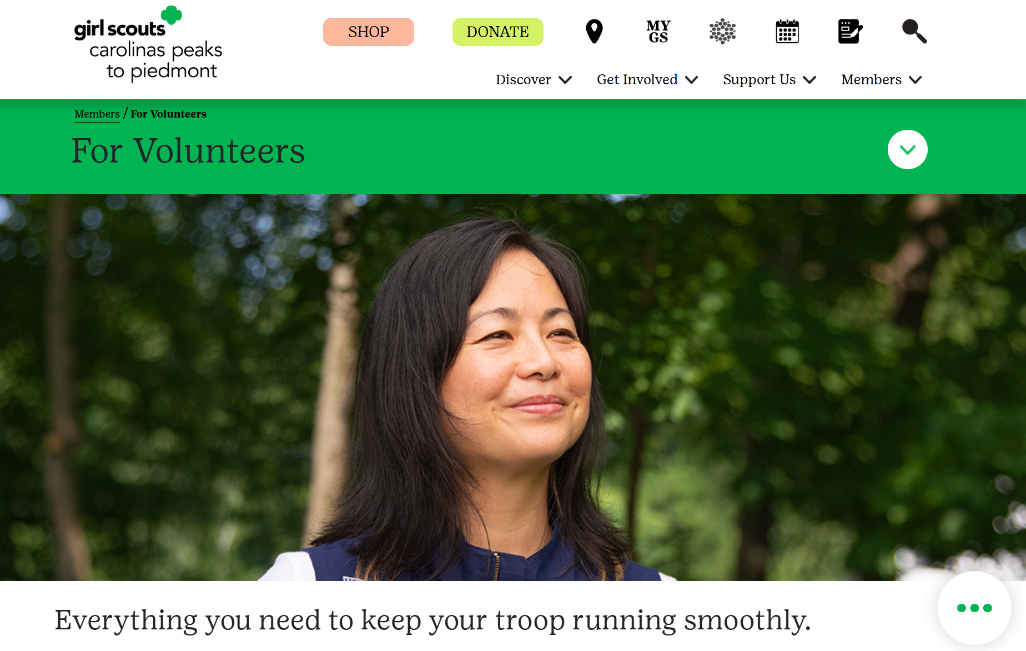

Rallyhood
Phase 1 implementation complete!
Phase 2: Integrating Stripe payment processor
Rallyhood Stripe Request Form coming soon!
Notes:
RALLYHOOD UPDATES
GSCP2P has successfully completed Phase 1. Thank you for encouraging members to join our platform. Our next, and final, onboarding step is to integrate Stripe into troop and service unit rallies. This will allow troops and service units to accept payments for dues, event registrations and more.
We are currently working on installing this feature with our early adopter group. Soon the form to request Stripe in your troop or service unit rally will be open to all troop and service unit volunteers. Requests will be completed in the order they are received, so stay tuned and keep an eye out for the Rallyhood Stripe Request Form in Today's Tips and on our Rallyhood information webpage at www.girlscoutsp2p.org. You can easily find this page by clicking on the rallyhood icon in the top menu.
We highly encourage your TCMs and SUCMs to join the rallies in Rallyhood for Cookie season. This is a great place for volunteers to share ideas/best practices and receive up to date information about the cookie program from council. Rallyhood is replacing TeamApp this year and all weather updates and inventory delays will be announced here.
Now, we would like to take a moment and see if you all have any questions on anything covered so far.

Slide 8

The Fall Product Program Updates
Notes:
We’re excited to share that we ended this year’s Fall Program with an overall flat sale. Even more exciting, we saw a significant increase in both nut order card sales and girl delivery items. That growth is a direct reflection of your dedication, creativity, and commitment to the girls.
Thank you for the countless hours you spent supporting your girls, sharing their stories, managing orders, and showing up week after week. Your efforts make a real difference in the lives of our Girl Scouts. We are so grateful for all that you do, and we couldn’t have done this without you. Congratulations on a job incredibly well done!

Slide 9


Girl Scout Cookie Program Updates
Upcoming Training Sessions
Cookies 101: December 2 at 6 p.m.
Digital Cookie- Girls/Parents:
December 9 at 7 p.m.
Digital Cookie- Troop Volunteers:
December 11 at 7 p.m.
Notes:
Give info and then invite anyone to ask questions here.

Slide 10
Girl Scout Cookie Program Updates
Important Dates
December
January
February
March/April
December 5– Troop initial order due in Smart Cookies
December 8 ⁻ Digital Cookie e-mails launched to both girls and troop volunteers
December 16 – Cookie Program begins
January 3 – Start of booth lottery selections
January 7– 10 – Cookie deliveries
January 10 – 18 – Walk-about week
January 12 – Cupboards open
January 16 – Booth sales begin
February 2 – Troops can begin changing proceeds and recognition plans in Smart Cookies
February 17 – Troops can begin creating recognition orders in Smart Cookies
March 1 – Program ends
March 5 – First ACH withdrawal
March 10 – Buy 5 entries due council
April 2 – Second/final ACH withdrawal
April 9 – ACH credits
Notes:
Believe it or not, Cookie Season is right around the corner! As you gear up in your role as Service Unit Cookie Manager — or support your Service Unit Cookie Manager — there are just a few important dates and next steps to keep on your radar.
Over the next few weeks, your Service Unit Cookie Manager will be reaching out to troops to make sure they have submitted their Initial Order. Troops may enter their Initial Order once their signed Troop Cookie Manager Agreement has been received. After that, an account will be created for them in the Smart Cookies platform so they can move forward.
Initial Orders must be submitted between now and December 5th — this is a firm deadline, so please help your troops plan ahead and enter their orders as early as possible.
The Digital Cookie email will go out on December 8th. While girls will be able to start setting up their accounts, selling will not officially begin until December 16th.
Here as a reminder are some of the key dates to keep in mind as we move into this year’s Cookie Program.
Thank you, as always, for your leadership and support — we couldn’t do this without you!

Slide 11
Daisies/Brownies/Juniors
12/6 Rutherfordton: SubZERO Effect - Using liquid nitrogen, we'll shatter a ball, make an explosion, and examine the three states of matter!
12/13 Rutherfordton: Aeronautics - Launch into learning while exploring the nature of things that fly!
1/3 Greensboro: UNCG Women's Basketball Girl Scout Day
1/9 Hickory: Sing in the New Year – Kick off 2026 right with a day of Girl Scout Songs and traditions.
1/9 Greensboro: Cookie Kickoff! *Link coming soon!
1/10 Rutherfordton: Rainforest Adventures

Slide 12
Cadettes/Seniors/Ambassadors
12/6 Rutherfordton: SubZERO Effect - Using liquid nitrogen, we'll shatter a ball, make an explosion, and examine the three states of matter!
12/13 Rutherfordton: Naturally ART-ificial - This dynamic program encourages creativity and critical thinking through the creation of a nature inspired robot! Girl Scouts will gain an understanding of the engineering design process and circuitry. 1/3 Greensboro: UNCG Women's Basketball Girl Scout Day
1/9 Hickory: Sing in the New Year – Kick off 2026 right with a day of Girl Scout Songs and traditions.
1/9 Greensboro: Cookie Kickoff! *Link coming soon!
1/10 Rutherfordton: Rainforest Adventures

Slide 13
Upcoming Adult Trainings
12/3 Virtual: Adult Awards Information Night
12/4 Virtual: Volunteer Toolkit info Night
12/11 Virtual: Gold Award Training
12/17 Virtual: Adult Awards Information Night
1/5 & 7 Virtual: Youth Mental Health First Aid – support the kids in your life by learning how to spot the warning signs for a mental health challenge. Registration coming soon!

Slide 14

Board Approved Awards
Notes:
KIM STIKELEATHER

Slide 15
Who can be nominated?
Anyone who meets the specific award criteria
Any active, registered, Girl Scout volunteer in good standing
Who can nominate?
Anyone but the volunteer themselves
How do I nominate?
Using the online nomination form and
Endorsement form found on our council's
webpage under Forms.
Deadline:
February 1
How do I choose the right award?
Direct service to girls
Volunteer of Excellence
Fantastic Volunteer
One Service Unit
Appreciation Pin
Goes above and beyond
Where is their impact?
Two Service Units or Communities
Honor Pin
Entire council or Girl Scout Movement
Thanks Badge

Slide 16
Writing Nominations and Endorsement Letters
DO
Nominate a person only for one award.
Nominate someone you know who is deserving and meets the requirements of the award.
Be specific in what you write.
Fill out the entire nomination form, sharing what the nominee has done that is above and beyond their position/role.
Ask people to write letters of endorsement.
Coordinate with people writing letters and submitting nomination form. Details need to be on the nomination form.
Ensure the Nomination and Letters of Endorsement are submitted by on-time.
DON'T
Nominate someone who has received an award in the last two years.
Nominate someone who does not meet the requirements.
Just make a list.
Nominate someone you do not know.
Leave questions on the nomination form blank.
Include information about what they do for other organizations.
Wait until the last minute to ask for letters of endorsement.
Submit the same letter for different people.

Slide 17

Retail/ Mobile Shops Updates
Reminder! Cookie Dough Expires on 12/12/2025.
Drop by the store or mobile shop near you or use the GSCP2P Shop Order Form and a Business Operations staff member will contact you to process your order.
Upcoming Mobile Shops & Special Shop Hours
Cookie Expo & University Mobile Shop
12/6 9 a.m.-3:30 p.m.
Black Mountain, NC
Triad Shop Open
12/14 3:30-4:30 p.m. for SU 147 & 148
Forsyth Cookie Rally Mobile Shop
Winston Salem
1/14 2-5 p.m. for SU144
Cookie Rally Mobile Shop
Connelly Springs
1/4 3-5:30 PM for SU129
Want to schedule a mobile shop? Check out our website and request a mobile shop today!
A huge congratulations to Tiffany, a Girl Scout Cadette from Troop 10182, for winning this year's Cookie Hoodie Design Contest! Pre-order your cookie hoodie by Sunday, November 30! All orders are available for delivery or pick-up in mid-December.

Slide 18
Service Unit XXX
Budget Updates
Updates on your SU's Bank Account

Slide 19
Service Unit Announcements

Slide 20
Upcoming Service Unit Dates and Events

Slide 21
Next Steps
Questions?

Slide 22
Thank you for joining us!
Next Meeting:

