Slide 1






Service Unit Meeting
DATE

Slide 2
Welcome!

Slide 3
Tonight’s Agenda

Slide 4
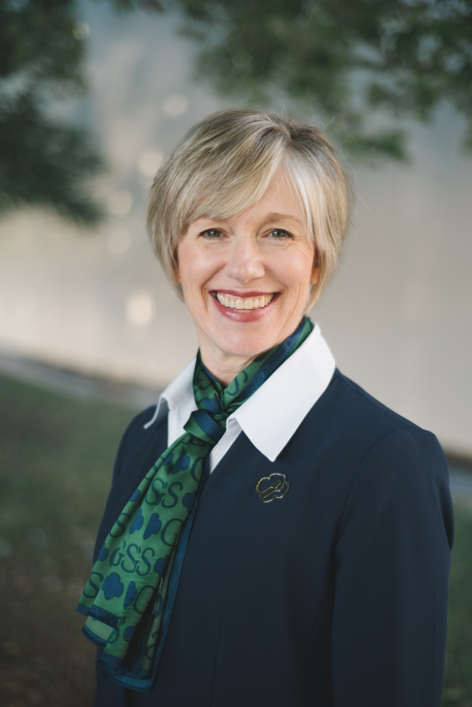

CEO Updates
Notes:
Elaine’s remarks

Slide 5

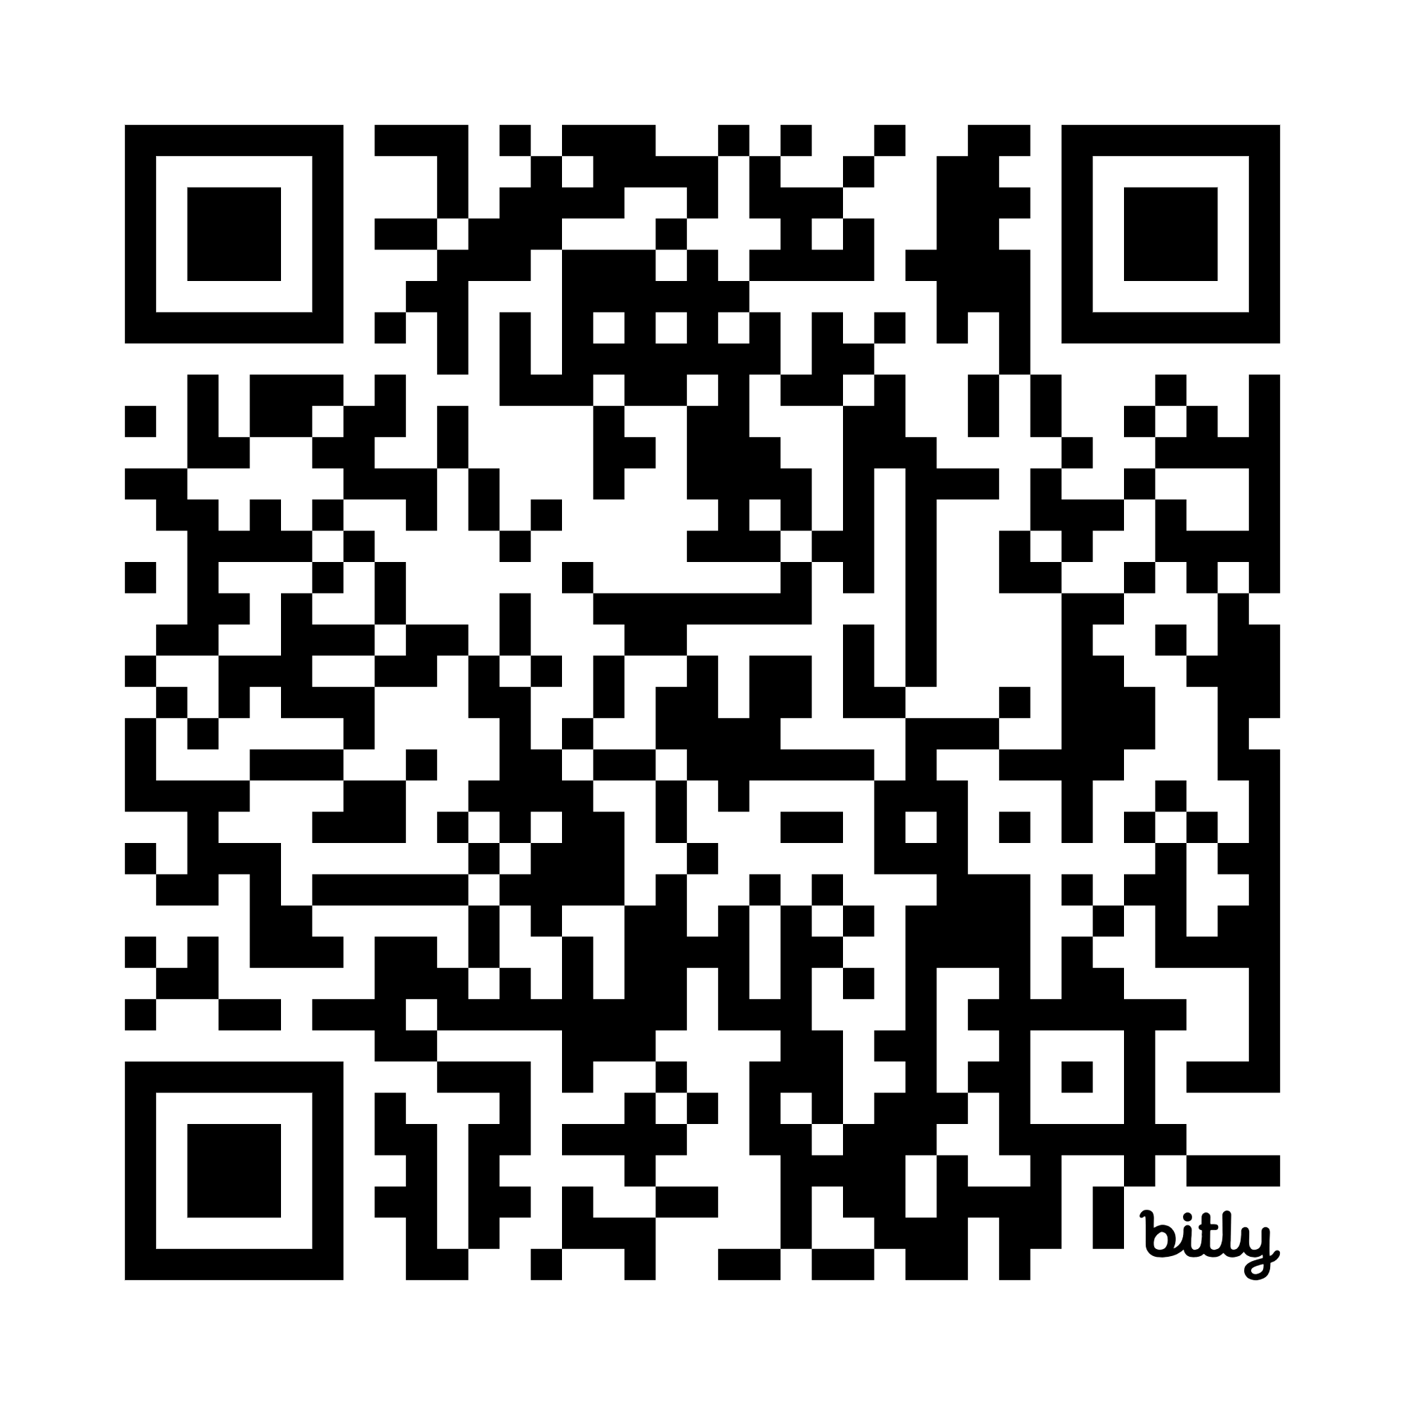
New!
GSCP2P Wants to Know Survey

Slide 6


Thank you for joining us at the
Save the date for next year's Annual Meeting in April 2027 and
stay tuned for the location!
Notes:
Thank you to everyone who attended Annual Meeting this past Saturday. We particularly want to say thank to the girls and volunteers who provided center pieces, ceremony support, our service unit and national delegates and attendees who took part in the roundtable topics. We would also like to extend an additional congratulations to the 17 volunteers who received a national award on Saturday. More information will be coming soon about our 2027 Annual Meeting plans.

Slide 7
GSCP2P Membership Updates
Renewed girls = 4068
New girls = 1391
Total girls = 5459 (currently down 607 YOY)
Total GSCP2P Members (Girls + Adults) = 9885 (currently down 6.9% YOY)
Where have we gained? Lifetime members up almost 5% (adults by 9, alum by 39 and 10+volunteers by 41)
New Troop Total = 32
Spring Renewal Numbers = 677 girls / 2803 total
Extended Year Number = 29 girls / 53 total
Need help renewing? Call your Engagement Manager at 800-672-2148 or join us May 18, 19, 25 or 26 for Office Hours from 6-7 p.m.
Notes:
SANDI: A quick update for everyone. Lifetime member push. Office hours added! May 18 & 19 and May 25 & 26 6-7pm

Slide 8
Service Unit XXX Membership Updates
As of...
Membership Year 2026
Girl Goal -
New Troop Goal -
As of …
MY26 Girl Membership –
New Troops –
Spring Renewal Goal and Numbers –
Extended Year Goal and Numbers –

Slide 9

SPRING RENEWAL
Notes:
All Girls who renew their membership during April 1 – May 31, 2026, will receive an automatic discount of $20 off their membership during the renewal process and a patch. Those girls who earned their MY27 membership through the cookie program will also receive a patch.
Every volunteer that renews between April 1 - May 31, 2026, will receive free admission to the Volunteer Conference August 1, 2026, including our Lifetime members. We will provide a code to be used during registration for this discount.
Every SU that meets their spring renewal girl goal will receive a $200 program or store gift certificate.
For every girl over the Service Unit's Spring Renewal goal, the SU will also receive $10 bonus.
I have had several questions about using financial aid for renewals. When renewing, they will select financial aid as payment and receive an email for next steps. These girls will receive the early bird patch, if the process is completed during April/May.
Office Hours again May 18 & 19, 25 & 26 6-7pm. On Zoom.
NEW EXTENDED YEAR INCENTIVE – Each SU that meets their extended year girl goal will receive a $50 program/retail gift certificate. Additionally, for every girl over their goal, they will receive a $5 extra bonus.

Slide 10

CELEBRATE GRADS
Lifetime Membership is 50% for young alums!
Notes:
Graduating Girl Scouts can enjoy a lifetime membership for $200—our discounted rate for alums under age 30. Best of all, your grad will get all the benefits of membership for years to come, like travel adventures, campus Girl Scouts and more!
Encourage graduating Girl Scouts to submit their Post Grad Plans with us! We'll give them a special shout out on social media but also provide the option to stay connected through our P2P young alum opportunities.

Slide 11
SU TEAM UPDATE
Rallyhood Top Contributors:
SU 146, SU 127 and SU 141
Coming Soon:
NEW SU Plan of Action forms
Please remember this first draft is due July 1, 2026. ***Date change due to SU Retreat.***
Coming Soon:
NEW End of Year forms
(which includes your troop financial report for what was carried out in MY26, troop updates for MY27 and a financial summary)
Notes:
Again, Thank you for continuing to be advocates for Rallyhood!

Slide 12
“Where Service Units Grow” Service Team Retreat
2026
Volunteer Conference
Saturday, May 30
10 a.m. - 3 p.m.
Monticello Community Church,
Statesville
Registration open!
Where Service Units Grow (Statesville)
Saturday, August 1
10 a.m. - 3 p.m.
Monticello Community Church,
Statesville
Registration opens June 5!
Notes:
Read and encourage to join!

Slide 13

Summer Camp
Overnight camp is for rising grades 2-12.
Overnight campers joining us June 21-26 or July 12-17 can request free transportation assistance from the Asheville or Hickory Service Center. Transportation assistance requests are due May 17.
Day camp is for rising grades 1-5 and will be hosted in Black Mountain, Greensboro, Hickory and Winston-Salem.

Slide 14


Rallyhood
& Summer Camp
Now is a great time to encourage volunteers and families to join Rallyhood as we approach local end of year celebrations and summer camp.
This summer, parents will be able to view photos of their camper while they are away at camp through Rallyhood. We will send an invite to access your camper's session prior to their arrival.

Slide 15
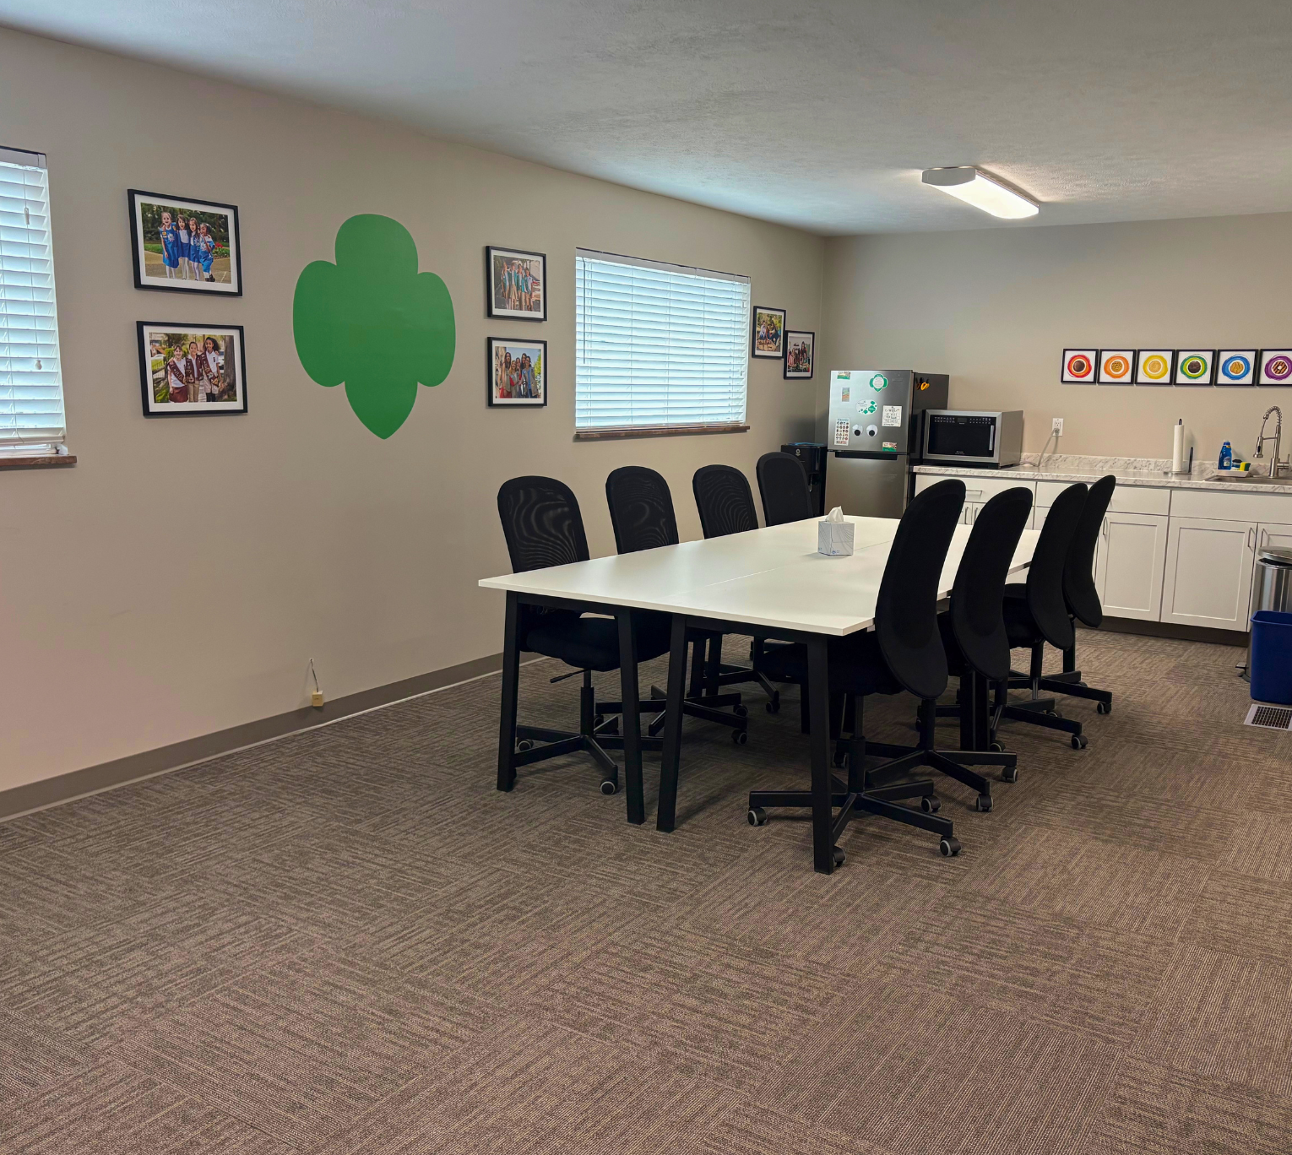
Asheville Experience Center
We are excited to announce a NEW resource to accommodate troop travels- the Asheville Experience Center! This space can be reserved for free and provides a unique space for troop sleepovers, meetings or programs.

Slide 16
Camp Property Updates
Camp Ginger Cascades
Current Projects:
- Rocky Ridge Roofs
- Dining Hall Roof
- Dining Hall/Troop House Decks
- Trail Clean Up
- Clean/Sterilize Water System
- Repair Road
- Director’s House
- Pool

Slide 17
Camp Property Updates
Keyauwee Program Center
March 28 Volunteer Day= 52 volunteers
Current Projects Around Camp:
- Pool Repairs
-Fixing Cracks
-Repairing Tiles and Grout
-Painting the Entire Pool
- Amphitheatre Stage Demo
- Dining Hall Retaining Wall Rebuild
- New Roofs on Savannah, Caraway and Climbing Shed
- Sally Williamson Flooring Shoring
- New Run-In Shelter at Circle C
- Nature Center
-"Summerizing" Camp

Slide 18
Camp Property Updates
Camp Pisgah
New Ranger- Charlie Alsup
- Working on getting water back on.
Water Inspection Passed!
-Total Coliform is very common and comes from any growth in the water lines due to stagnancy or intrusion from outsides sources (i.e. broken lines). It is NOT E. Coli.
May 9: Camp Pisgah Volunteer Workday!
May 5: Registration Opens for Troop Reservations!
May 15: Camp Pisgah Officially Re-opens!
Programming will be limited this summer to self-guided programs. (Archery, Boating, Arts & Crafts and Nature Hikes)

Slide 19
Outdoor Experience Updates
Plan for Future Programming
Fall 2026:
- Hire 5 Programmers (3 at CP and 2 at KPC. Will add more when CGC opens.)
- Programmers will be trained in all programming on camps:
- Lifeguarding
- Boating
- Challenge Courses (Adventure Course & Cooperation Courses)
- Archery
- Climbing Wall
Spring 2027:
- Start offering trainings for volunteers at camp for various camp activities.

Slide 20

Girl Scout Cookie Program Updates
Notes:
Thank you to all our amazing volunteers for a great 2026 Cookie Program. Your time, flexibility, and dedication—especially through challenges—made this a successful cookie season.
We appreciate all you do to support our girls and this program!
Cookie Dough/Daisy Dollar emails were issued last week.
GEO event details and registration email will be sent out this week.
ACH Credits were issued last Thursday to troops. This included:
Crossover Promotion Credit- Troops who participate in the 2025 Fall Product Program and sell at least 100 items will receive an additional $0.05 per package of cookies sold during the 2026 Cookie Program.
Overpayment Credits – For troops with higher credit card sales, the council may owe funds back to the troop due to overpayment.
Troop Additional Proceeds- Recognition level troop credits- 425 package level for $15 and 3, 000 package level for $500
Bonus Proceeds (Cookie Program Extension Bonus)-
$0.10 per package: Increase PGA by 50+ packages and exceed 2025 total
$0.20 per package: Increase PGA by 100+ packages and exceed 2025 total
If you have questions about these amounts or did not receive an e-mail please email info@girlscoutsp2p.org

Slide 21

Girl Scout Day at Wet n' Wild
Saturday, June 6, 2026
Tickets Available This Week!
All members are invited to splash into summer with discounted waterpark tickets and a special celebration honoring Girl Scouts who reached G.E.O. status (500 packages or more) during the Girl Scout Cookie Program.

Slide 22

Summer Game Days
Summer nights at the ballpark are approaching with the 2026 baseball season kicking off! Girls of all ages and their families are invited to enjoy the excitement of America’s pastime during special Girl Scout Nights across the region.
We’re also partnering up with other sports teams for more
Girl Scout Nights this summer and bringing a new patch program too!
New sports patch program coming this May!
Notes:
We already have game nights booked with the Gastonia Ghostpeppers, Winston-Salem Dash, Burlington Sock Puppets, Greensboro Grasshoppers, Hickory Crawdads, and Charlotte Knights baseball, The Groove Women's Basketball and NC Courage Women's Soccer. Plus more games are in the works!

Slide 23

Summer Adventure
Keep Girl Scouts engaged this summer with screen-free fun and a "Bucket List" of activities!
New patch program coming this summer!

Slide 24

Money Earning Booklet

Slide 25
Daisies/Brownies/Juniors
May 2 – GS Day at the NC Transportation Museum, Spencer
May 9 – Brownie Day Camp at the Little House, Brevard
June 6 – Girl Scout Day at Wet n’ Wild, Greensboro
June 13 – Council-wide Bridging and Family Fun Day, Keyauwee Program Center, Sophia
Girl Scouts doesn’t stop just because school is out. Stay connected through our Tuesday Explorer Series! Girls can join us virtually every Tuesday night for a troop meeting or head out on an adventure with one of our community partners. Our full summer calendar is coming soon—stay tuned!

Slide 26
Cadettes/Seniors/Ambassadors
May 2 – GS Day at the NC Transportation Museum, Spencer
May 7 – Gold Award Training, Virtual
May 16 – Her Future, Her Impact: A Girl Awards Gala, Dobson
June 6 – Girl Scout Day at Wet n’ Wild, Greensboro
June 9 – Gold Award Training, Virtual
June 12 – Power of Engineering with Doosan Bobcat, Statesville
June 13 – Council-wide Bridging & Family Fun Day, Keyauwee Program Center, Sophia

Slide 27


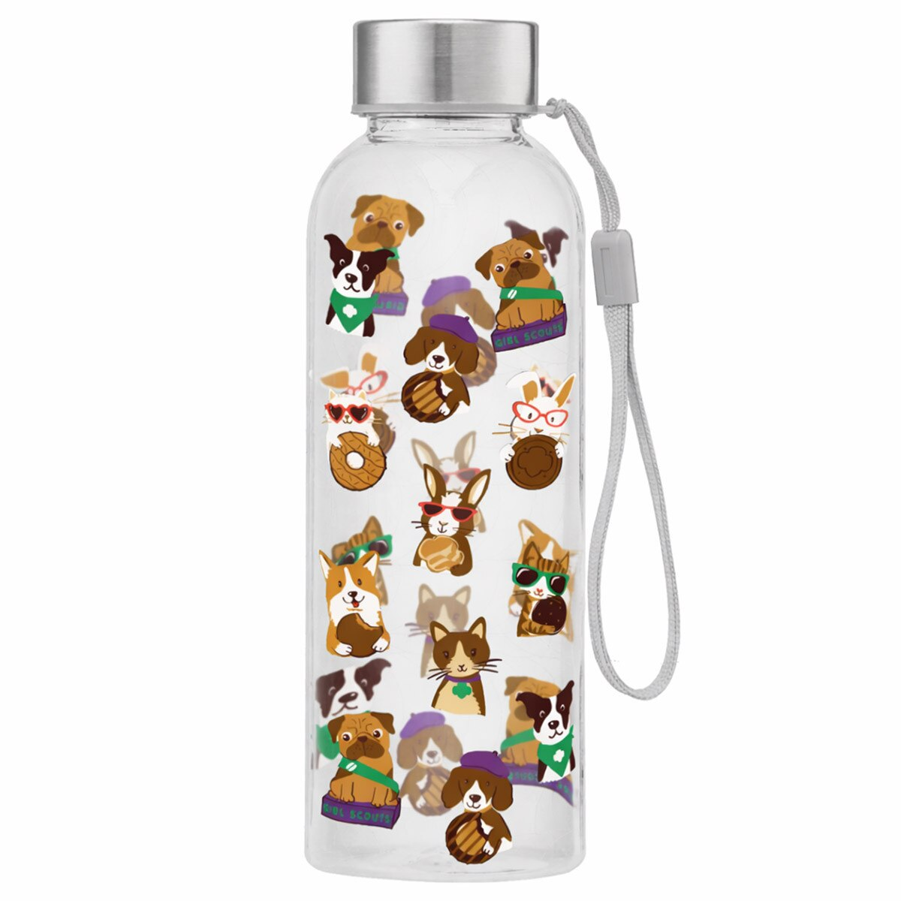

Retail/ Mobile Shops Updates
New Merchandise Coming Soon!
Want to schedule a mobile shop? Visit our website and request a mobile shop today!

Slide 28
Service Unit XXX
Budget Updates
Updates on your SU's Bank Account

Slide 29
Service Unit Announcements

Slide 30
Upcoming Service Unit Dates and Events

Slide 31
Next Steps
Questions?

Slide 32
Thank you for joining us!
Next Meeting:

