Slide 1









Service Unit Meeting
DATE
Please enter your name, Service Unit number and Service Team position in the chat!

Slide 2
Welcome!

Slide 3
Tonight’s Agenda

Slide 4




Rallyhood!
Apologies for Zoom Issues – Training not able to be held on the 18th
Admin Training to be rescheduled ASAP
Need tutorials now? They're on YouTube and each tutorial is short! https://www.youtube.com/watch?v=cIMHUn3rzq8&list=PL5AHxZ1pqzMzeXz98219vyu-2N4wO3qcu
YouTube may have some ads but you can click on the trainings that are right for you!

Slide 5


Property Updates
Pisgah and Ginger Cascades are set to begin Winterizing procedures in October
KPC is winterized at the end of the fall season
Interested in serving on a Volunteer Task Force to help provide certified volunteer instruction for high adventure at our camps?
  Idea from Tina "Dakota" Barber and it's a great one!
  Working to see if there is interest
  Look for information to come out soon to express interest in serving on Task Force that will examine the possibilities.

Slide 6
Fund Development Updates
Carrie Harrison, Individual and Family Giving Volunteer Chair
Items Carrie is working on:
Re-establishing connections that were lost through pandemic with each Service Unit
Re-establishing connections with donors who have given in the past
Helping to ensure we are increasing our presence with the local community
Total Fund Development Goal: $400,000 – increase of 202%

Slide 7
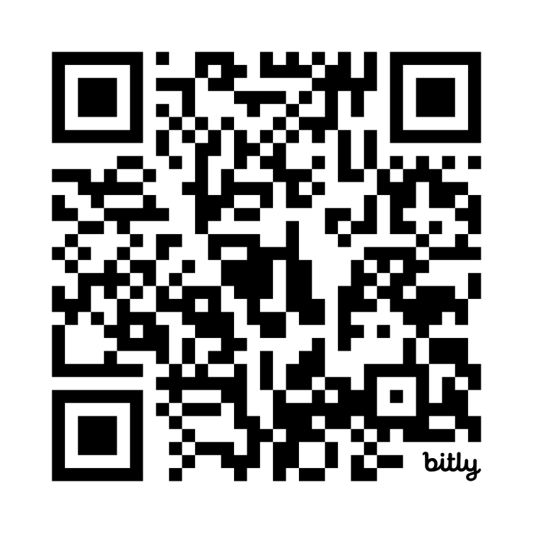
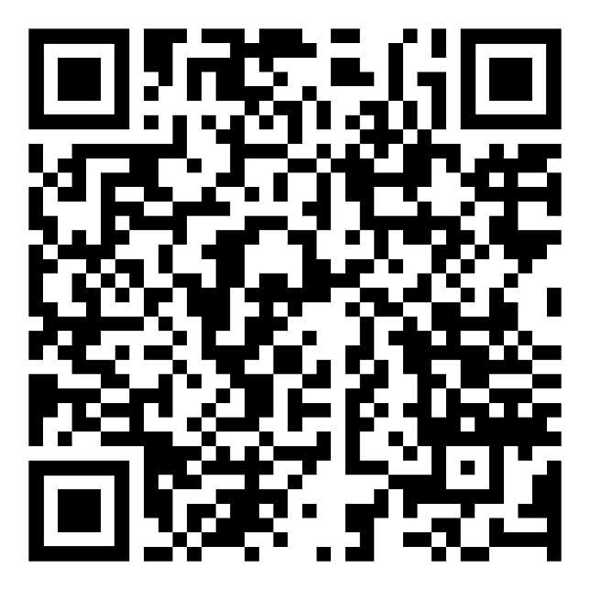
Fund Development Updates
Launch two Individual Campaigns:
1. Camp Magic – to donate for maintenance and repairs – can select in honor of your favorite camp and help us with some of the much needed repairs.
Goal: $100,000 – and we are 10% toward our goal for the year
2. Friendship Fund: Unrestricted fund for Financial Assistance- Girl and Adult Membership Dues, Background Screenings, Program and Camperships!
GSCP2P also has a new partnership with CSM Philanthropic, LLC to develop a full Fund Development strategy so look for more information at SALT Meetings that you can share with your troops!
QR Code the Camp Magic Fund!
QR Code for Friendship Fund!

Slide 8
Fund Development Updates
If you haven't made a donation this year, please consider.
Make a recurring gift monthly and become an Evergreen Circle Member – information in the giving platform to set up an automated donation each month.
BECOME A JULIETTE CIRCLE MEMBER!
Members who donate $88 dollars per month through Evergreen Circle OR
$1000 or more
Receive a recognition Juliette Circle Pin
SAVE THE DATE!
Juliette Circle Thank You Dinner – December 19 at the Hickory Country Club!
  Honor one Individual Donor and one Corporation or Foundation!
  Hear from a Girl Scout on the impact Girl Scouting has had
  Network and connect to forward the movement of Girl Scouting

Slide 9
GSCP2P Membership Updates
MY25 Membership:
Girls- 6304 (93.4% of 6750)
Adults- 4637 (101.4% of 4572)
MY26 Membership as of 9.21.25:
Girls- 3905 (8.5% down from last year- 4271)
New: 403 this year vs. 586 last year
Renewed: 3502 this year vs. 3685 last year
Congratulations to SU 124 and SU 134 that have ALREADY achieved their ON TIME GOAL!
Shout out to SU's 114, 118, 125, 132, 141 - all almost to goal and well over 90%!
Notes:
You will see that we have kicked off MY26 memberships and we have had a slow start to our new girl recruitment after an amazing spring renewal period as we are currently down about 8.5% from last year at this time. Please reach out to a member of your Engagement team if you can assist us in recruitment efforts throughout our council. BUT we are celebrating with SU 124 and SU 134 that have ALREADY achieved their ON TIME GOAL! And a shout out to SU's 114, 118, 125, 132, 141 who are all almost to goal and well over 90% there! Way to go!!

Slide 10
Service Unit XXX Membership Updates
Membership Year 2025
Total Girl Goal -
Total Adult Goal -
As of...
MY25 Girl Membership –
MY25 Adult Membership –
For a Total of
Membership Year 2026
Girl Goal -
New Troop Goal -
As of …
MY26 Girl Membership –
New Troops -

Slide 11
SU TEAM UPDATE
September/October:
Make sure the SU Team votes on a budget and then presents to troops at SU Meeting.
Delegates:
October is the time to elect! After election – delegates go in and select the role in Volunteer Systems – reach out to us if you need assistance.

Slide 12

The Fall Product Program Started September 15!
Notes:
Please encourage your troops to participate—it’s the perfect way to earn start-up funds before cookie season begins!
Troop Earnings:
15% of all proceeds for participating troops
Up to 18% if troops choose to opt out of rewards for higher proceeds
This is an easy, impactful way to build excitement, practice skills, and give girls a head start on reaching their goals before cookies even launch!

Slide 13

Our goal is to have 1000 more of our Girl Scouts participate in the
Fall Product Program this year!
Service Unit Meeting Agenda Item- Fall Product: What Skills do your Girl Scouts gain?
By doing this program, you can EASILY complete LOTS of badges- and not just Cookie Badges.
BADGE MEETINGS AVAILABLE WITH COOKIE MATERIALS to help you earn at EVERY LEVEL.
MOST IMPORTANT: TROOP EARN NEEDED FUNDS FOR FALL AND WINTER EXPERIENCES!
Girls GAIN real E-COMMERCE experience, make their own Online Store and Avatar and gain real world experience in TODAY's Business world – which is all WEB BASED!

Slide 14

Council-Wide Camp Out Updates
Council-Wide Campout venue changes due to property challenges at Camp Pisgah; you can find registration and more information for 2 new events on the Online Calendar
  Fall Festival at Girl Scout Little House in Brevard on October 18 from 2-5 p.m.
  Council-Wide Campout at Dale Earnhardt Environmental Leadership Campus at Oak Springs in Statesville, October 25-26
Notes:
Thank you for all your great promotion of our September events after last SALT meeting. Our Girl Scouts Love State Parks events filled up very quickly with nearly 450 registrations for girls and adults (including a wait list) and we had 134 registrants for the KPC 80th birthday we held on Saturday. We hope that you and your troops had a great time celebrating at all those events!
We did want to let you all know about changes to our upcoming Council Wide Camp Out planned for October. Due to the continued property challenges at Pisgah we are unable to host the camp out there but we are excited to share with you two alternative options for you and your troops. Registration should be live now on our calendar.
Girl Scout Spirit Day
Girl Scout Little House
Brevard, NC
Kick off the new Girl Scout year with an afternoon of traditional Girl Scout activities, fall fun in the field and celebrating what it means to be a Girl Scout in beautiful Brevard! A sweet treat will help us celebrate the historic milestone of the 77th anniversary of the Little House grand opening. Bring your family, invite your friends and join us for this joyful, family-friendly event open to all Girl Scouts and their families!
Saturday, October 18 2-5 p.m.
Girl Scout Little House
251 Lakeview Avenue, Brevard, NC 28712
And then, the following weekend, join us for an unforgettable Council-Wide Camp Out at The Dale Earnhardt Environmental Leadership Campus at Oak Springs! Gather your troop and fellow Girl Scouts for this exciting weekend immersed in camp classics like archery, boating, campfires, s’mores and more! Enjoy a full day of adventure with lunch and dinner on Saturday and a hot breakfast on Sunday.
The Spring 2026 troop and service unit camping calendar opens October 10th! Register for your camping weekend on our new system CampLife

Slide 15

Daisies/Brownies/Juniors
  10/11 Greensboro: Grow, Glow and Connect - International Day of the Girl Celebration
  10/14 Virtual: Power of Me (for Juniors) – Presented by MADD, introduces skills to make healthy choices in the face of peer pressure.
  10/15 Virtual: Safe Sitter Safe@Home (Junior) – Learn the skills needed to be safe at home alone or while supervising siblings.
  10/18 Brevard: Girl Scout Spirit Day
  10/21 Virtual: Sharks, Science & Service – Talk with Ocearch marine biologists about conservation and cutting-edge technology.
  10/25 KPC: Horses in STEM (Juniors)
  10/25-26 Statesville: Council-Wide Camp Out
Notes:
Be sure to check out our program calendar for exciting programs for every level. We have some great programs for Daisies Brownies and Juniors coming up, including Grow, Glow and Connect – an International Day of the Girl Celebration and the Cookie Expo, where Girl Scouts practice their five entrepreneurial skills AND they will get to taste the new cookie!

Slide 16

Daisies/Brownies/Juniors
  11/1 KPC: Brownie RIIT Explorers
  11/8 Gastonia: Hero In You – Grow your super-powers while earning the Healthy View, Healthy You patch.
  11/9 Winston-Salem: Science of Roller Skating – Family fun on wheels. Registration coming soon!
  11/11 Virtual: Sharks, Science & Service – Talk with Ocearch marine biologists about conservation and cutting-edge technology.
  11/22 KPC: No Horse No Problem! Model Artist Show
  12/6 Black Mountain: Cookie Expo – Get ready for the Girl Scout Cookie program and flex those entrepreneurial muscles.

Slide 17


Cadettes/Seniors/Ambassadors
  10/11 Greensboro: Balance, Bravery, Belonging - an International Day of the Girl celebration
  10/15 Virtual: Safe Sitter Safe@Home (Cadettes) – Learn the skills needed to be safe at home alone or while supervising siblings.
  10/16 Virtual: Power of Youth – presented by MADD, teaches the skills teens need to make safe choices around underage drinking and driving.
  10/18 Brevard: Girl Scout Spirit Day
  10/18 KPC: Barn Rat Olympics - RIITs, get ready to put your horse knowledge and barn skills to the test at the Barn Rat Olympics!
  10/21 Virtual: Highest Awards Info Night - Learn more about earning your Bronze, Silver, or Gold Award
  10/23 Virtual: Sharks, Science & Service – Talk with Ocearch marine biologists about conservation and cutting-edge technology.
  10/25-26 Statesville: Council-wide Camp Out
  10/29 Virtual: Passport to Destinations – Learn about international travel opportunities
Notes:
We also have some fabulous programs for our Cadettes, Seniors and Ambassadors. Girls can talk with a marine biologist during out Sharks, Science and Service events, earn their Program Aide Award or become a Babysitter Boss. Girl Scouts can also join us in Black Mountain to build on their Cookie Program skills while creating their own business.

Slide 18
Cadettes/Seniors/Ambassadors
  11/1 Virtual: Program Aide Award – Cadettes lay the foundation for earning their Program Aide Award.
  11/4 Virtual: Power of Youth – presented by MADD, teaches the skills teens need to make safe choices around underage drinking and driving.
  11/9 KPC: Cadette Animal Helpers Badge
  11/9 Winston-Salem: Science of Roller Skating – Family Fun on Wheels – Registration coming soon!
  11/9 Virtual: Safe@Home (Cadettes) – Learn the skills needed to be safe at home alone or while supervising siblings.
  11/13 Virtual: Sharks, Science & Service – Talk with Ocearch marine biologists about conservation and cutting-edge technology.
  11/17 Virtual: Highest Awards Info Night – Learn more about earning your Bronze, Silver or Gold Award
  11/19 Virtual: Safe Sitter – Earn your Cadette Babysitting Badge and Safe Sitter certification.
  11/22 KPC: No Horse No Problem! Model Artist Show
  12/6 Black Mountain: Cookie University – Take your cookie skills to the next level. Create your own business and roll the dice to see where life takes you.

Slide 19
Upcoming Adult Trainings
10/4 Asheville: Basic Camping Skills License & First Aid/CPR
10/6 Virtual: Gold Award Training
10/21 Virtual: Lead the Change Highest Awards Info Night
10/29 Virtual: Destinations Info Session
11/6 Virtual: Power of Parents – Presented by MADD. Learn how to support your teen in making smart choices about underage drinking and peer pressure.
11/6 Virtual: Gold Award Training
11/8 Hickory: Basic Camp Skills
11/17 Virtual: Lead the Change Highest Awards Info Night
12/8 & 10 Virtual: Youth Mental Health First Aid – support the kids in your life by learning how to spot the warning signs for a mental health challenge.
12/11 Virtual: Gold Award Training
COMING SOON: Troop and Service Unit Role Trainings
Notes:
For volunteers - we have one more opportunity for volunteers to take their Basic Camp Skills course coming up in October. We have a special enrichment opportunity for all volunteers presented by Mothers Against Drunk Driving about how parents can support teens in making smart choices around underage drinking and driving. And in December we will offer Youth Mental Health First Aid. Coming soon will be specialized trainings for all troop and SU roles. We won’t have all trainings ready to go at the same time but will roll out as they are finished.

Slide 20
GSUSA Leadership Awards Updates

Slide 21
Click icon to add image
Girl Scouts grades 4-12 practice leadership their way—for themselves, with their team and in their community.
“I get to have great leadership experiences in Girl Scouts” ~current Girl Scout member
Notes:
You all know that we as Girl Scouts have a special opportunity to strengthen how we teach Girl Scouts to lead – themselves, others and their communities.

Slide 22
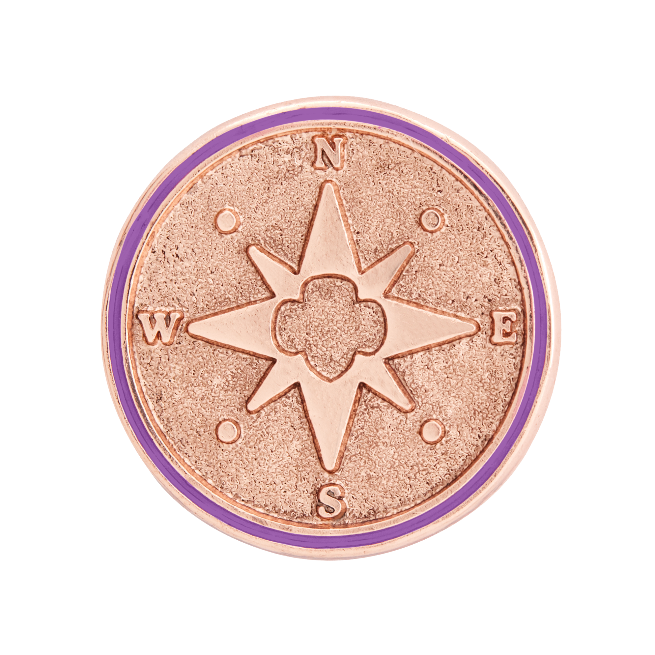

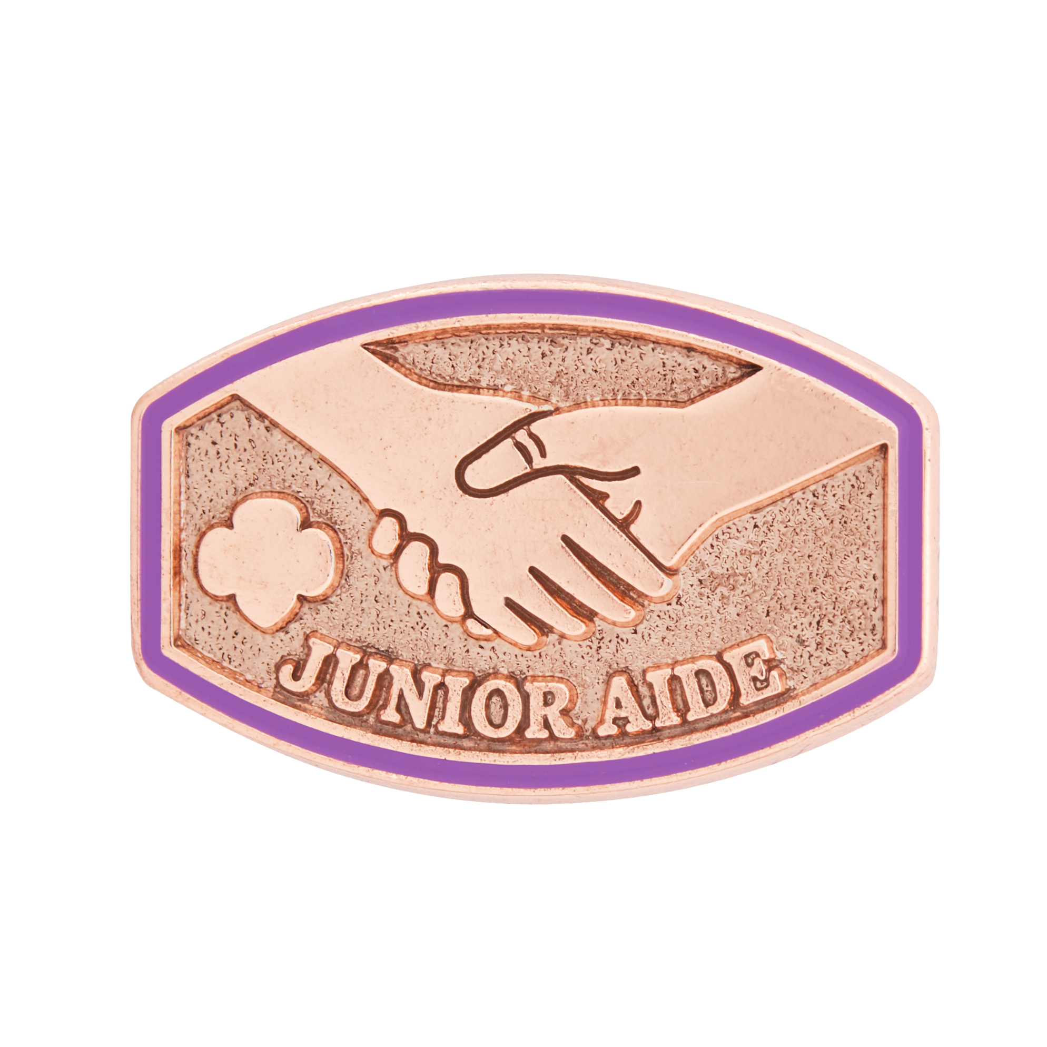




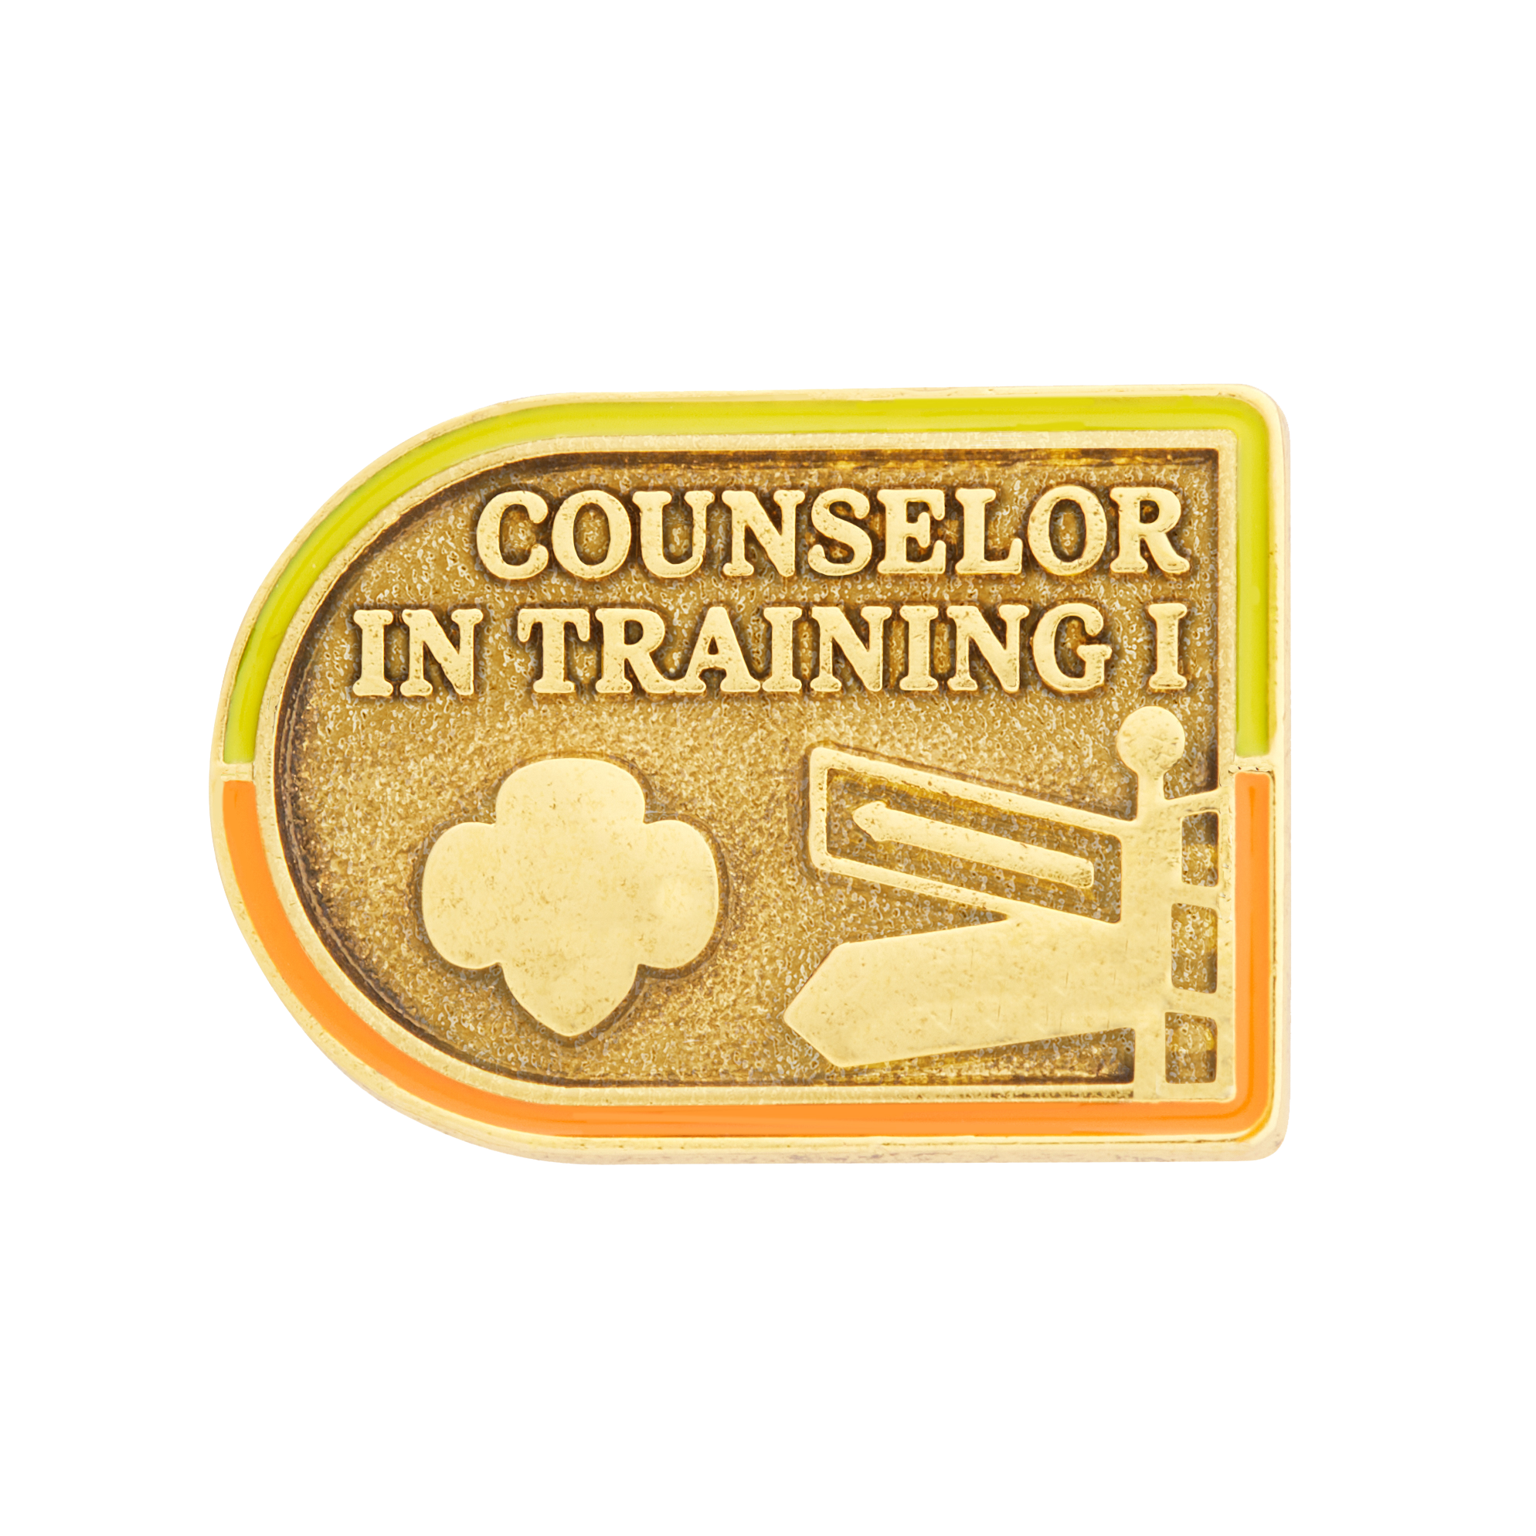
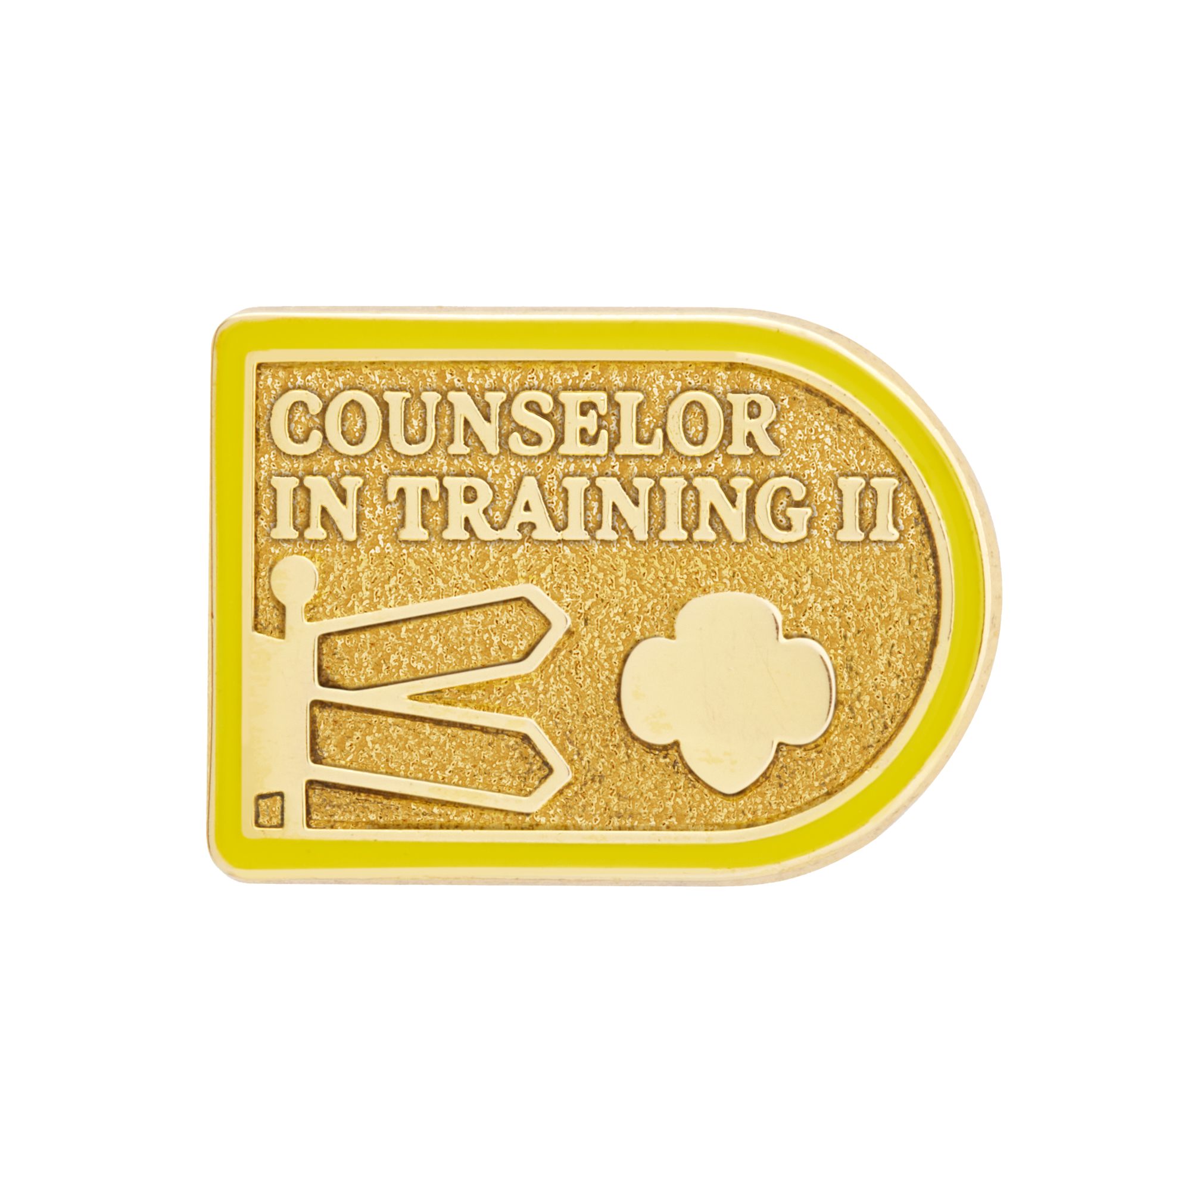
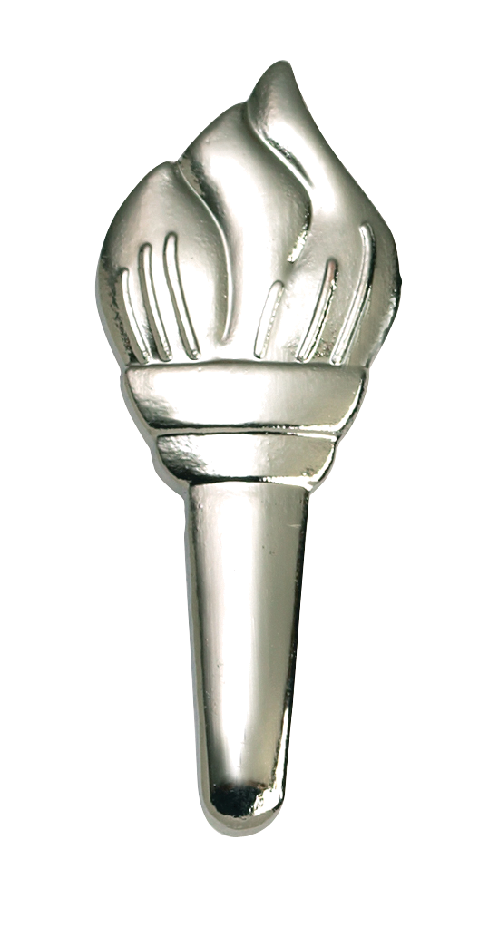

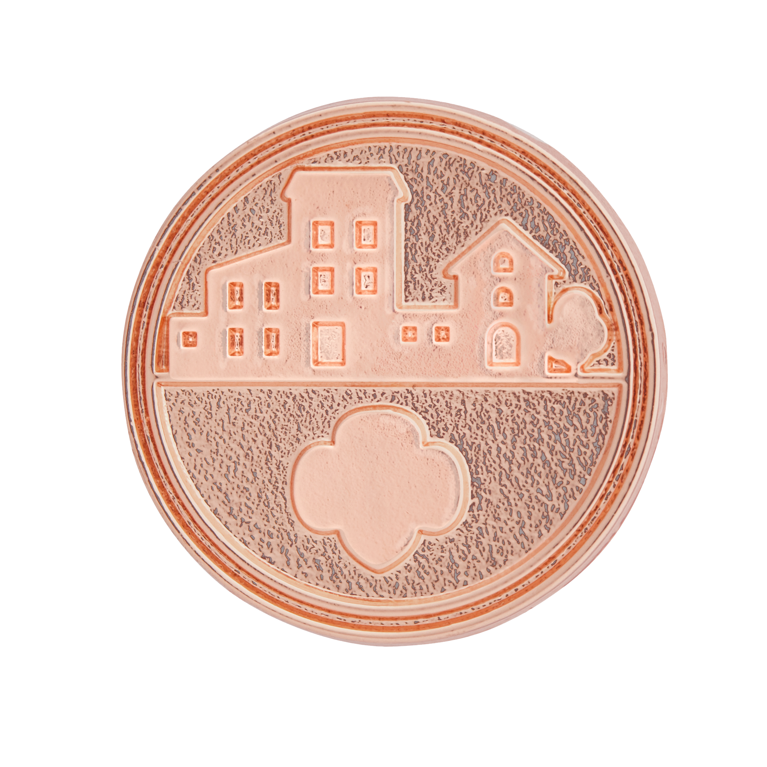
New and Updated Leadership Awards
Notes:
VALERIE:
Tonight, we are going to review the following new and updated program content including New and Updated Leadership Awards

Slide 23
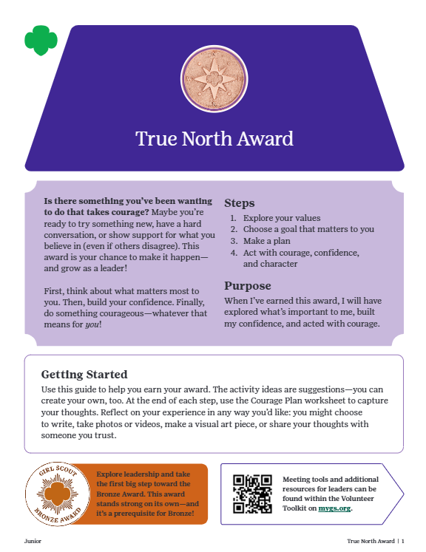
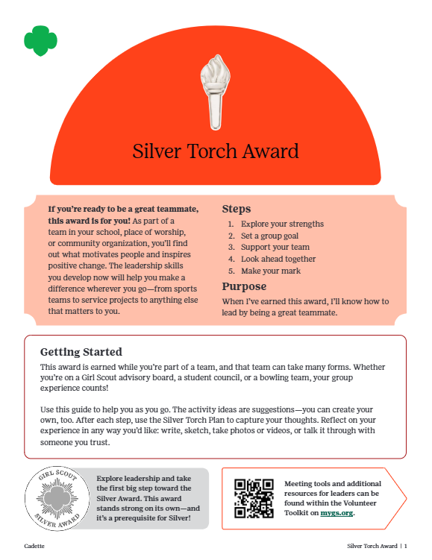
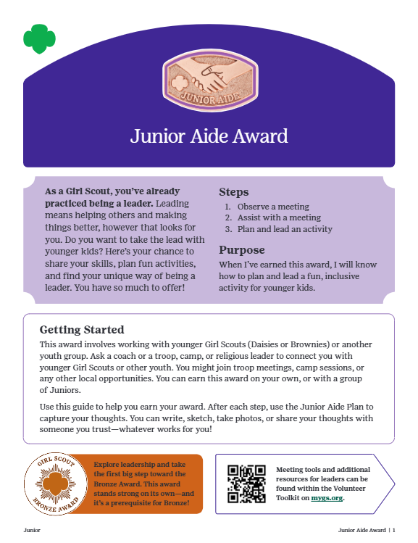
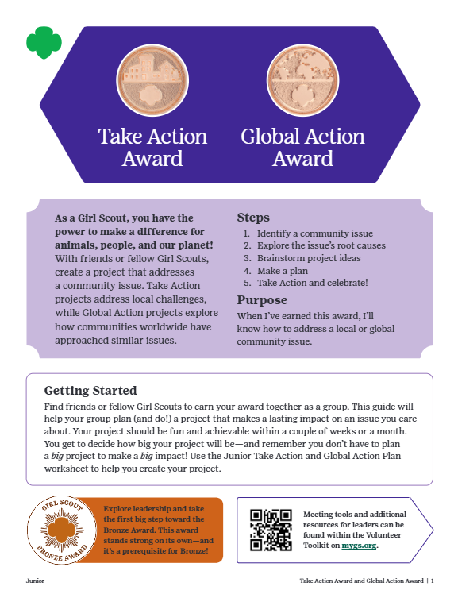
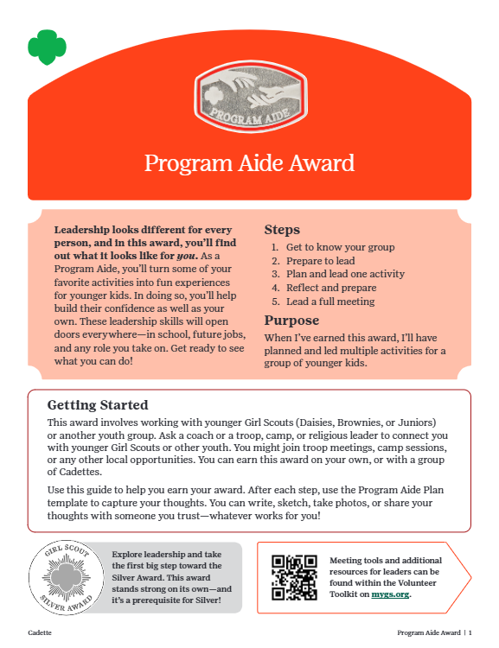
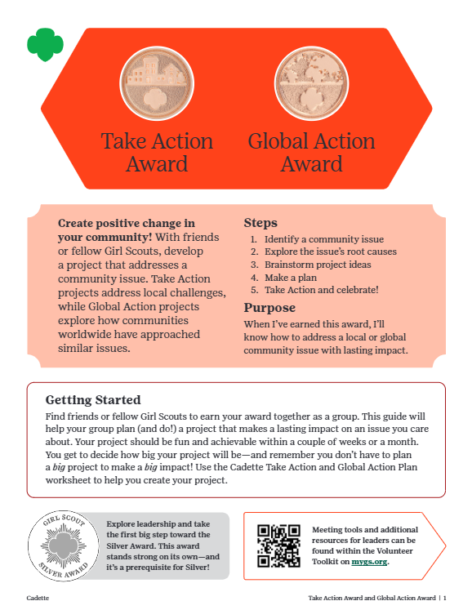
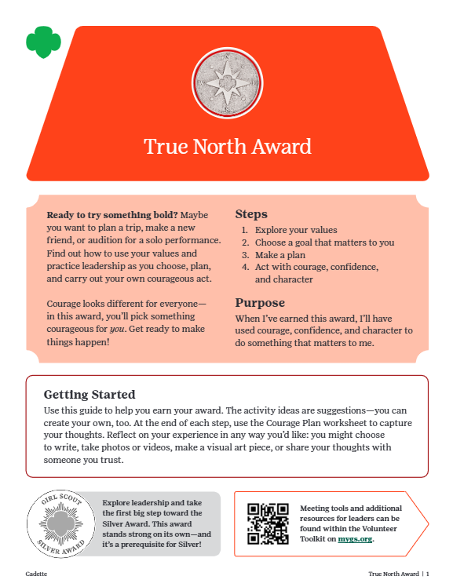
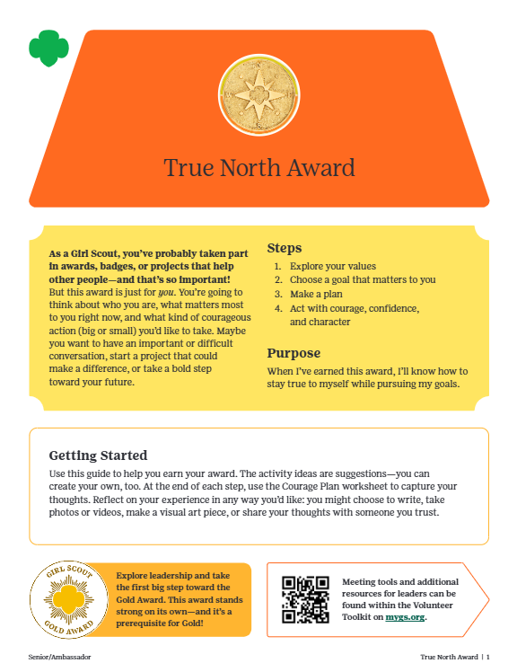
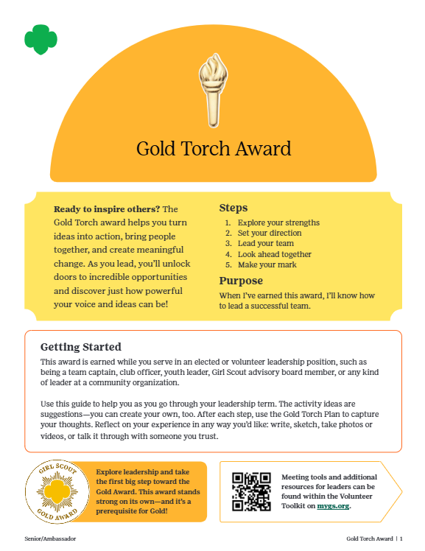
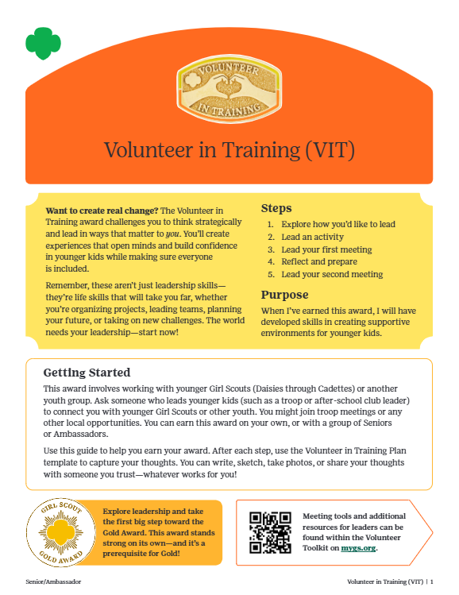
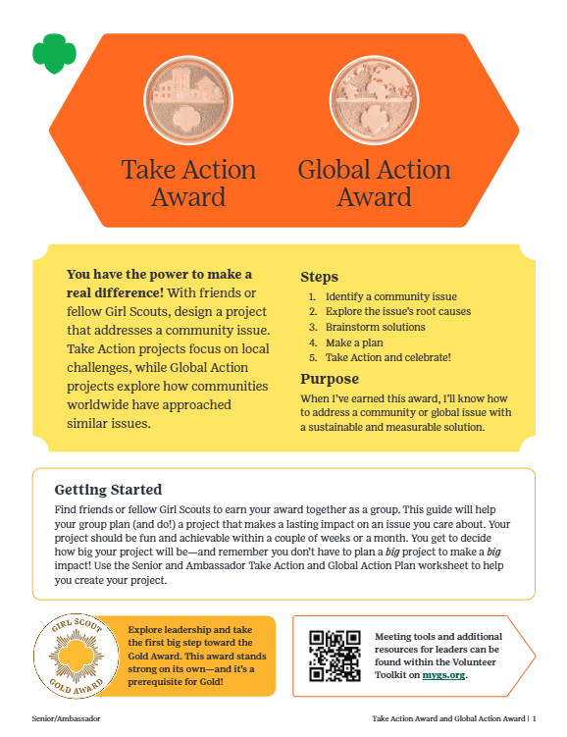
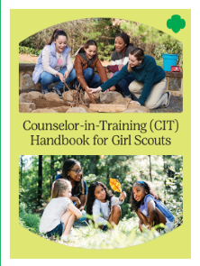
Leadership Award Suite
Personal Leadership
True North Award
Build confidence and courage to lead your way.
Available for Juniors, Cadettes, Seniors/Ambassadors
Peer Leadership
Silver Torch Award & Gold Torch Award
Be an awesome teammate + learn to guide a group.
Available for Cadettes,
Seniors, and Ambassadors
Teaching Leadership
Junior Aide, Program Aide, Volunteer-in-Training, Counselor in Training I & II
Share your skills and inspire younger kids with hands-on leadership.
Available for Juniors, Cadettes, Seniors/Ambassadors
Community Advocacy
Take Action & Global Action Awards
Turn your passions into action by making change locally or globally.
Available for Juniors, Cadettes, Seniors/Ambassadors
Notes:
With that – I am excited to officially present our refreshed Leadership Award Suite. Let’s take a look:
Review Name
Purpose
Availability
When you dive into our final award booklets, you’ll see that there is an intentional progression both by skill development and grade level. Here are a few highlights:
Unique, sophisticated design using our branding to complement badge booklets, yet stand out as separate assets
Progression across grade levels in content and using color – True North Award progresses to be age-appropriate, where Teaching Awards progress in terms of developing group leadership skills. Whether you’ve earned the previous award in the progression or are just getting started at your current level (ie: You’re a Cadette who already earned Junior Aide – or you’re just getting started on Teaching Leadership with Program Aide) – we’ll take you through a review of the fundamentals, before progressing into a more advanced skill.
There is also a clear callout to progression to Highest Awards

Slide 24
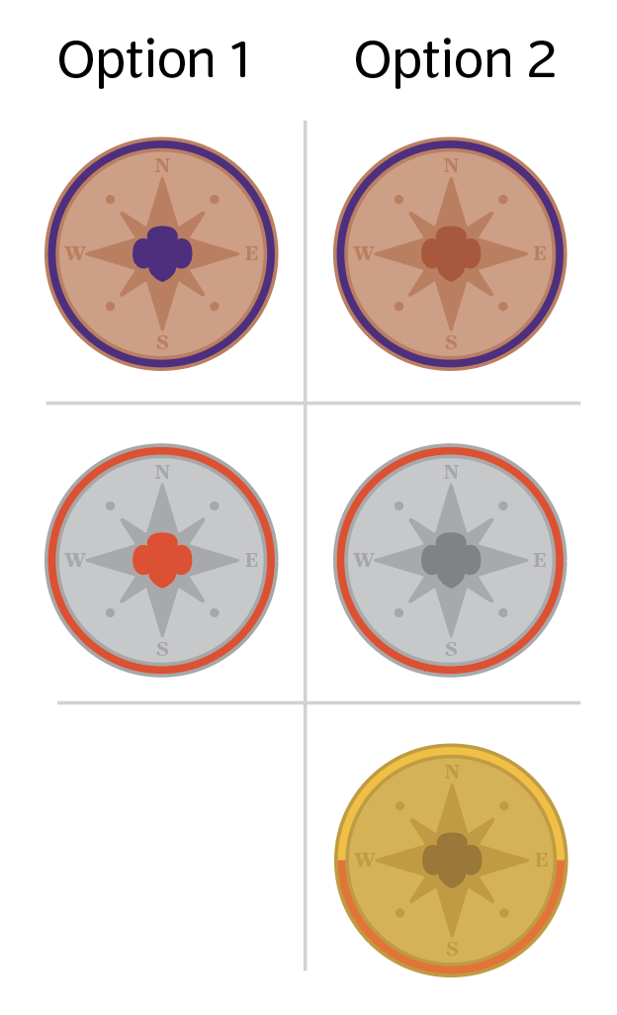


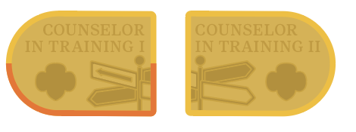


New Leadership Awards
Practice Leadership
Leading Themselves
Leading Others
Leading Their Communities
Senior / Ambassadors
Cadettes
True North
[Personal Leadership]
Develop Practical Life Skills
Confidence
Critical Thinking
Teamwork
Communication
Project Planning
Advocacy
Junior
True North
[Personal Leadership]
Gold Torch
[Peer Leadership]
True North
[Personal Leadership]
Volunteer-in-Training
[Teaching Leadership]
Silver Torch
[Peer Leadership]
Program Aide
[Teaching Leadership]
Counselor in Training I & II
[Teaching Leadership]
Membership Retention
“I get to have great leadership experiences in Girl Scouts”
Junior Aide
[Teaching Leadership]
Take Action
[Community Advocacy]
Global Action
[Community Advocacy]
[Badge elevation = build on topics they are passionate about ]
Notes:
You’ll see a visual of the award progression.
I love looking at this alongside the key skills Girl Scouts will develop – and that we also know parents/caregivers want: their GS to develop practical life skills that are applicable today and beyond.
Not only will these leadership award pathways help us in membership retention; we’ve seen in the data that Seniors and Ambassadors in particular are excited to have these leadership experiences, and they’re a reason girls stay
We know these are also now going to be directly connected to another reason Girl Scouts stay… the Highest Awards.
On the next slide…

Slide 25



Bonus Feature
ONE Leadership Award Opens the Door to Highest Awards
55%
Senior and Ambassador Girl Scouts want to pursue Highest Awards
Lead Community Change
Prestigious honor
Resume boost
Access Scholarships
Notes:
You’ll see our external framing for how we’ll be framing the Leadership Awards as part of the new menu of Highest Award prerequisites. We know that the Leadership Awards will stand proudly on their own, and as a bonus feature, which started officially July 14, one Leadership Award will open the door to the Highest Awards.
When we confidentially shared the news with our Girl Scout Advisory Group this weekend, they emphasized that one prerequisite feels more achievable and will definitely “open the door so more girls will participate”. They also agree that this will reduce barriers!

Slide 26
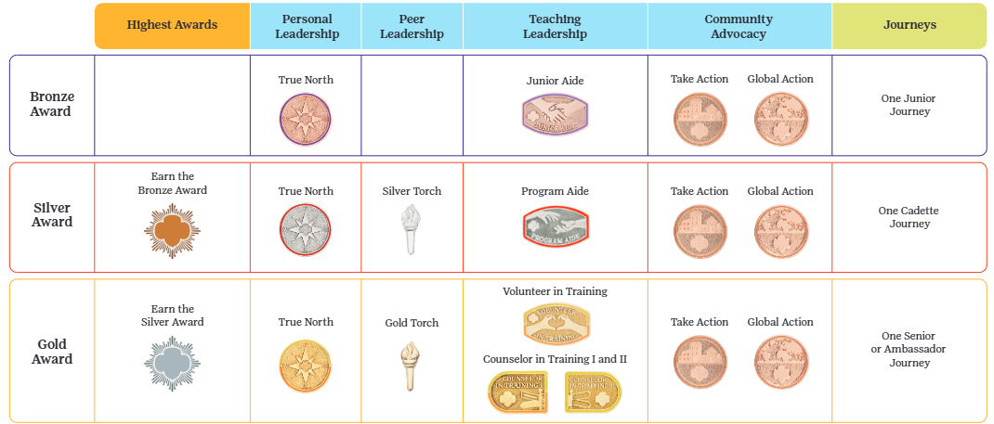
Earning Highest Awards
As of July 14, 2025, there are now more options for girls to earn their Bronze, Silver and Gold Award
Notes:
Here it is – and I’ll reiterate two points you’ve likely heard from me already:
While the old award / pin designs aren’t on this chart, I want to emphasize that starting this past July we’ll honor Girl Scouts who earned the Leadership Awards using the retired or new guidelines. While we developed the new Leadership Awards with the Highest Awards in mind, we also recognize that Girl Scouts developed important leadership skills using the Journeys and the retired guidelines. Let’s commit to making this transition as simple as possible both for our council partners and our members.
Journeys (and the current Global Action Awards, also not pictured) will be removed when they are retired on October 1, 2026.

Slide 27
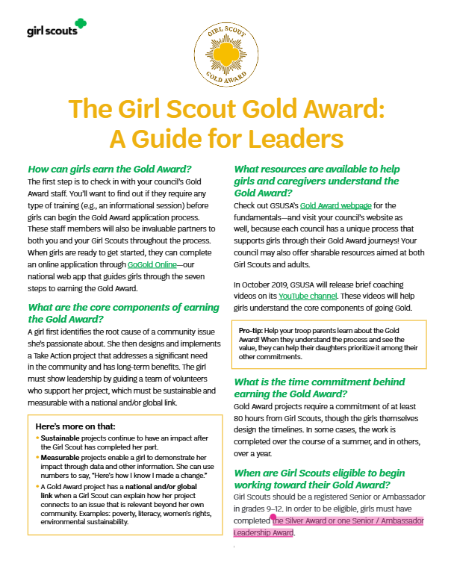

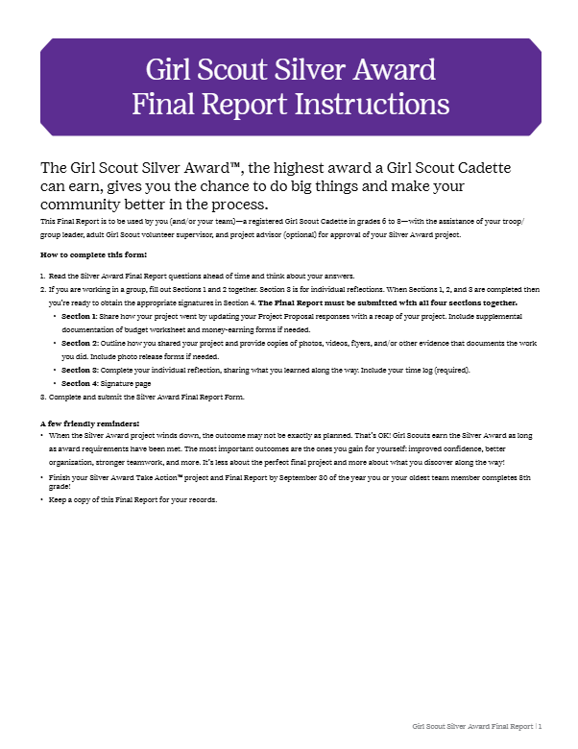
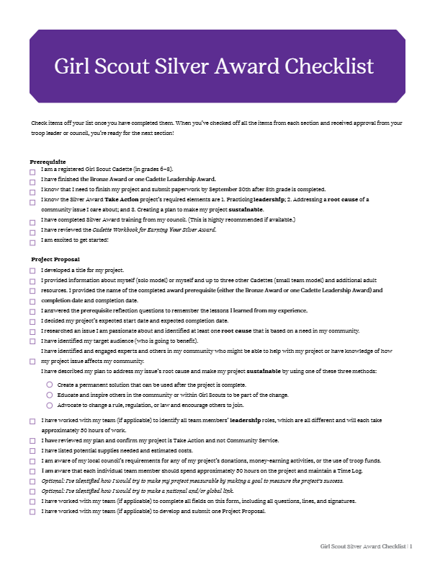
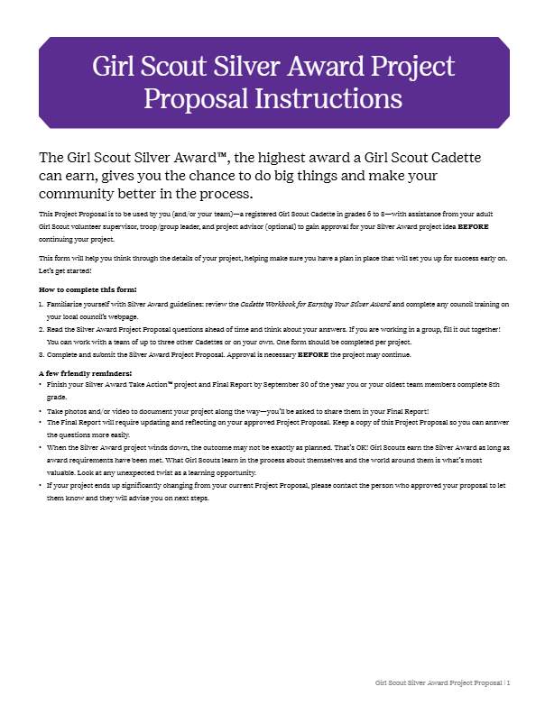
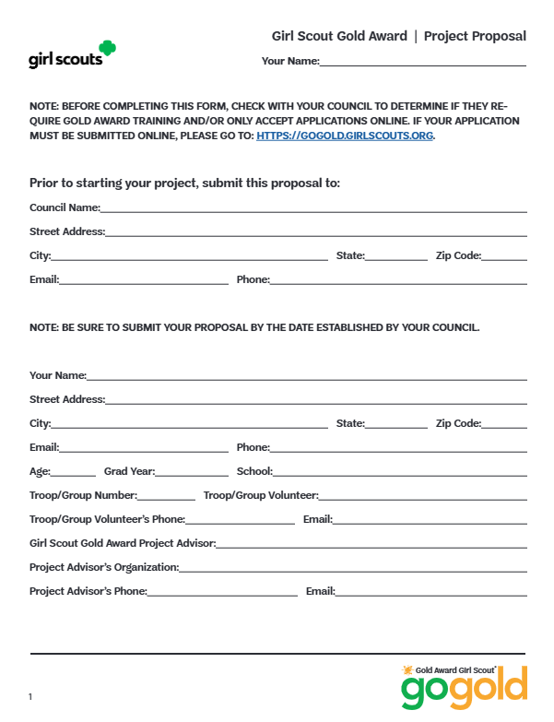
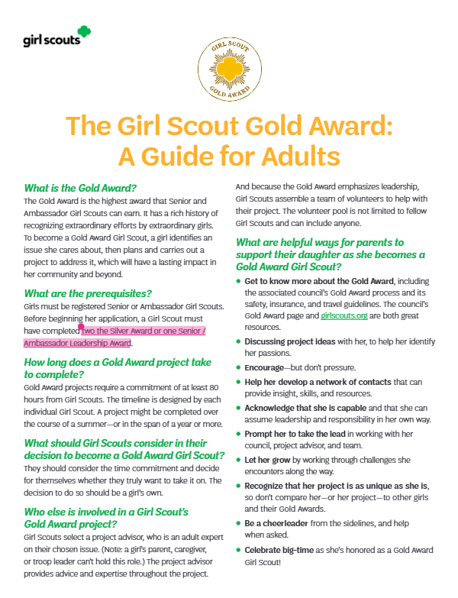



Transition Started July 14
Updated Highest Award Materials
Expanded Requirement Options Messaging/Toolkit
Big News for Highest Awards: Expanded Ways to Get Started
We’re expanding the options to kick off your Highest Award—it’s as easy as 1, 2, or 3:
Level up: One award now leads to the next—Bronze counts for Silver, and Silver counts for Gold. If you’ve already earned one, you’re ready to keep going!
Lead your way: Complete one of the new Leadership Awards—lead yourself, your team, or your community—and check the prerequisite box. Win-win!
Keep it going: Journeys are retiring in 2026, but there’s good news—you now only need one to fulfill the prerequisite (it used to be two for the Gold Award!). If you’ve already started, keep going—your Journey will still count, even after they retire.
What about Daisies and Brownies?
Even without Journeys, younger Girl Scouts will still have big opportunities to lead! Through badges and service projects, Daisies and Brownies can explore what it means to lead, be kind, and make the world a better place.
Gold
Project Proposal
Your Guide to Going Gold
Gold Award Guide for Adults and Caregivers
GoGold Guide for Leaders
Council customizable files
Silver
Project Proposal
Cadette Workbook
Adult Guide
Checklist
Final Report
Council customizable files
Check out assets to communicate this update in the MY25 Program and Volunteer Resources Go-to-Market Guide.
Updated Online Presence
VTK and gsLearn: Journeys and Highest Award meetings, materials, and training courses.
Org webpages: Gold, Silver and Bronze; Highest Awards FAQs; Badge and Award Explorer; Badge, Journeys, and Awards; Take Action vs. Service
Journey products in girlscoutshop.com
Notes:
Here it is! Take a moment to soak in this slide, especially the messaging for the expanded prerequisite messaging. It’s as easy as 1, 2 or 3!
Importantly, please note that in addition to releasing a marketing toolkit that features a flyer, email content block and featured story, we're in the final stages of updating our council's Gold and Silver Award assets. You can expect an updated online presence notifying folks about the new Highest Award prerequisites and our impending Journey retirement.
We can’t wait to hear how this change makes the Highest Awards more accessible to Girl Scouts and celebrate the many ways Girl Scouts take the lead, and make the world a better place.
Thanks!
Now I am going to turn things back over to Jaclyn.

Slide 28
Retail Updates
Our Asheville and Triad Service Centers operate brick-and-mortar Girl Scout Shops on Monday, Tuesday and Thursday.
Asheville Shop hours are 10 a.m. - 5 p.m.
Triad Shop hours are 10 a.m. - 6 p.m.
Troop Leaders and Service Unit volunteers can request a brick-and-mortar shop to be open for troops or Service Unit events outside of regular hours. You can also bring the shop to you through our mobile shop opportunities.
Find all the ways you can shop with us by visiting the Visit Us page on our website.
Notes:
Our final update tonight is an exciting reminder about our retail experiences! Did you know we do mobile shops by appointment anytime and anywhere? We can come to you and your service unit OR we can also just open up the service center shop for your group after hours!

Slide 29
Service Unit XXX
Budget Updates
Updates on your SU's Bank Account

Slide 30
Service Unit Announcements

Slide 31
Upcoming Service Unit Dates and Events

Slide 32
Next Steps
Questions?

Slide 33
Thank you for joining us!
Next Meeting:

