Slide 1









Service Unit Meeting
DATE

Slide 2
Welcome!

Slide 3
Tonight’s Agenda
LIST HERE

Slide 4




Rallyhood!
Private communication all in ONE platform
Multiple rallies for communication between troops, service units and families!
Each service unit has its own rallies.
Each troop will have its own rally.
Rallies all have: Message wall, calendar, opportunity to collect payment (for a small fee), space for photos (gallery), files for documents, most utilized links section and more
Troop leaders will invite families to join.
Rallies for Troop Fall Product and Service Unit Fall Product invitations going out next week!
Notes:
If you attended our Volunteer Conference on August 2 this will be a slight repeat for you but we do have some more information on our timeline for on-boarding onto Rallyhood. For those of you who were not able to make the Conference, let me introduce you to Rallyhood!
We as a council, as I know you as Service Teams and as troops, have been looking for a better way to keep everyone connected.
Rallyhood is your central hub for private communication between troops, service units and families!
Every service unit has its own rally. Every troop has one too.
Each rally includes:
A message wall for updates
A calendar to stay organized
Secure payment collection options
A photo gallery
Document storage
A go-to section for your most-used links …and more!
Troop leaders will personally invite families to join their troop’s rally.
Coming next week — invitations for Troop Fall Product and Service Unit Fall Product rallies!

Slide 5
Rallyhood!
Rallies coming for:
Daisy Troop Leaders
Brownie Troop Leaders
Junior Troop Leaders
Cadette Troop Leaders
Senior/Ambassador Troop Leaders
Plus, rallies for outdoors, Highest Awards and more coming!
Accept EACH invitation to each rally to join the conversation! And request to join the rallies you are interested in and hold the role!
Rallyhood will become the PRIMARY communication device– all with one log-in- to fix trying to find items on website!
Notes:
Rallies are also coming for all Troop Leaders, too, to join the conversation around your program level.
But that’s not all!
We’re also launching Rallies for Outdoors, Highest Awards, and much more!
Now here’s what you need to do:
➡️ Accept every invitation to each Rally that applies to your role — that’s how you join the conversation. ➡️ Request to join the Rallies you're interested in and qualified for.
This will help keep communication streamlined, organized, and accessible.
Rallyhood will become our primary communication tool. Just one login — no more digging through the website to find what you need.
Everything will be in one place — clear, easy, and connected.

Slide 6
Rallyhood Training!
Learn how to be an ADMIN for your Service Unit Rallies or your Troop Rally.
Troop Leadership and Service Unit Specialists receive invites to Admin Training in the next two weeks
Training: September 18 from 8-9 p.m.
Can’t make it? It will be recorded!
REMINDER! Accept the invitations to the "Welcome Volunteers" Rally! You will also receive invitations to Level Rallies, SU Team Rallies and more. Accept now to be included in the conversation.
The "Welcome Volunteers" Rally is a GREAT PLACE to ask questions!
Notes:
Want to learn how to be an ADMIN for your Service Unit Rallies or your Troop Rally? Troop Leadership and Service Unit Specialists—watch your inbox! Admin Training invites are going out over the next two weeks.
The training session is happening on September 18, from 8–9 p.m. Can’t make it? Don’t worry—it will be recorded!
Remember to accept your invitations to the “Welcome Volunteers” Rally! You’ll also receive invites to Level Rallies, SU Team Rallies, and more. Accept now to make sure you’re part of the conversation from the start.
And don’t forget—the “Welcome Volunteers” Rally is the perfect place to ask and answer questions!

Slide 7



Service Unit Delegates! YOUR DIRECT REPRESENTATION!
Notes:
Now I want to shift gears to the Delegate Process here at GSCP2P.

Slide 8
Volunteer Run, Volunteer Led – Your SU Delegates give and get feedback and represent with your Volunteer Board of Directors
Delegate Count –
Each Service unit gets one delegate per 100 girls registered for the previous year.
1-100 girls: 1 Delegate/1 Alternate
101-200 girls: 2 Delegates/2 Alternates
201-300 girls: 3 Delegates/3 Alternates
301–400 girls: 4 Delegates/4 Alternates
401–500 girls: 5 Delegates/5 Alternates
Service Unit | Total Girls registered by August 2025 | Total Number of Delegates
Service Unit 129 | 201 | 3 Delegates/3Alternates
Service Unit 127 | 99 | 1 Delegate/1 Alternate
Service Unit 144 | 335 | 4 Delegates/4 Alternates
Service Unit 151 | 157 | 2 Delegates/2 Alternates
Service Unit 117 | 425 | 5 Delegates/5 Alternates
EXAMPLE:
Notes:
This year, as you see on the slide, we are adjusting our delegate process and SU allotment of delegates. Each SU will get one delegate for every 100 girls registered for the previous year.

Slide 9
Volunteer Run, Volunteer Led – Your SU Delegates give and get feedback and represent with your Volunteer Board of Directors
NEW PROCESS TO PROVIDING FEEDBACK AT FORUMS:
Service Units Elect delegates between October 1 and December 15, 2025.
Delegates and Alternate Delegates register in role in Volunteer Systems for a 1-year term ending September 30, 2026.
Girl Delegates/Alternates (aged 14 years of age or older by January 1) that are elected contact Info@girlscoutsp2p.org to be added to role.
Delegates receive questions from board to get feedback from Service Unit volunteers.
Delegates and Alternates attend one FORUM to give and receive feedback and information with Board members.
Forums will be held in each office location in February and March 2026.
Delegates go back to their service unit and share feedback and experience at forums and prep for Annual meeting votes.
Delegates attend Annual Meeting in April – Alternates are promoted to Delegate if Delegate cannot attend.
Notes:
So, Service Units—get ready to elect your delegates!
Elections run October 1 through December 15, 2025.
Delegates and Alternate Delegates will register their roles in Volunteer Systems for a one-year term ending September 30, 2026.
For Girl Delegates or Alternates—if you’re 14 or older by January 1, once elected, contact Info@girlscoutsp2p.org to be added to your role.
So, what do delegates do?
Receive questions from the board and gather feedback from Service Unit volunteers.
Attend one Forum in February or March 2026 to share and receive information directly with board members.
Bring that feedback from the Forum back to your Service Unit and prepare for Annual Meeting votes.
Delegates also attend the Annual Meeting in April. If a Delegate can’t attend, Alternates are promoted to Delegate.

Slide 10
Volunteer Run, Volunteer Led – Your SU Delegates give and get feedback and represent with your Volunteer Board of Directors
For Delegate Availability:
FORUMS:
Gastonia Office: February 5, 2026 6-7:30 p.m.
Hickory Office: February 17, 2026 6-7:30 p.m.
Triad Office: March 5, 2026 6-7:30 p.m.
Asheville Office: March 17, 2026 6-7:30 p.m.
Notes:
Here are the dates, times and locations for the Delegate Forums planned for next February and March so please make note now of which one is closest to you.

Slide 11
Volunteer Run, Volunteer Led – Your SU Delegates give and get feedback and represent with your Volunteer Board of Directors
For Service Unit Specialists and Service Unit Meetings:
Please ensure you add elections at some point during your meetings either October or November (ideally before December).
Ensure you add time for your Delegates to seek feedback at your January Meeting.
Add time for your delegates to report back at your March or April Meeting.
Add time for your delegates to report back at your May meeting about the Annual Meeting.
Notes:
So what do you need to do now?
READ LIST ON SLIDE

Slide 12
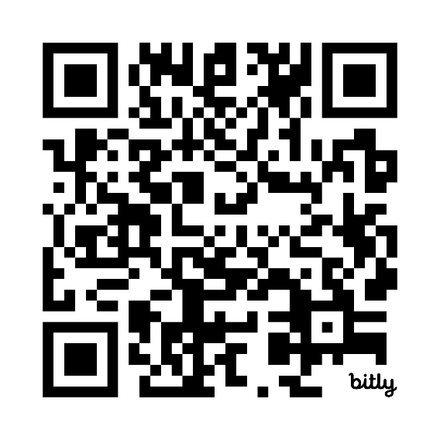
Property Updates
Pisgah, Keyauwee and Ginger - OH MY!
A GSCP2P Property Assessment took place with Structural Engineers last week, visiting all four service centers and three camp properties.
We will receive a comprehensive cost list of items that need repaired to begin a priority list.
Members will receive a survey on their property needs and priorities
Volunteers and girls can be a part of focus groups conducted by the Property Assessment company.
If you would like to be a part of an in-person focus group, complete the form here: https://bit.ly/4mUVArU or scan the QR code below.
The Property Assessment will be complete in December of 2025.
Notes:
Now, shifting gears again to some Property updates.
Last week, structural engineers completed a Property Assessment, visiting all four service centers and three camp properties.
What’s next? We’ll receive a comprehensive cost list for needed repairs, which will help create a priority list.
Members will receive a survey to share your property needs and priorities.
Plus, volunteers and girls can join focus groups conducted by the Property Assessment company.
Want to participate in an in-person focus group? Complete the form at the link on the screen or scan the QR code and complete the interest form.
The full Property Assessment is due to be completed in December 2025.

Slide 13

Current State: Camp Ginger Cascades – currently closed
Dining Hall:
Cannot be used at this time
Decking around dining hall and troop house has been deemed unsafe
Dining hall roof has significant issues - Needs further assessment
Rainbow and Rocky Ridge:
Issues with deck removal and new decking
Not able to be used at this time – Need further assessment
Hilltop:
Roof issue causing mold
Mushroom:
New building replaced due to Hurricane damage
New bathhouse still needs to be built
Mary Leach:
Some structural issues found in area – need assessment
We hope to open the Challenge Course and Archery Range this fall for day use!
Notes:
Now I am going to share some initial property findings with you for each site. Please note that other findings may come later as the structural engineer has plans to return back to the sites.
READ SLIDE

Slide 14

Current State: Camp Pisgah
Water is not passing inspection due to bacteria (Not e-coli)
Lightning strike took out Internet
Multiple electrical issues need fixed prior to Internet replacement
Structures need further assessment to determine if there are issues
Cannot allow girls to use the site due to water issue at this time
Notes:
READ SLIDE

Slide 15

Current State: Keyauwee Program Center
Celebrating its 80th birthday!!!! Please come out on September 20th – Registration is available on gsEvents!
5 new canvas tents!
New maintenance building (replacement for building that burned down)
New deck at Caraway!
New sump pump going in THIS week to fix issues!
New $105,000 dining hall roof going in this week
New fire alarm system in dining hall
Need new horse lean-to structure needed
Structures “offline” due to potential hazards – need further assessment:
Apache Unit
Chippawa Unit
Comanche Unit
Amphitheater Stage
Nature Center
Area around the dining hall retaining wall
Notes:
We’re celebrating a huge milestone—our 80th birthday! Mark your calendars for September 20th and join us for the celebration. Registration is now open on gsEvents!
There’s so much happening at this camp:
Five brand-new canvas tents!
A new maintenance building to replace the one that was lost.
A new deck at Caraway.
A new sump pump going in this week to fix ongoing issues.
A brand-new dining hall roof—$105,000 investment—being installed this week!
A new fire alarm system in the dining hall.
But there’s still work to do:
We need a new horse lean-to structure.
Several structures are offline due to potential hazards and need further assessment, including:
Apache Unit
Chippawa Unit
Comanche Unit
Amphitheater Stage
Nature Center
The area around the dining hall retaining wall

Slide 16
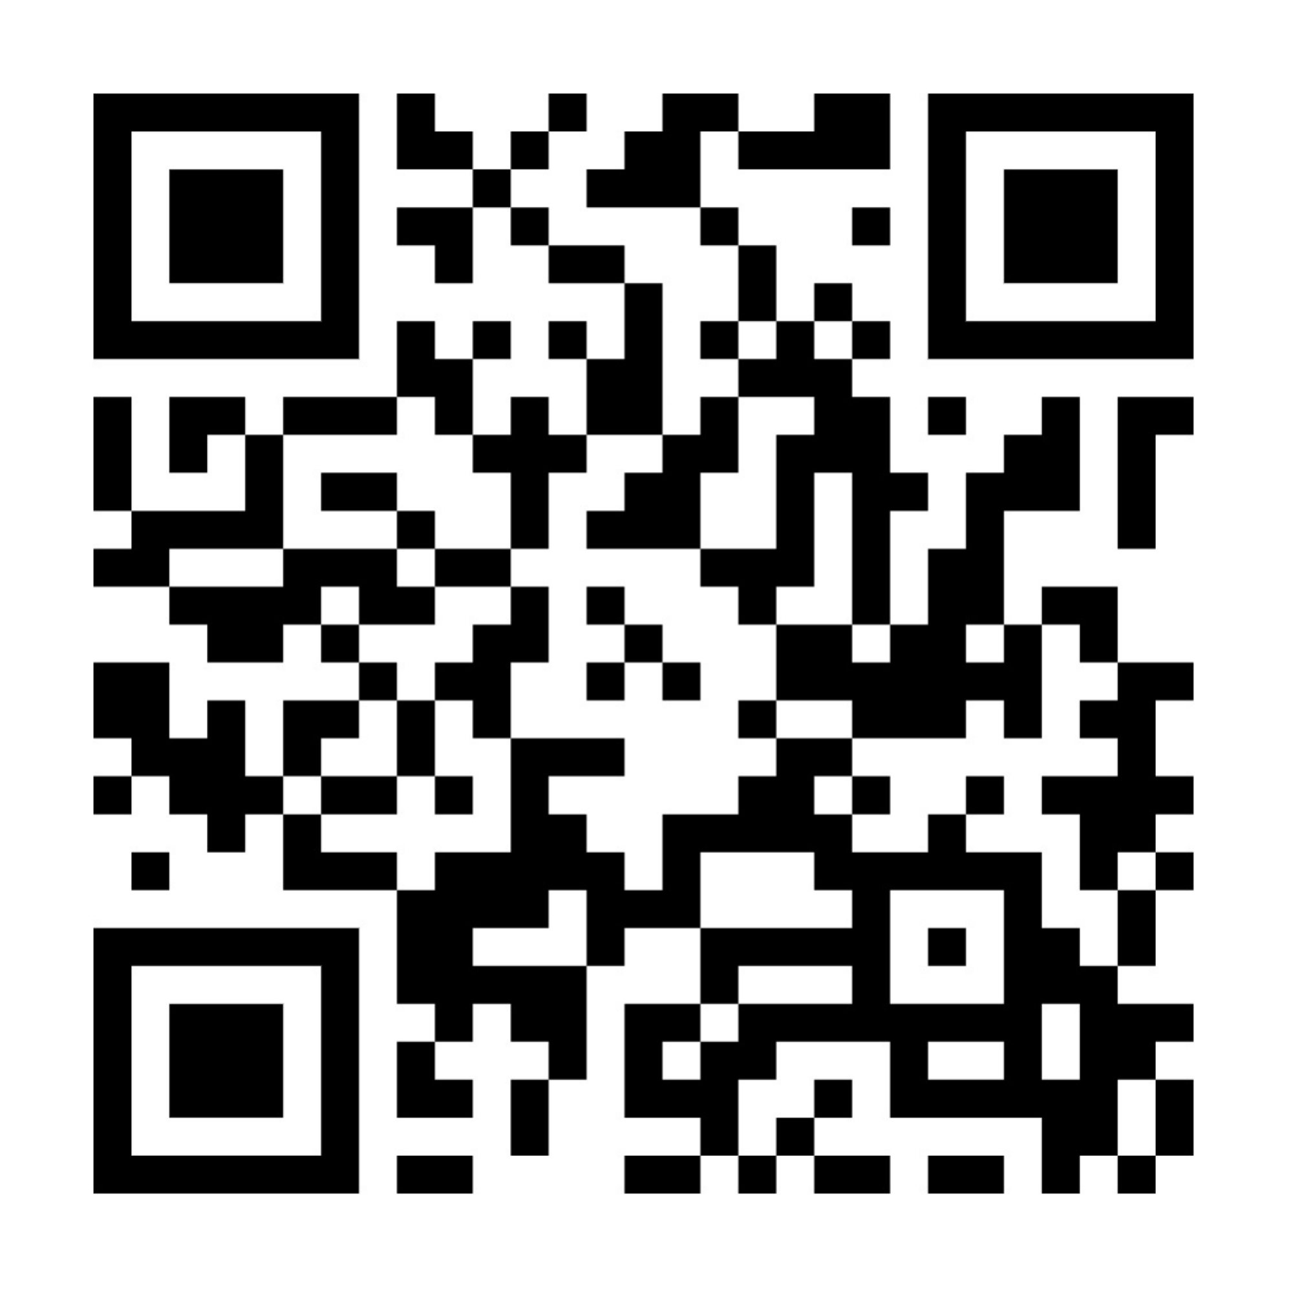
Please help us help Girl Scouts!
Volunteer Delegates voted to raise dues last year and annual dues will go to $65.
More girls and families will need financial assistance!
As a non-profit organization, GSCP2P relies on donations to ensure our program continues!
Consider becoming part of our Evergreen Circle and making a monthly donation to help all girls have the opportunity for Girl Scouting!
Donating $10 per month can help a new Girl Scout join along with her family.
Donating $25 per month can assist programming each corner of our council.
Donating $50 per month can help us to cover some of the costs of our amazing Circle C Equestrian Center.
Donating $85 per month allows you to join the Juliette Circle and make a lasting impact to an area.
Juliette Circle donors of $1000 in a year receive a special Sterling Silver pin and an invitation to our Chairwoman’s Dinner!
Use this QR code to make a donation to help Girl Scouts today!
Notes:
And shifting gears one more time to some fund development updates.
As you all know, national Volunteer Delegates voted last year to raise annual membership dues. Beginning with the upcoming membership year, annual dues will increase to $65 for girls.
This change means that more girls and families will need financial assistance to participate. As a non-profit organization, GSCP2P relies on donations to ensure that every girl has the opportunity to experience the benefits of Girl Scouting.
We encourage you to consider becoming part of our Evergreen Circle by making a monthly donation:
$10/month – Helps a new Girl Scout and her family join.
$25/month – Supports programming across our council.
$50/month – Offsets costs at our Circle C Equestrian Center.
$85/month – Allows you to join the Juliette Circle and make a lasting impact.
Juliette Circle donors who contribute at least $1,000 in a year receive a Sterling Silver pin and an invitation to our Chairwoman’s Dinner.
You can start your donation journey now by scanning the QR code on the screen.
Thank you for your continued dedication and support. Together, we can ensure that Girl Scouting remains accessible and impactful for all.

Slide 17
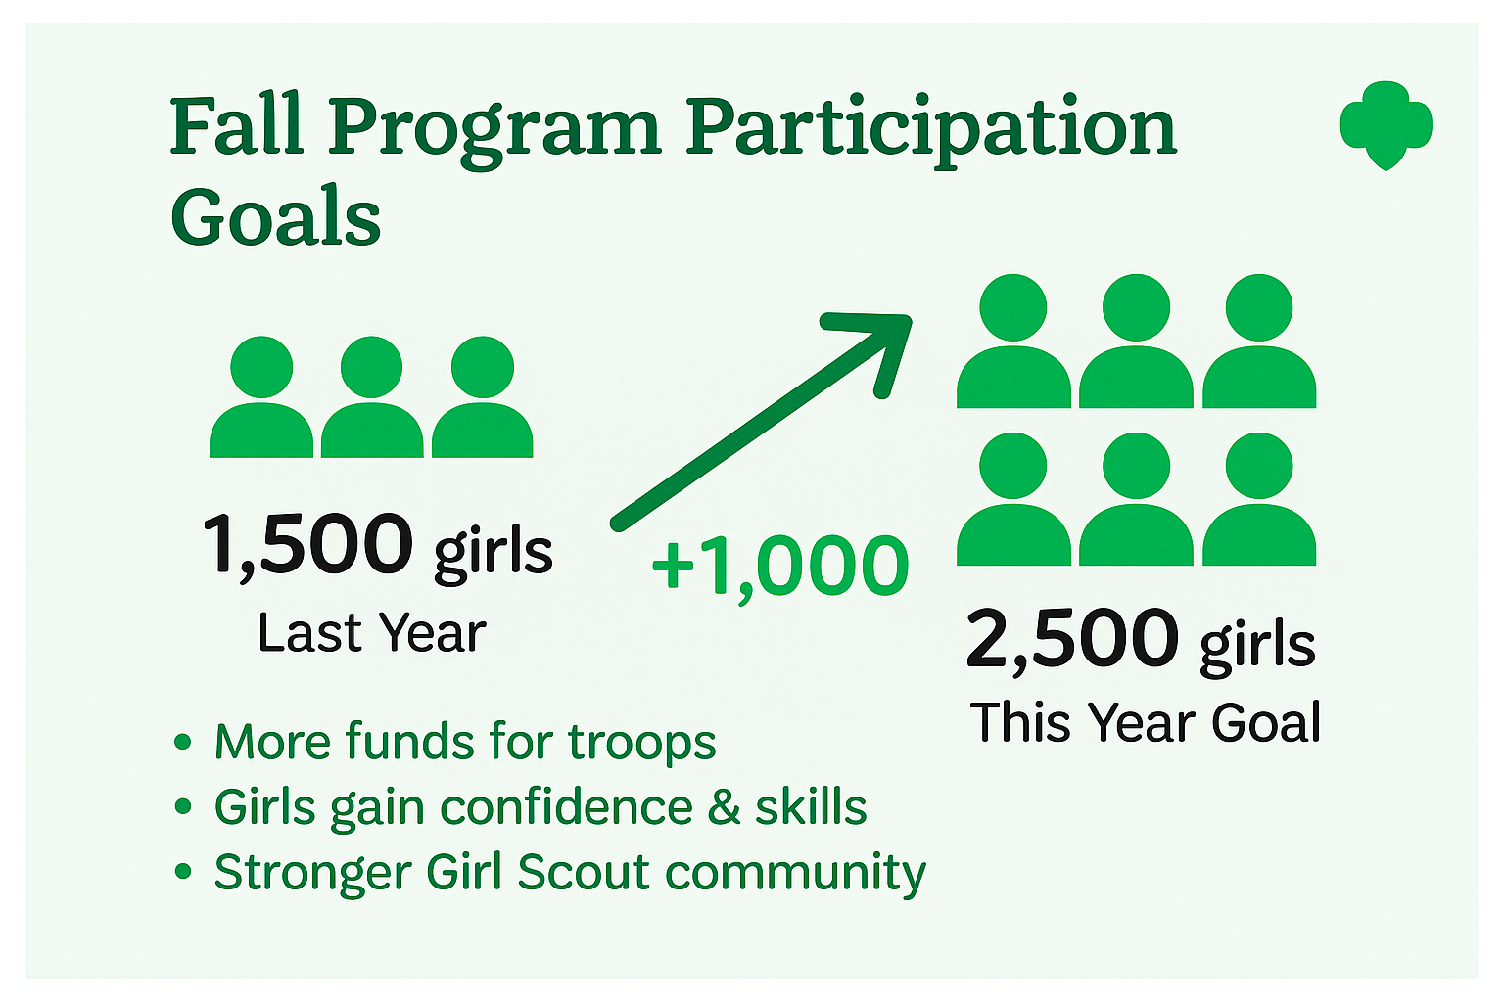
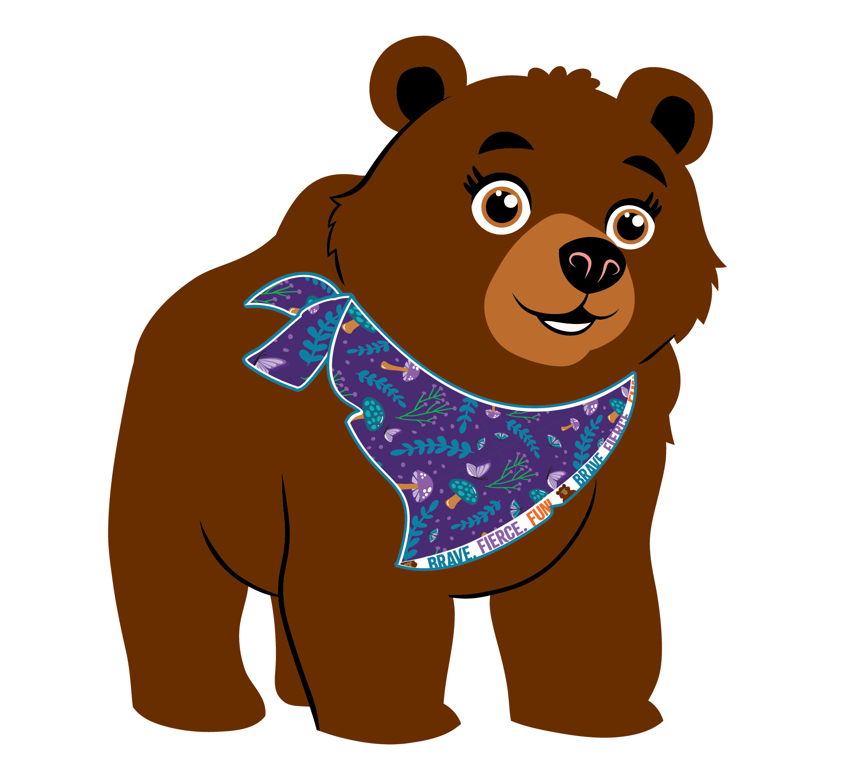
Fall Program: Council-wide Goal
Notes:
Last year, we had a really strong Fall Product Program. Over 1,500 girls participated, and together our troops raised more than $230,000. We saw great engagement—but we also know there’s still room to grow.
This year, we’re setting our sights even higher. Our goal is to increase participation by 1,000 more girls.
So why does participation matter? When more girls take part, everyone benefits:
Troops earn more funds for activities and adventures.
Girls gain new skills and confidence that last a lifetime.
Families feel more connected and engaged.
And most importantly, we’re building an even stronger Girl Scout community across all of our counties.
The Fall Program kicks off on September 15. So let’s talk about some simple and creative ways we can encourage more troops to join in and help us reach this exciting goal.

Slide 18

Fall Program: How can you help?
Notes:
You are probably asking yourself, "how can I help?" "how do I encourage more troops to participate?" As service unit and troop volunteers, you are the key to reaching that goal of 1,000 more girls.
The first thing I want to recommend is that each of you join Rallyhood. You’ll receive an invitation the first week of September, as was mentioned earlier.
By joining Rallyhood, you’ll not only get direct updates and materials from staff, but you’ll also be able to connect with other service unit and troop volunteers. This creates a space to share ideas, activity guides, and best practices that can encourage more troop participation.

Slide 19
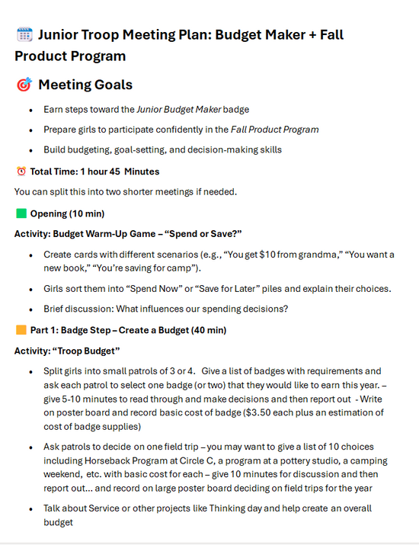
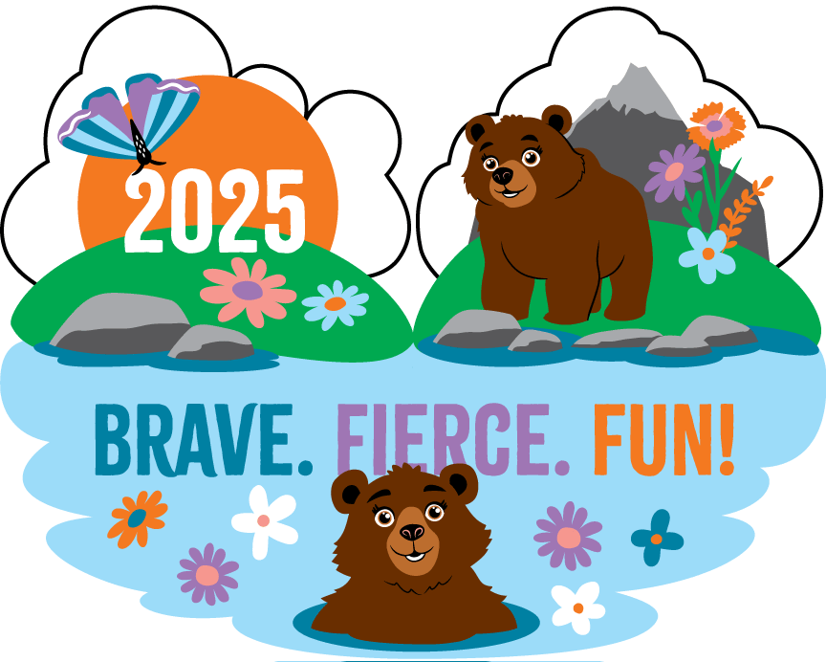
Fall Program: How can you help?
Notes:
We’re also developing several new guides to support you and your troops. One exciting resource is our Badge Guide, which goes hand-in-hand with the Fall Product Program. It’s organized by age level and highlights specific badges girls can earn alongside their Fall Product Program rewards. This makes it easier for troop leaders to fold the program into regular meetings and badge work. All of these guides will be available on Rallyhood.
Here’s how it works: girls automatically earn the badges you see on the left of the screen when they reach participation goals during the Fall Program. But leaders can go further by using the guide to connect the program with additional badges.
For today’s example, I’m sharing the Junior Troop Meeting Plan. This plan shows how the Fall Program aligns with badge work—specifically, how Juniors can work toward their Budget Maker badge while participating. The guide even includes helpful tips and activity suggestions to make it simple for leaders to bring these connections to life.
And the best part? By participating in the Fall Product Program, troops earn funds that can immediately be used to cover the cost of those badges—so girls aren’t just earning them, they’re helping pay for them too.

Slide 20
Service Unit XXX
Fall Product Program Data
Membership Year 2025
Troop Participation Last Year -
Girl Participation Last Year -
For MY26
Goal for Troop Participation -
Goal for Girl Participation -
Notes:
Each troop earns their own proceeds, but the service unit also earns funds when more troops participate. Those service unit funds can be put right back into supporting girls. For example, they could help cover the cost of a year-end celebration, awards banquet, or other special events.
This makes the Fall Product Program not just a fundraiser, but a way to build community within each of your individual Service Units and provides experiences for all of our girls.
And it’s simple! Troops can choose to participate fully, or even just online. If a volunteer prefers not to handle money, the online-only option is perfect. Just asking each girl to send 10–20 emails can make a big difference. Small steps like that add up quickly across an entire service unit.

Slide 21
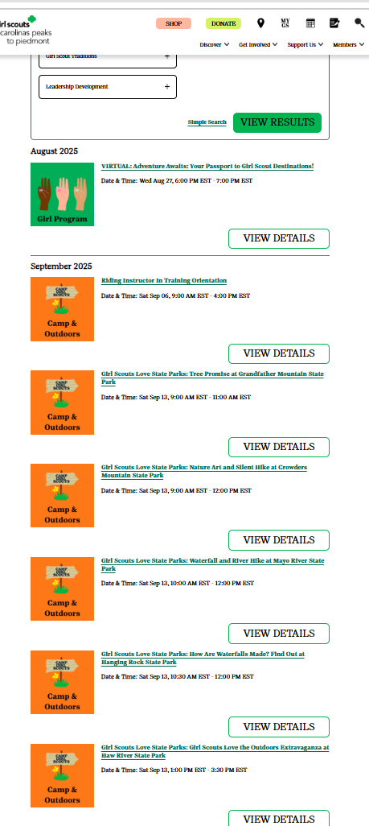
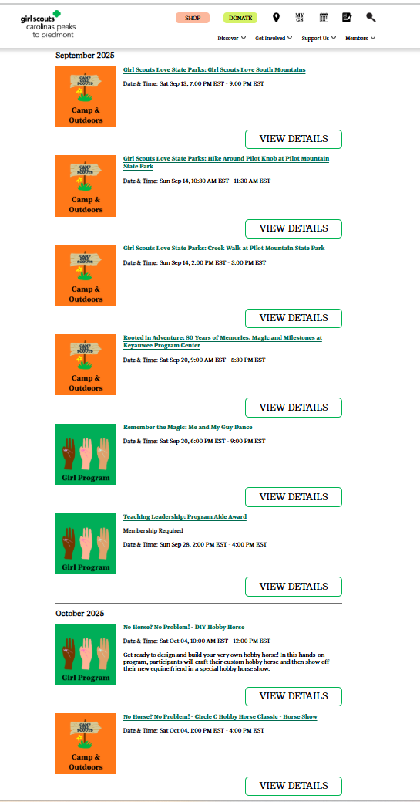
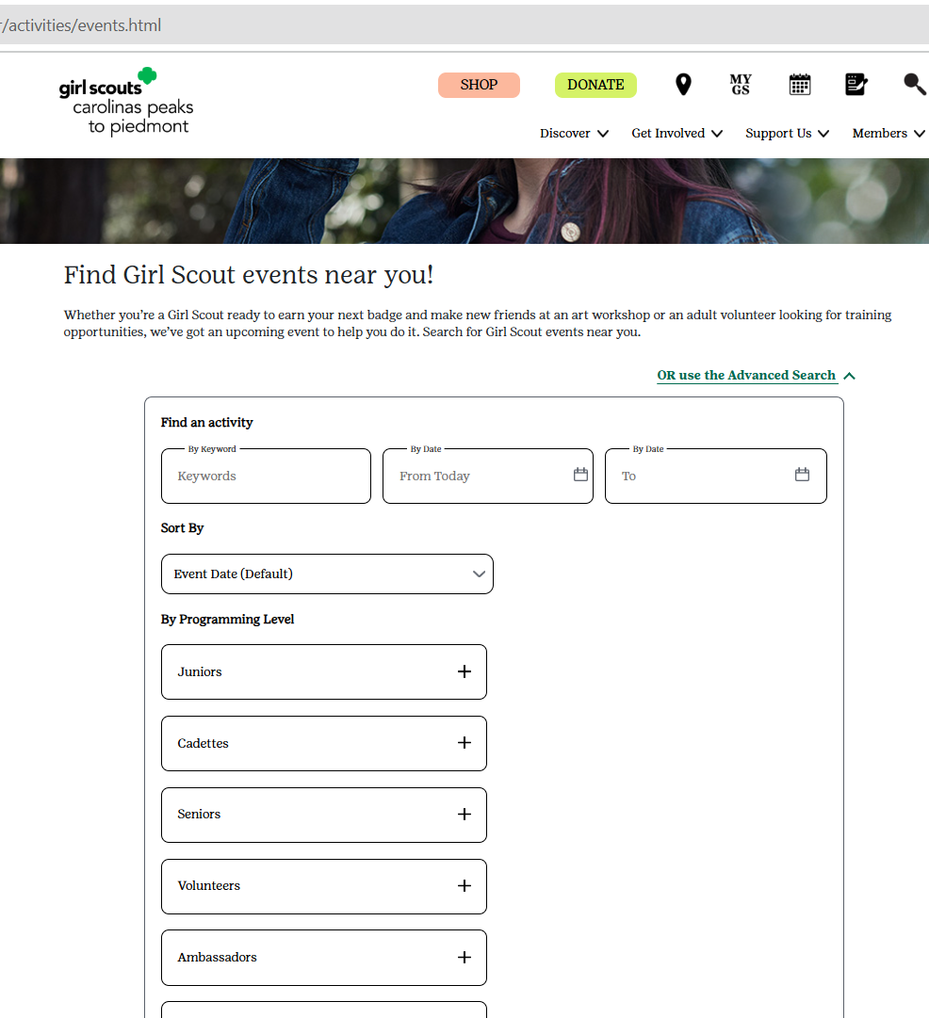
Upcoming Events- Search the Calendar!
Notes:
Fall also means FUN at Girl Scouts. Be sure to check out our program calendar on our website and encourage your troops to begin registering for their Fall activities. You can search the calendar on our website at any time for upcoming programs by activity, date, programming level and more.
For example, you can see if you search by Cadette level, all the events for our Cadette Girl Scouts show up in list form.
Some events for all Girl Scouts to sign up for now are the Keyauwee 80th Birthday, Girl Scouts Love State Parks, International Day of the Girl, an assortment of Circle C programs and more. Events are being added every day right now so keep checking back.

Slide 22


NEW! Road Map to a Great Year and The Girl Scout Adventure- My First Year patches!
Notes:
As you may have seen early this month, we are proud to introduce the Road Map to a Great Year patch program. This guide is here to support troop leaders through a successful year—from meetings and badge work to special events and traditions. Even better, each year that your troop completes the road map, you'll earn a unique souvenir patch! Whether you are brand new or a returning leader, the Road Map is a great tool to guide your journey and make every Girl Scout year one to remember. This patch replaces our Outstanding Troop Award.
For new, first year troops - Get ready for a year filled with connections, adventure, and fun through The Girl Scout Adventure – My First Year patch! Created especially for first-year Daisy and Brownie troops, this program brings the Girl Scout Law to life with monthly activities that foster friendship, teamwork, and community.

Slide 23
GSCP2P Membership Updates
Membership Year 2025
Total Girl Goal - 6,760
Total Adult Goal - 4,562
As of 8/25/25...
MY25 Girl Membership – 6,302
MY25 Adult Membership – 4,635
For a Total of 10,937
Membership Year 2026
Girl Goal 6500
New Troop Starts at 150
As of 8/25/25…
MY26 Girl Membership – 3,331
Notes:
Our current MY25 numbers are 6,302 girl members and 4,635 adult members, which includes all volunteers and lifetime members. That puts our total membership number for P2P at 10,937. We are around 5 ½ percent down in girls and down around 8% of adults from last year. For 2026, we have set a Girl Membership Goal of 6500 girls and starting approximately 150 new troops. As of today, we are at 3,331 girls (or 51.2% to our goal).

Slide 24
Service Unit XXX Membership Updates
Membership Year 2025
Total Girl Goal -
Total Adult Goal -
As of 8/25/25...
MY25 Girl Membership –
MY25 Adult Membership –
For a Total of
Membership Year 2026
Girl Goal -
New Troop Goal -
As of 8/25/25…
MY26 Girl Membership –
New Troops -

Slide 25
Fall Recruitment
Updates for your SU's Fall Recruitment

Slide 26
Service Unit XXX
Budget Updates
Updates on your SU's Bank Account

Slide 27
Service Unit Announcements

Slide 28
Upcoming Service Unit Dates and Events

Slide 29
Thank you for joining us!
Next Meeting: September 22 at 8 p.m.

