Slide 1

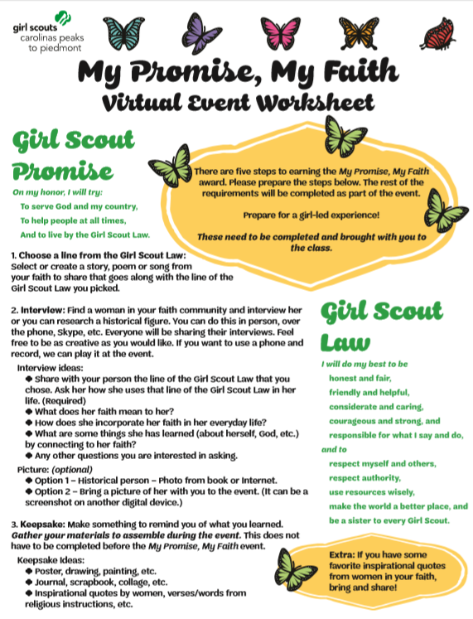
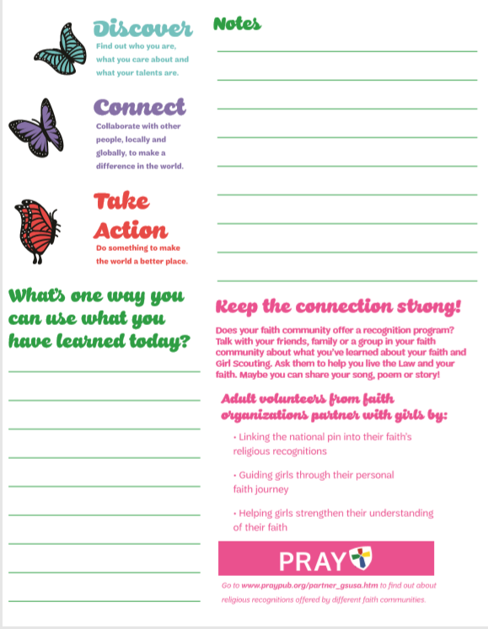
Welcome!
“My Promise, My Faith”
Session Materials checklist:
Page 2 of the participant worksheet
Your story, poem, song, etc.
Your interview/Research notes
Materials to make your keepsake
Notes:
SHARE SCREEN
Facilitator: Welcome girls into the meeting.
Co-Facilitator: Manage attendance & Chat Box
Facilitator: Remind them of the materials they will need for the class.
Keep it Girl-led: Prompt girls to share their first name and where they live in chat box. (This will help with attendance.)
Note: Facilitator and Co-facilitator can interact and facilitate together to help the girl’s comfort level and manage the flow of the class.

Slide 2

Introductions
Facilitator:
  Name
  Council Name and Title
  State where you reside
  “Role” in session
Co-facilitator:
  Name
  Council Name and Title
  State where you reside
  “Role” in session
Notes:
DO NOT SHARE SCREEN
Facilitator:
Name
Council Name and Title
State where you reside
“Role” in session
Co-facilitator:
Name
Council Name and Title
State where you reside
“Role” in session

Slide 3
“Housekeeping”
What does “housekeeping” mean?
Have fun!
Practice our Girl Scout Law:
Respect each other
Be a sister to every Girl Scout
Microphone: Please stay muted unless you are speaking
Chat box: Please use chat box when prompted and limit chatter unless it’s to encourage another Girl Scout during the presentation.
Chaperones should plan to stay and assist their child during the session. (Depends on age of participants.)
Notes:
SHARE SCREEN
Facilitator:
Ask participants what “housekeeping” means?
Relate that term and their answers to keeping the meeting organized.
Discuss 5 points of virtual etiquette with girls.
Keep it Girl-led: If you are using a virtual platform that has “reactions” (clapping hands/thumbs up, etc.) have the girls practice reactions and encourage them to use these to interact and support the other girls when they are presenting.

Slide 4
Opening Ceremony
Girl Scout Promise
On my honor, I will try:
To serve God and my country,
To help people at all times,
And to live by the Girl Scout Law.
Girl Scout Law
I will do my best to be
honest and fair,
friendly and helpful,
considerate and caring,
courageous and strong, and
responsible for what I say and do,
and to
respect myself and others,
respect authority,
use resources wisely,
make the world a better place, and
be a sister to every Girl Scout.
Notes:
SHARE SCREEN
Facilitator:
1. Invite participants to make the Girl Scout sign and stand if they choose.
Keep it Girl-led: Ask volunteer to lead group in Girl Scout Promise and Law

Slide 5
Discover & Connect
Interview Presentations
Each participant share the following:
  Interview:
    What is your line of the Girl Scout Law you chose for this project?
    Who was the person you interviewed/researched about their faith?
    How do you know them or is there a reason you researched this particular person?
  Songs, Poems, Story Sharing
When listening to others: (Notes section of sheet)
1. What is something you noticed or liked about someone else’s interview?
2. What is one thing you have learned that you can use in your life?
Notes:
SHARE SCREEN/DON’T SHARE SCREEN (Either way you choose. Older girls may appreciate seeing the print.)
*Note: Large group: You may need to split into breakout rooms for time purposes. At least one adult in the rooms. Two would be preferable.
Each person will have the opportunity to share all of their pre-work at the same time.
1. Direct participants to the 2nd page of the worksheet. Explain note-taking sections.
2. Prepare them for note-taking with the two questions in slide.
3. Suggestions for engaging conversation listed on slide.
Keep it Girl-led: Ask for volunteers to share. Encourage “reactions” if available. If time allows, offer girls to ask each other questions about their presentation.
*Note: Large group: Quick review when everyone comes back to the group if you break into groups.

Slide 6




Discover & Connect
Notes:
SHARE SCREEN
Facilitator:
“What is a quote?”
“What does a quote mean?” “What does it mean to ‘quote’ someone?”
“Here are some quotes that go along with our theme today.” “Take a few minutes and read. Which one do you most connect with?”
Opportunity to engage co-facilitator here to share as well.
“Did anyone prepare any quotes or today?”
“Would you like share?”

Slide 7
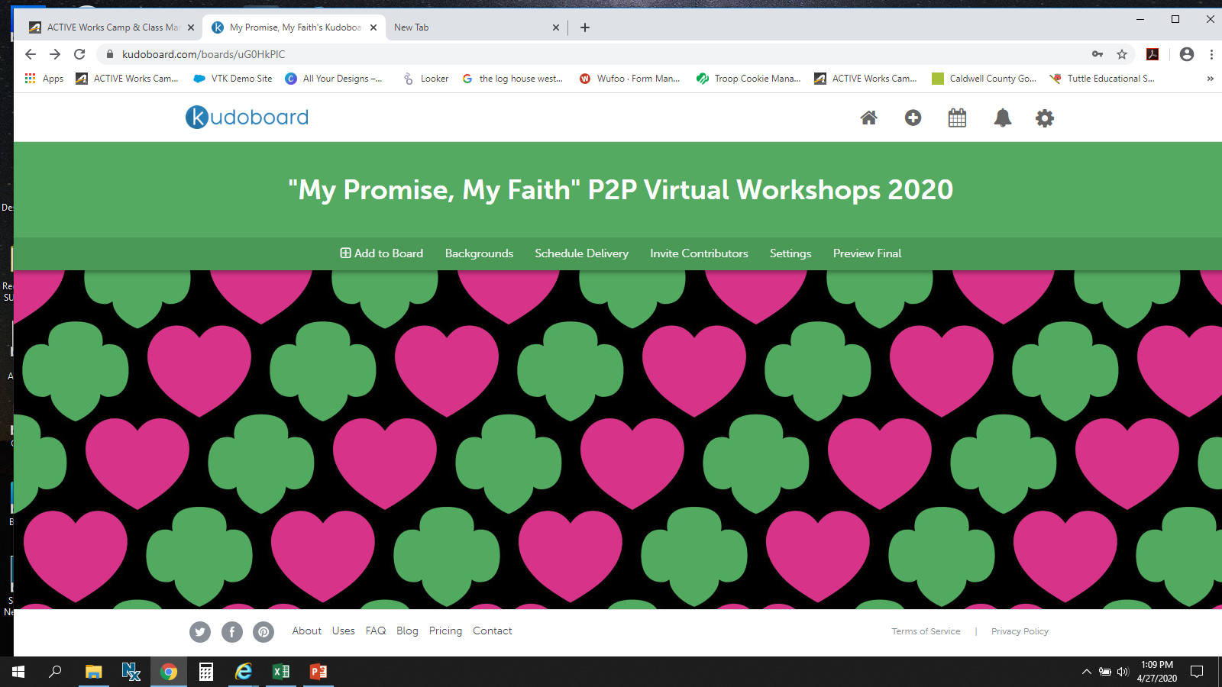
Take Action
Make a Keepsake
Keepsake Ideas:
  Poster, drawing, painting, etc.
  Journal, scrapbook, collage, etc.
  Include: Inspirational quotes by women, verses/words from religious instructions/leaders, etc.
When Complete:
    Take a picture of keepsake
    Upload to our council’s “Kudoboard”
      Link is included in your 2nd confirmation email.
      LINK: https:______________________
    Message field
      Include any of the following:
        First name and last initial
        Troop # & State where you live
        Line of Girl Scout Law you chose and/or Favorite Quote
Notes:
SHARE SCREEN
Note: Some girls may have already completed their keepsake. They can share it with the group at this time.
Facilitator:
Direct girls to their keepsake materials. Go over possibilities for projects.
Explain “Kudoboard” activity.
Note:
Younger girls: Instruct girls to start keepsake. Invite chaperones to learn more about faith-based opportunities in the next part of the power point.
Older girls: They should be able to work on project and listen to the next part of the presentation. If they have chaperones, invite them to the session.

Slide 8


Take Action
Girl Scout Faith Engagement Opportunities
“My Promise, My Faith” Pin
Religious Awards (PRAYPUB.ORG)
Girl Scout Sunday
Troop faith-based activities
P2P Faith-based Events – “Girls of Faith”
GSUSA – Virtual Opportunities
Notes:
SHARE SCREEN
Note: Customize this list for your council/service unit/troop.
Facilitator: Review list
Time saver note: You can jump to the slide with uniform picture to save time or if you don’t have chaperone involvement with older girls. The slides go into more detail.

Slide 9
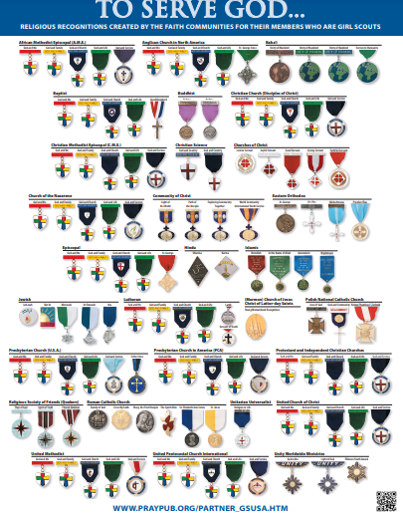
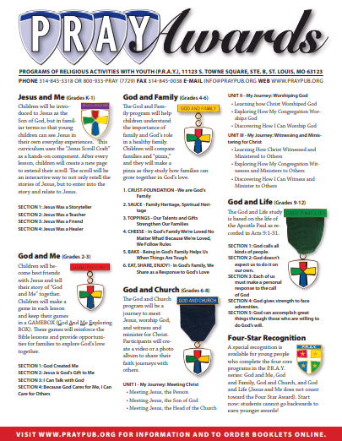
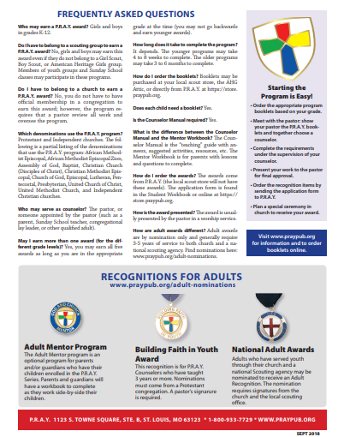
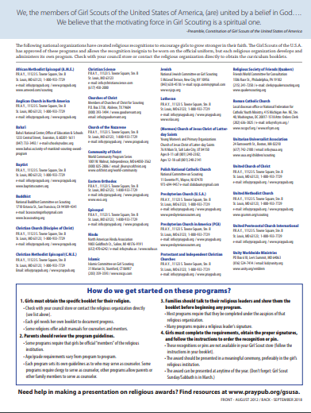
Take Action
Religious Recognition Programs
PRAYPUB.ORG
Notes:
SHOW SCREEN
Facilitator:
“Each year you can earn the ”My Promise, My Faith” Pin, which will allow you to further strengthen the connection between your faith and Girl Scouts throughout the years.”
“Once each year, you can earn the ”My Promise, My Faith” Pin by carefully examining the Girl Scout Law and tying it directly to your faith.”
“Requirements for this pin are included in The Girl's Guide to Girl Scouting handbook for all levels.”
“These brochures and more resources are available on-line: PRAYPUB.ORG”

Slide 10


Take Action
Girl Scout Week/Girl Scout Sunday
Notes:
SHARE SCREEN
Note: Customize this list for your council/service unit/troop.
Facilitator:
1. “Girl Scout Week is celebrated each March, starting with Girl Scout Sunday and ending with Girl Scout Sabbath on Saturday. This week gives you {girls} an opportunity to attend your {their} place of worship and be recognized as a Girl Scout. “
2. Explain Girl Scout Sunday practices in your council/service unit/troop.

Slide 11

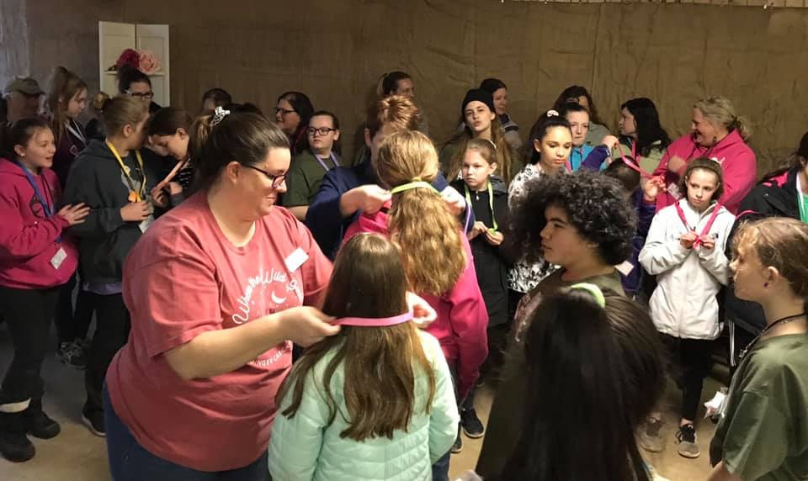
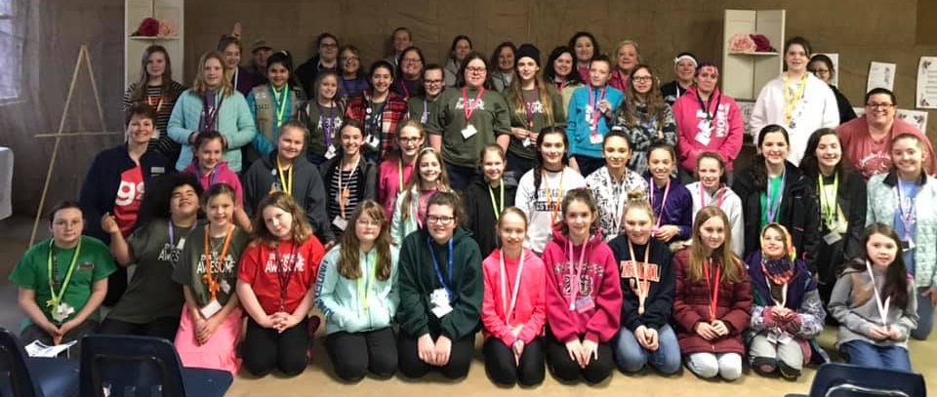
Take Action
GSCP2P “Girls of Faith”
Offered at least every other year
Ages: 4th-12th Grades
Girl Scout Traditions…
Awards, Campfire, Ceremonies,
S'mores, SWAPS, Songs, Sleepovers
Earn My Promise, My Faith Pin in a unique group setting.
Notes:
SHARE SCREEN
Note: Customize this list for your council/service unit/troop. (You may want to delete this slide.)
Facilitator:
This is one of GSCP2P’s Signature Events. It will be hosted at least every other year.
Review list on slide

Slide 12
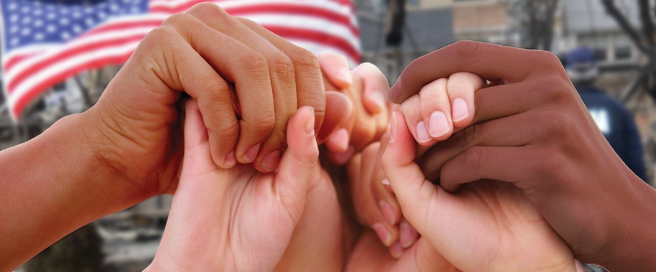
Take Action
GSUSA Virtual Event
Date: Thursday, June 4, 2020
Time: 6:45 p.m. – 7:45 p.m.
A time for Girl Scouts to gather to share positivity and learn about other faiths.
Guest Panel representing various faith backgrounds
Interactive experience with Girl Scouts around the nation.
Notes:
SHARE SCREEN
Note: Customize this for current year happenings. (You may want to delete this slide.)
Facilitator:
This event is part of a GSUSA “Awesome Girls” virtual event series.
Review details on slide.

Slide 13
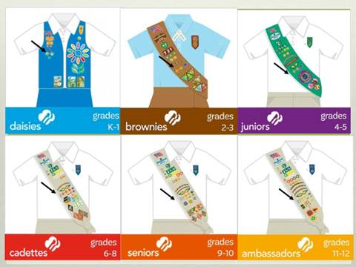
Take Action
Everything in Girl Scouting is based on the Girl Scout Promise and Law.
“On my honor, I will serve God”
(The word “God” is allowed to be customized.)
Girl Scouts has always encouraged girls to take spiritual journeys via their faith’s religious recognitions.
Troops are allowed to incorporate on-going faith-based programming into their troop.
GSUSA approves programs and allow awards to be worn on official uniforms.
Notes:
SHARE SCREEN (Optional)
Facilitator:
General talking points on slide - geared towards chaperones
Older girls may want to review pin/award placement on their uniform.
Optional group questions: “Are there ways you or your troop incorporates faith in Girl Scouts?” “What ideas do you have for doing this?”

Slide 14
Closing Ceremony
Virtual Friendship Circle
“Make New Friends”
Congratulations on earning your
My Promise, My Faith Pin!
Alberta “Bertie” Swain
aswain@girlscoutsp2p.org
Notes:
SHARE SCREEN
Facilitator/Co-facilitator:
1. Invite participants to stand (if able) and cross their arms (as if they were in a Friendship Circle). Encourage girls to look at the screen and position hands to look like they are touching the hands of the person(s) next to them on screen.
Optional:
* One of the facilitators may want to take a screenshot of the group for keepsake or to add to “Kudoboard”. This could also be done by a trusted adult and emailed to facilitator.
* If girls don’t want their face in the photo, they can cover their face with computer screen or arms, but still participate in group photo.
2. Sing closing song of choice
3. Offer continued support with contact info.
4. Quick reminder of “Kudoboard” and follow-up email with more resources that you may be offering.
5. Close Meeting
Keep it Girl-led: Offer participants choice of closing song(s). Ask for volunteers to lead closing song(s).

