Slide 1
Your Girl Scout Member Account More Features. More Fun!

Slide 2
Coming this fall: My Account
A refreshed member account management system designed with you in mind.
Cleaner views, more features and functions, and enhanced search options will make it easier for you to find more fun for your Girl Scout!

Slide 3
Understanding access to the new member platform
In our current state, many parents/caregivers are sharing an email address to access their family’s Girl Scout account
In our future state, all parents/caregivers will need to have a unique email address to identify them in the system. During data migration:
Primary caregivers in our current state will migrate to the new environment as they appear.
Secondary caregivers who do not have a unique email address in our current system will migrate with a noemail@gs.org email and will need assistance to access the household account
The key to accessing the refreshed member platform, My Account, after Go-Live is a unique email address.

Slide 4
How can you ensure a smoother transition for your family
Follow the steps below to review the Girl Scout accounts for all parents and caregivers in your household before November 15.
Three easy steps:
Log in to your MyGS account.
Review the email addresses for your household, are the parents/caregivers in your household using the same email address? If “YES”, complete Step 3.
Provide a new email address for the secondary caregiver.

Slide 5
In case you were wondering
Why do we need different email accounts?
Unique email addresses support new functionality in the new system including the ability to allow household managers (primary caregivers) to affiliate other adults to a Girl’s account e.g. parents in two households and/or grandparents who may now directly register and pay for Girl Scout experiences.
We’d rather not share an additional email address. It’s going to result in more Girl Scout emails and we’d like to avoid that.
We understand. In the refreshed member account management portal, you will have the ability to edit your preferences for receiving Girl Scout communications without council assistance, once the new system is live.

Slide 6
Member Preview: Girl Scouts Refreshed Environment
Notes:
NOTEs
this presentation is intended to give members and volunteers a PREVIEW of the new system and does reflect all of the enhancements, features and functionality members will enjoy. It’s important to let them know that this is just a preview
All screen shots were taken prior to final development and may appear differently in the final version but all concepts are the same.

Slide 7
VS 2.0 myAccount
Portal for member self-management of their household memberships and participation.
Gateway to managing household member accounts
Initially created when a person begins the “Create Account” workflow to purchase a new membership or registers for a non-member event
Most often used during renewal process or to update account information or troop participation
Accessed through a link on the council website
Notes:
Talking Points
See slide.

Slide 8
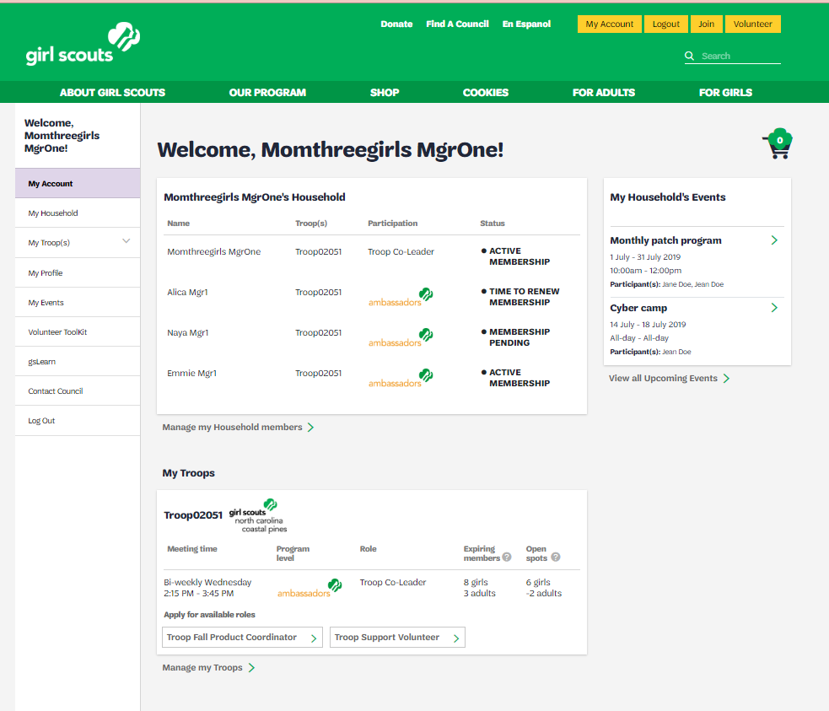
myAccount navigation and page views
Home Page/Landing Page – “one-stop-shop for member household account management”
Left Menu
Dashboard
1
Summary view of household members
Summary view of troop involvement
Portal to account management
Summary View of Household Memberships
Summary View of Troop Participation
Notes:
Talking Points
Please remind audience that this is a system in active development and that screenshots are not representative of the final release, but the concepts are consistent.
Here’s a glimpse of the landing page that members see when they access their Girl Scout account — known as ‘My Account.’ Essentially, they’ve just opened the door to their “one stop shop” for managing their household.
As they enter their account, they’ll be greeted by the landing page and immediately be able to see a summary view of their household memberships, a summary view of their household’s troop participation, and several tabs in the left column menu that will take them to a variety of other views and options for managing their household.

Slide 9
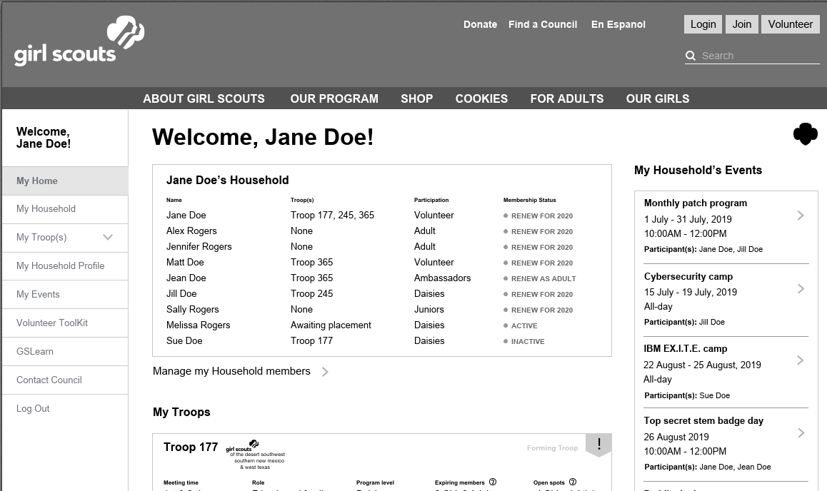
myAccount home page/landing page – a closer look
1
4
3
2
*Screens are snapshots of a system that is still in active development and testing; field names and other written material in the system are still subject to change before Go-Live but the concepts are the consistent.
Notes:
Talking Points
Here’s a closer look at the landing page for myAccount. Please direct your focus to the numbered areas as I walk through what members can expect to find here.
First area 1 – the household summary. This is a scrollable list of all Girl Scout members in the household, including current and inactive members. Information they see here includes troop affiliations, participation type, and membership status for each member of their household.
For example, Jane, and the first entry in the list, shows that Jane is a volunteer for troops 177, 245, and 365 with an expiring membership. Sue’s entry, the last item we see in the list, shows that her Daisy membership in Troop 177 is inactive.
Area 2 is the troop summary view where members can see basic information on troops that household members are affiliated with.
And last area 3, the left menu column, where members can access more detailed account views and options for updating and editing their account records.

Slide 10
myAccount navigation and page views
Left Menu Column
2
Portals to member information, participation details and account management options
My Household
My Troop(s)
My Profile
My Events
Contact Council
Log Out
Notes:
Talking Points
Now let’s dig a little deeper and look at the features and functionality provided in the left menu column.
You’ll notice that My Household and My Troop are both starred; we’re going to come back to those. The others in the list are more intuitive so here’s a quick summary.
My Events is a detailed view of the events that were listed in the Event Dashboard. Here is where members would go to find more information about the events that they have coming up. For example, maybe it’s an overnight at the museum and it’s time to look at the packing list – this is where you’d be able to find that.
Then you’ll see links to the Volunteer Toolkit and gsLearn followed by options to contact the council and log out.
Footnotes:
Events in My Events will show whether the parent or the troop leader completed the event registration
Members will also be able to register more family members for the event in My Events – in case they missed someone (pending openings)

Slide 11
myAccount – my household and my troop tabs (parent view)
Example: primary caregiver to multiple girls; active in multiple volunteer roles
 | My Household | My Troop/s
Features | Detailed information for all household members including: troop affiliations volunteer roles membership dates renewal checkboxes membership cards | Detailed information for all household members’ troop affiliations including: current role (volunteer, member) program level membership status (current/expiring) open spots open volunteer roles
Benefits | Clear and consolidated view of all household memberships Ability to renew multiple household members in a single order | Clear and consolidated view of all household members’ troop participation information Highlights open volunteer opportunities
Notes:
Talking Points
Now let’s look at the features and functionality members will experience when choosing My Household or My Troop/s.
In the first example we’ll look at the experience of a primary caregiver with multiple girls and who is active in several volunteer roles.
In My Household our primary caregiver will find detailed information on each member in the household’s Girl Scout membership and troop participation. It’s also where primary caregivers (you might sometimes hear them called household managers) can go for renewals and other relevant information regarding the family’s Girl Scout involvement.
My Troop/s is very similar. In My Troop/s primary caregivers will find detailed information about each of the troops the members of the household are affiliated with.
It sort of looks like this:
in My Household I would see detailed member information and limited troop information.
in My Troop I would see detailed troop information and limited member information.
Footnote: the primary caregiver can give other adults access to manage the account

Slide 12
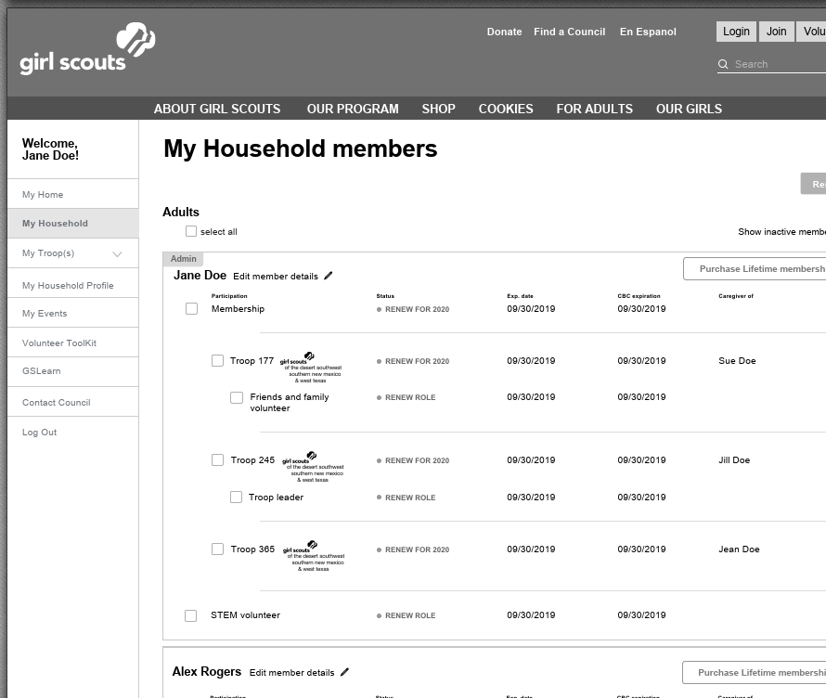
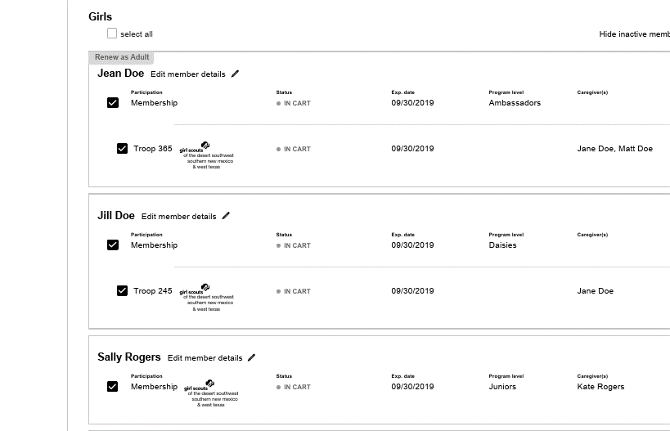
myAccount my household tab – a closer look
2
1
✓
*Screens are snapshots of a system that is still in active development and testing; field names and other written material in the system are still subject to change before Go-Live but the concepts are the consistent.
Notes:
Talking Points
Here’s a closer look at what our primary caregiver, Jane, sees when she goes into My Household.
In area 1, she can see full details for each member’s participation and their membership status. Clicking on the edit pencil (in blue circle) for any household member in the list expands the view and opens a window where the primary caregiver can not only view but update their information. Looking at Jane’s listing, we can see that her membership status is “renew” (circled in gold) and can easily click the box to begin the renewal process for Jane. Below Jane’s membership status is a list of all the troops she’s affiliated with and her role, if any. For example we can see that Jane is a troop leader for one troop and a parent supporter for another.
Callout 2 is here to illustrate that as Jane scrolls through the list of her household members and clicks on “renew”, these purchases are automatically added to her CART. She would then complete the renewal process by checking out similar to what we have all experienced on other ecommerce sites.
Footnote:
Parents and troop leaders can also update member information as they are renewing members.
As members click who they want to renew, there is a count on the cart icon of how many have been selected which will really help with larger troops.

Slide 13
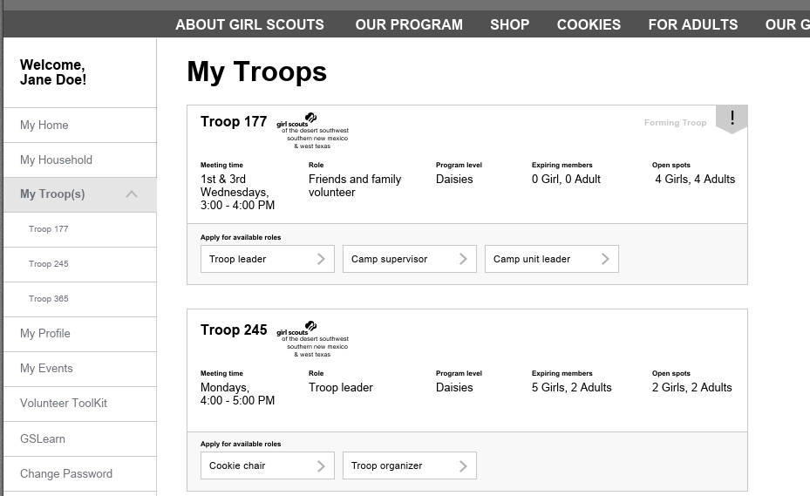
myAccount my troop(s) tab - let’s take a look
2
1
3
*Screens are snapshots of a system that is still in active development and testing; field names and other written material in the system are still subject to change before Go-Live but the concepts are the consistent.
Notes:
Talking Points
And here’s a look at what Jane sees when she clicks on My Troop/s.
You’ll notice in area 1 – the left menu column — that My Troop/s has expanded to show all troop affiliations for the household.
In area 2, we’re highlighting the list of all of the individual troop affiliations for this household.
Focusing on area 3, we can see that Jane is the Troop Leader for Troop 245, the grade level is Daisies, there are 5 girl and 2 adult members whose memberships are about to expire, and 2 girl and 2 adult openings in the troop. We can also see that the troop is still in need of a Cookie Chair and a Troop Organizer.
Footnotes:
primary caregivers will not be able to edit troop information
If open volunteer spots are shown for the troop, a person can click on them to get a bit more information, not a lot but enough to provide some clarification
Volunteer roles and names shown here are decided by each council

Slide 14
myAccount – my troop tab (troop leader view)
Example: troop leader manages membership for troop participants
 | My Troops
Features | Review and edit troop details Meeting details (time, place) View contact information for troop volunteers Detailed breakdown of existing troop members (adults and girls) Membership status (current/expiring) Renewal checkboxes Membership cards Ability to register new troop members
Benefits | Clear and consolidated view of all troop members’ troop participation Highlights opportunity to expand participation on behalf of existing and new members and open volunteer opportunities
Notes:
Talking Points
Now let’s look at the My Troop/s view that a member who is also a troop leader will see.
Highlights here are the ability to review and edit troop details, including meeting time and place and the ability to see a detailed breakdown of existing troop members (girls and adults) including their membership status (current/expiring) and the ability to register new troop members from this screen.
Troop leaders will also be able to select and process member renewals in one large, bulk transaction.

Slide 15
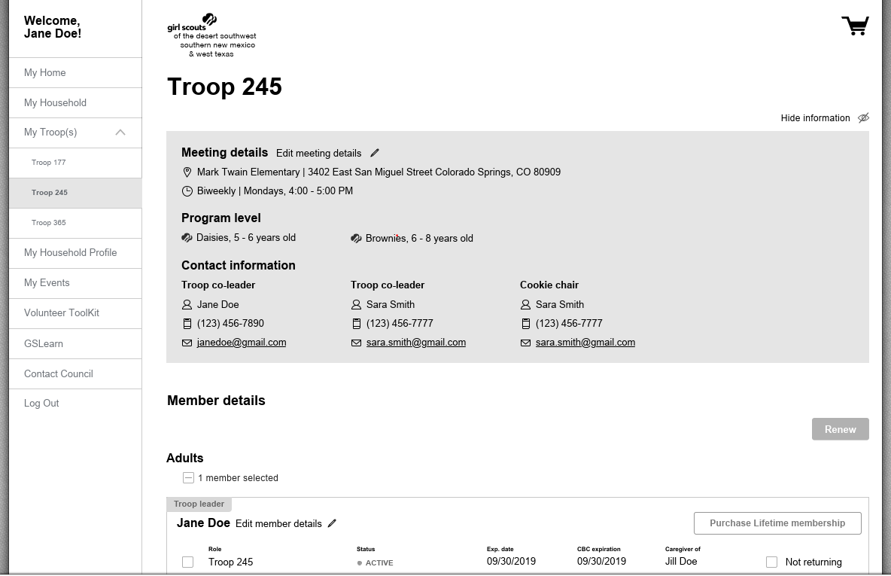
myAccount – my troop tab (troop leader view) – a closer look
1
2
*Screens are snapshots of a system that is still in active development and testing; field names and other written material in the system are still subject to change before Go-Live but the concepts are the consistent.
Notes:
Talking Points
Here’s a closer look.
In the shaded area you see meeting details for the troop — dates and times and program levels. You can also see the contact information for the troop “team” – other adults helping to support the troop in different roles — all front and center.
Below that are member details for each member in the troop.
Like our primary caregiver, a troop leader can scroll through the list, check the members that need to be renewed, and complete the cart checkout process accordingly.
Notice the gold circles around the pencil icons for editing in these areas.

Slide 16
VS 2.0 Go-Live Member Timeline

Slide 17
More Features. More FUN!
Guide for volunteer and member household planning as we prepare for the launch of Girl Scouts refreshed member environment.
November
December
Oct
1 | 2 | 3 | 4 | 5 | 6 | 7 | 8 | 9 | 10 | 11 | 12 | 13 | 14 | 15 | 16 | 17 | 18 | 19 | 20 | 21 | 22 | 23 | 24 | 25 | 26 | 27 | 28 | 29 | 30 | 1 | 2 | 3 | 4 | 5 | 6 | 7
Nov 25 – 29
Thanksgiving Break
Volunteer/Member Household Prep & Readiness
Member Support Through Downtime Period
Anticipated Go-Live
Nov 2 – 17
Nov 18 - ##
Go-Live Window
Current systems remain active and available during this time.
Member platforms unavailable. Activities (Activities councils) myGS, VTK, gsLearn
Newly re-designed experience opens to members.
We’re asking all volunteers and member households to be on the lookout for regular emails and updates throughout this period. We’re excited to support you through the transition and welcome you to our new member platform later this fall!
Your friends and family at Girl Scouts Carolinas Peaks to Piedmont

Slide 18
Questions?

